Slide 1

FORMAL LANGUAGES AND
AUTOMATA THEORY
Lecture 25: Module 5
Turing Machines
Prepared By: Sridhar Iyer

Slide 2
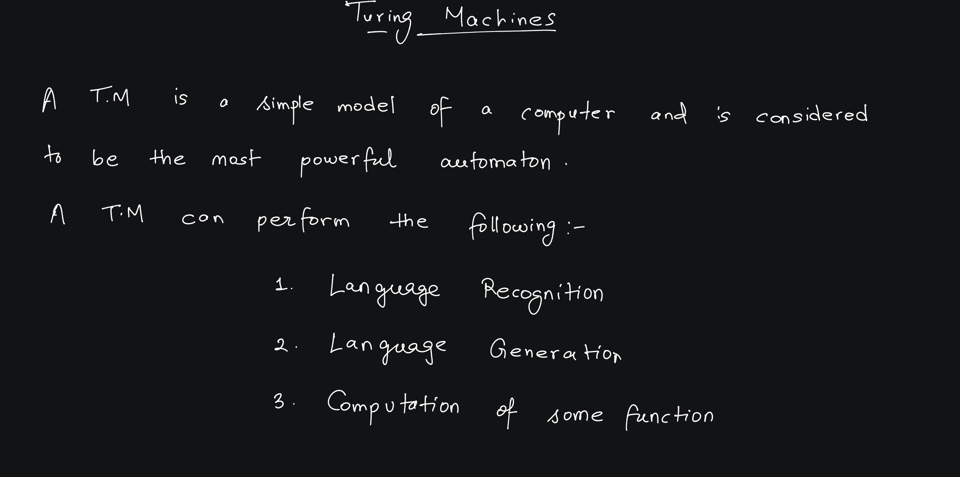

Slide 3
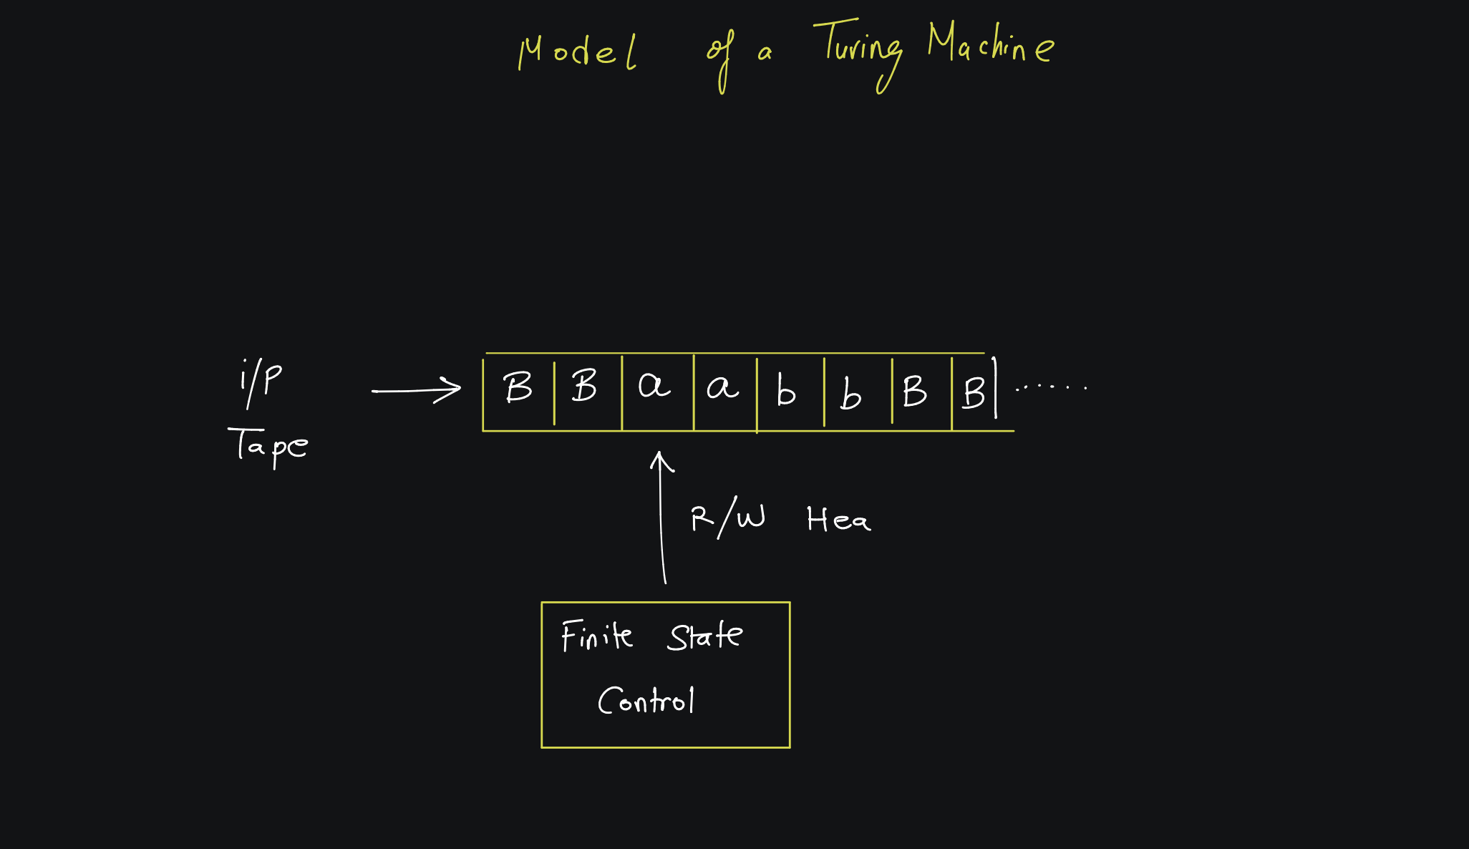

Slide 4
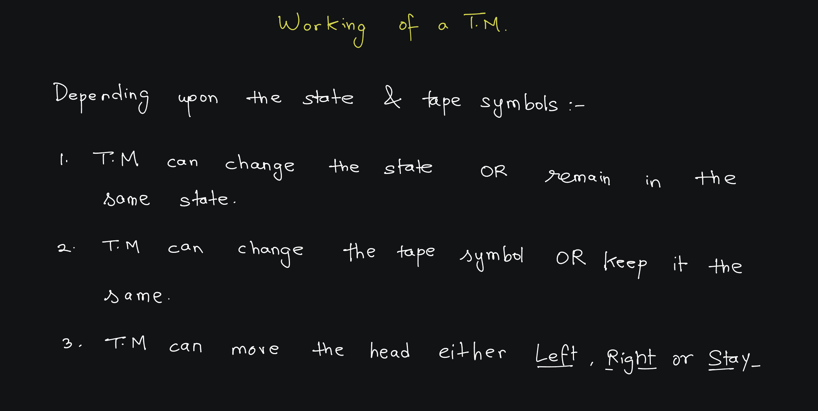

Slide 5
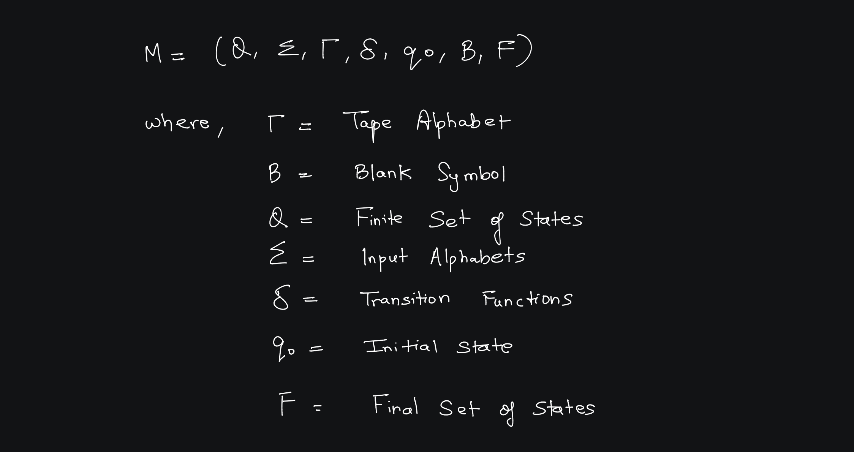

Slide 6
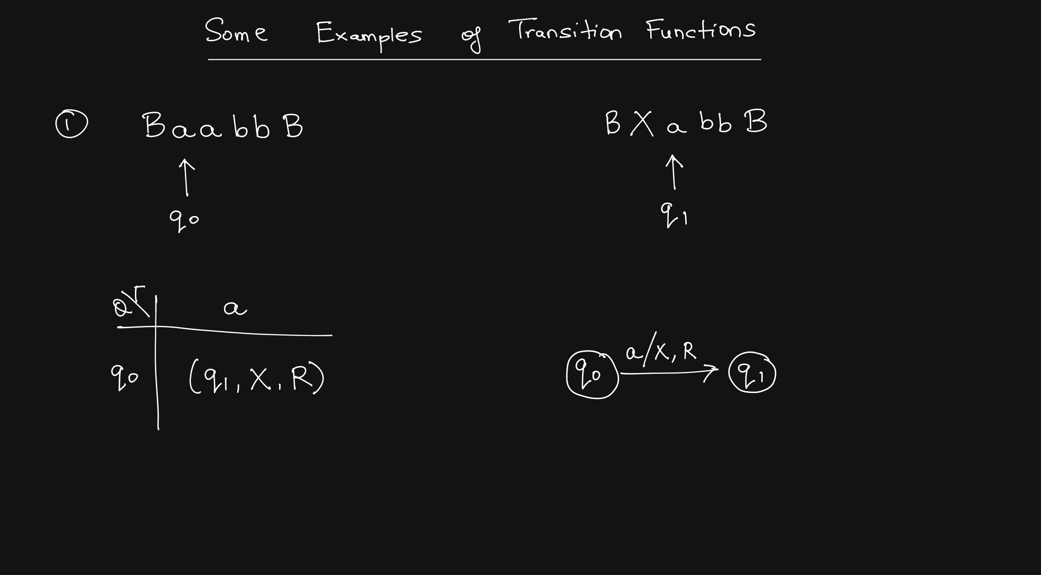

Slide 7
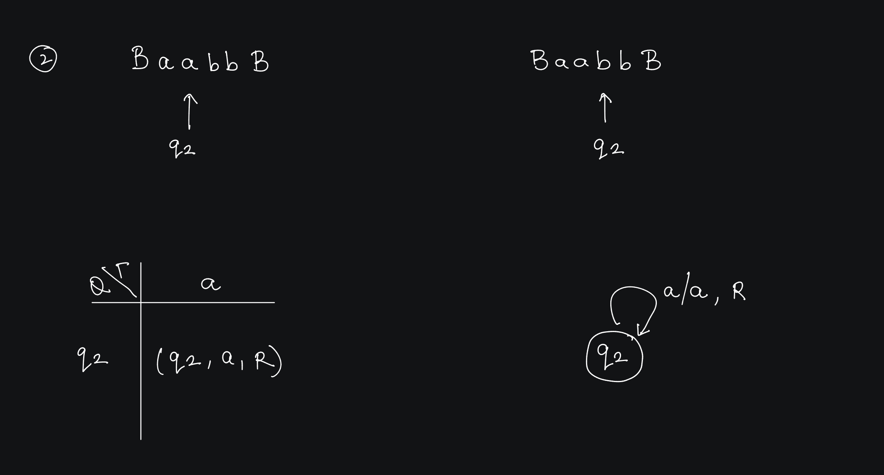

Slide 8
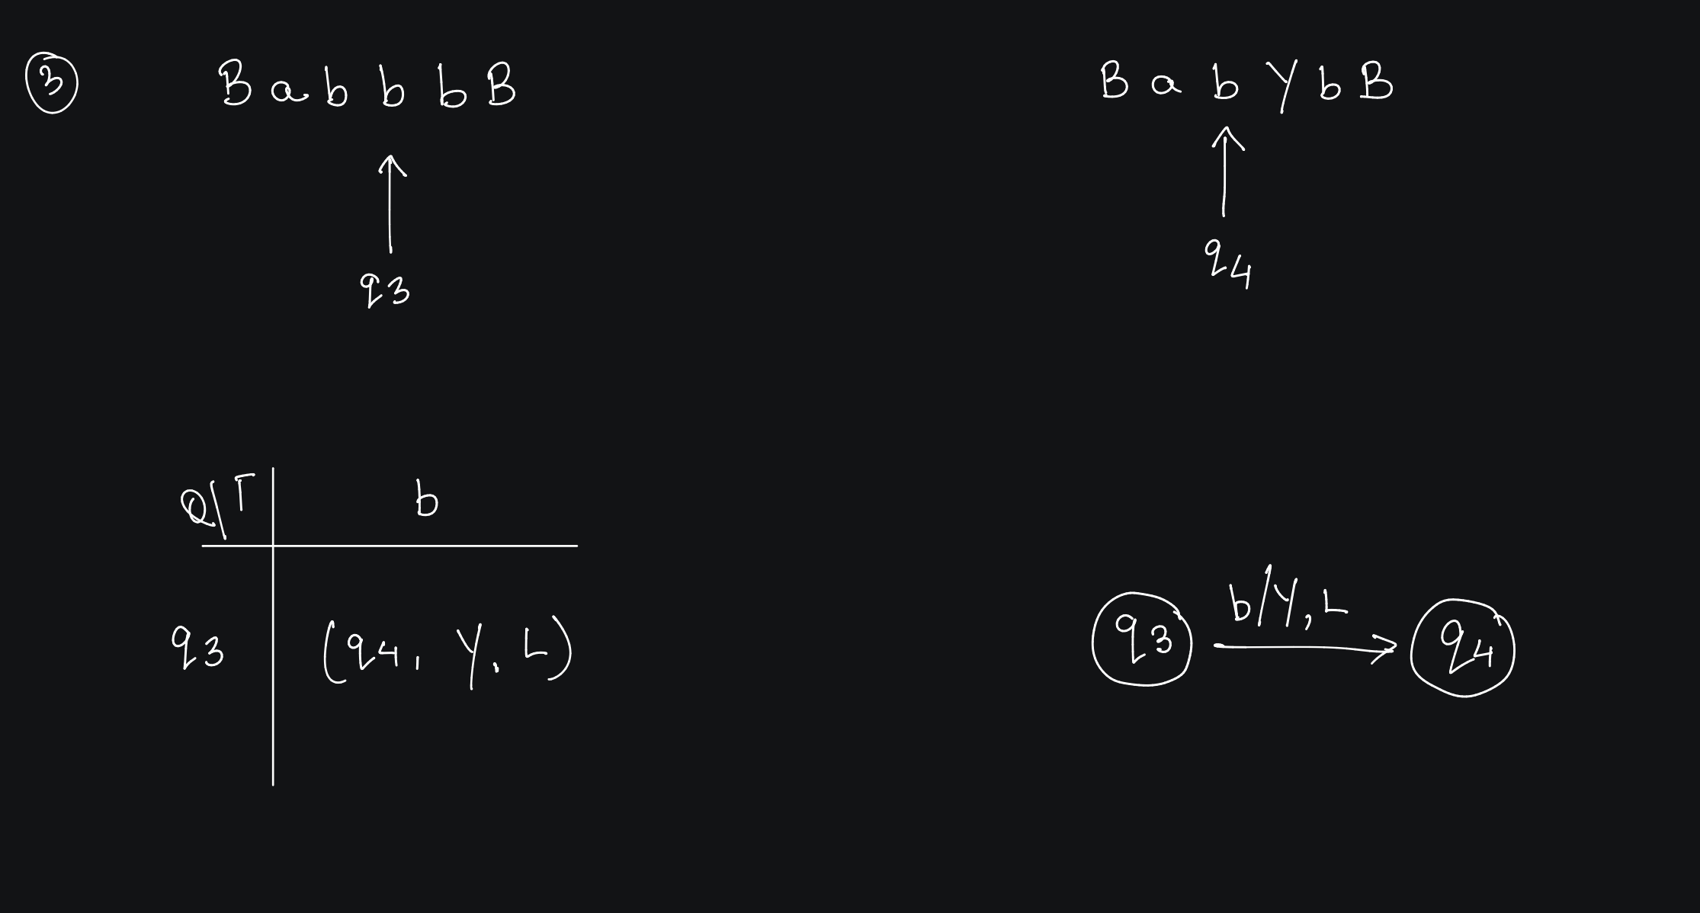

Slide 9
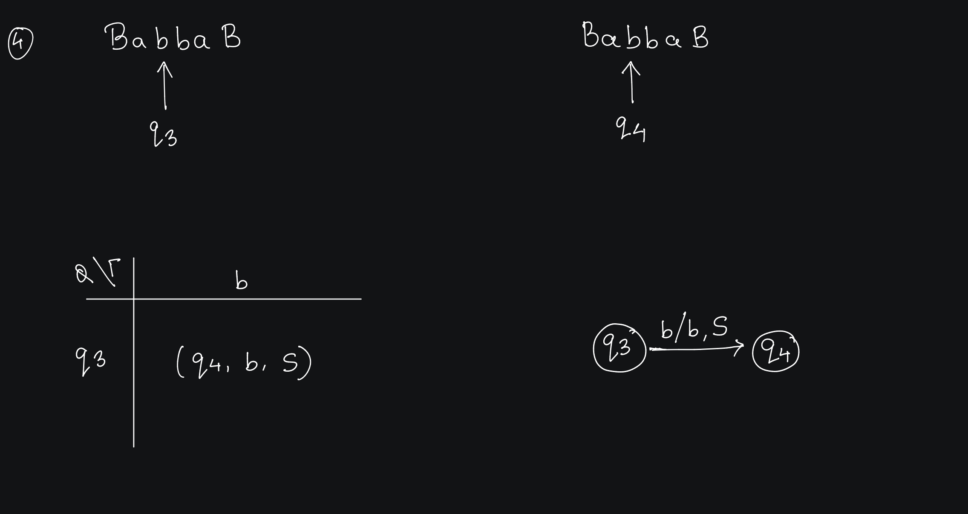

Slide 10
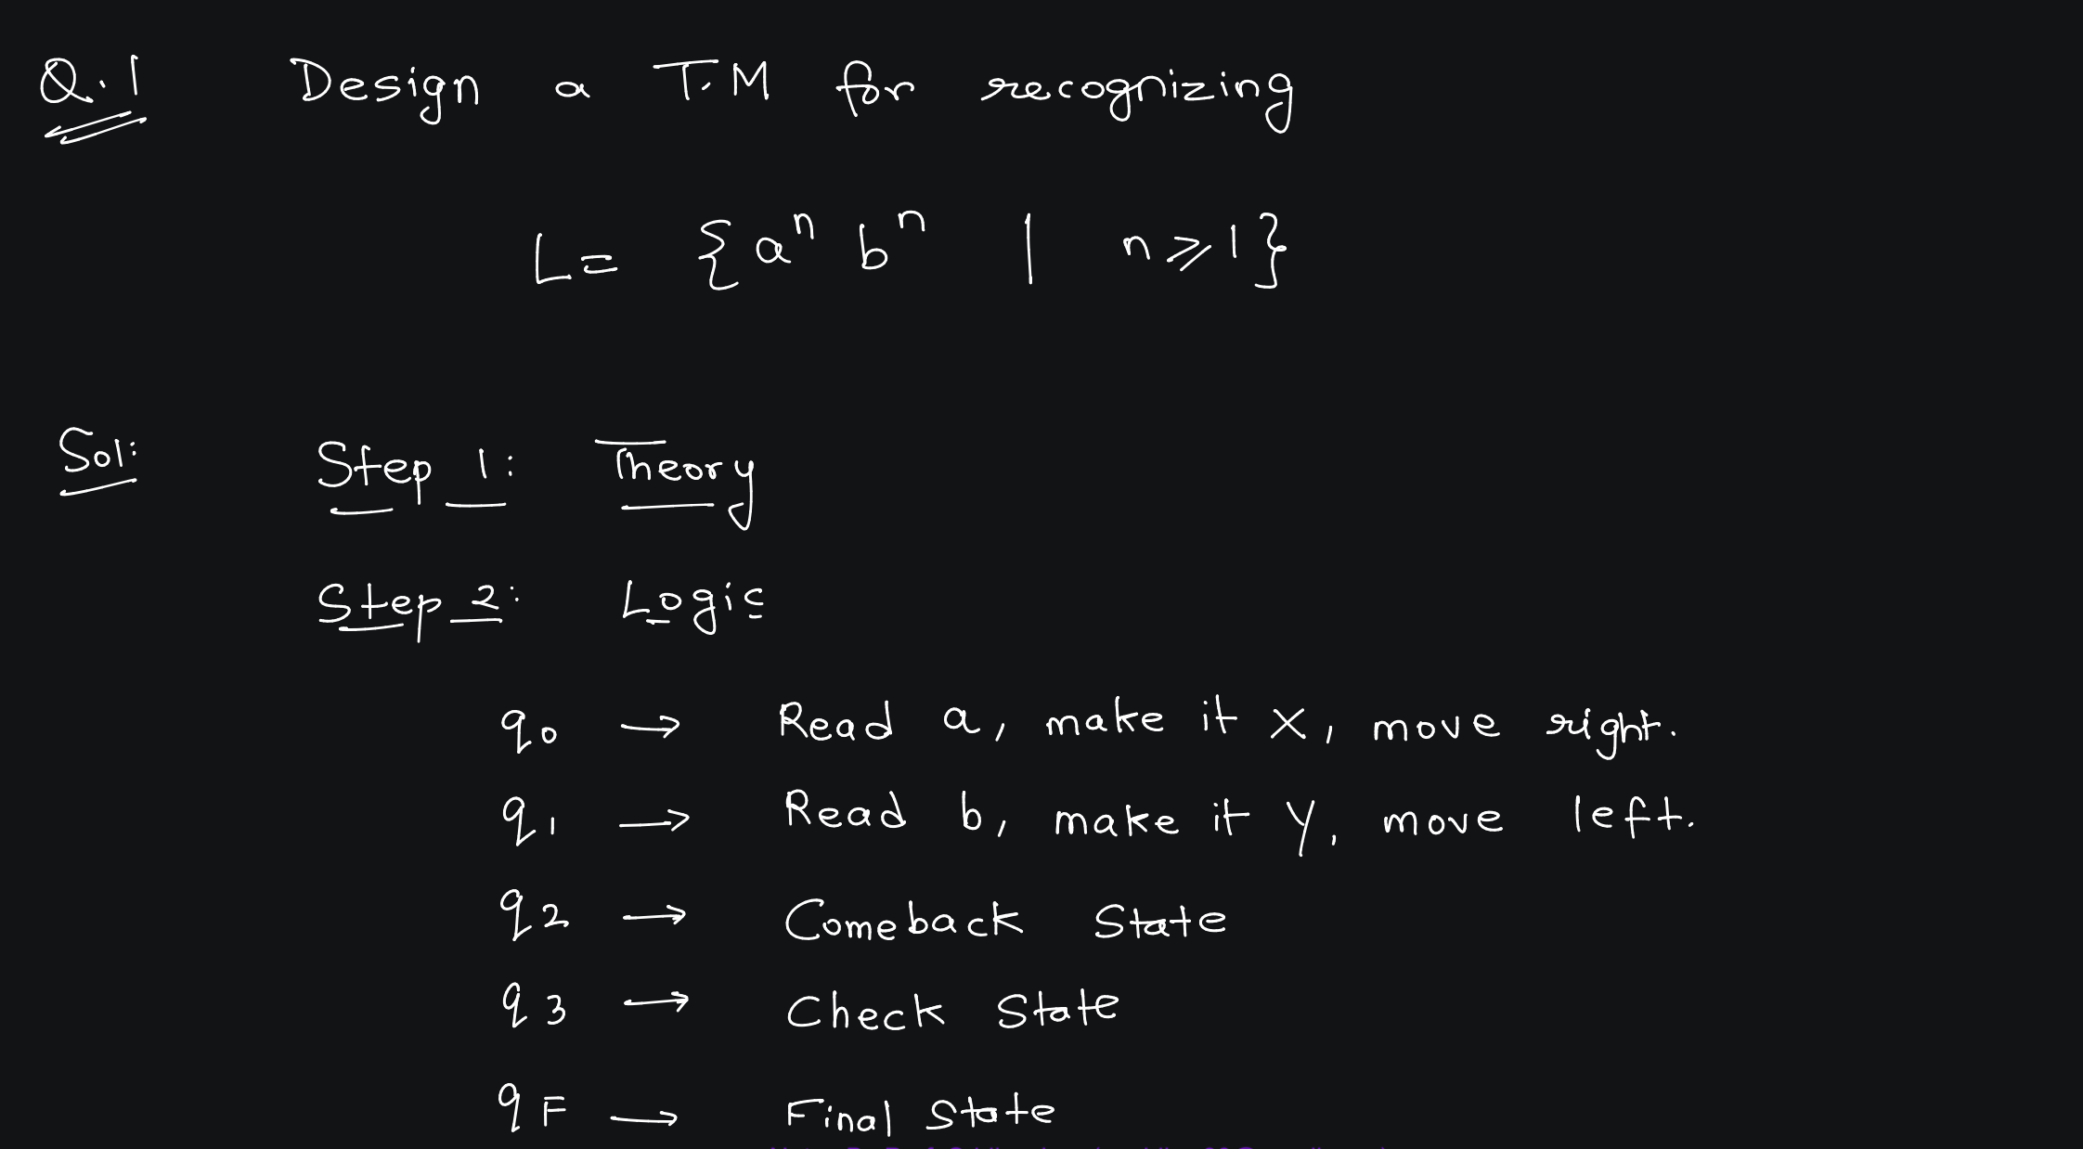

Slide 11
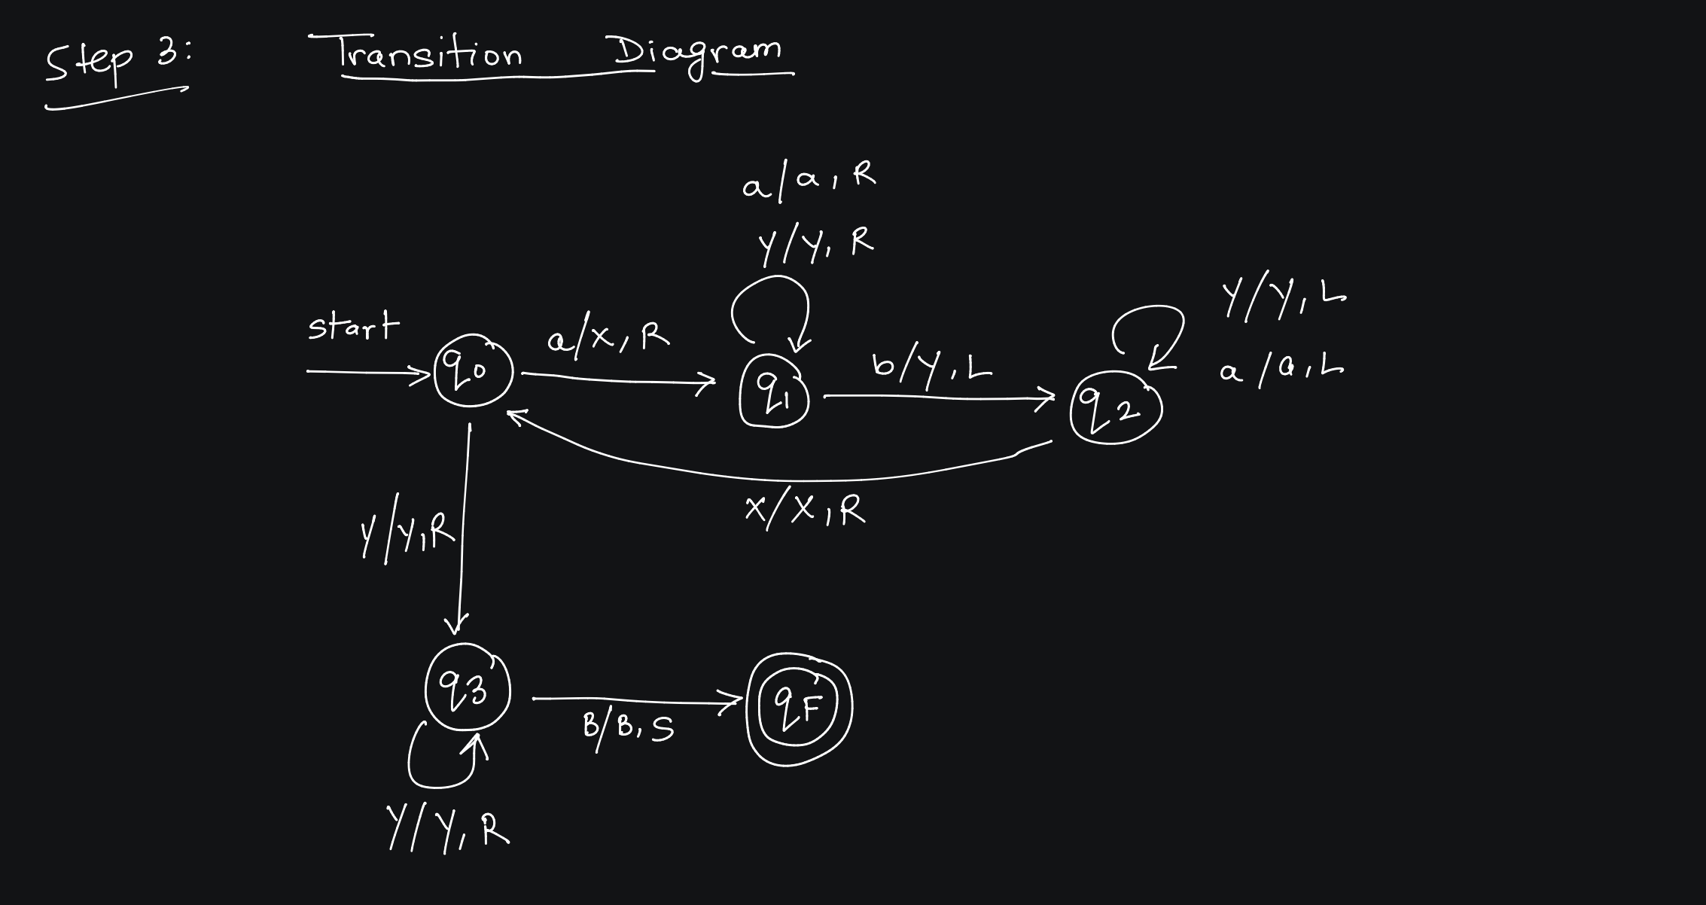

Slide 12
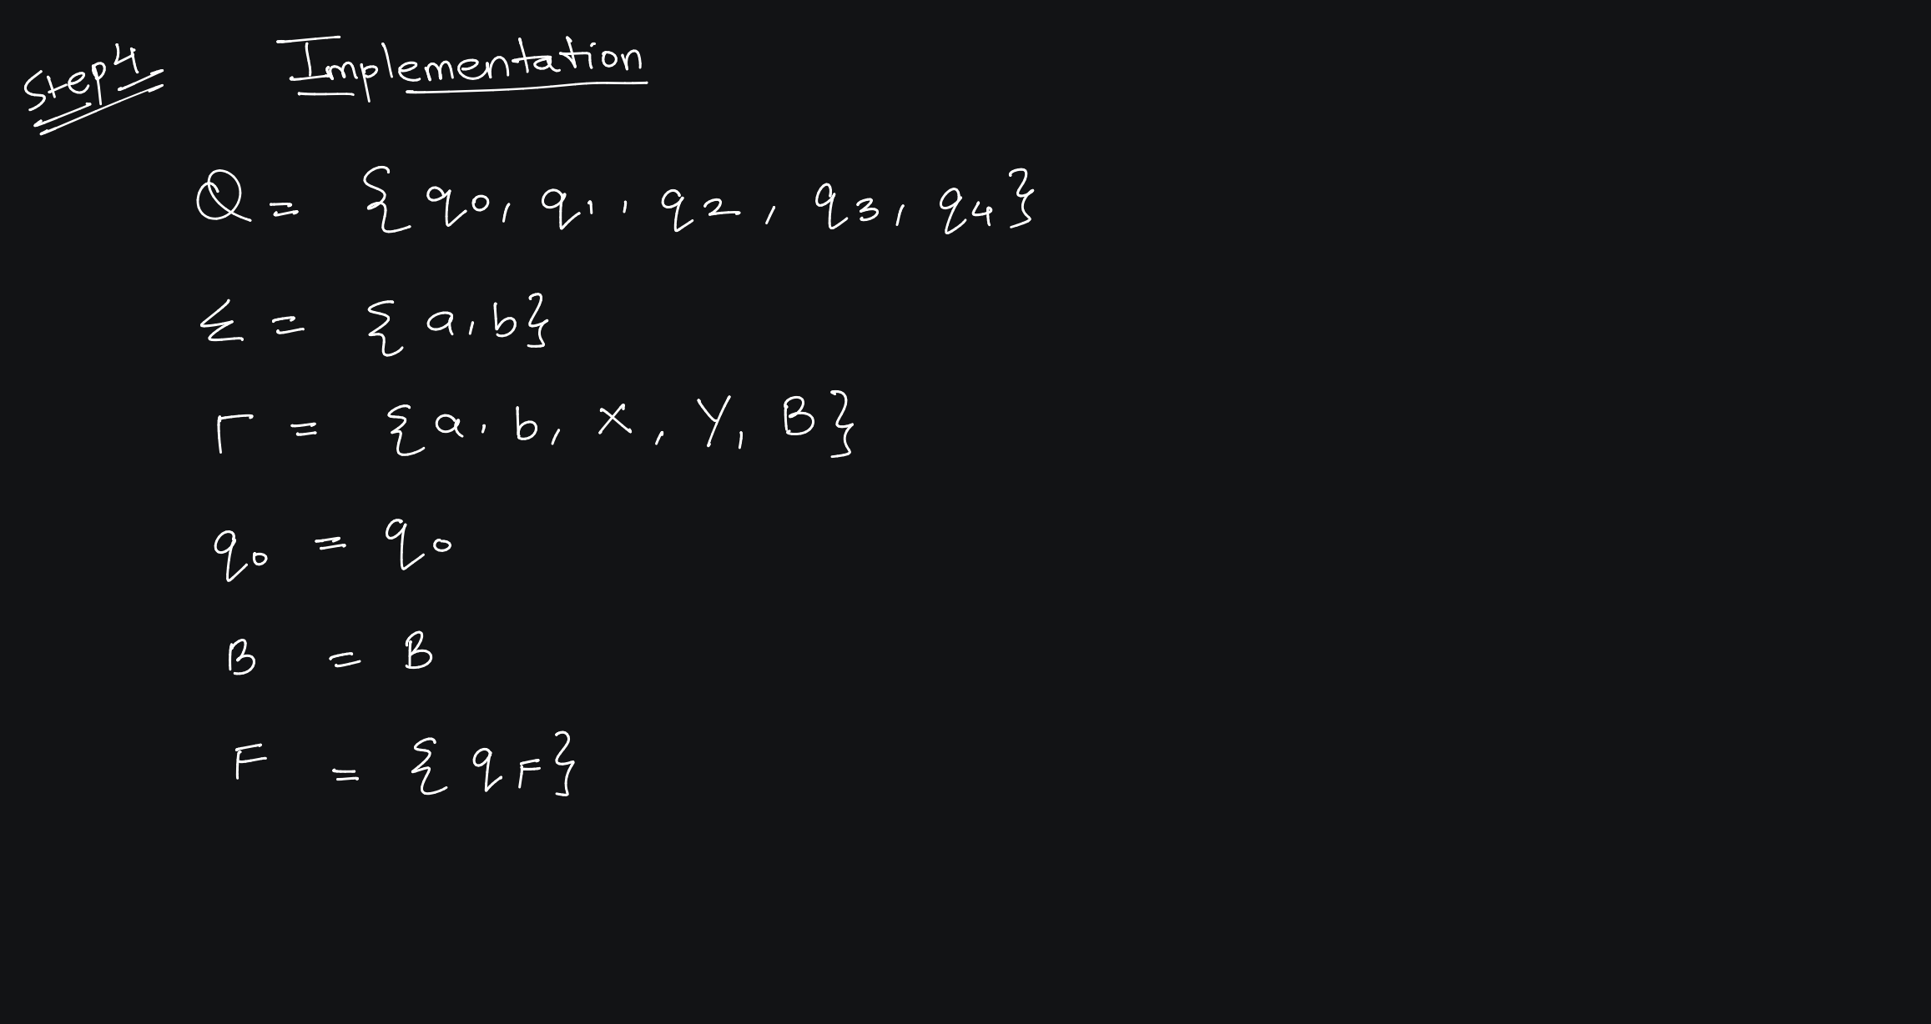

Slide 13
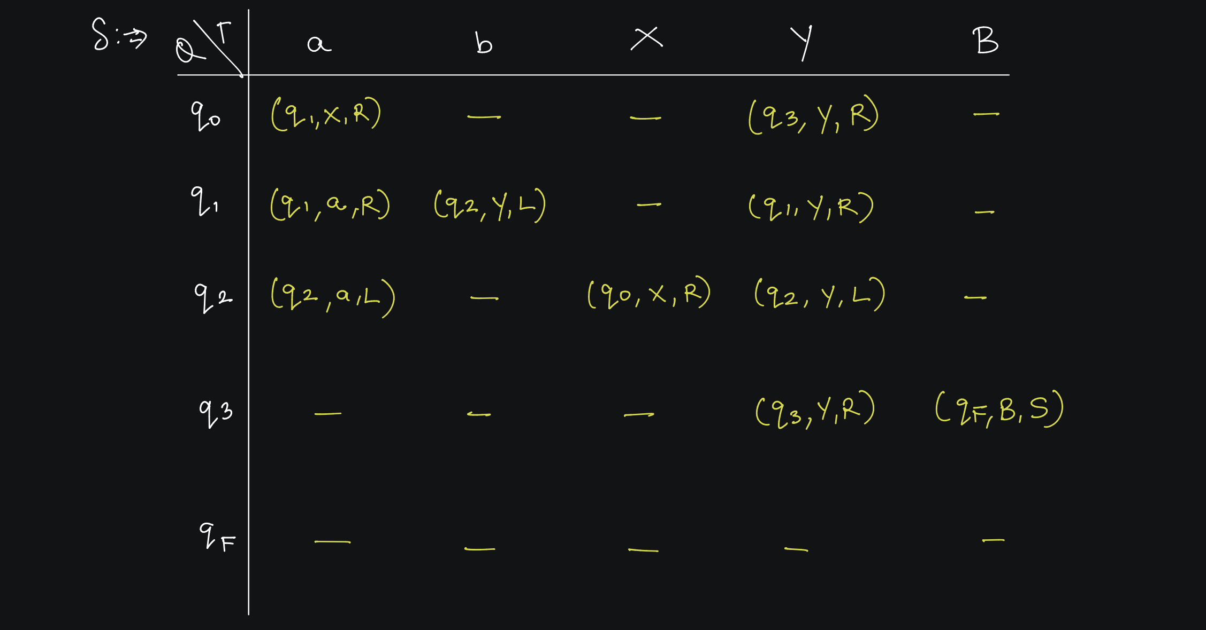

Slide 14
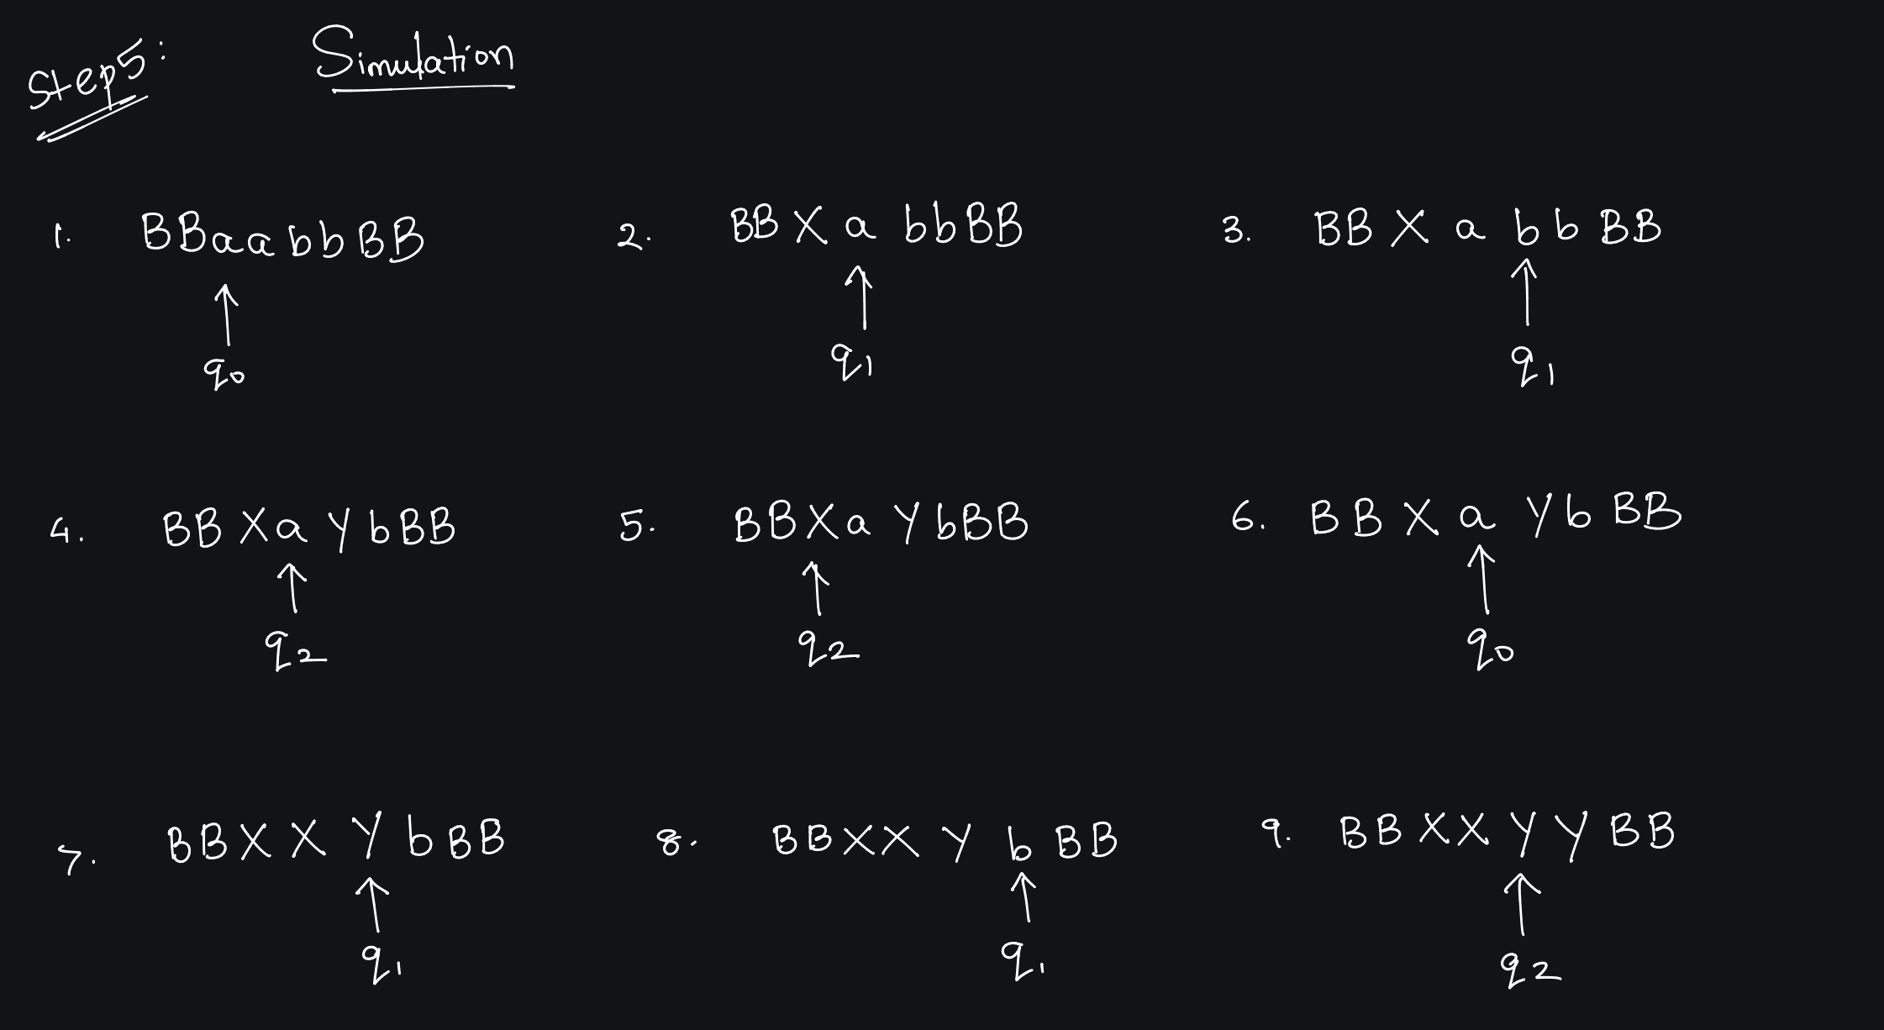

Slide 15
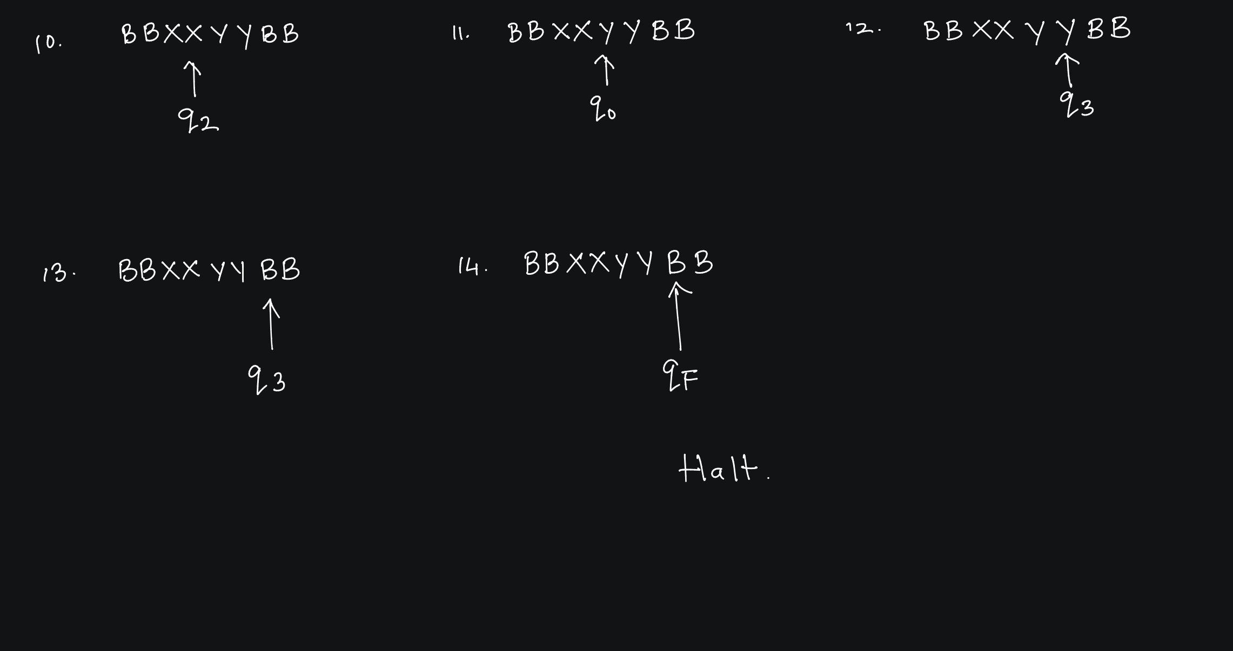

Slide 16
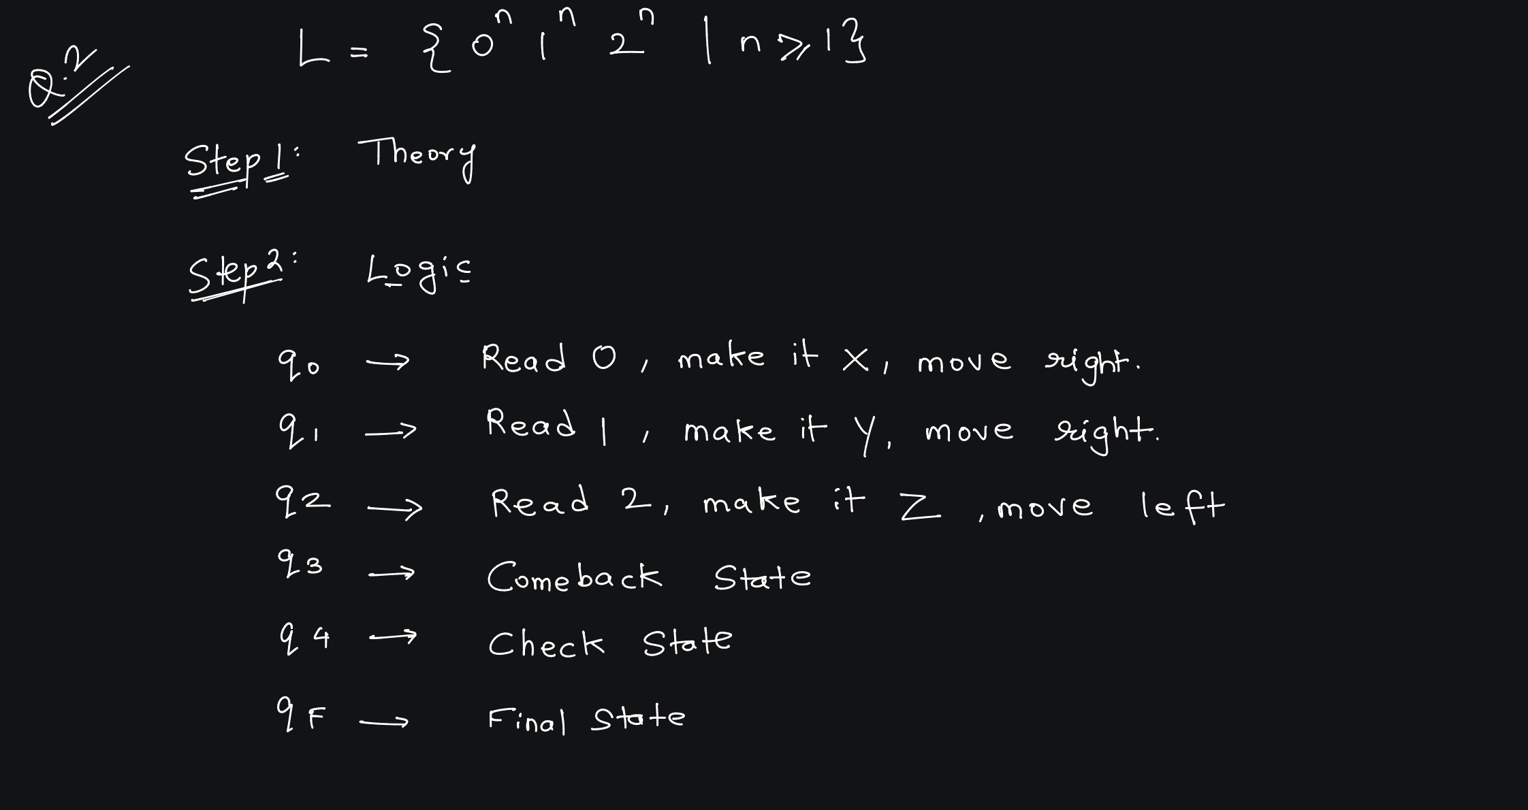

Slide 17
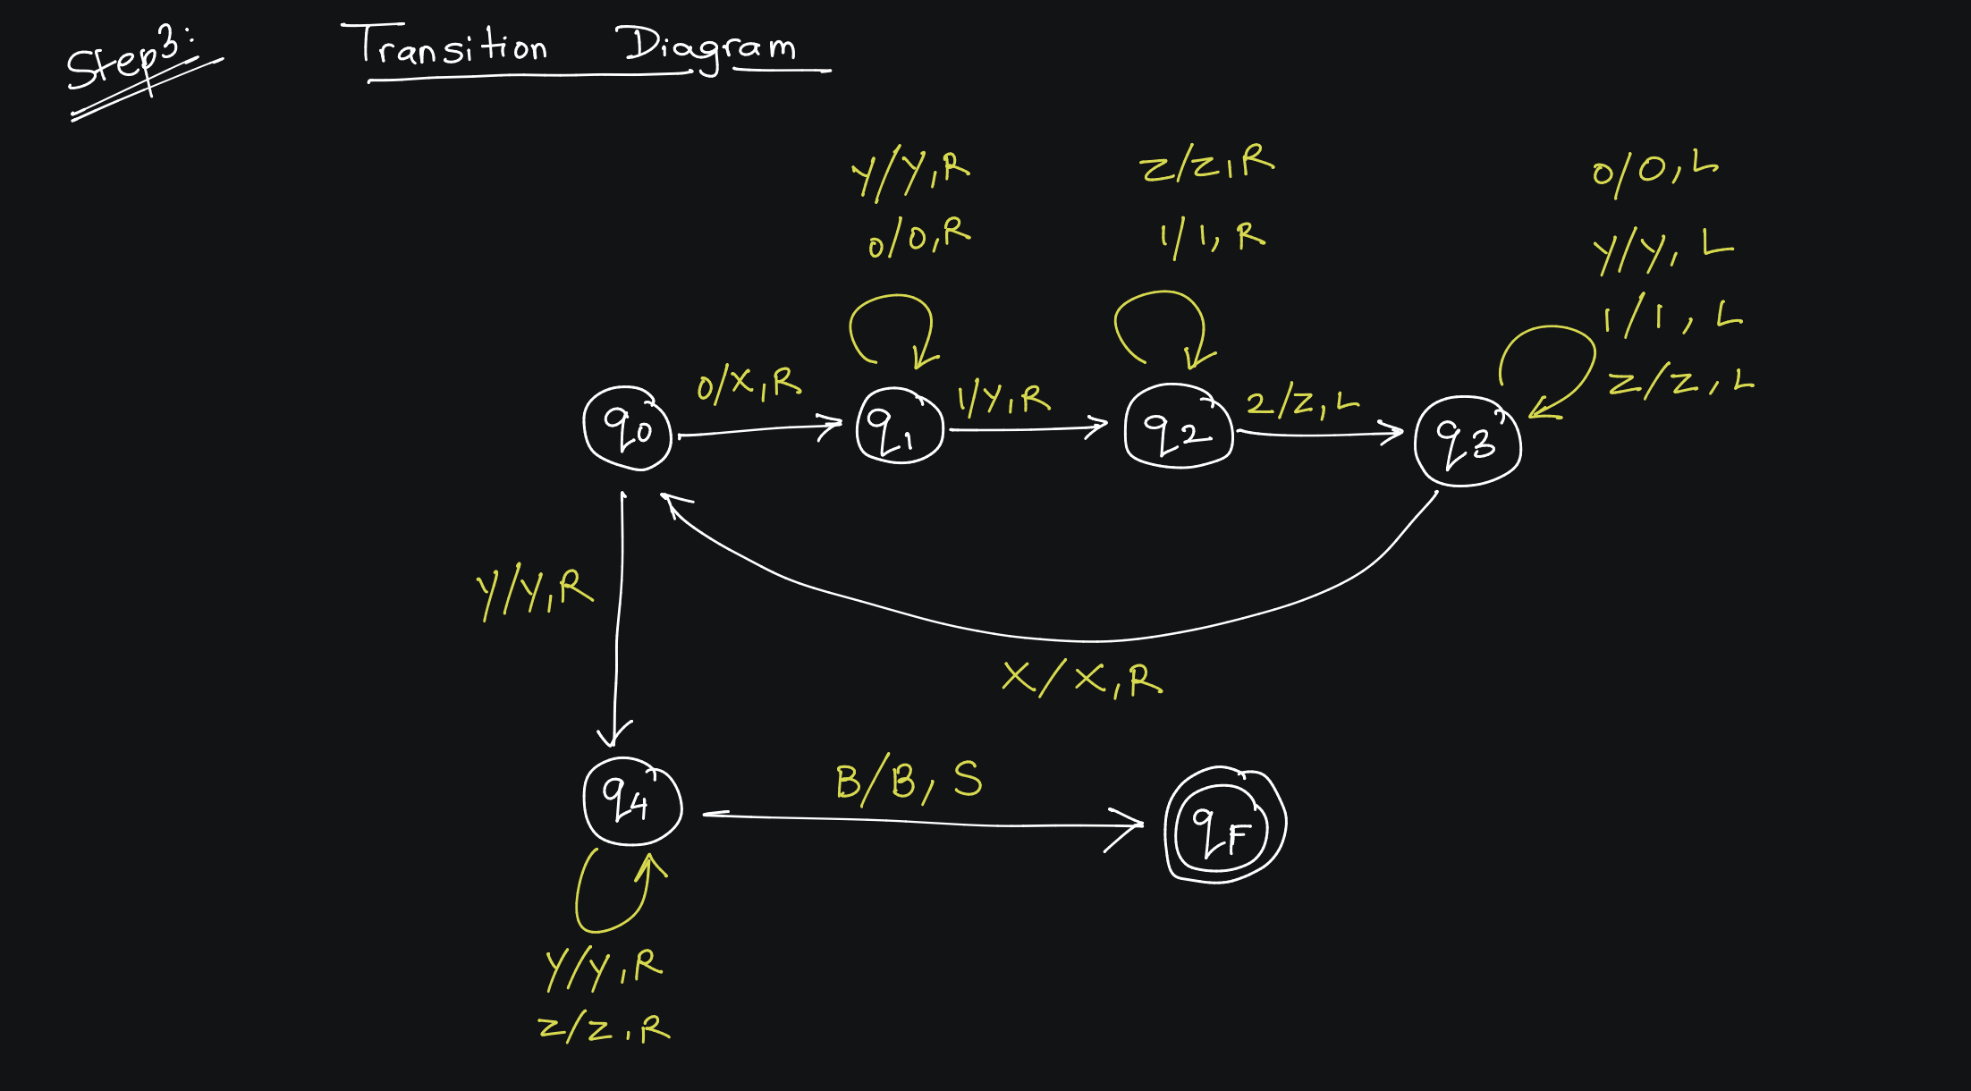

Slide 18
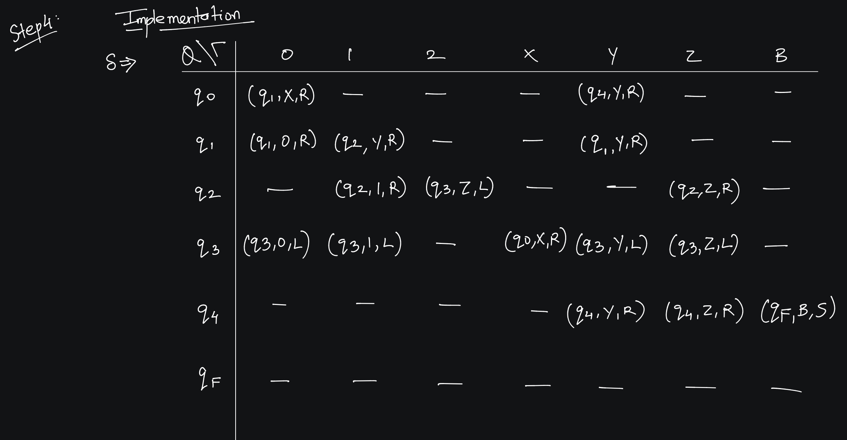

Slide 19
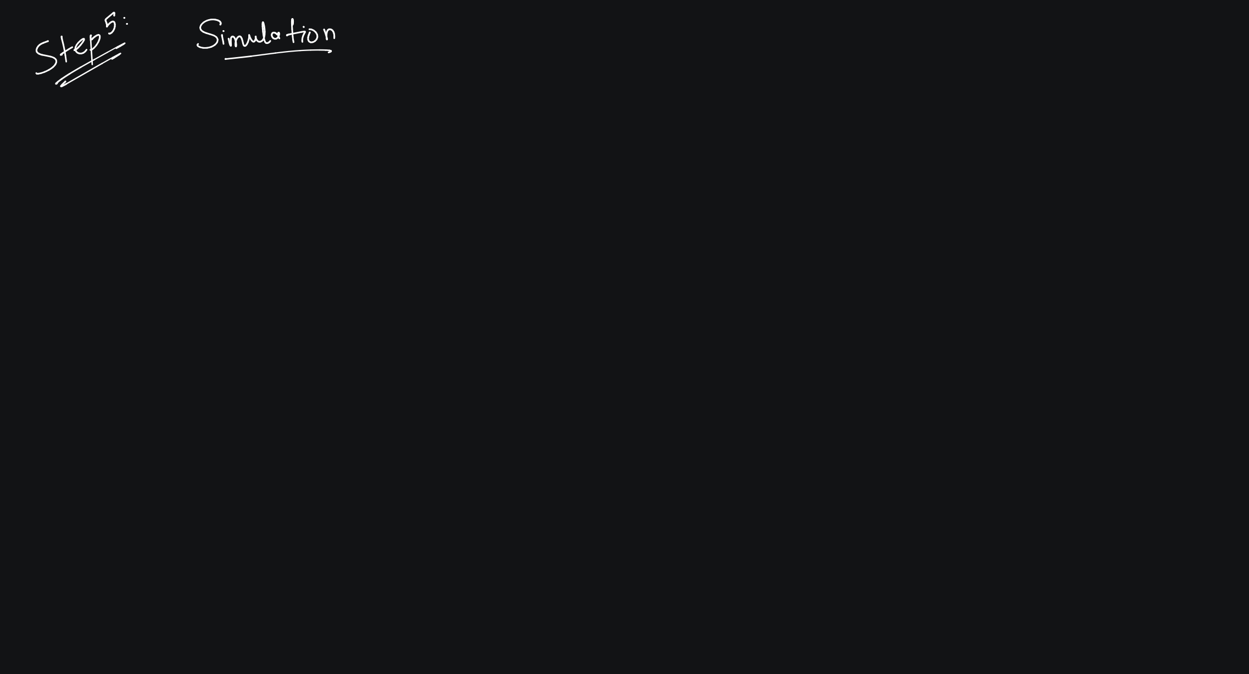

Slide 20


Slide 21
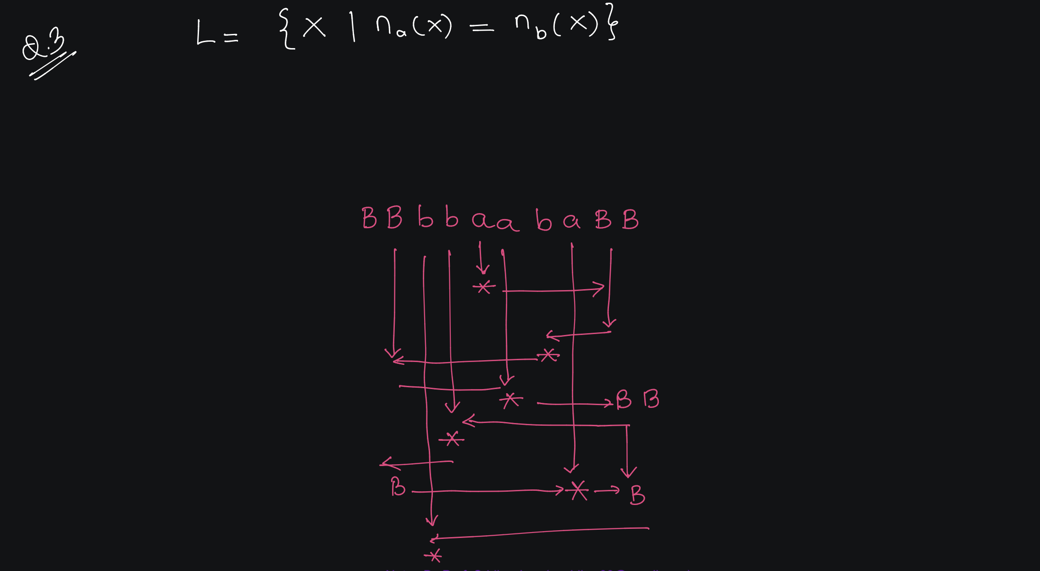

Slide 22


Slide 23
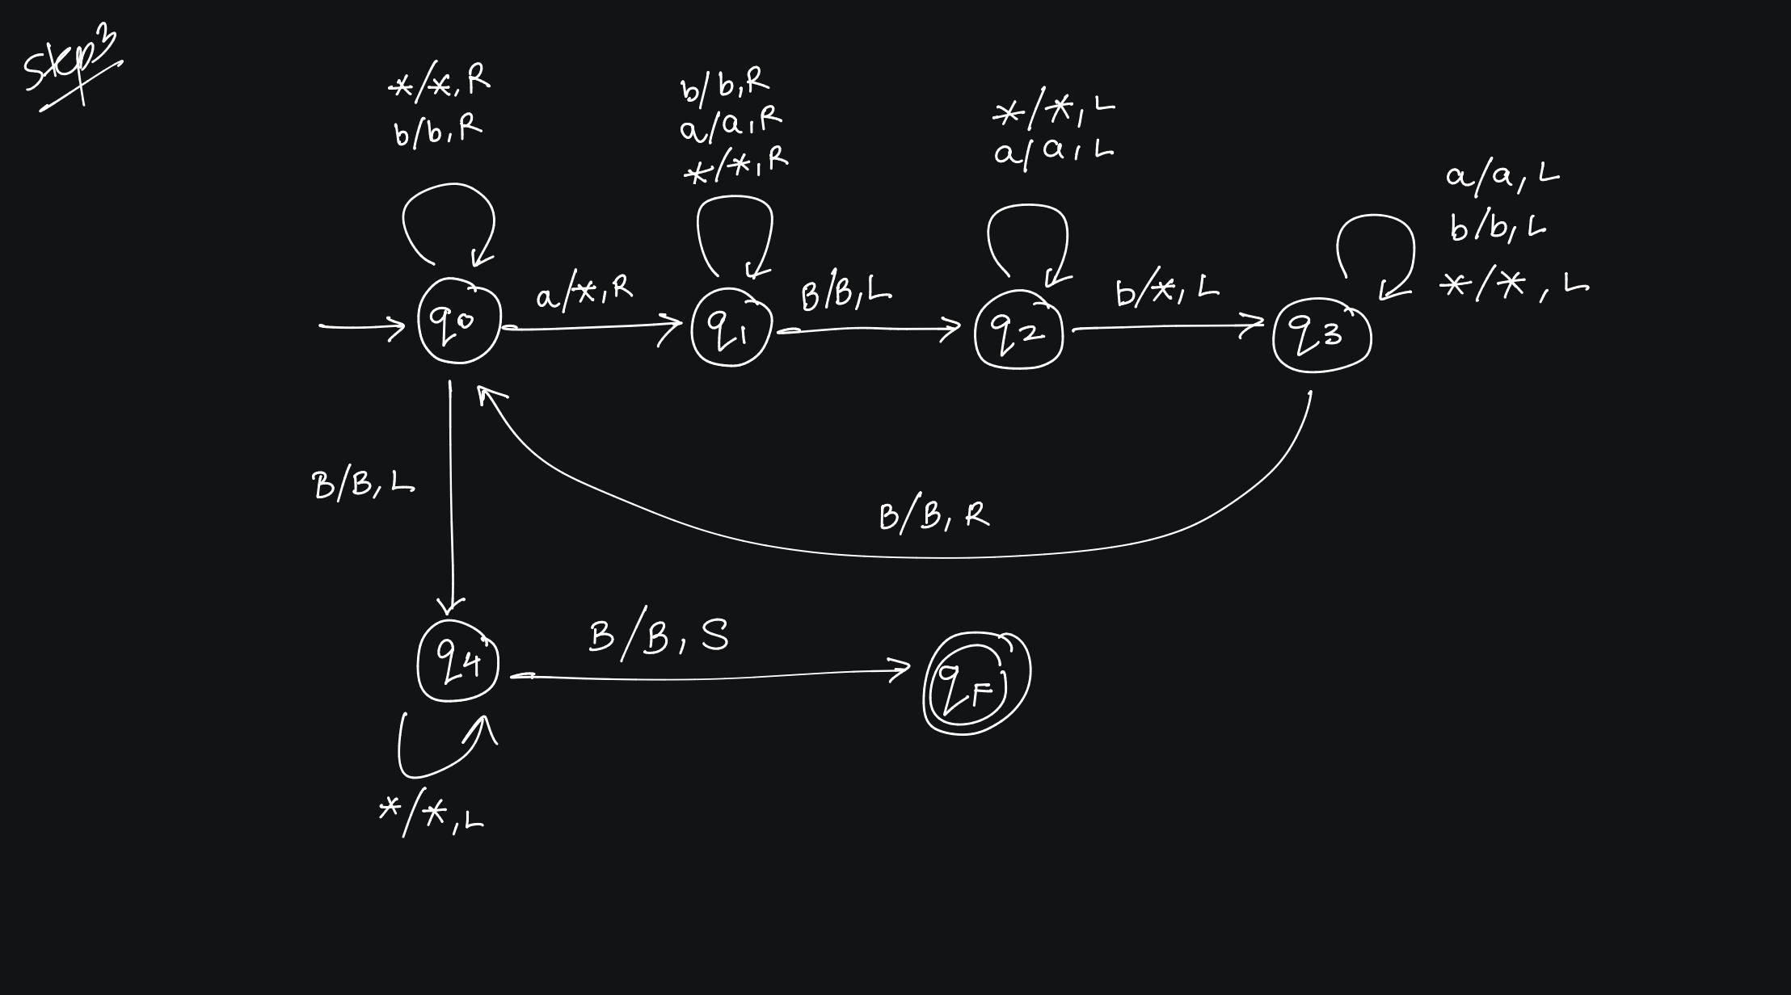

Slide 24


Slide 25


Slide 26
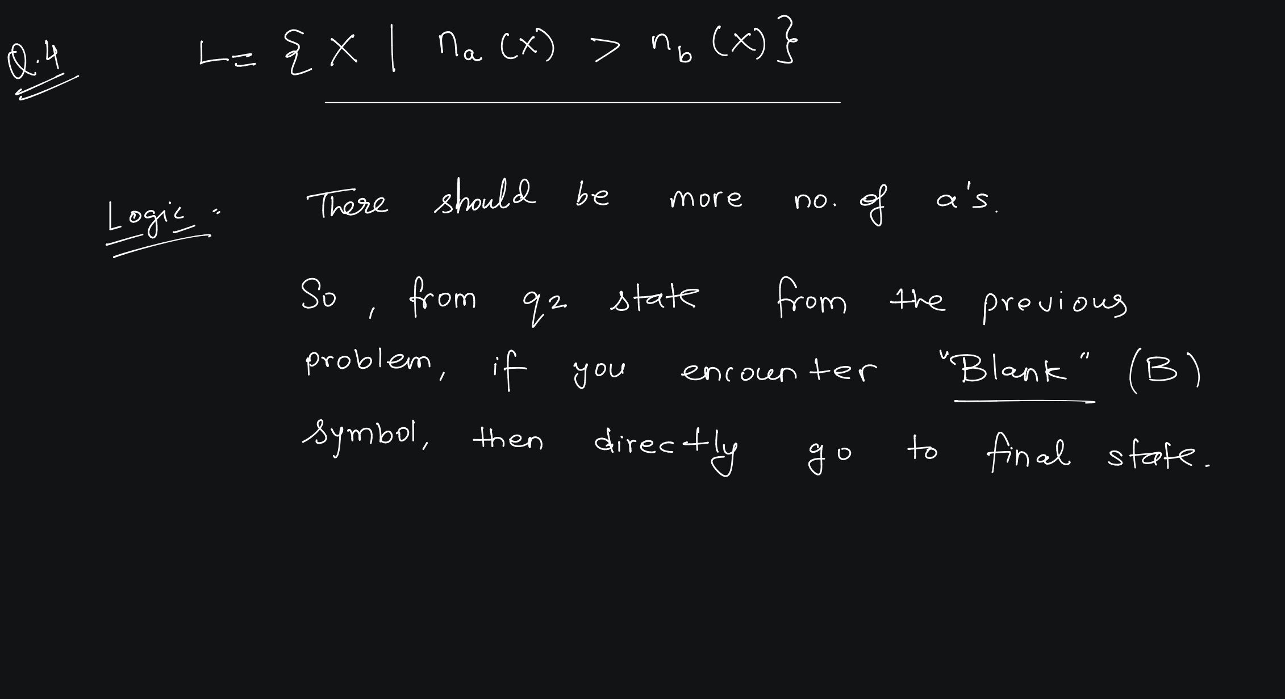


Slide 28
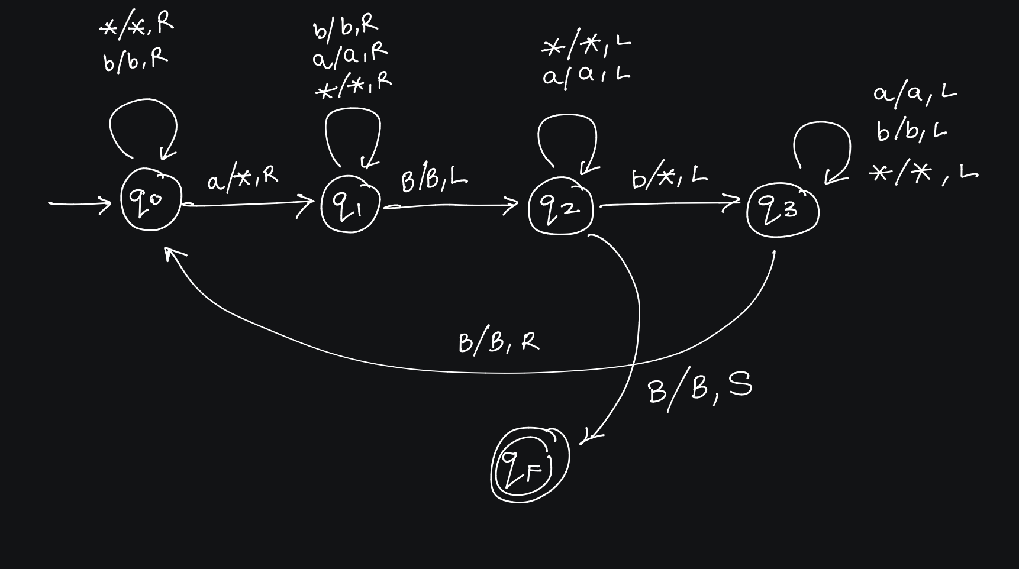

Slide 29
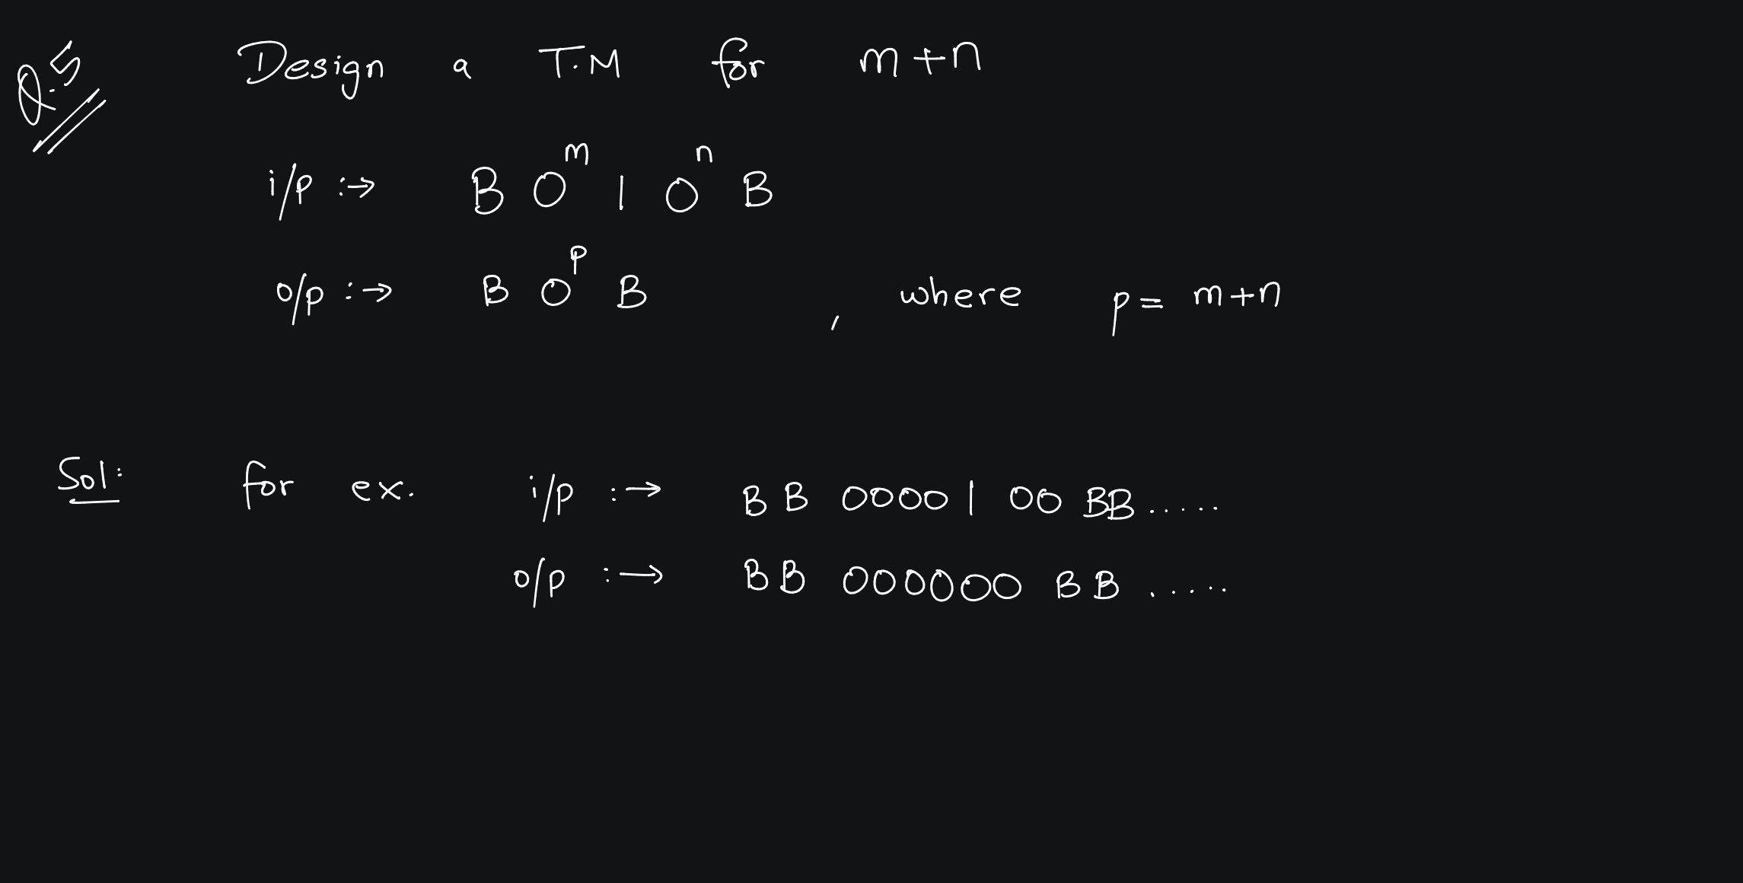


Slide 31
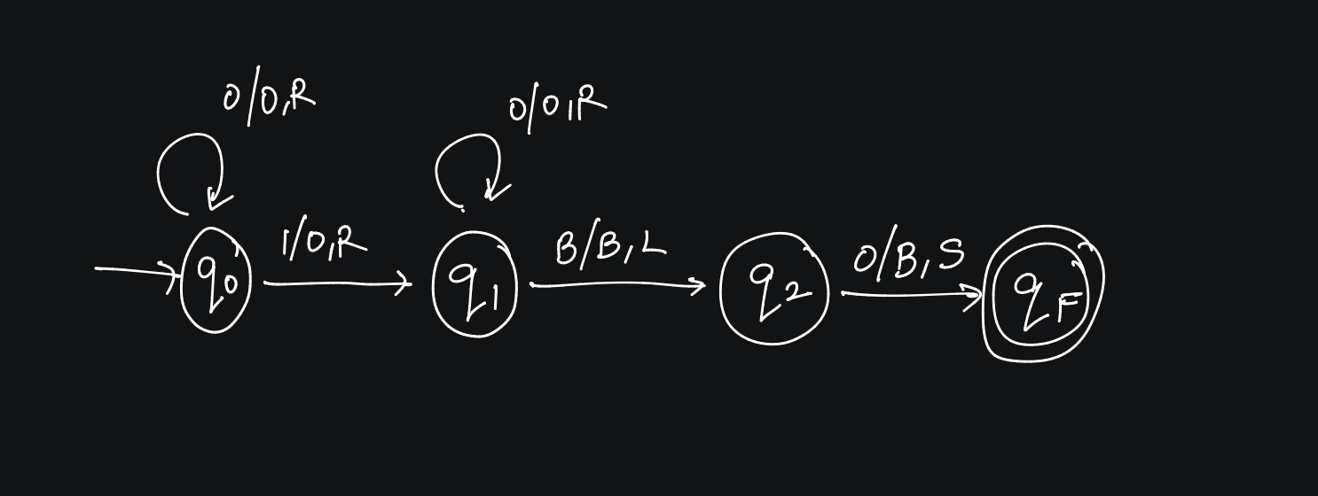

Slide 32
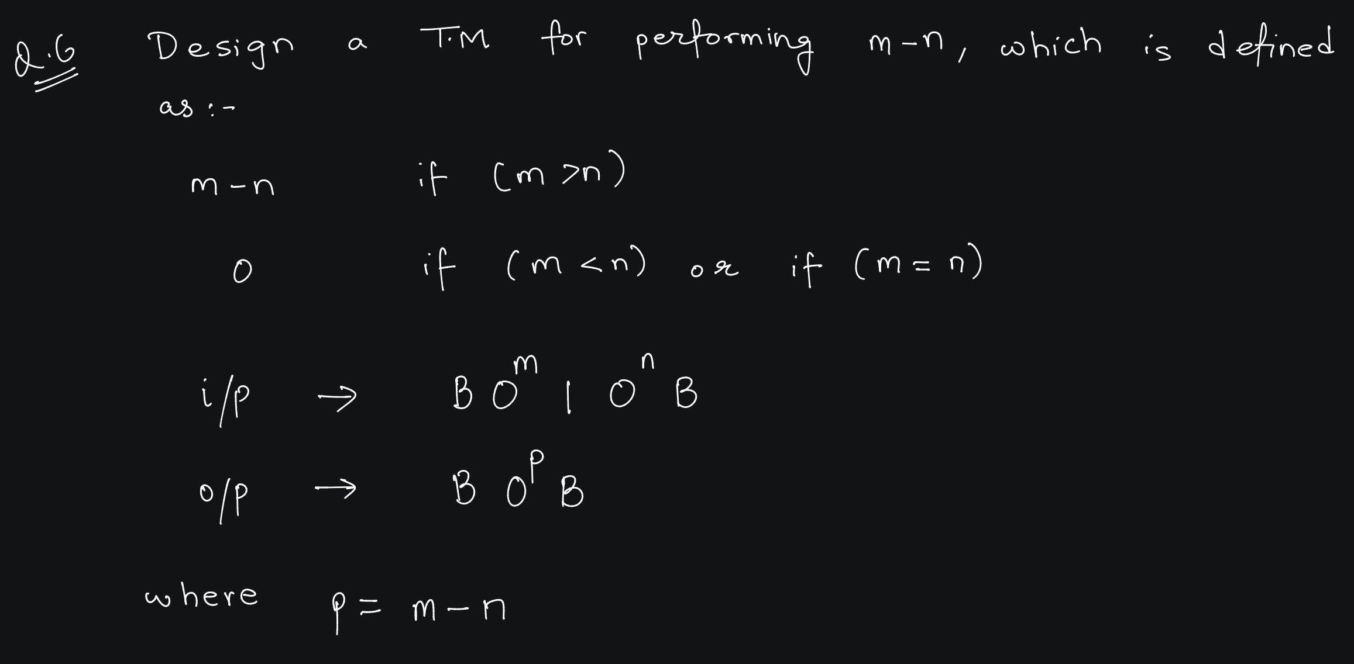

Slide 33
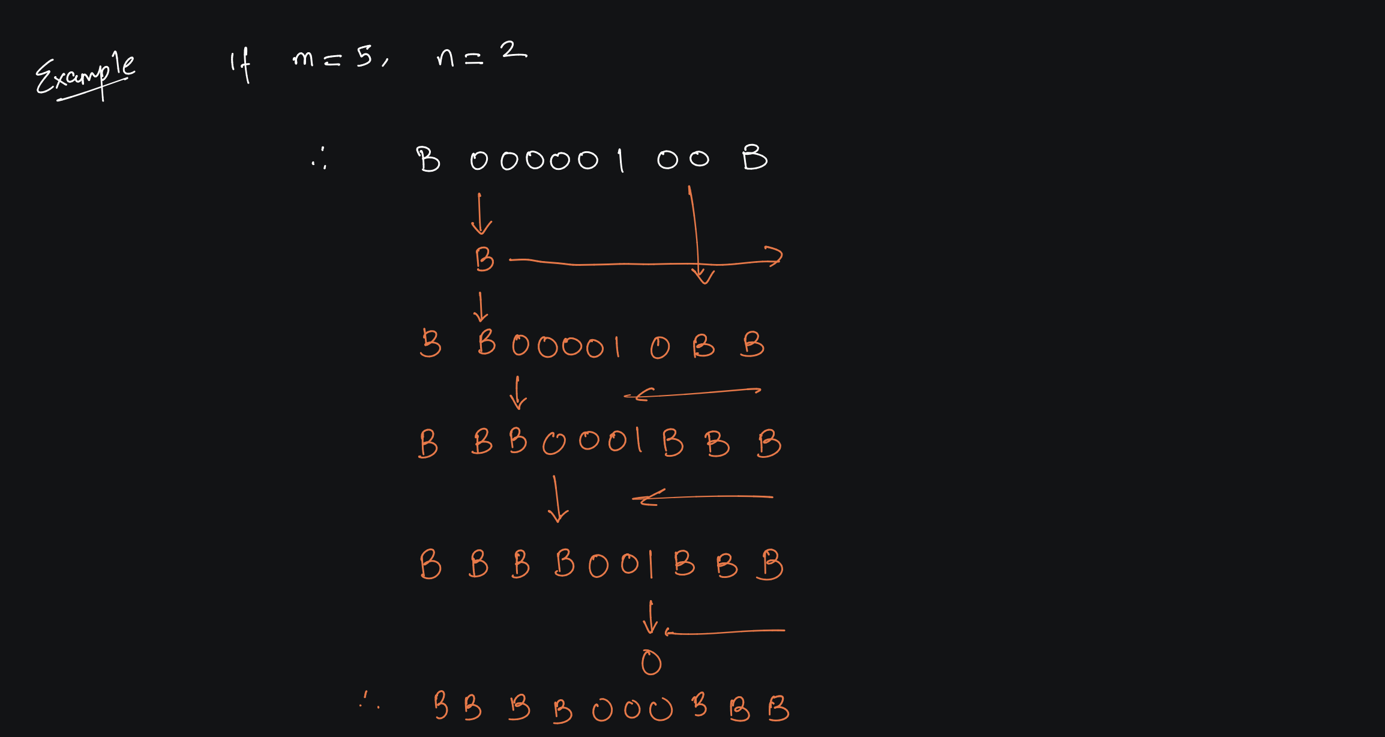

Slide 34
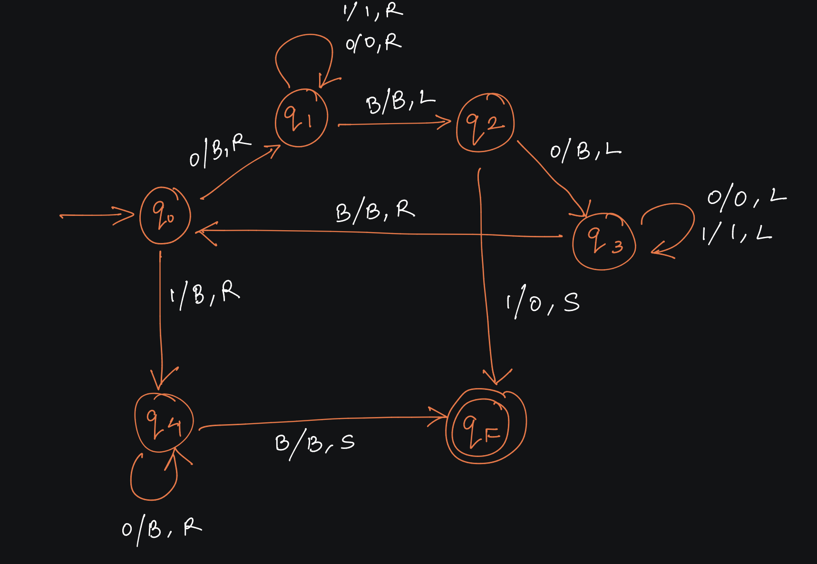

Slide 35
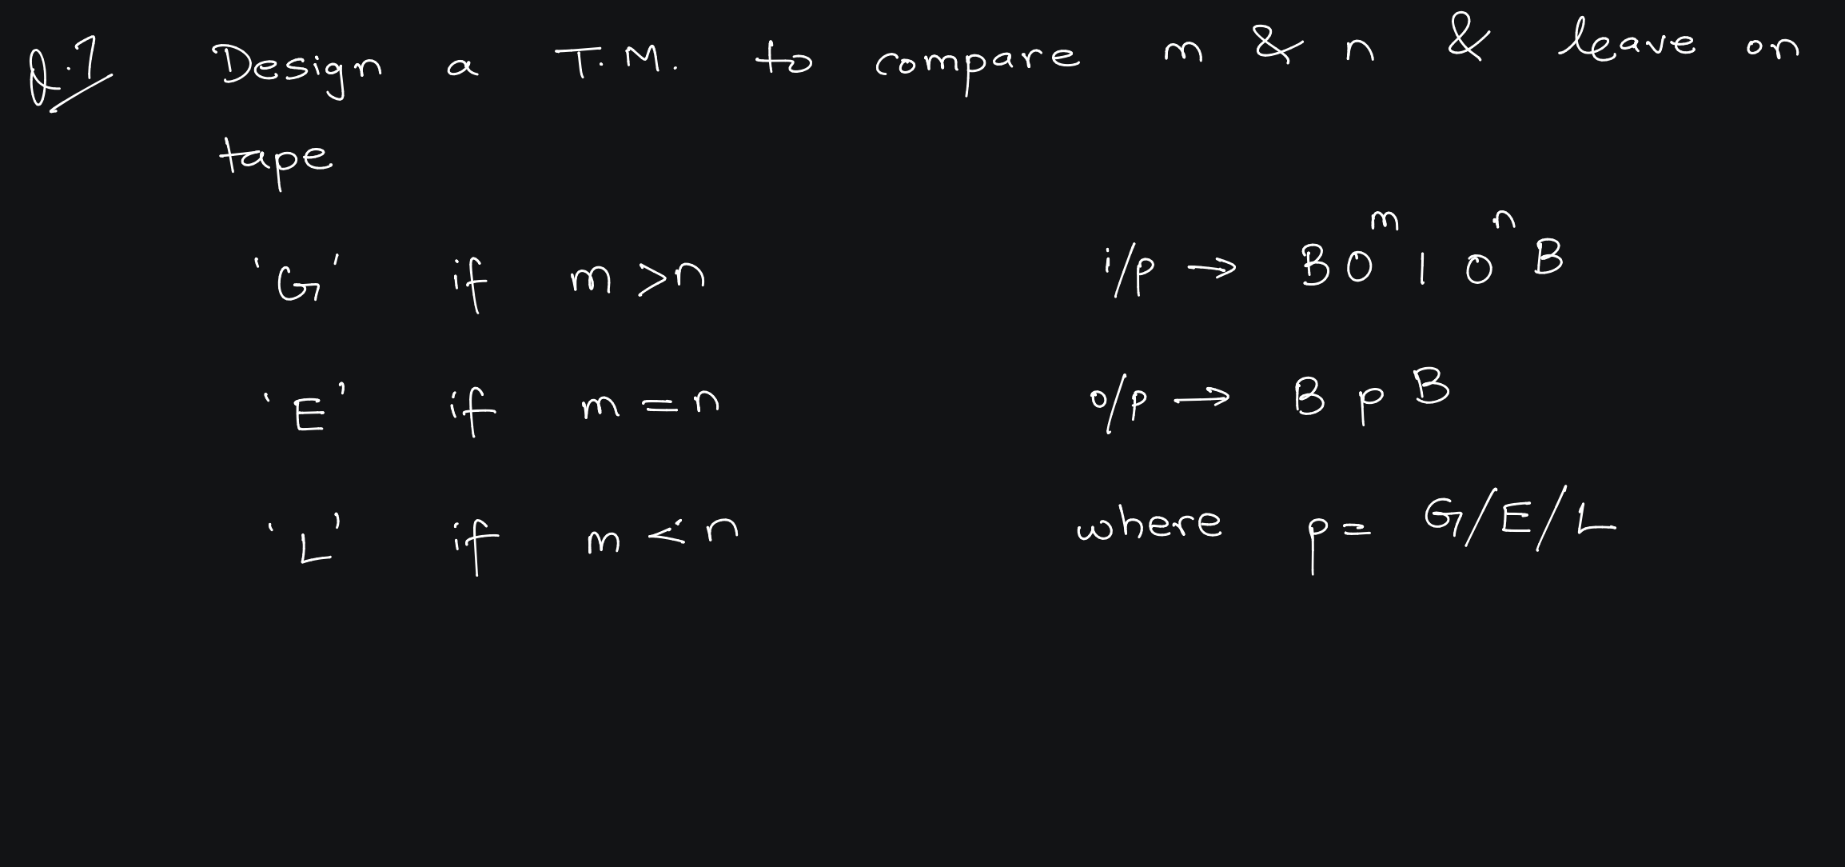

Slide 36
Logic:
  Read 0, make it Blank, Move Right
  Bypass Every character till Blank, Move Left
  Read 0 , make it Blank , Move Left
  Continue for remaining inputs
  If 1 is encountered in qo state, check if more 0’s are left.
  If no more 0’s are there then replace 1 by E, Stop
  If more 0’s are left, replace all 0’s by Blanks and move Right, after reaching the Blank Symbol, Replace by L and Stop.
  If 1 is encountered in q2 state, replace 1 by B, Move Left. Replace Blank by G and Stop.

Slide 37
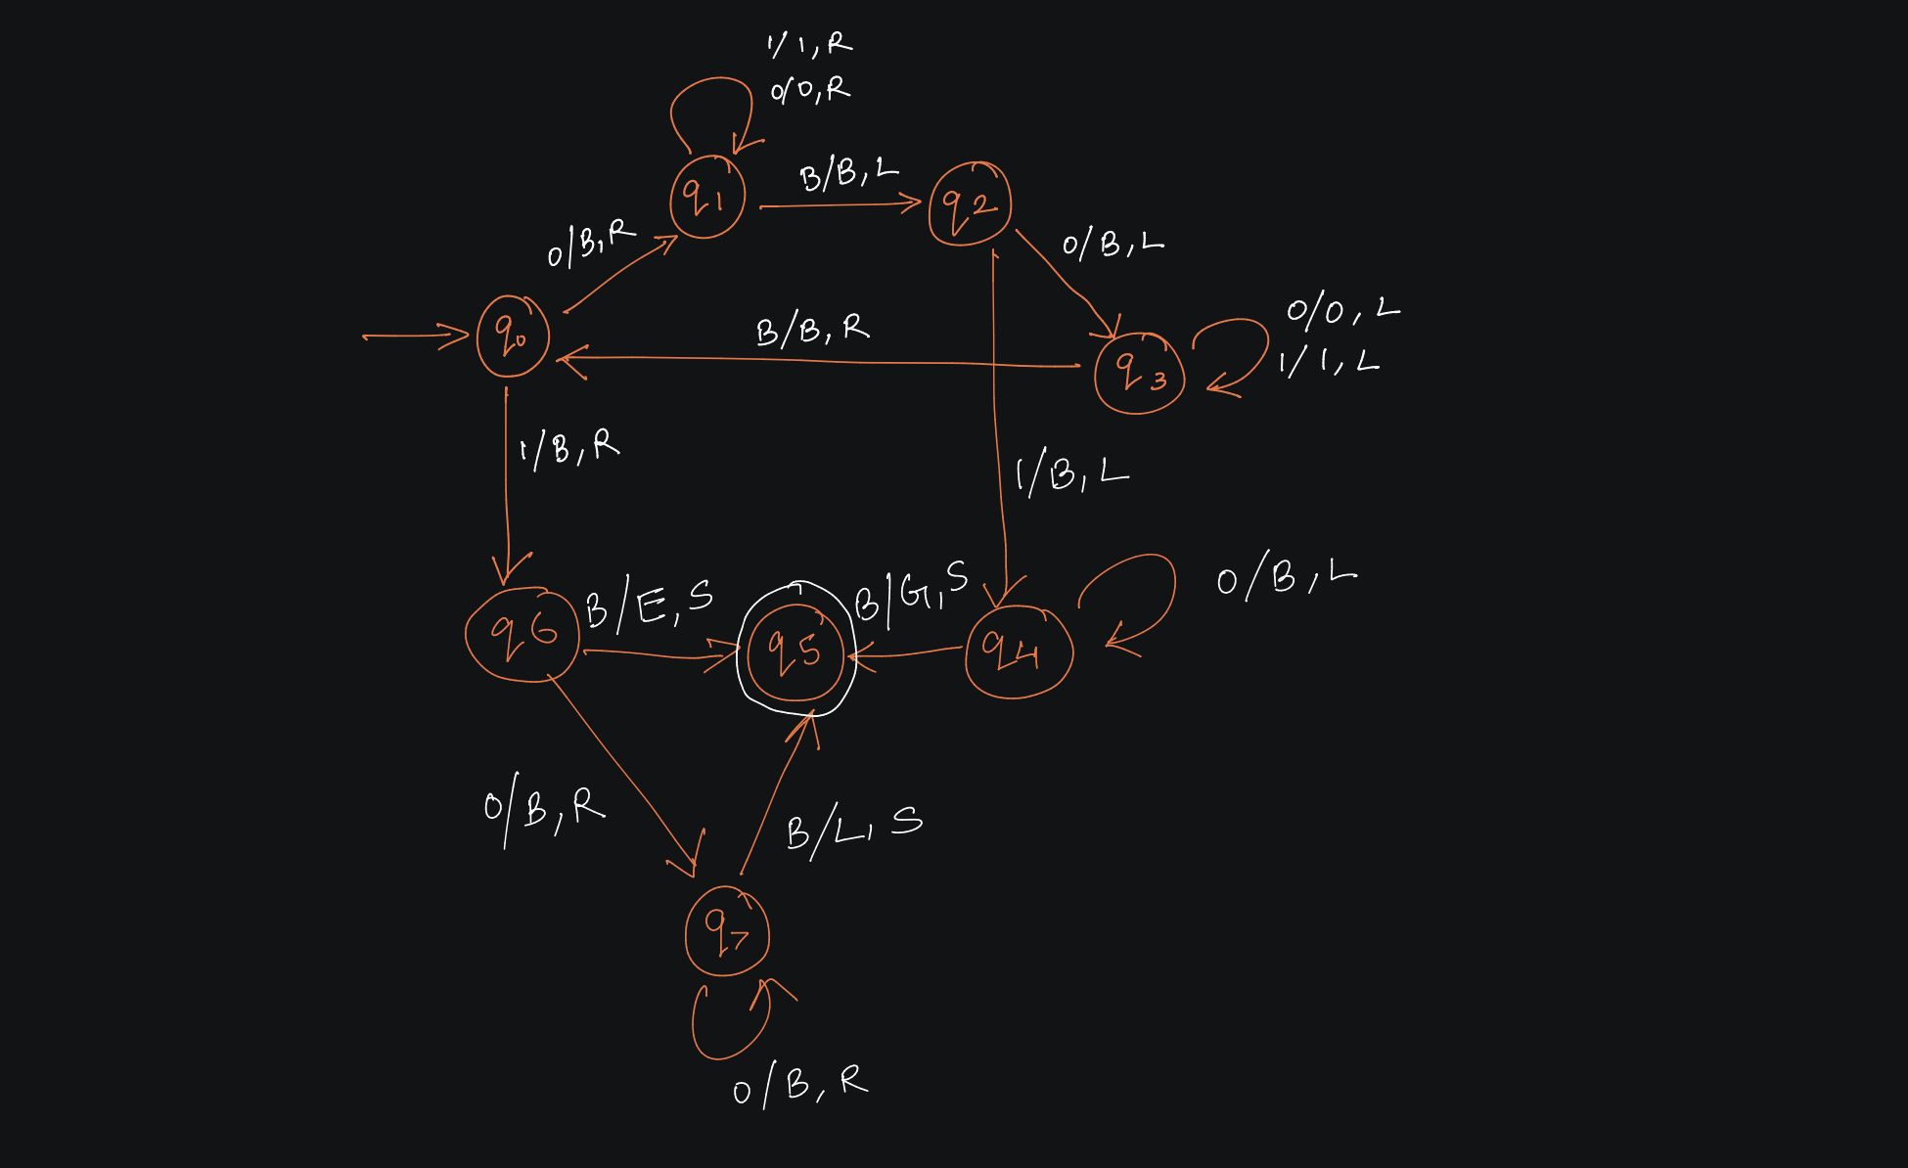

Slide 38
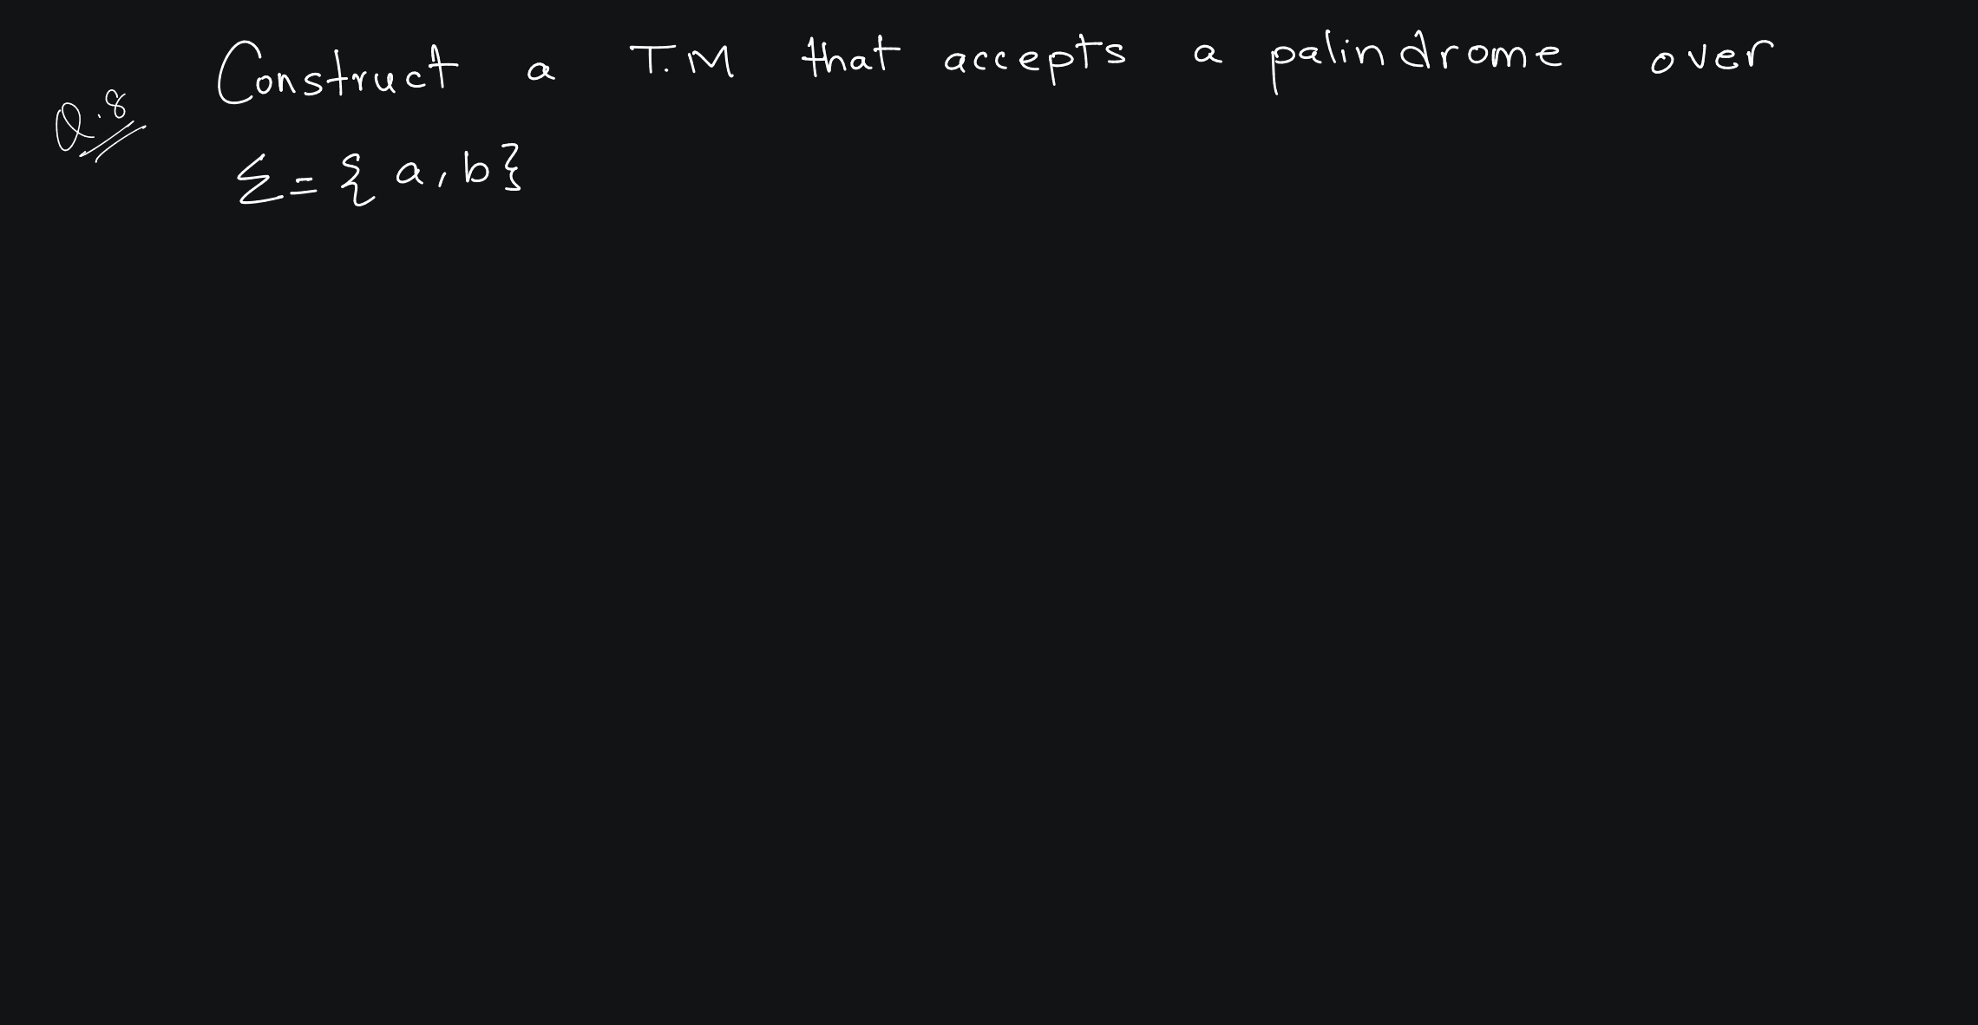

Slide 39
Logic:
  Read a/b, make it Blank, Move Right
  Bypass Every character till Blank, Move Left
  Read a/b , make it Blank , Move Left
  Bypass every character Till you encounter Blank, Move Right and Continue for remaining inputs.
  In qo state, if Blank is encountered, go to Final State (EVEN PALINDROME)
  If Blank is encountered in q2 or q5 state, go to Final State (ODD Palindrome)

Slide 40
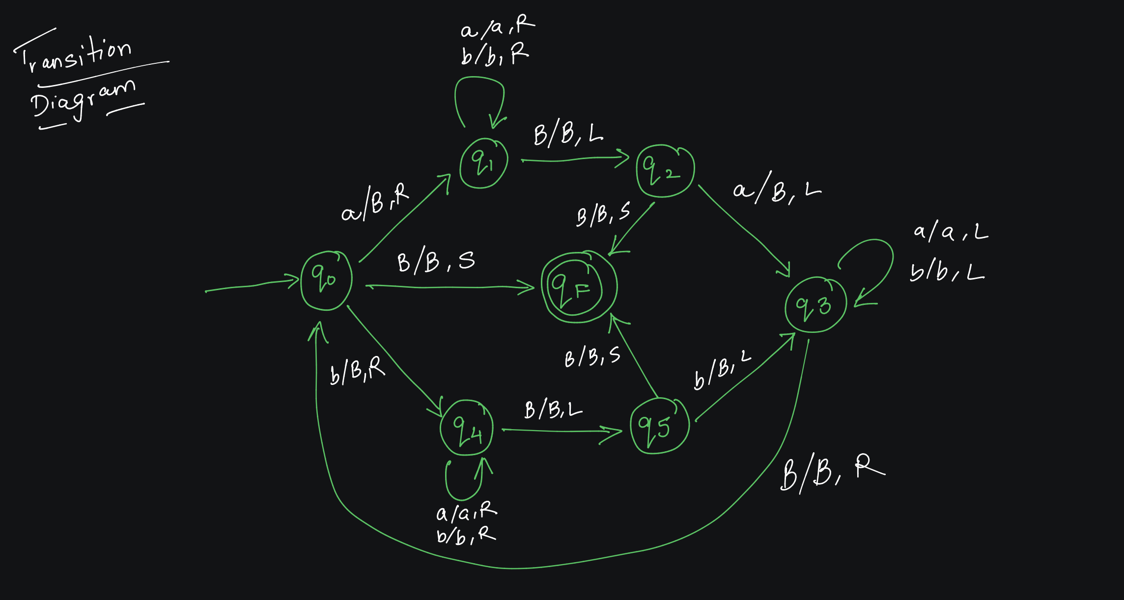

Slide 41
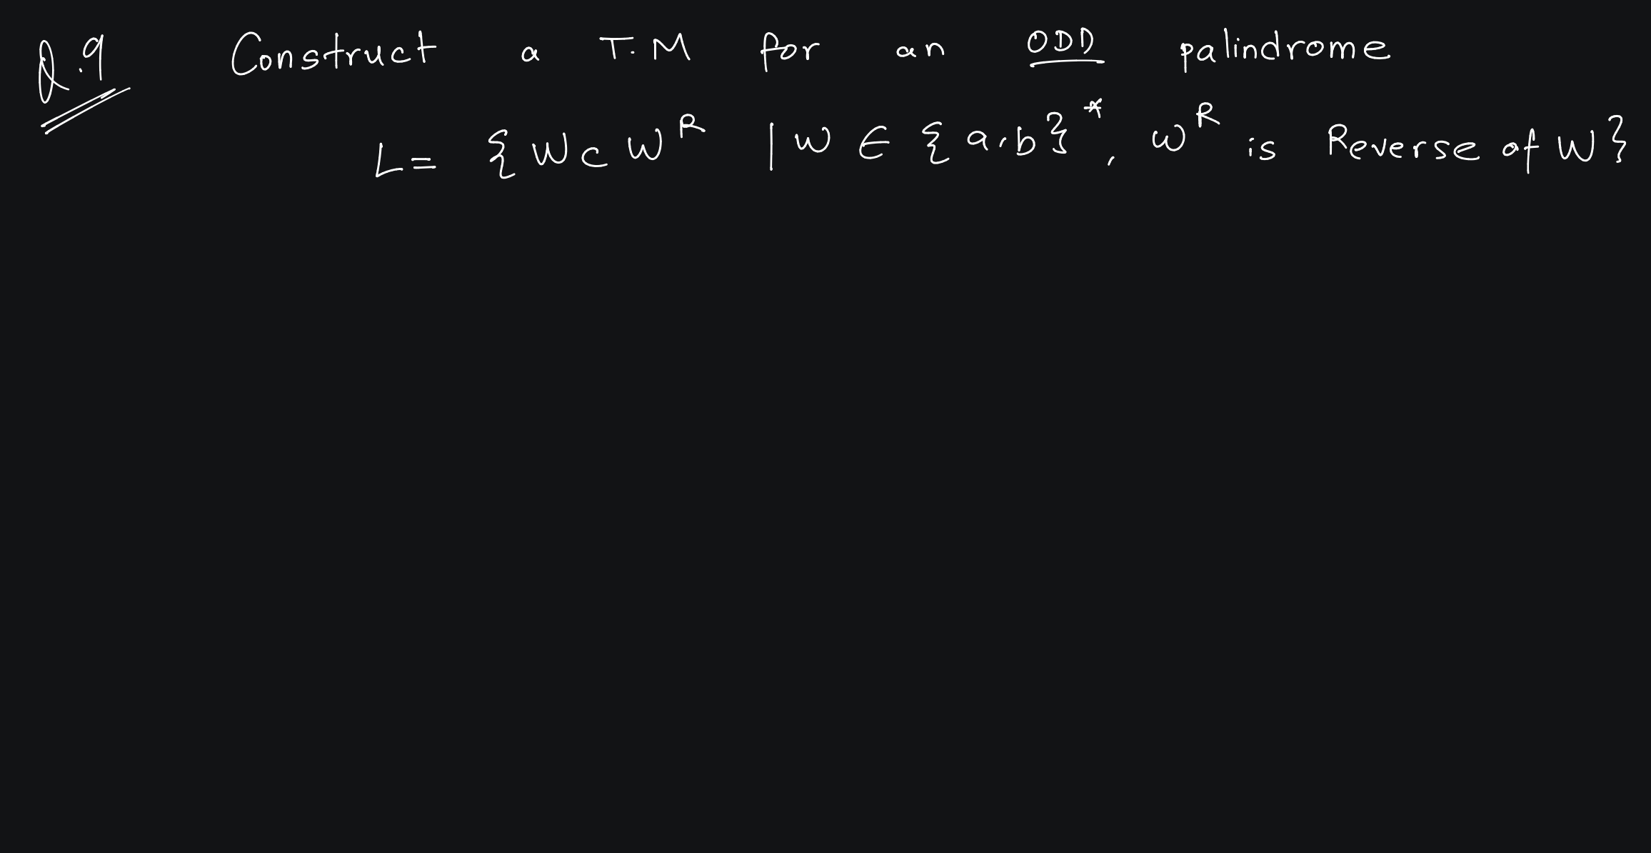

Slide 42
Logic:
  Read a/b, make it Blank, Move Right
  Bypass Every character till Blank, Move Left
  Read a/b , make it Blank , Move Left
  Bypass every character Till you encounter Blank, Move Right and Continue for remaining inputs.
  In qo state, if c is encountered, make it Blank. Move Right.
  If Blank is encountered again, go to Final State.

Slide 43
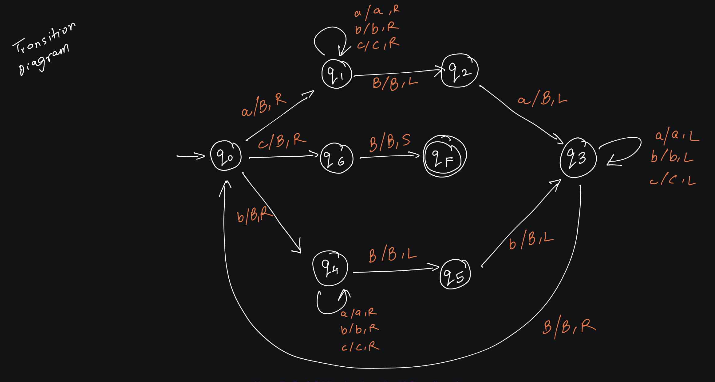

Slide 44
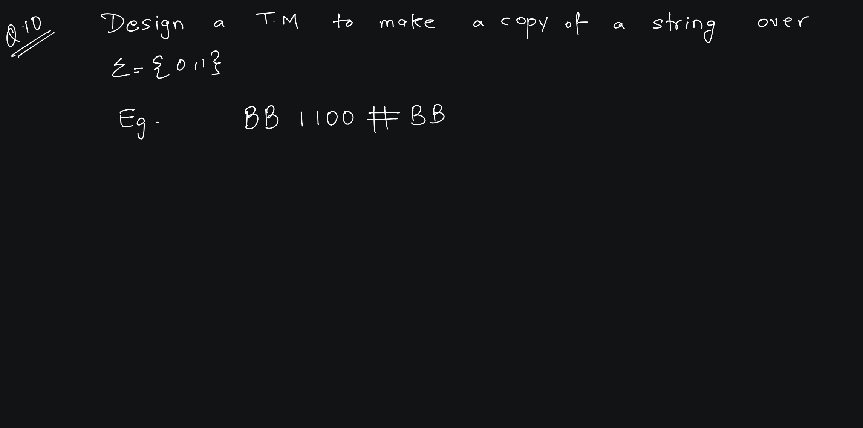

Slide 45
Logic:
  Read 0, make it X, Move Right Or Read 1, make it Y, Move Right
  Bypass Every character till Blank, Move Left
  Bypass Every character till X/Y, Make it 0/1 Move Right.
  Continue for remaining inputs.
  In qo state, if # is encountered, Keep it same and STOP

Slide 46
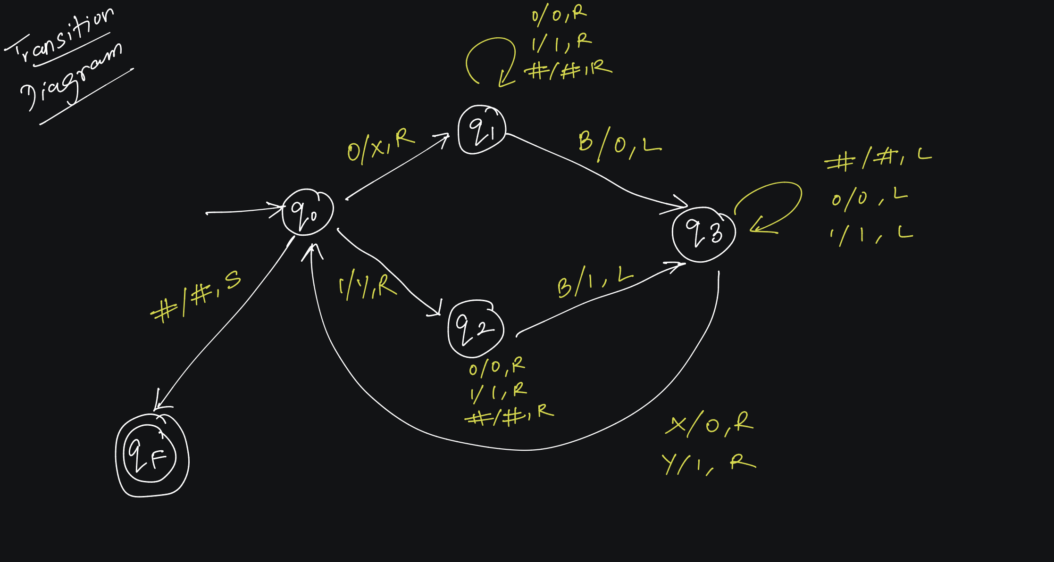

Slide 47
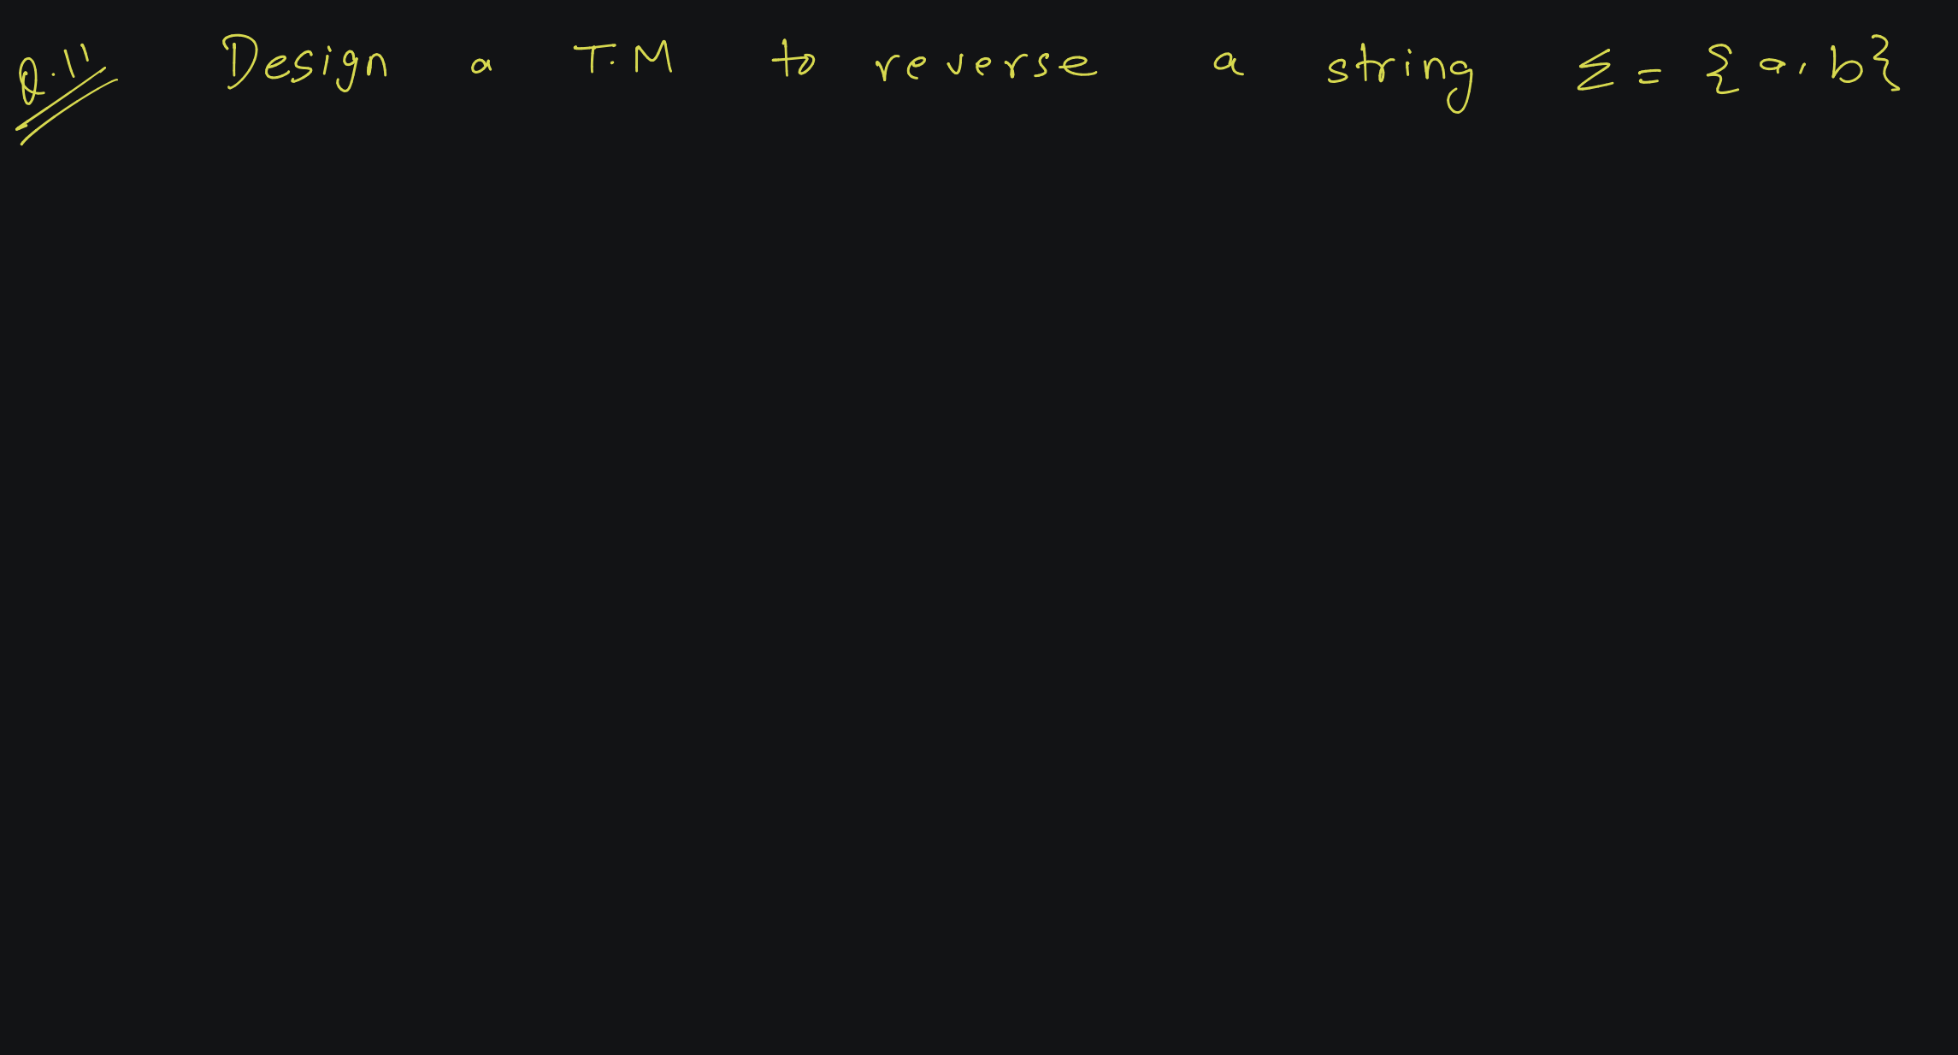

Slide 48
Logic:
  Bypass Every Character till Blank. Move Left.
  Read a/b, make it X, Move Right.
  Go Till Blank, Make it a/b as per state, move left.
  While Going Left Replace the X by X only and keep moving left until a/b is encountered.
  Continue for remaining inputs.
  In qo state, if Blank is encountered, Keep it same and Move Right.
  Replace all X by Blank, move right, Stop.

Slide 49
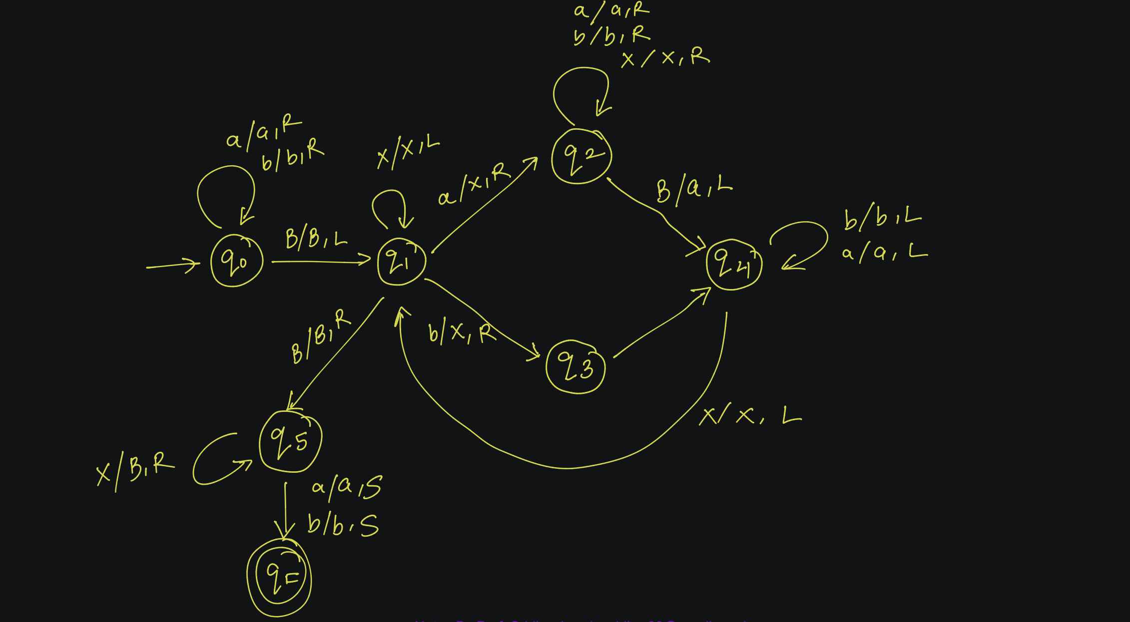

Slide 50
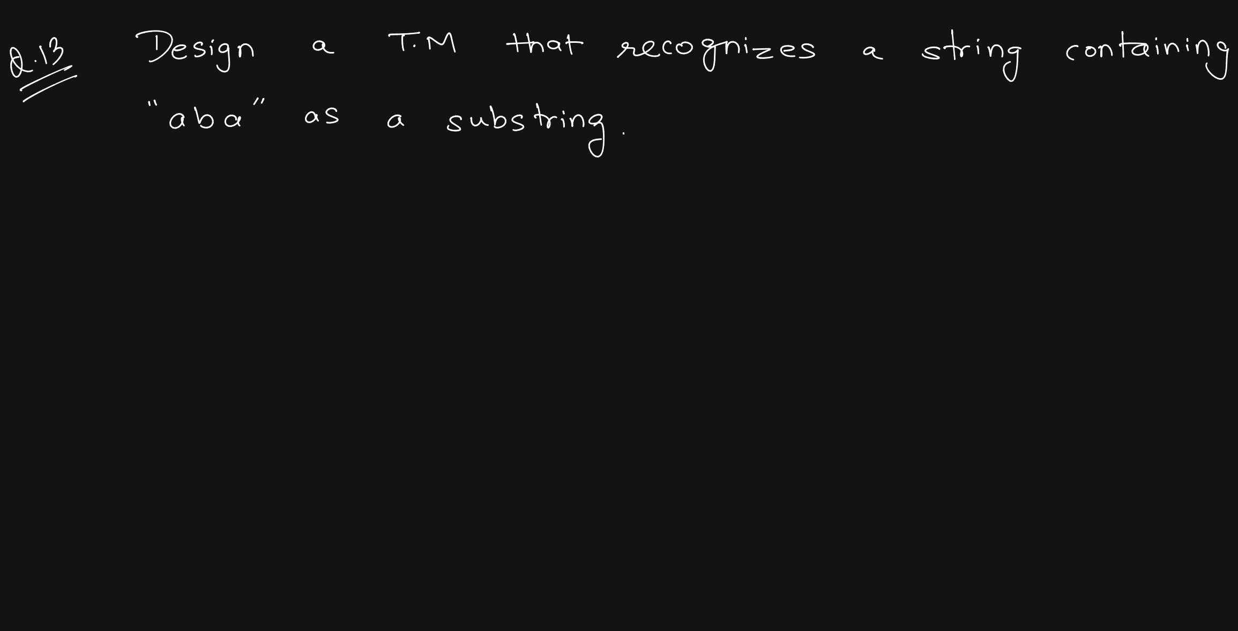

Slide 52
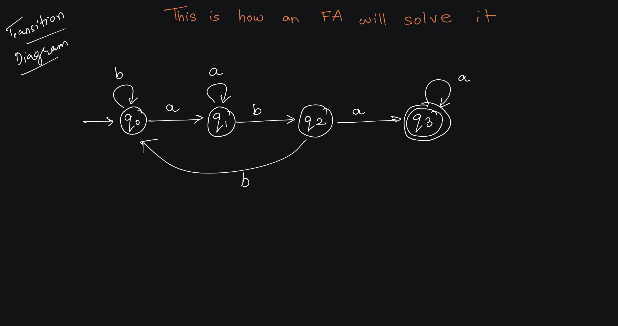

Slide 53
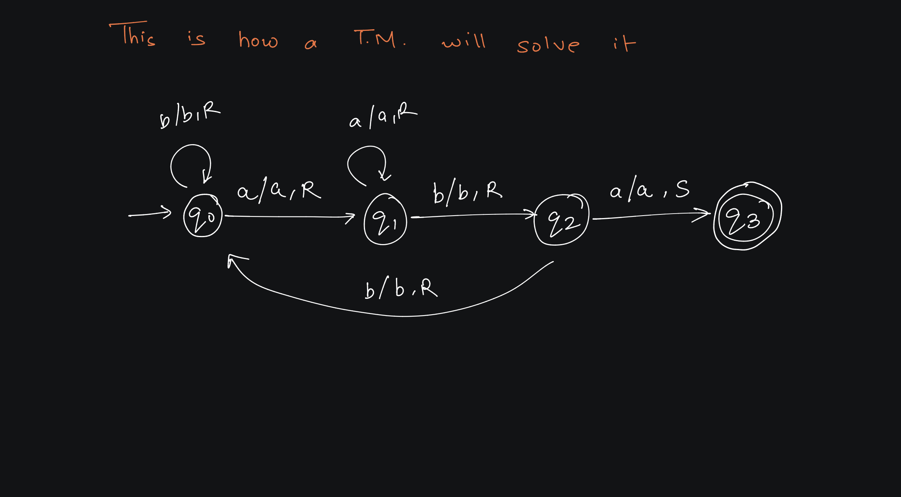

Slide 54
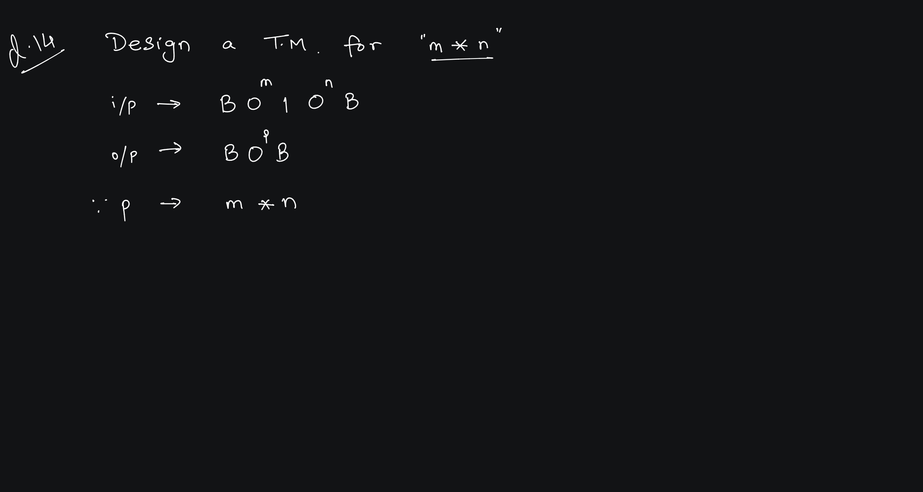

Slide 56
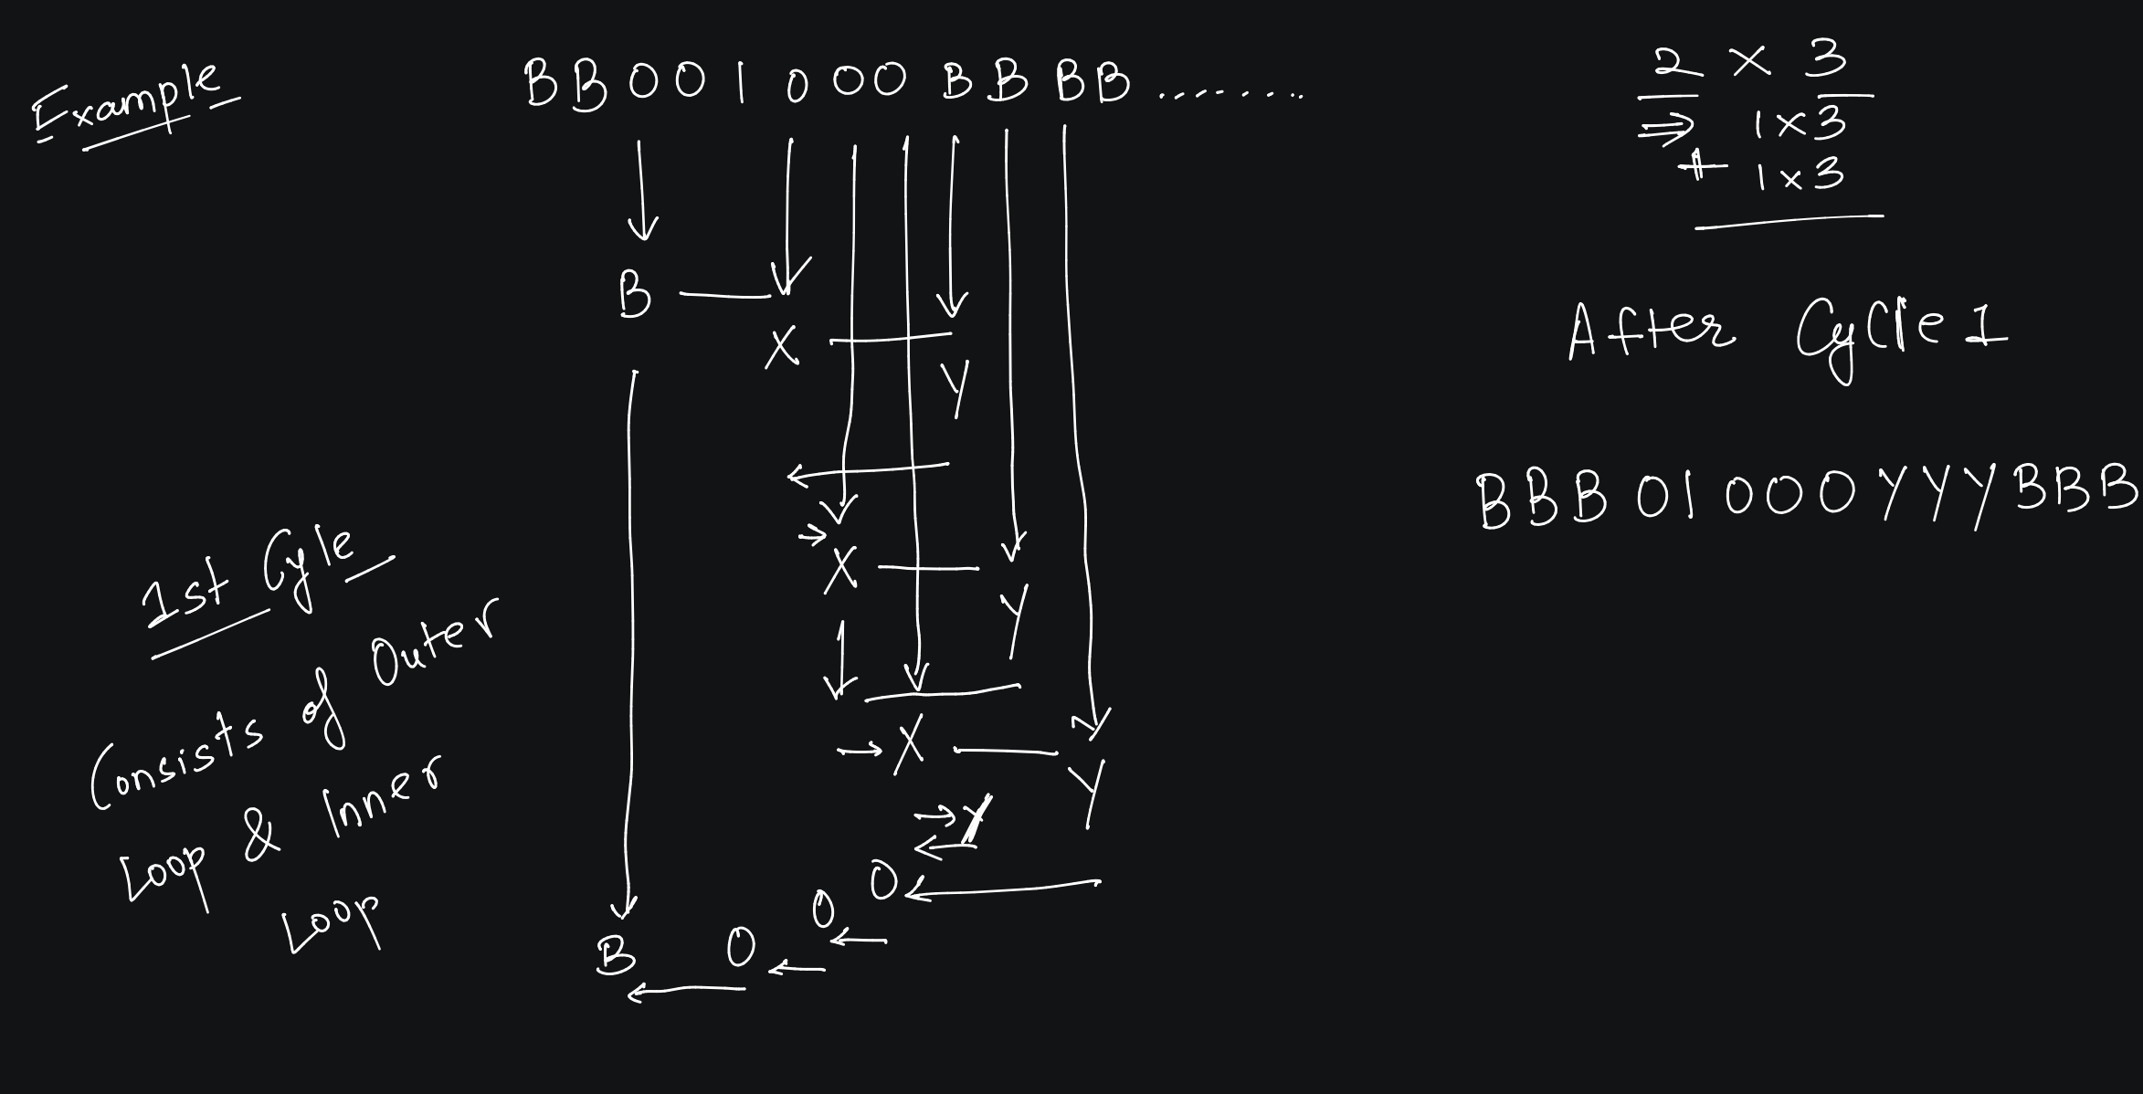

Slide 57
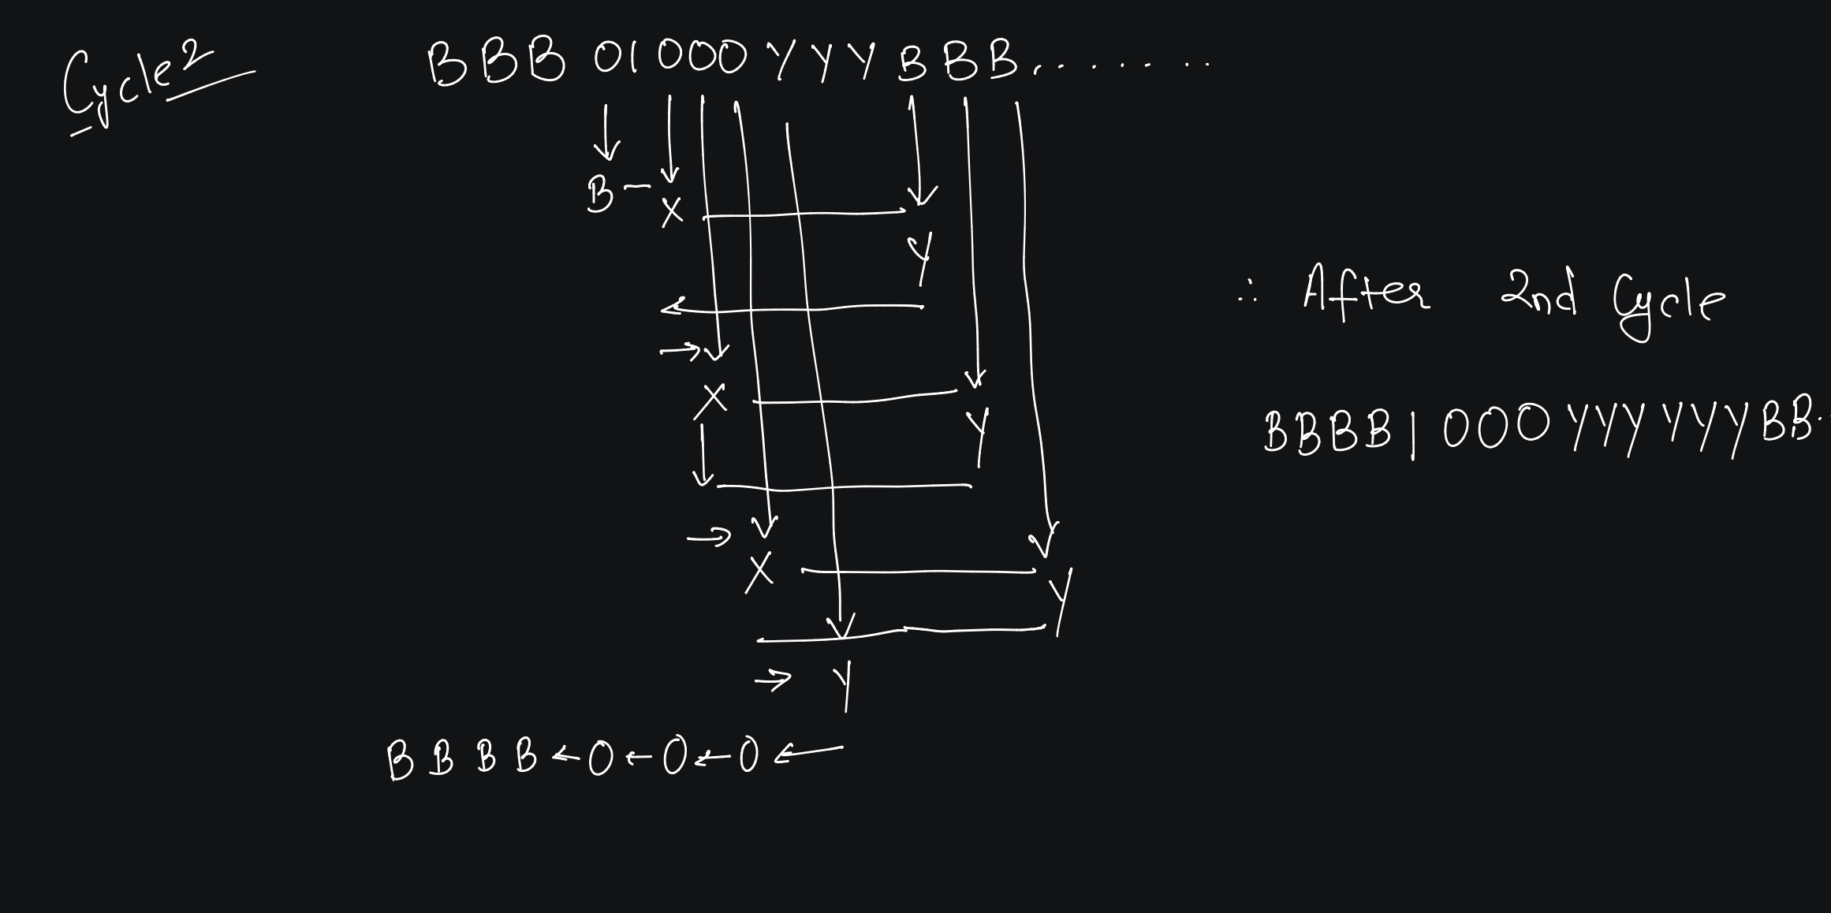

Slide 58
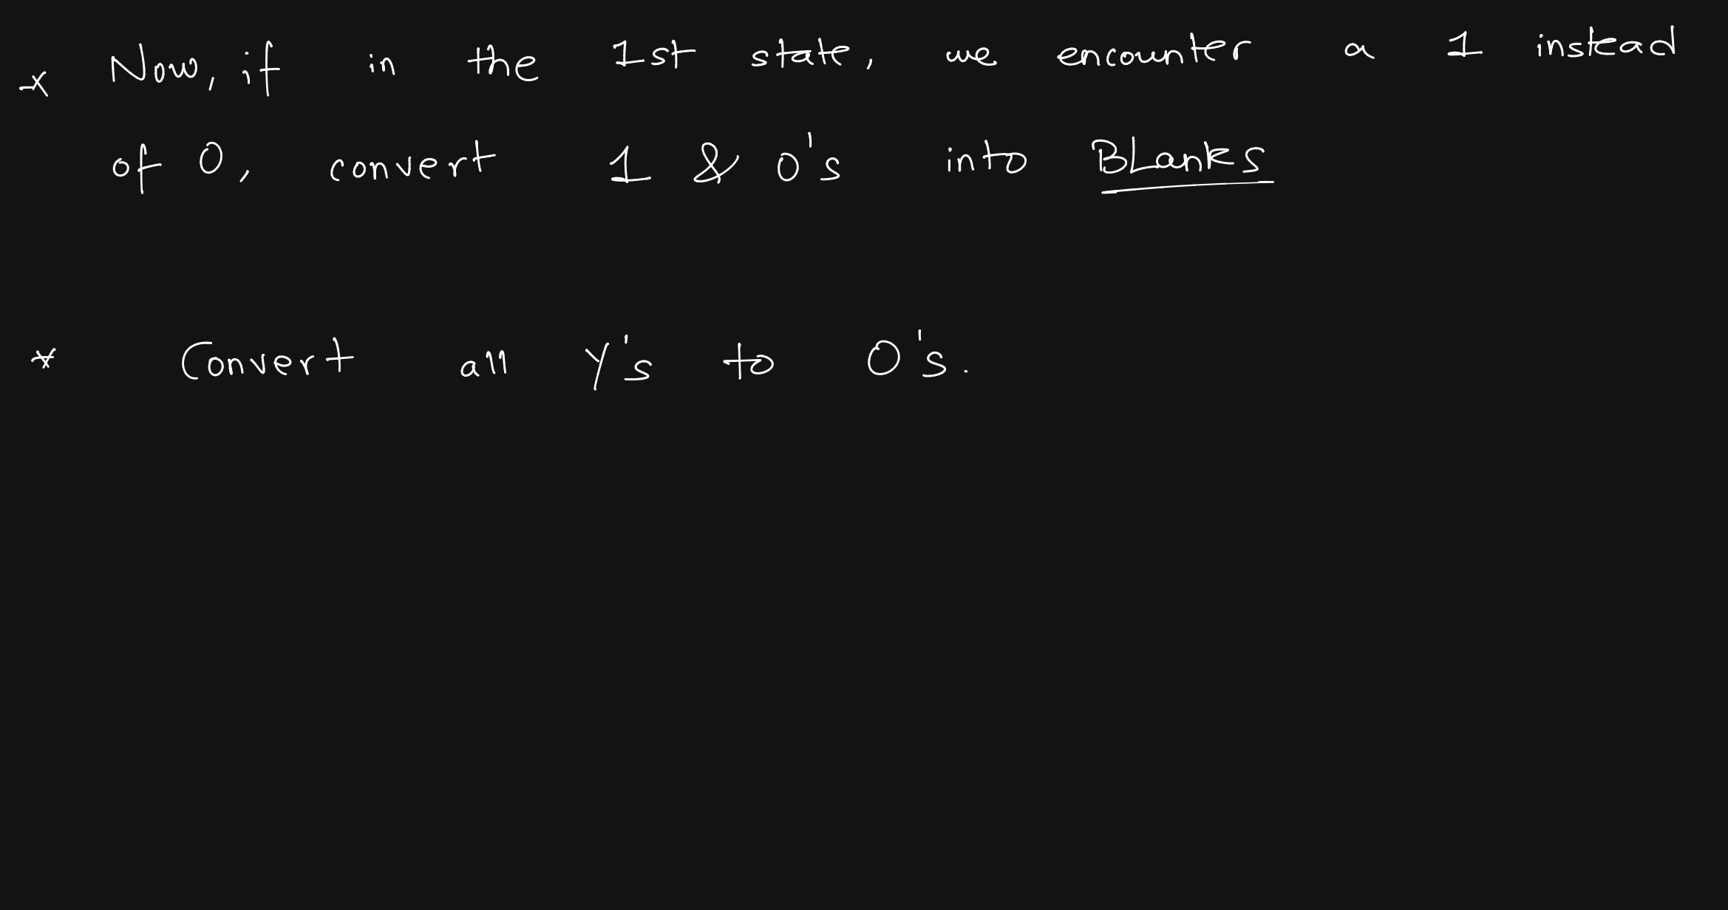

Slide 59
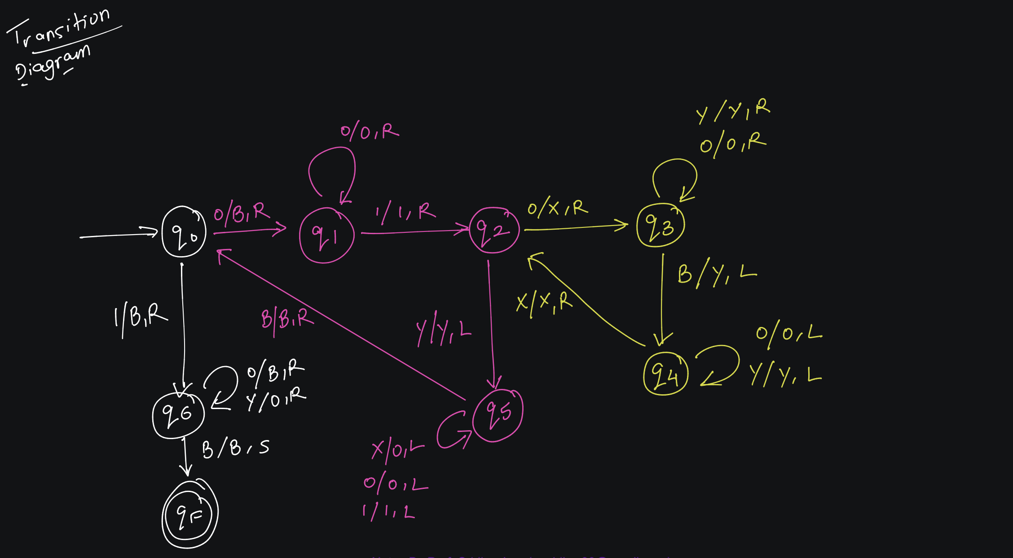

Slide 60
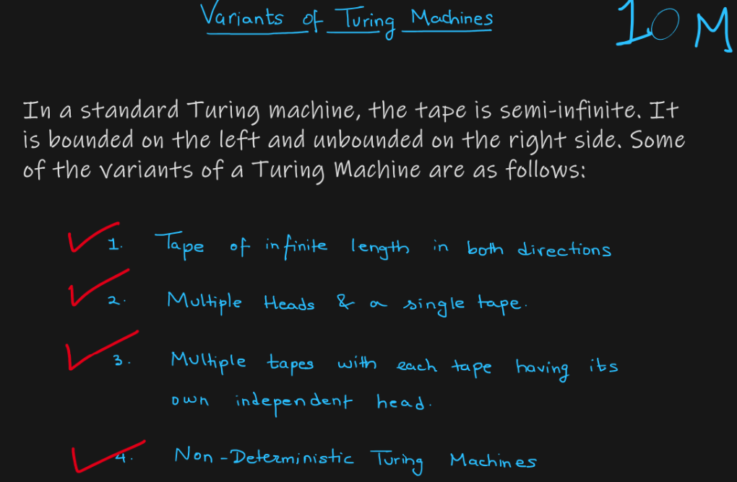

1
2
3
4

Slide 61
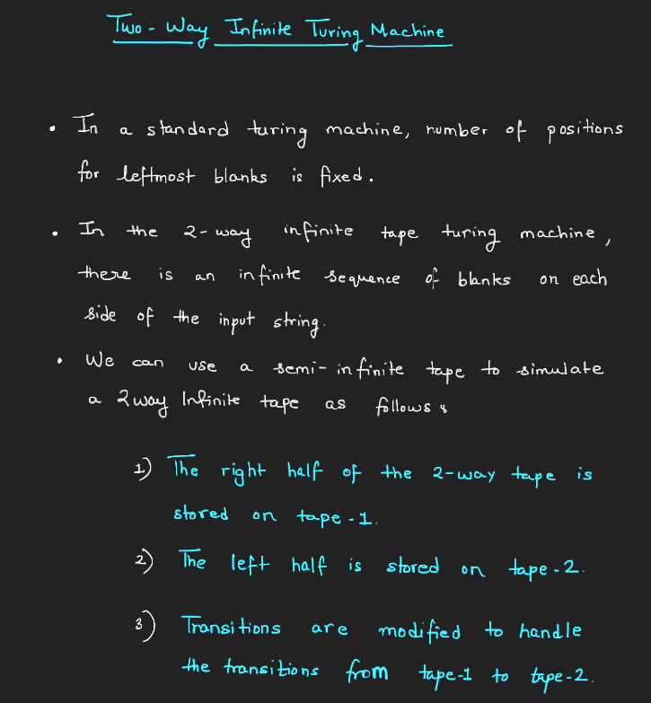

Slide 63
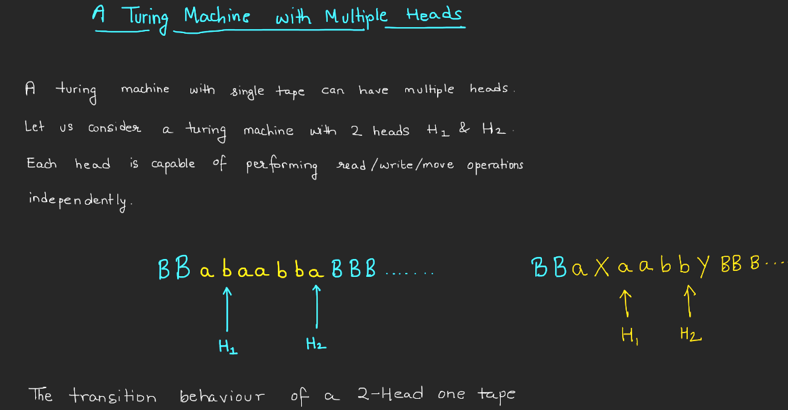

Slide 64
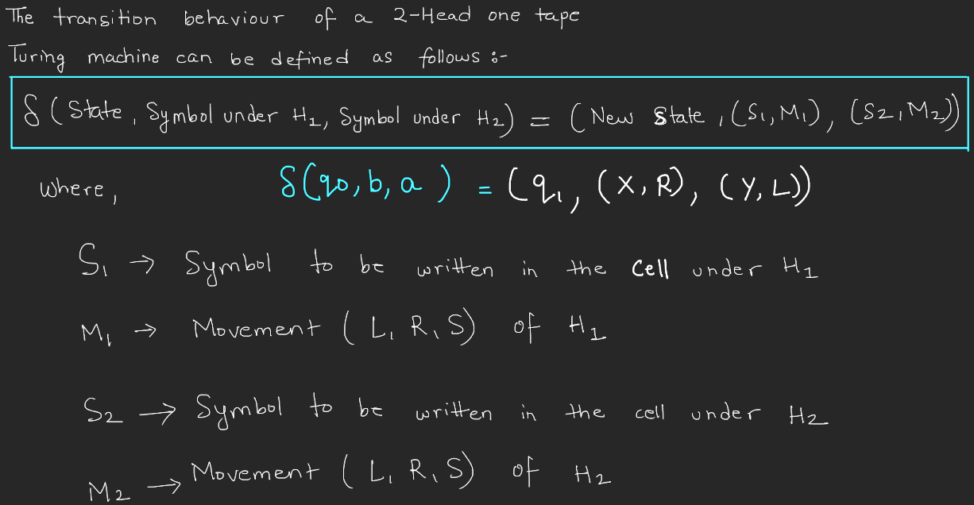

Slide 65
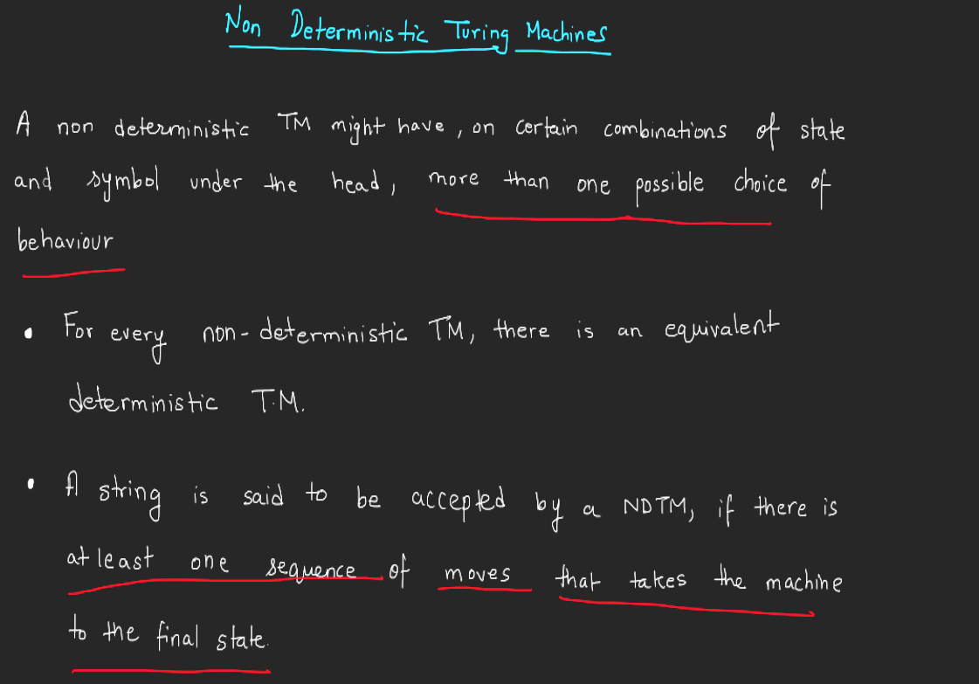

Slide 66


Slide 67


Slide 68


Slide 69


Slide 70


Slide 71


Slide 72


Slide 73


Slide 74


Slide 75


Slide 76


