Slide 1

FORMAL LANGUAGES AND
AUTOMATA THEORY
Lecture 25: Module 4
CFG to PDA
Prepared By: Sridhar Iyer

Slide 2
Extra Problems

Slide 3
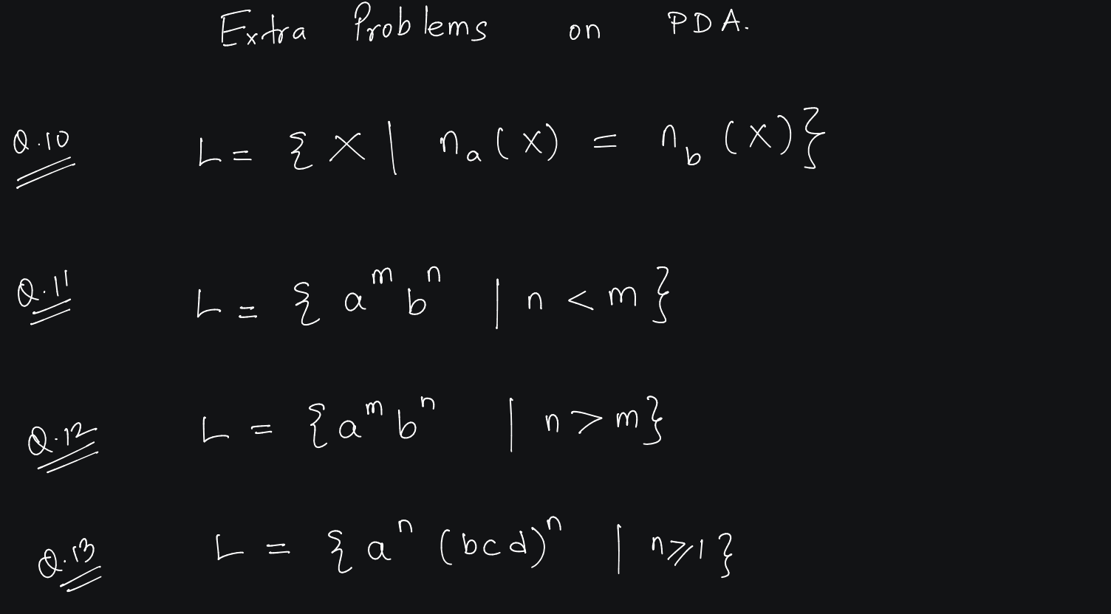

Slide 4
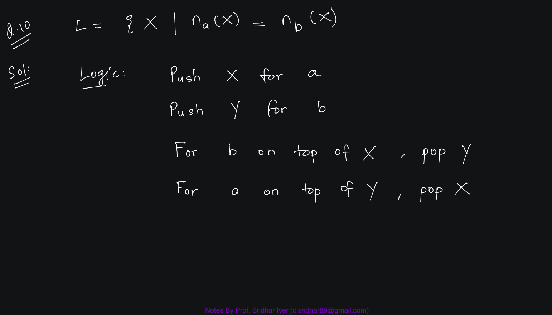

Slide 6
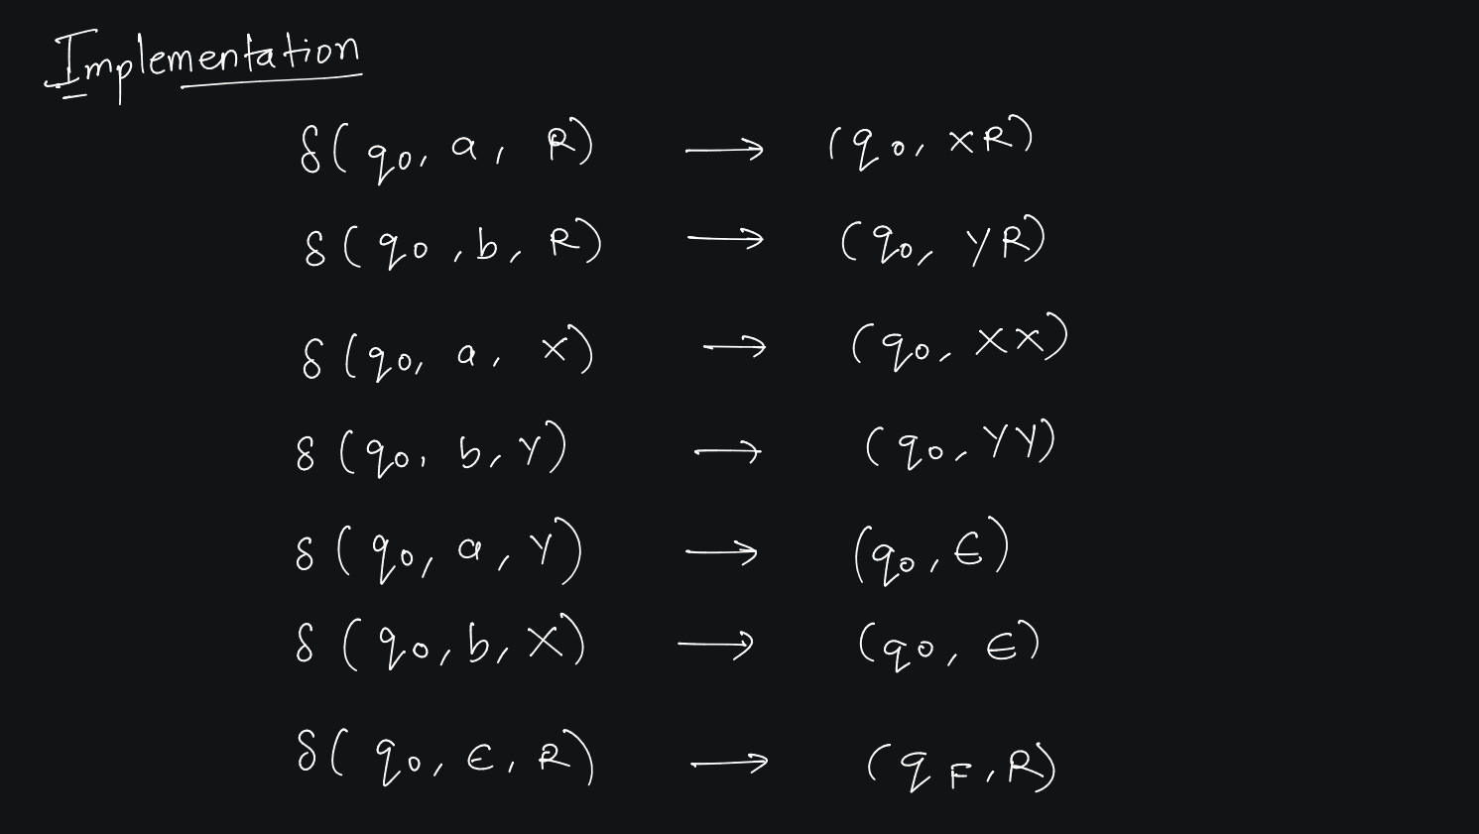

Slide 7
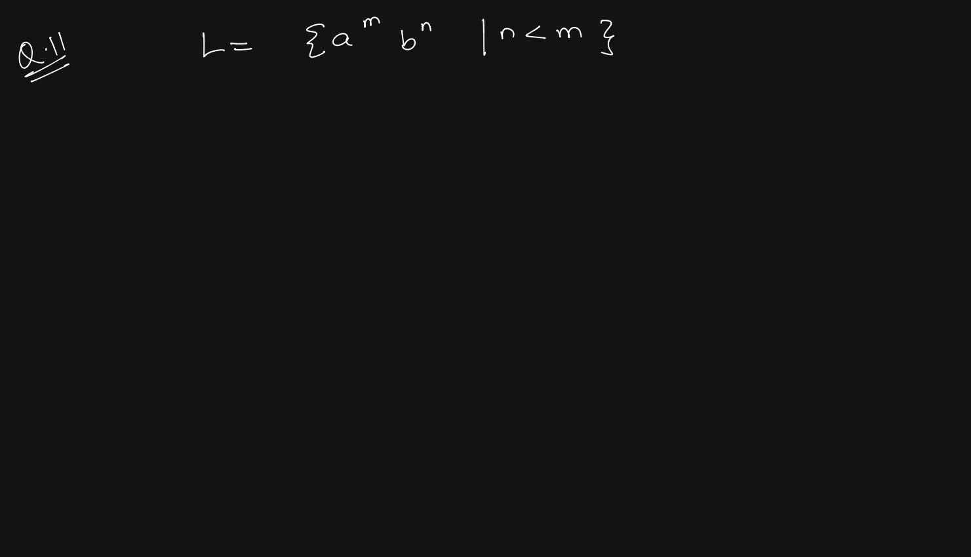

Slide 8
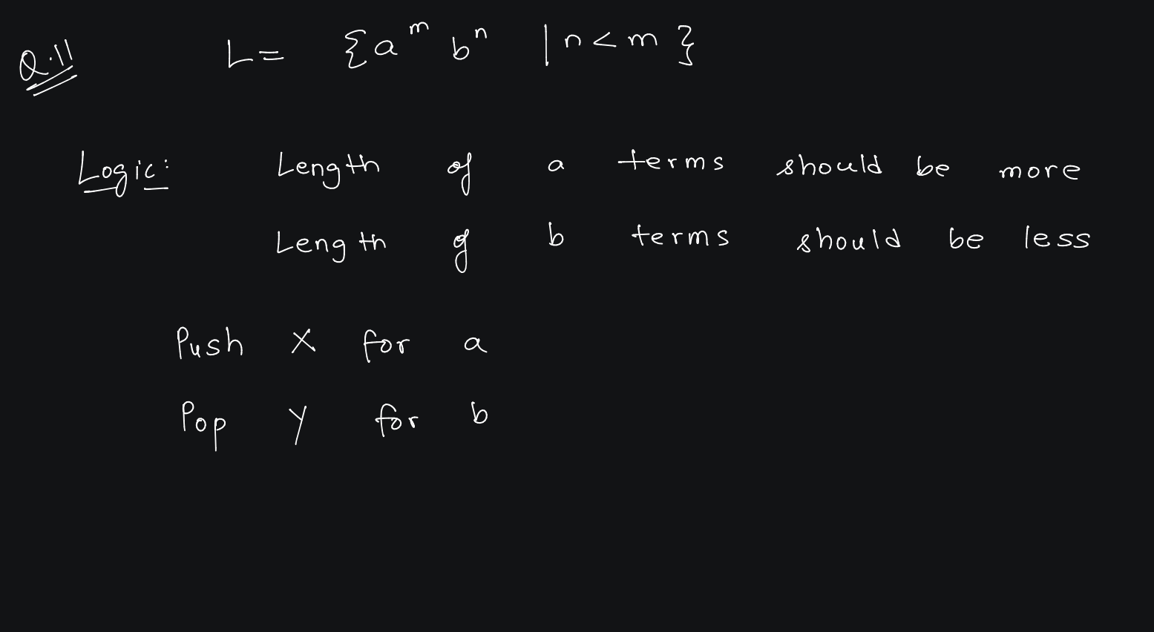

Slide 10
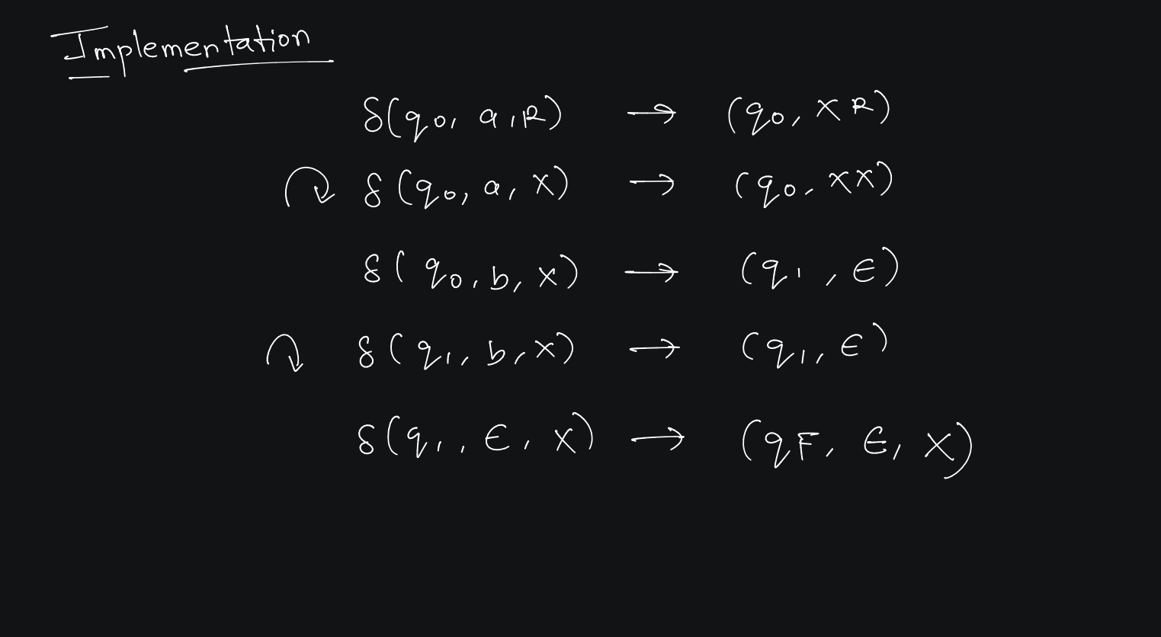

Slide 11
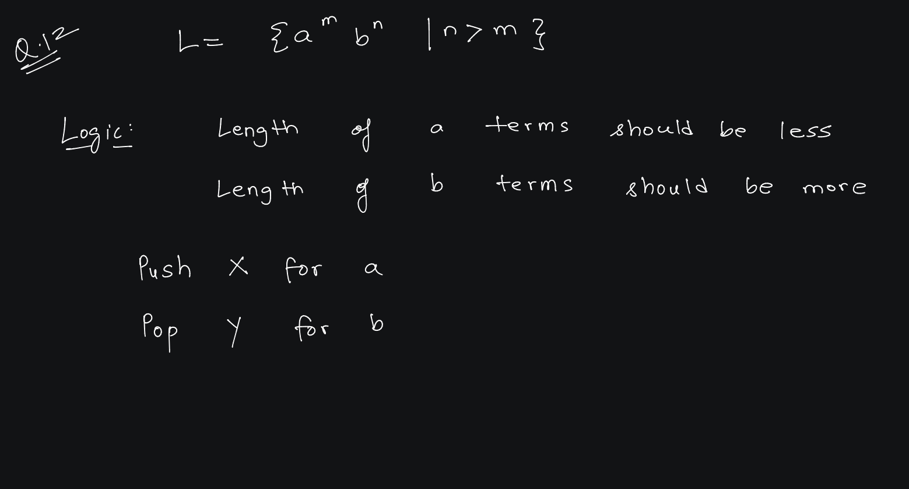

Slide 13
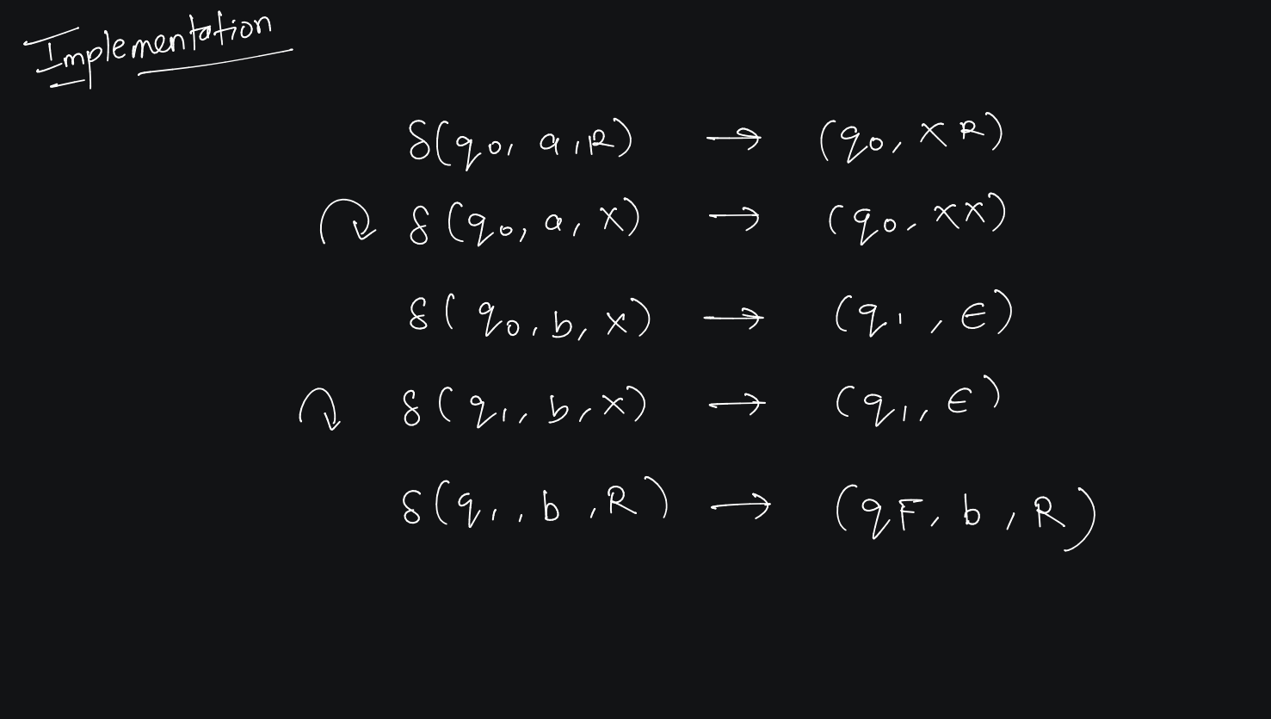

Slide 15
CFG to PDA

Slide 16
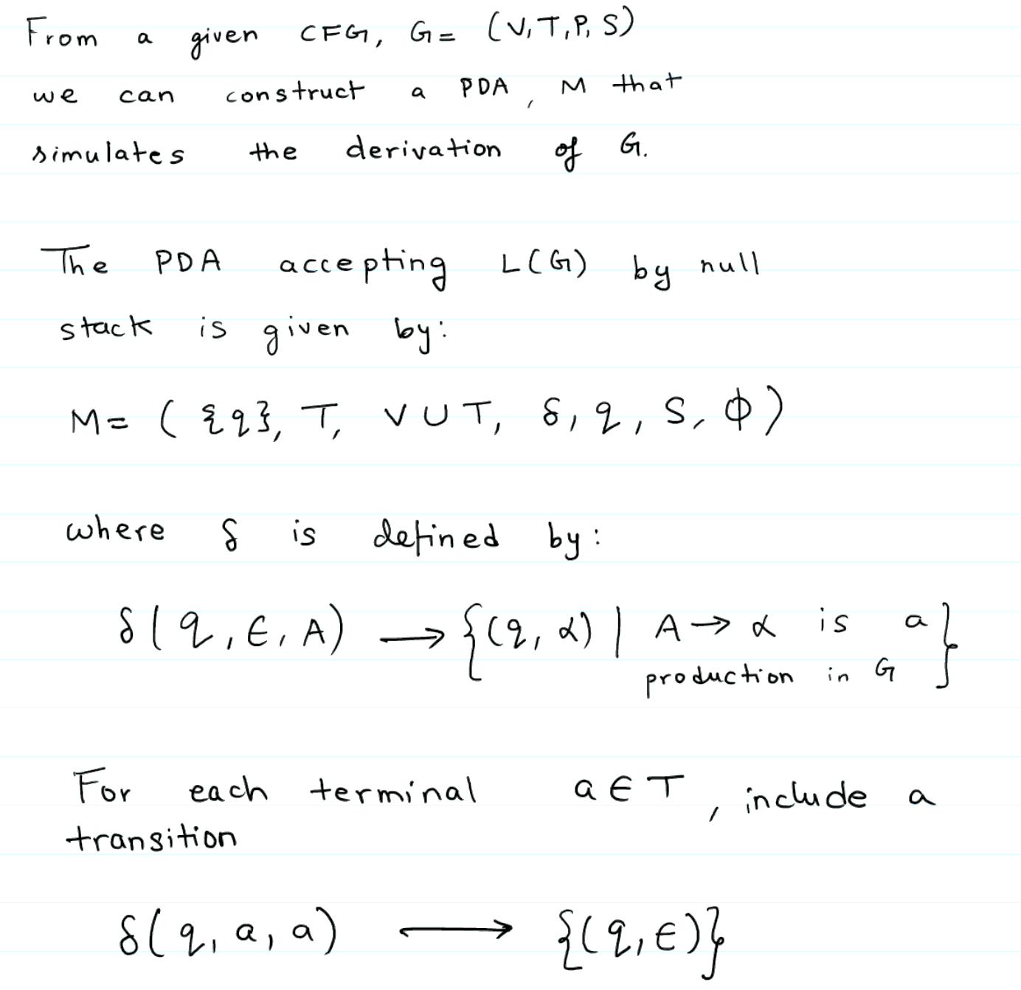

Slide 17
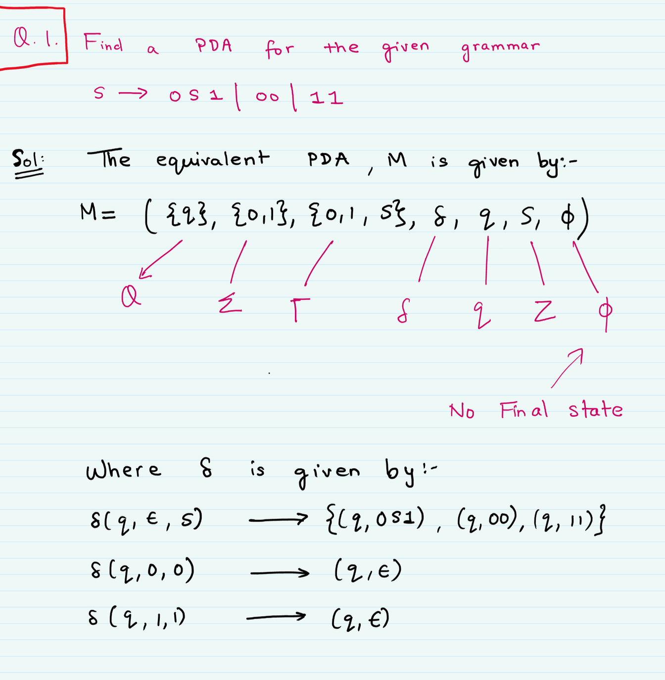


Slide 19
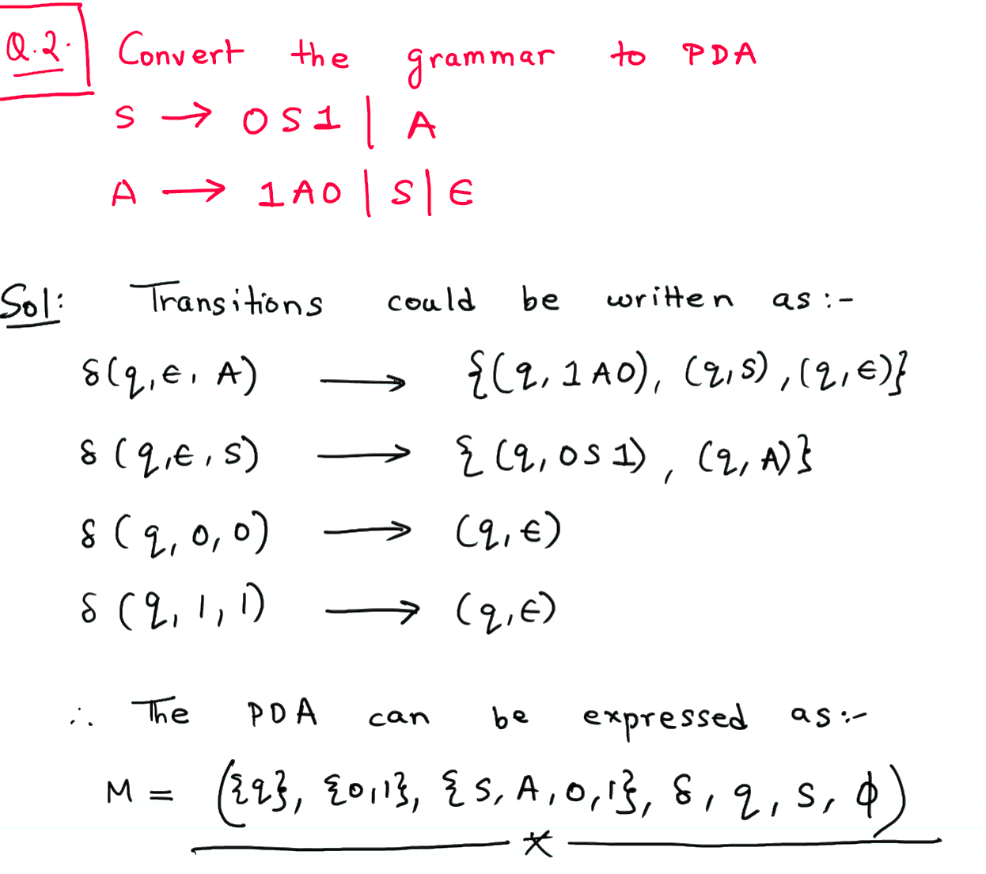

Slide 24
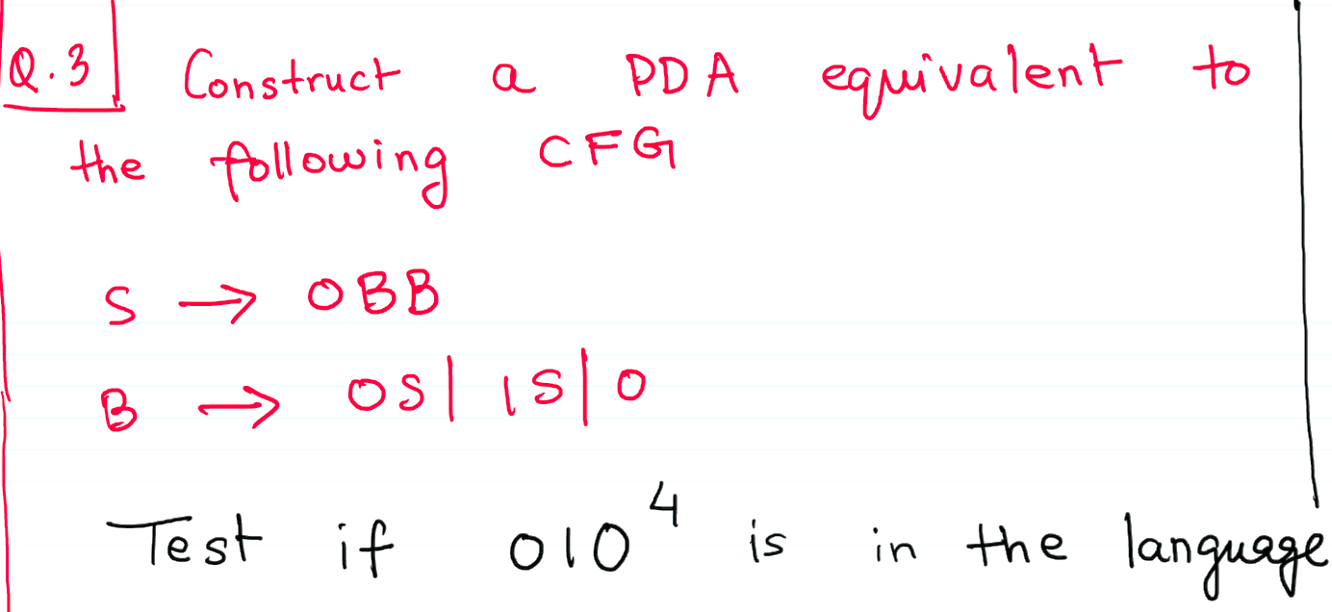

Slide 25
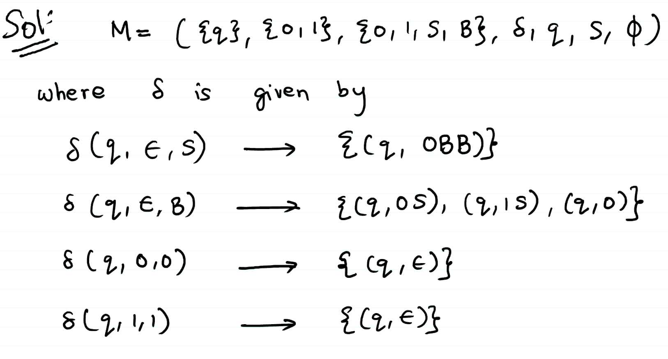

Slide 26
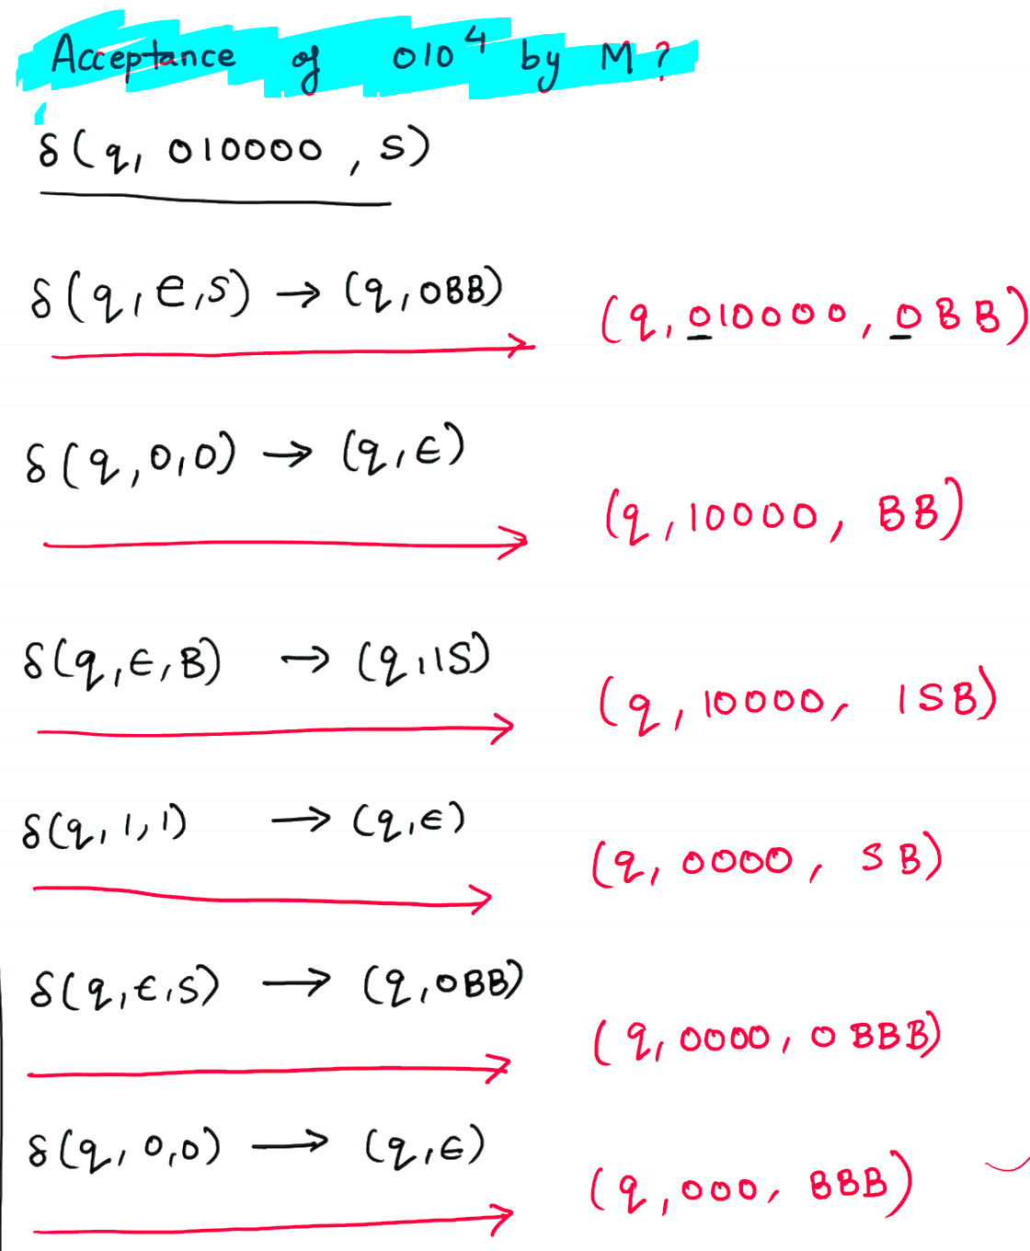


Slide 33
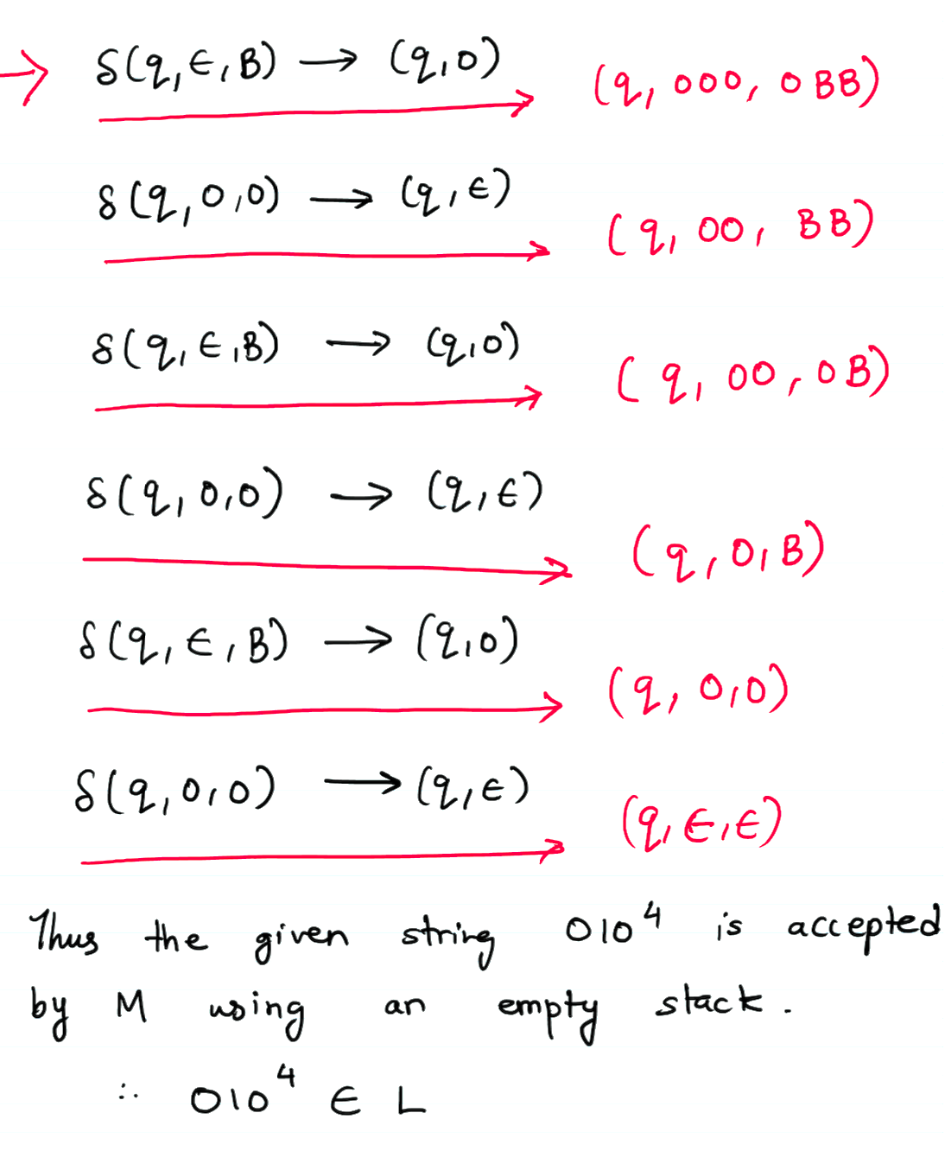

Slide 34
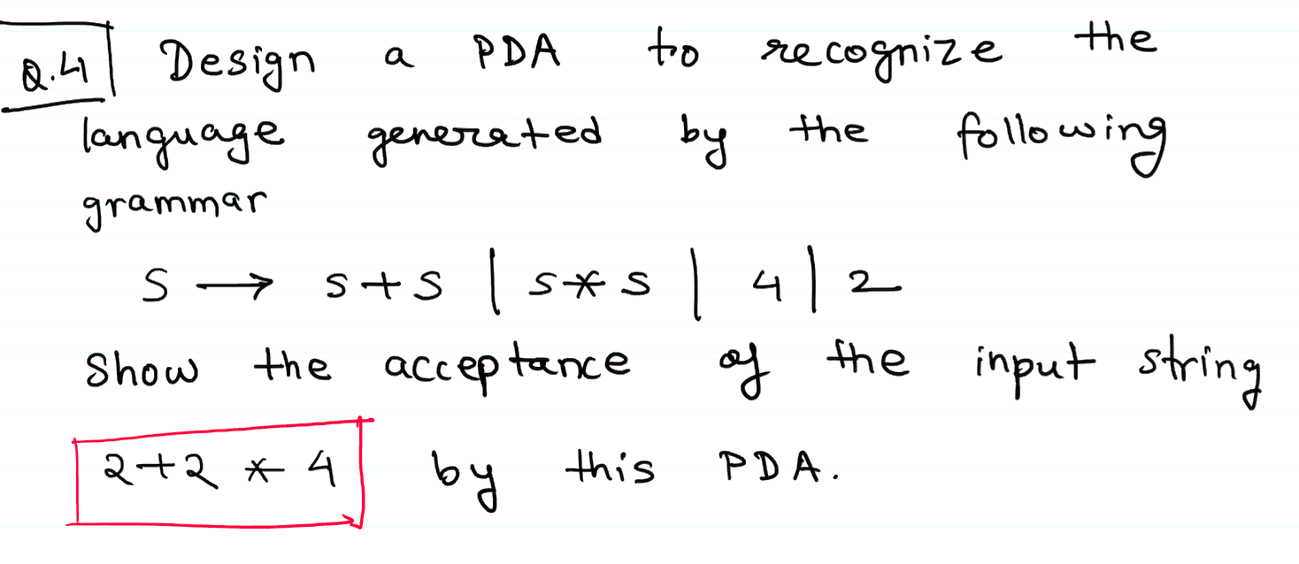

Slide 36
Q. 1
Design a PDA to recognize the language generated by the following grammar:
S→S+S ∣ S∗S ∣ a ∣ b
Show how the PDA accepts the string a+b*a.
Q.2 Construct a PDA that accepts the language generated by the grammar:
S→0S1 ∣ 1S0 ∣ϵ
Show the acceptance of the input string 0110.
Q.3 Design a PDA to recognize the language generated by the following grammar:
S→aSb ∣ bSa ∣ϵ
Show the acceptance of the input string abba by this PDA.

