Slide 1

FORMAL LANGUAGES AND
AUTOMATA THEORY
Lecture 18: Module 3
Chomsky’s Normal Form
Prepared By: Sridhar Iyer

Slide 2
Normal Form

Slide 3
Chomsky’s Normal Form

Slide 4
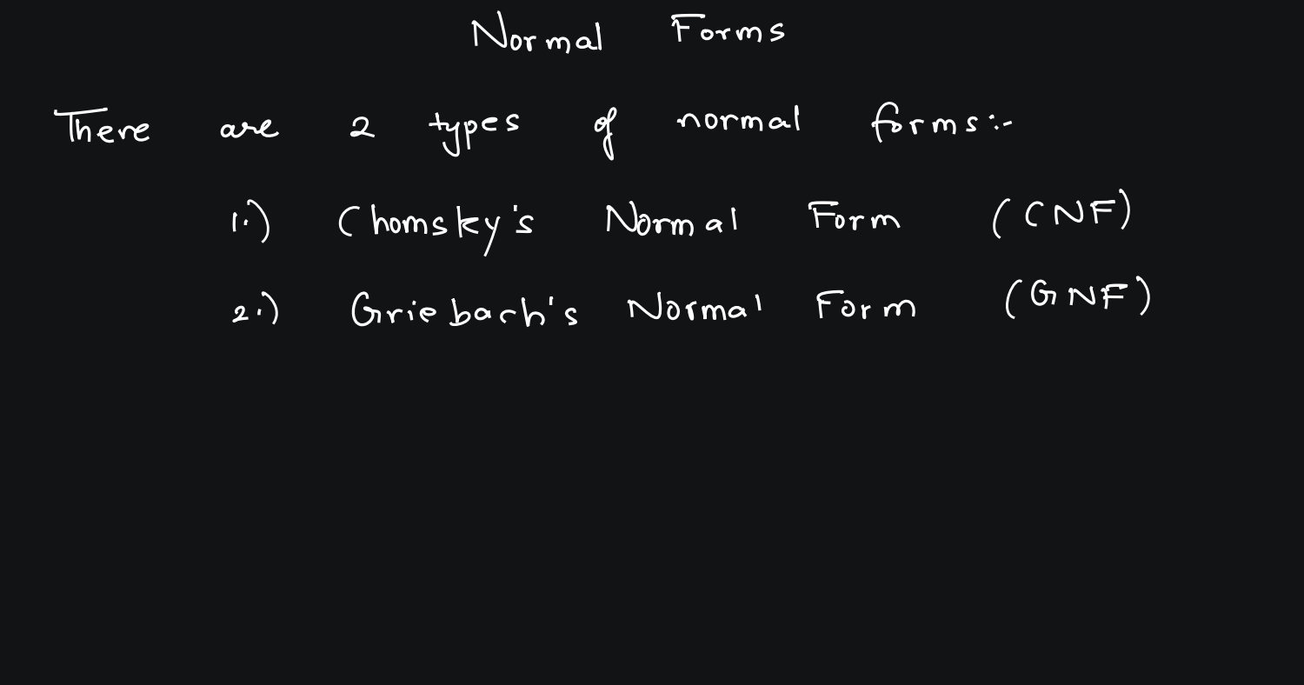

Slide 5
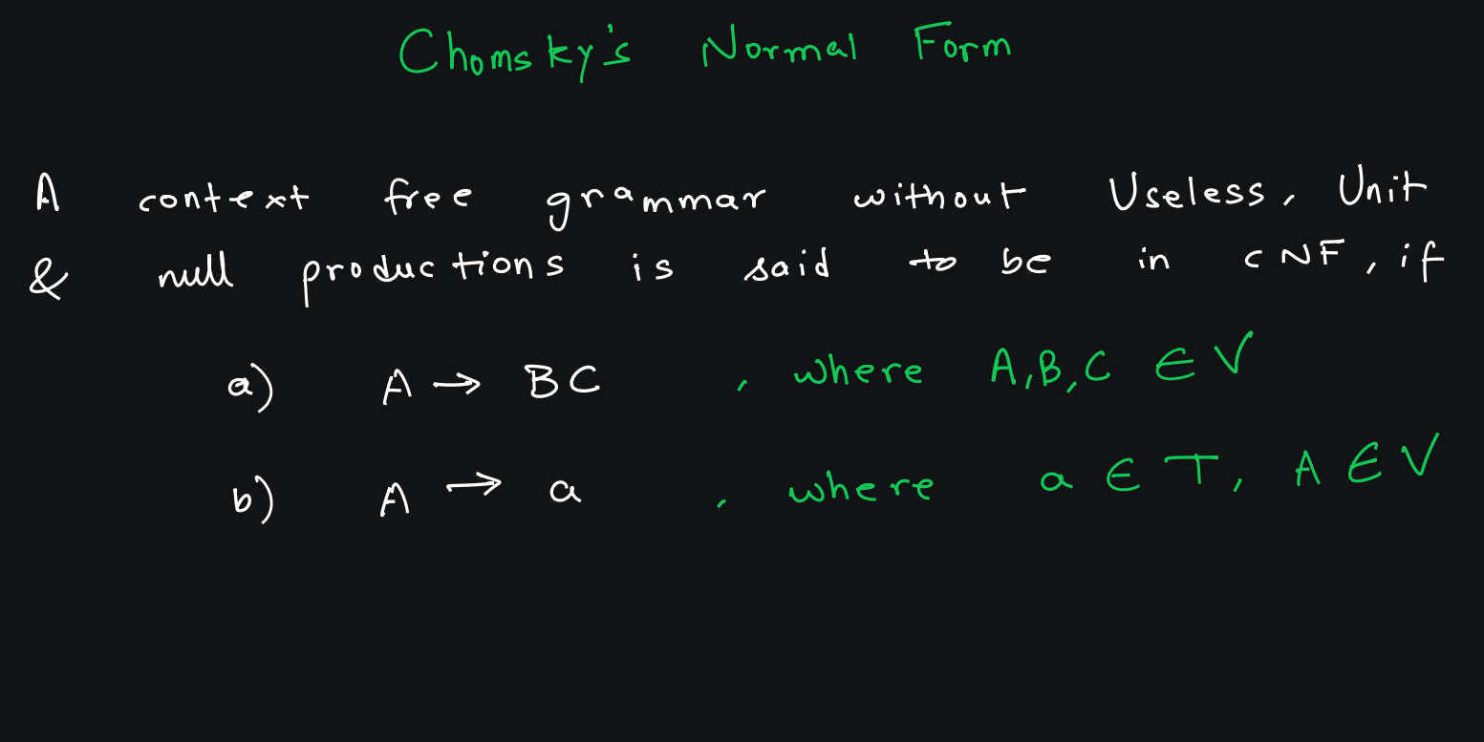

Slide 6
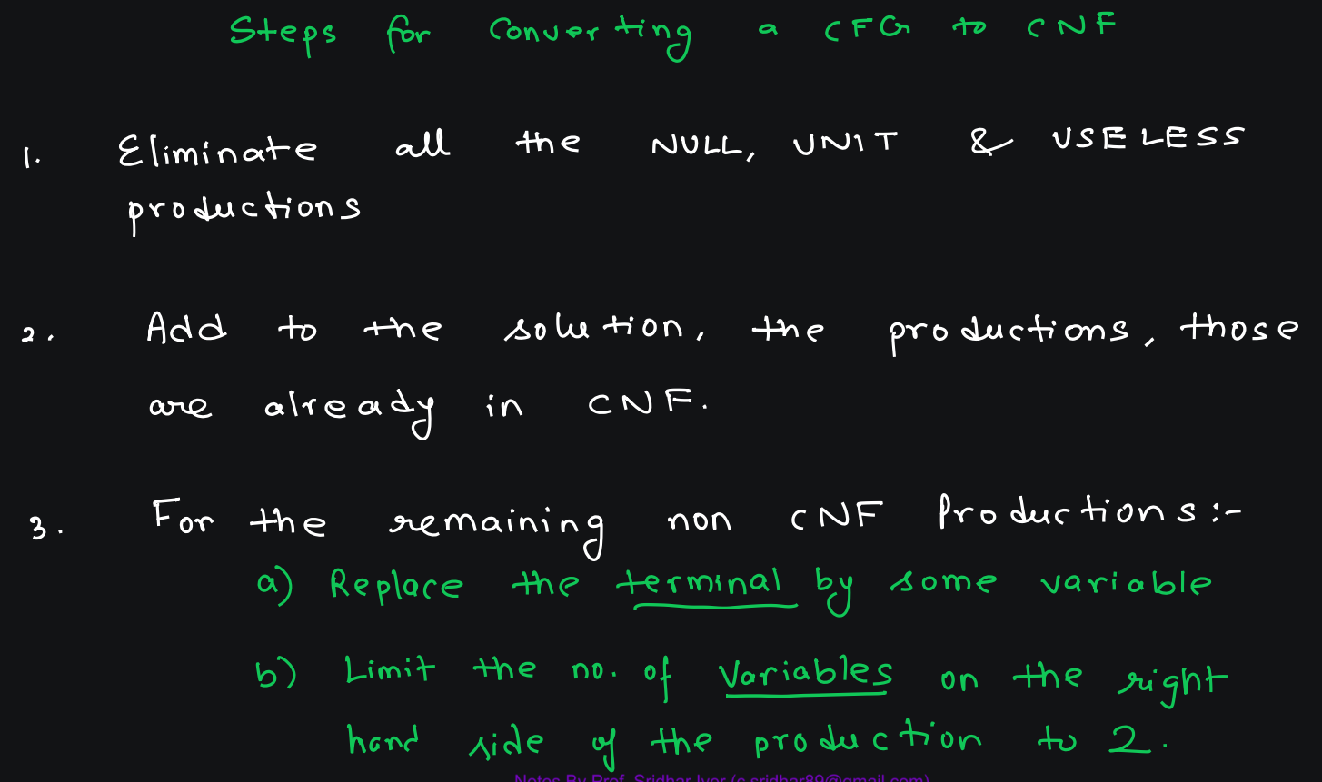

Slide 7
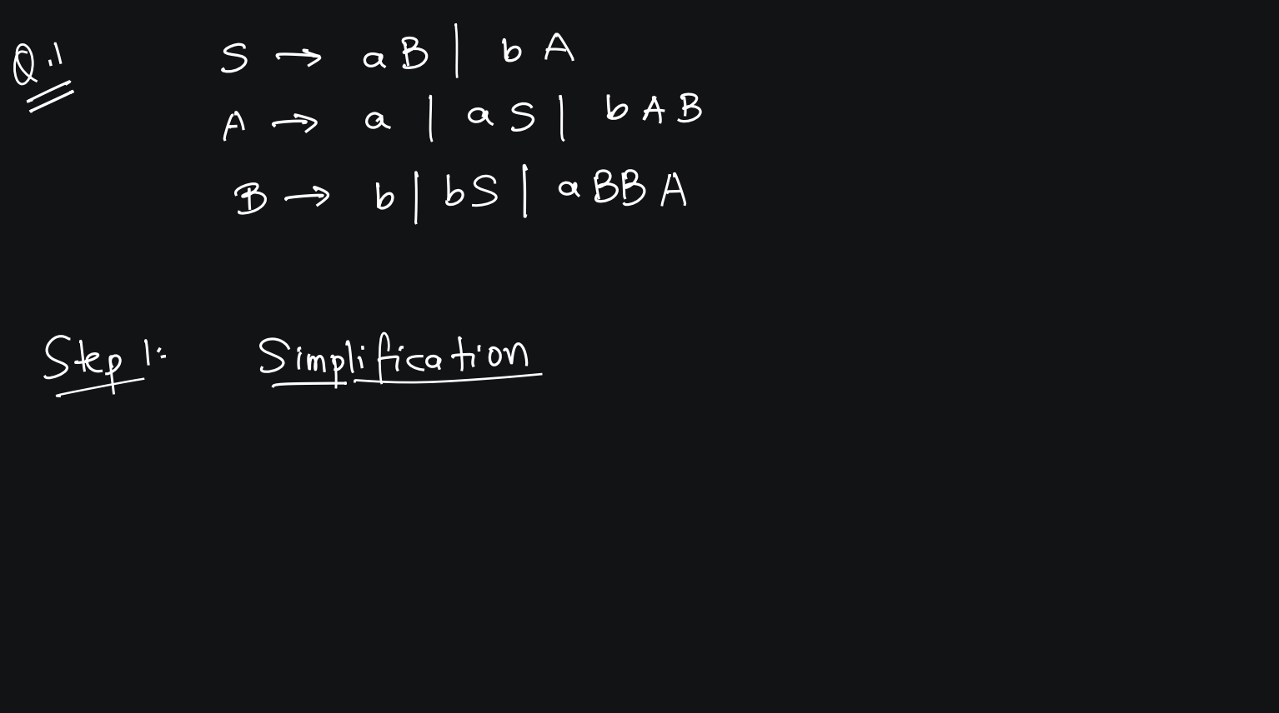

Slide 8
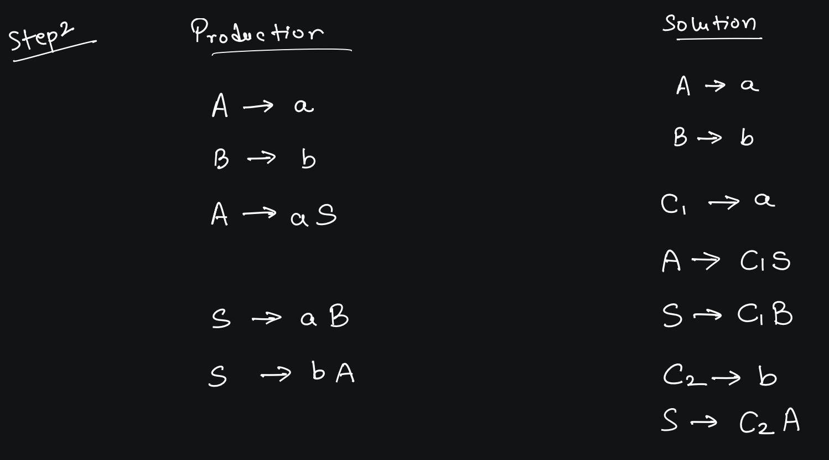

Slide 9
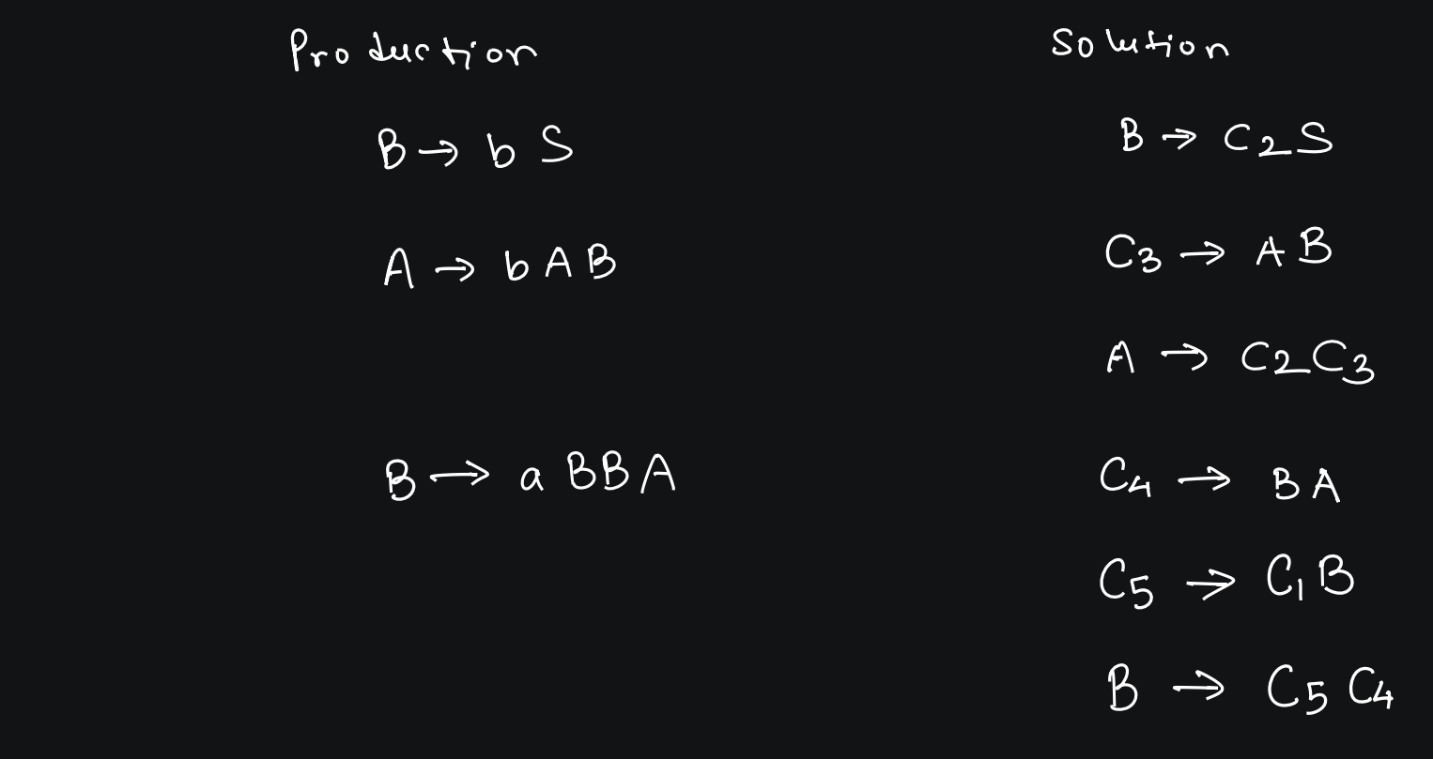

Slide 10
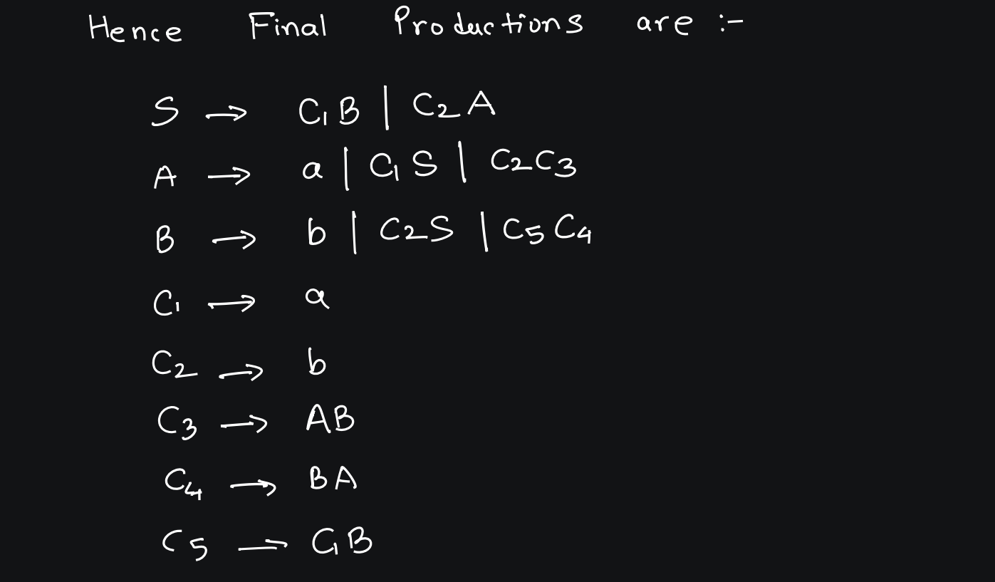

Slide 11
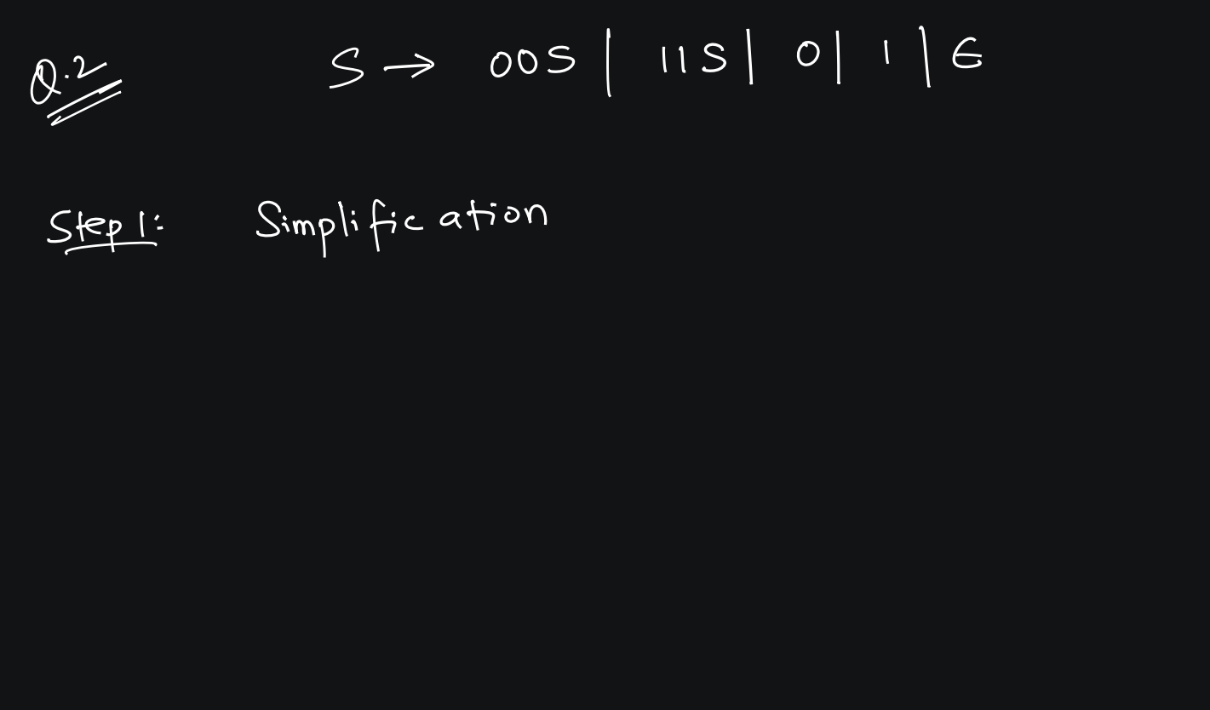

Slide 12
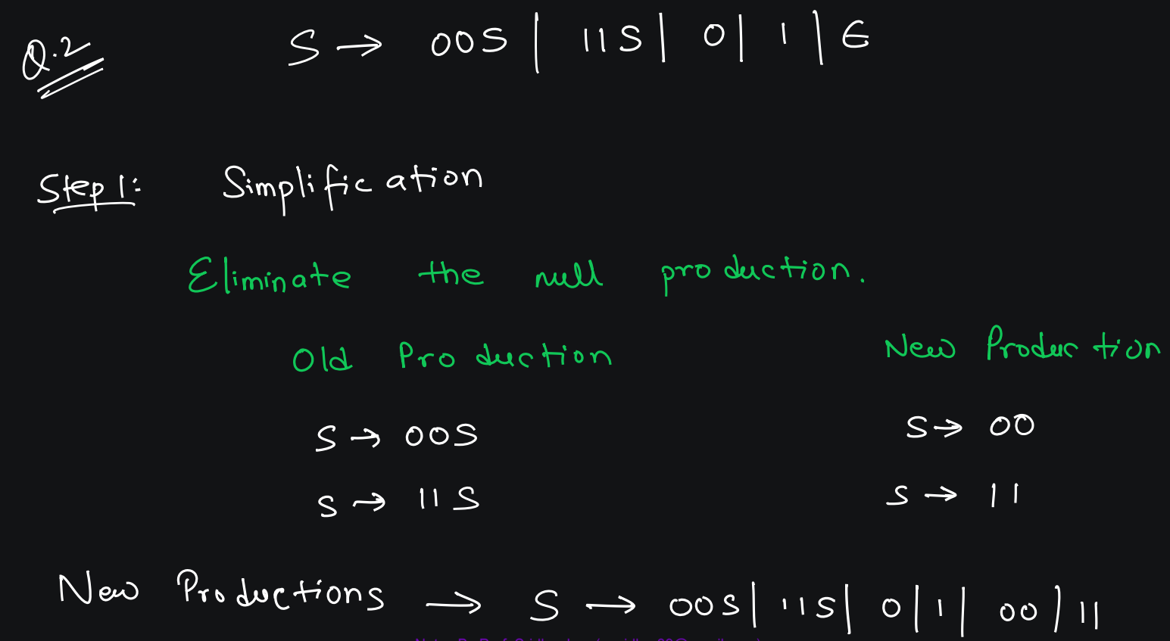

Slide 13
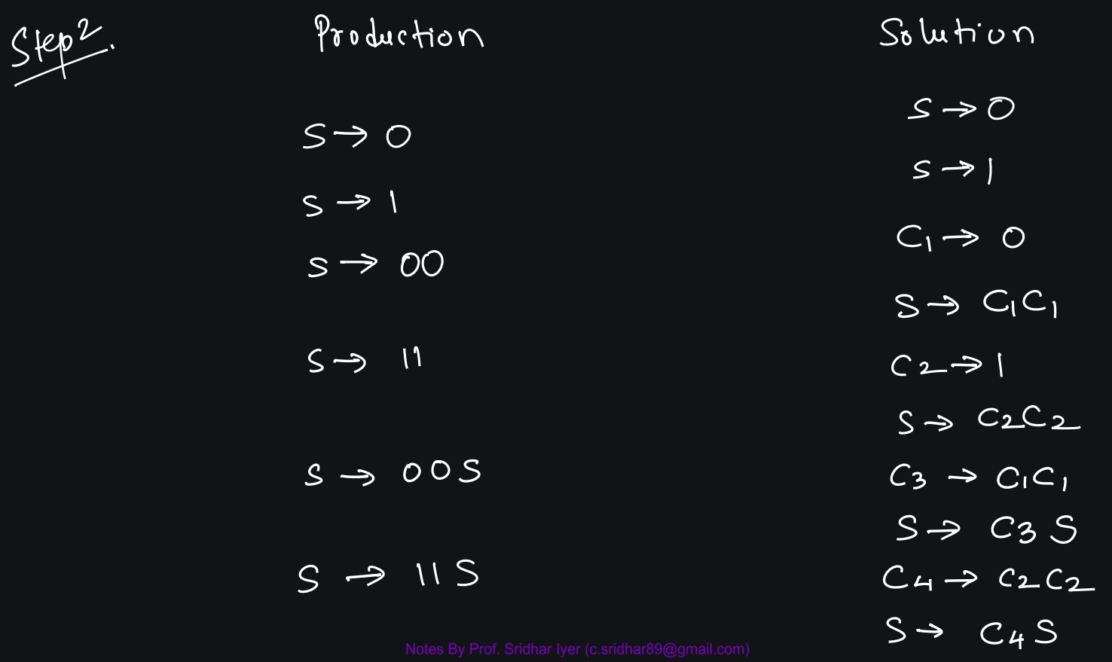

Slide 14
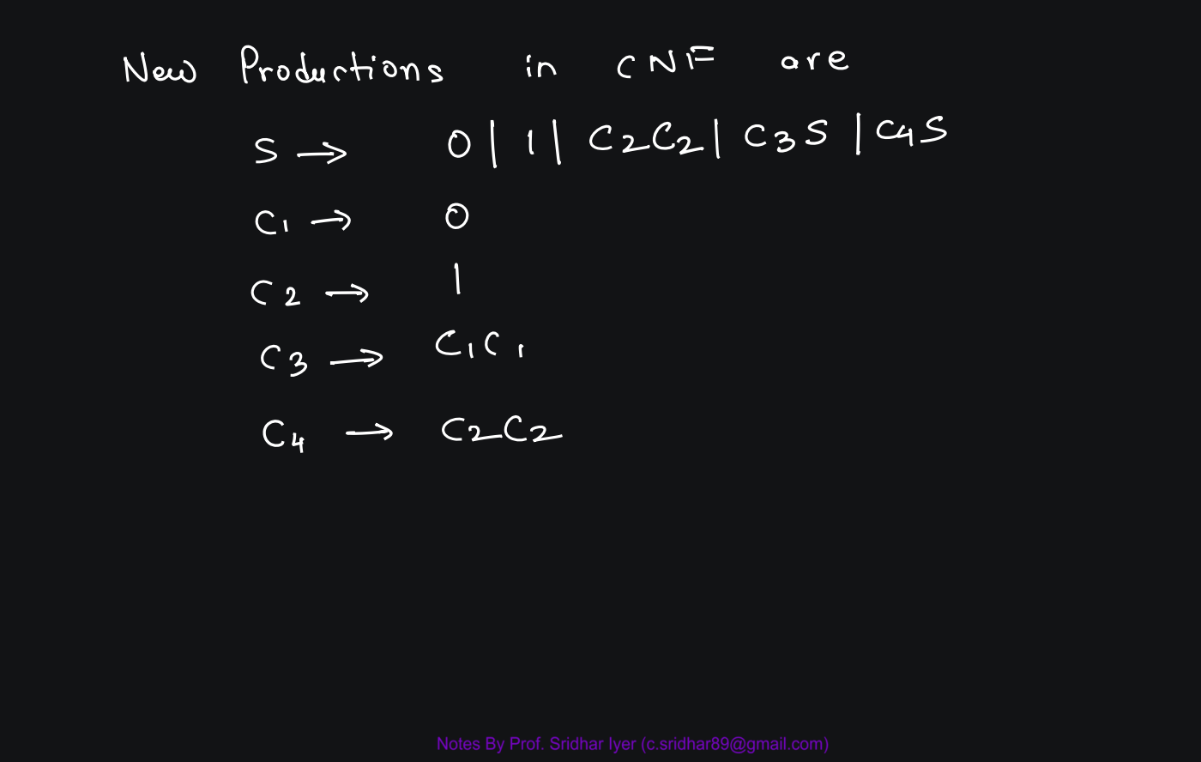

Slide 15
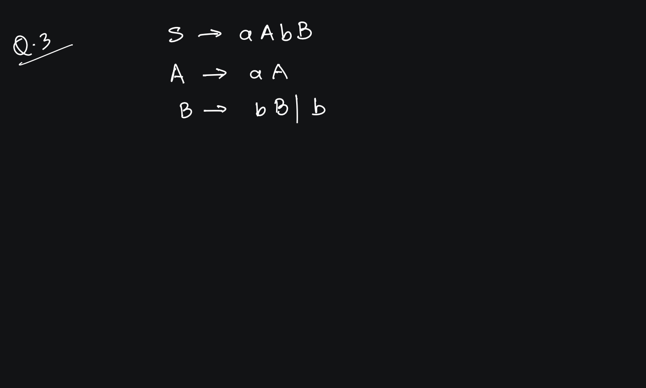

Slide 18
Greibach’s Normal Form

Slide 19
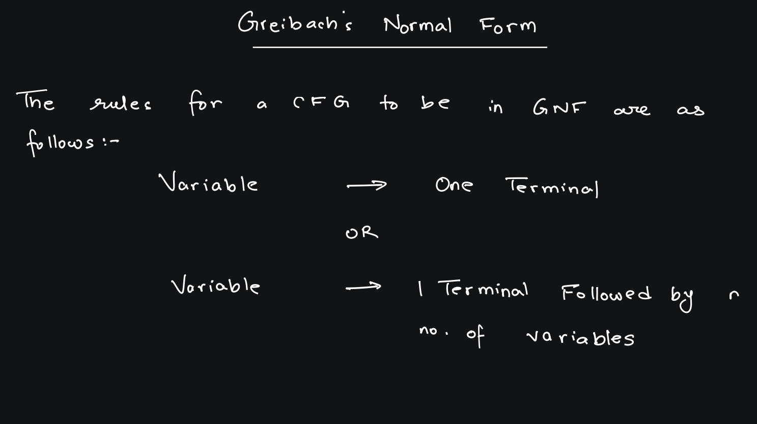

Slide 20
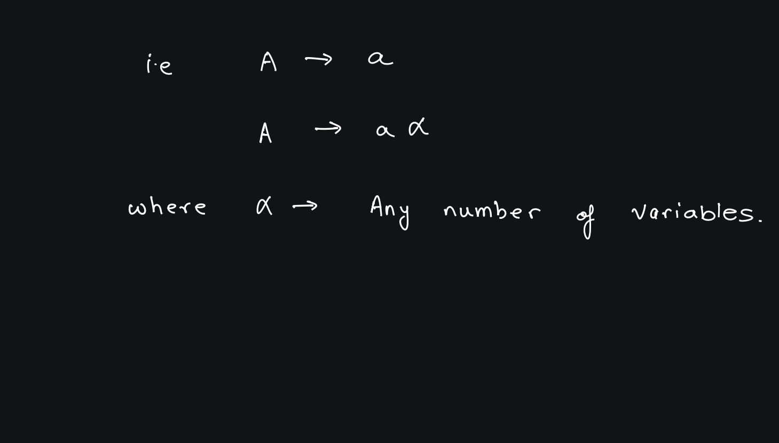

Slide 21
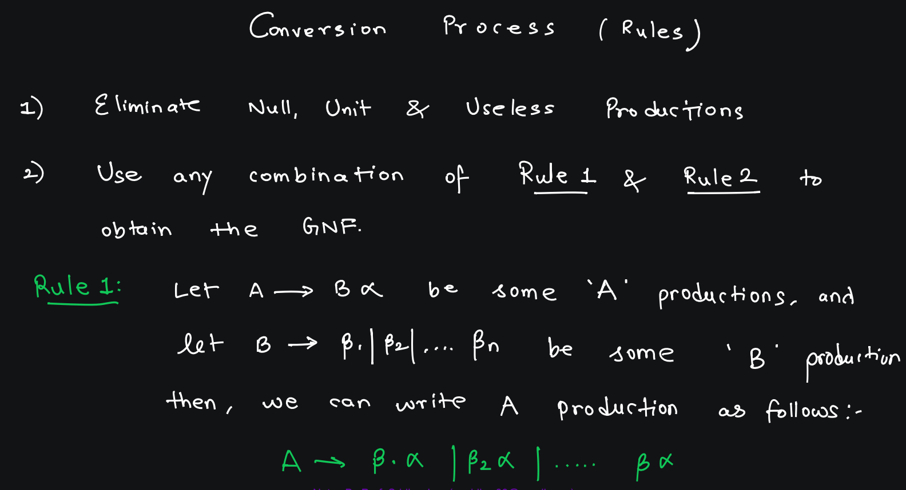

Slide 22
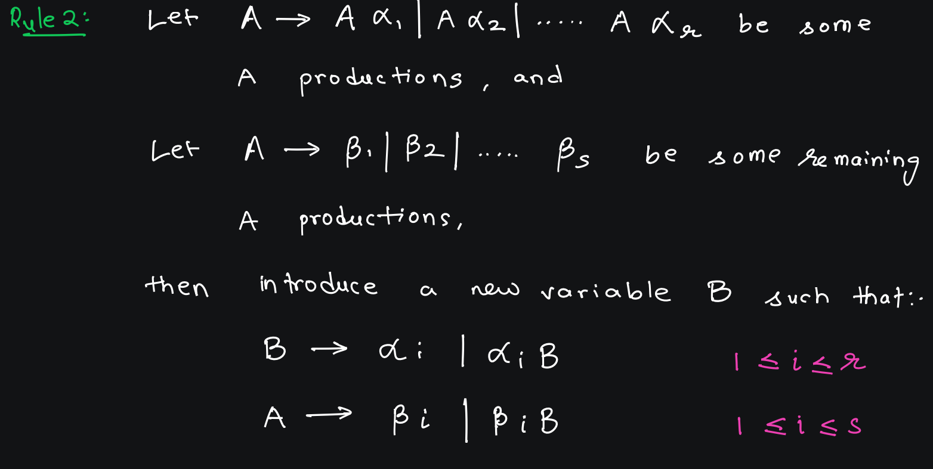

Slide 23
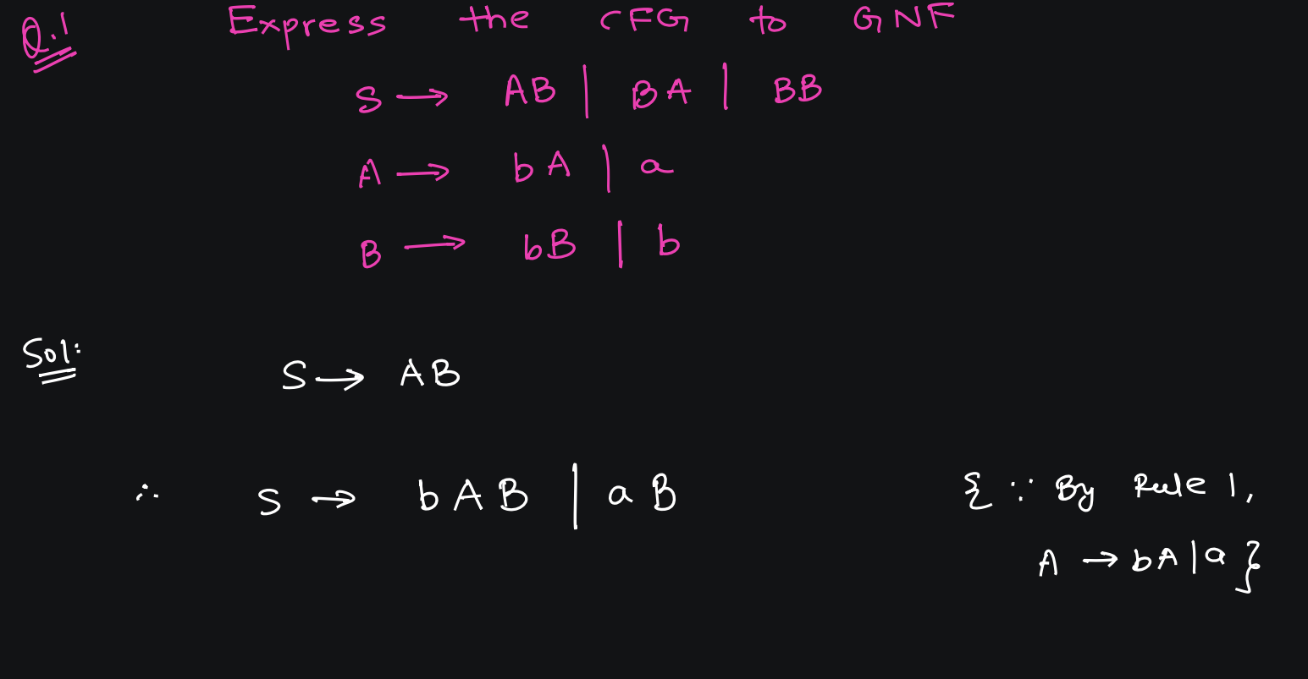

Slide 24
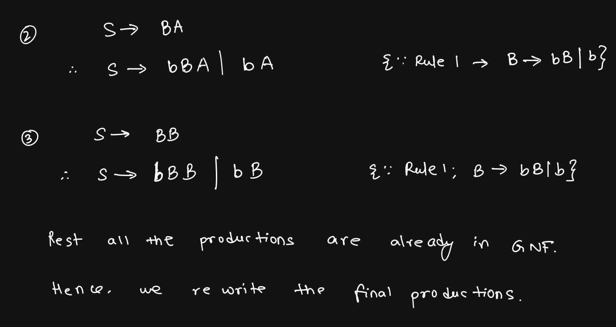

Slide 25
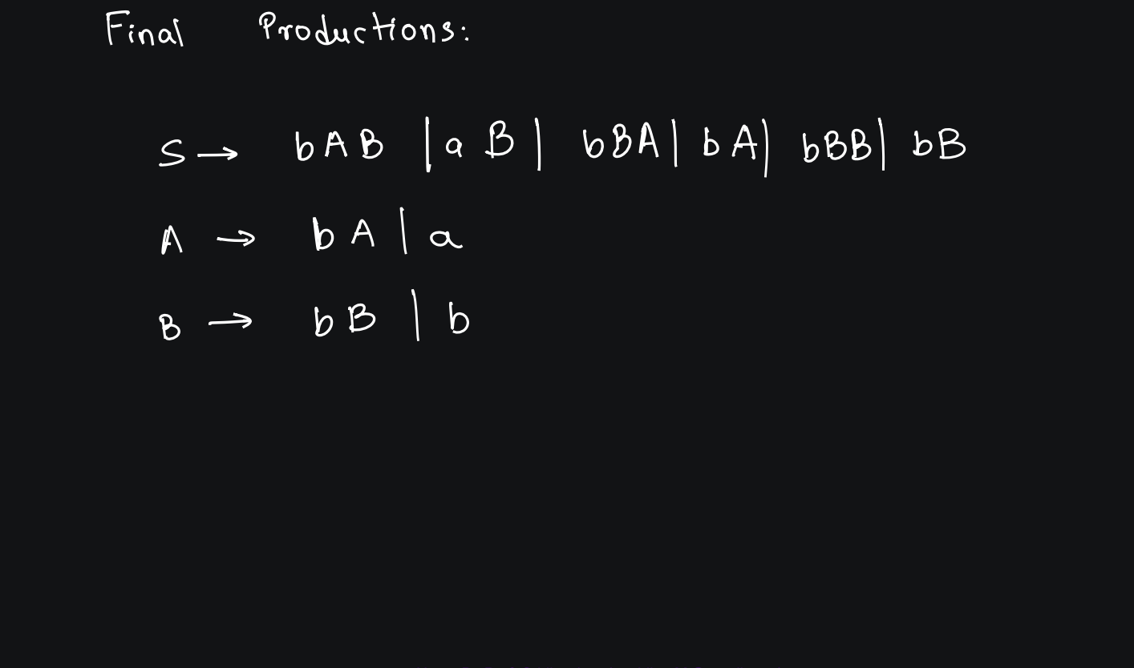

Slide 26
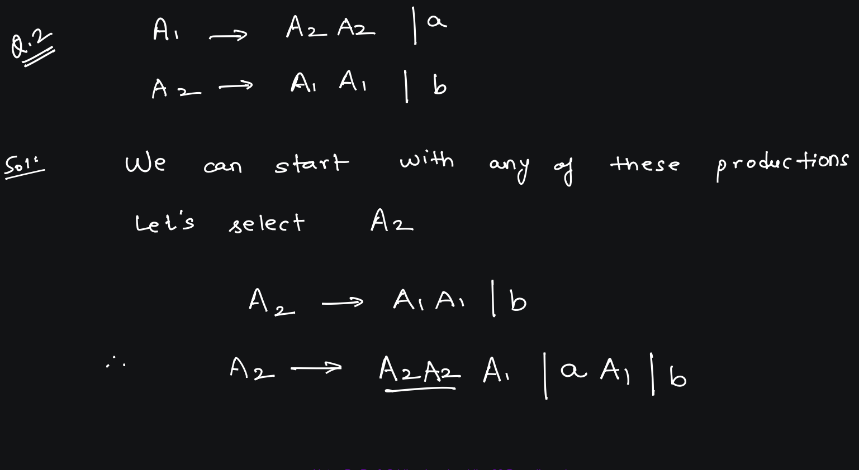

Slide 27
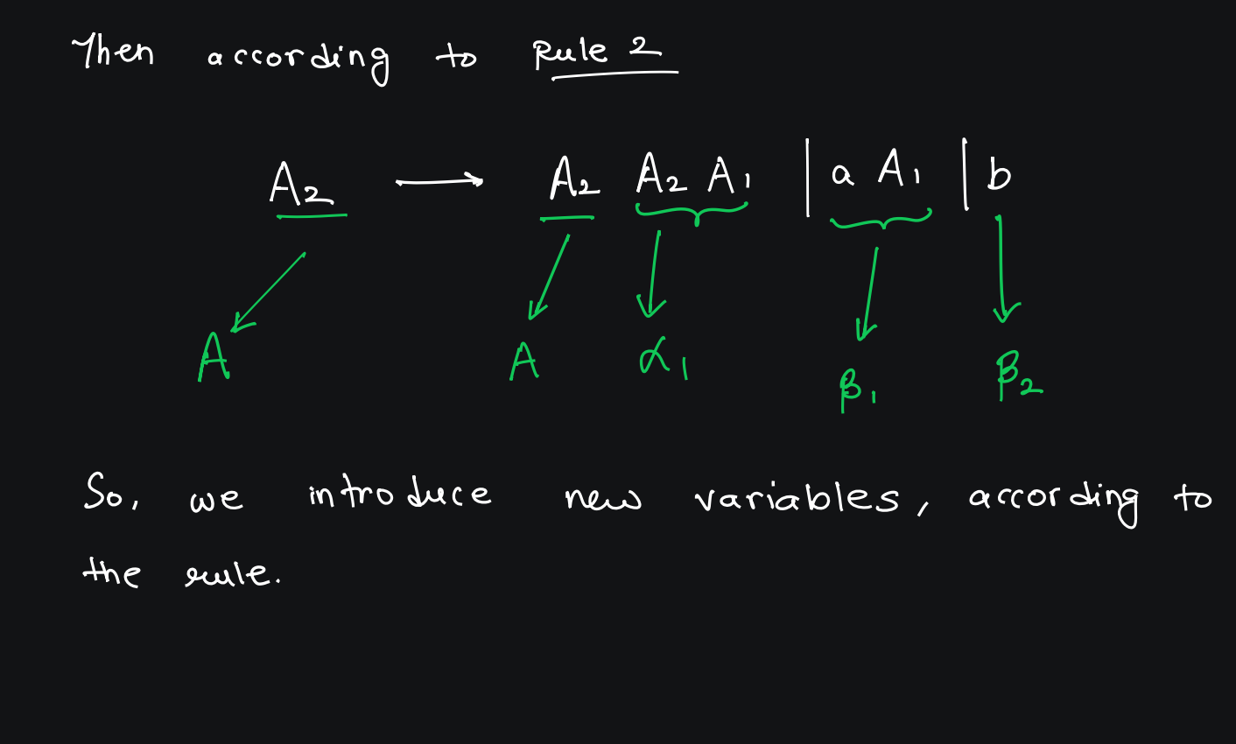

Slide 28
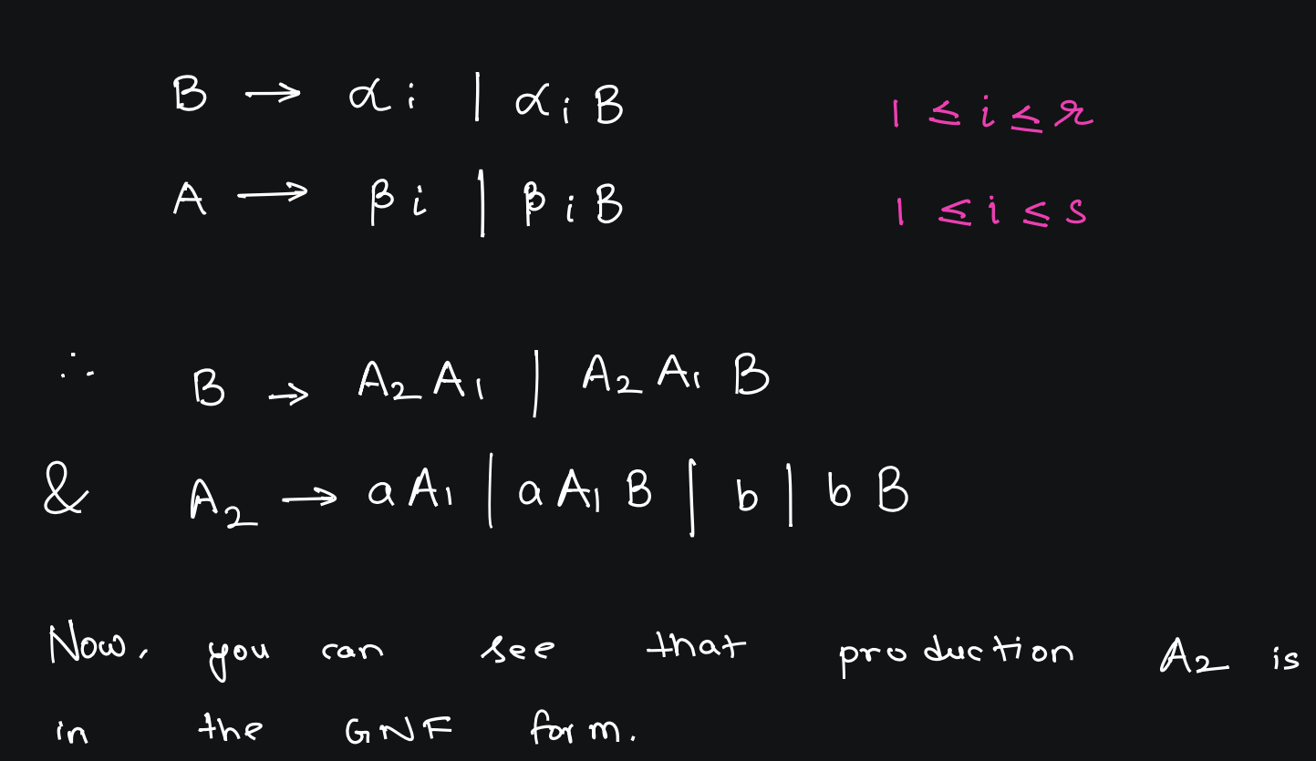

Slide 29
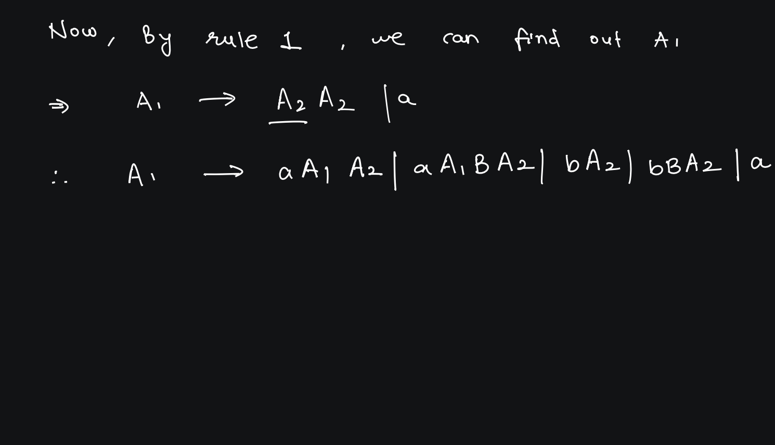

Slide 30
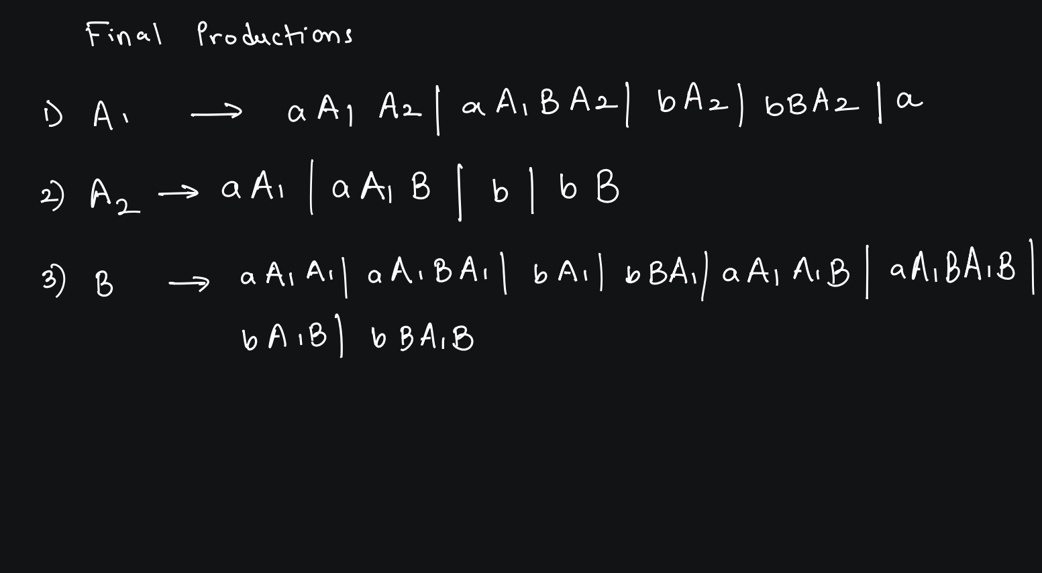

Slide 31
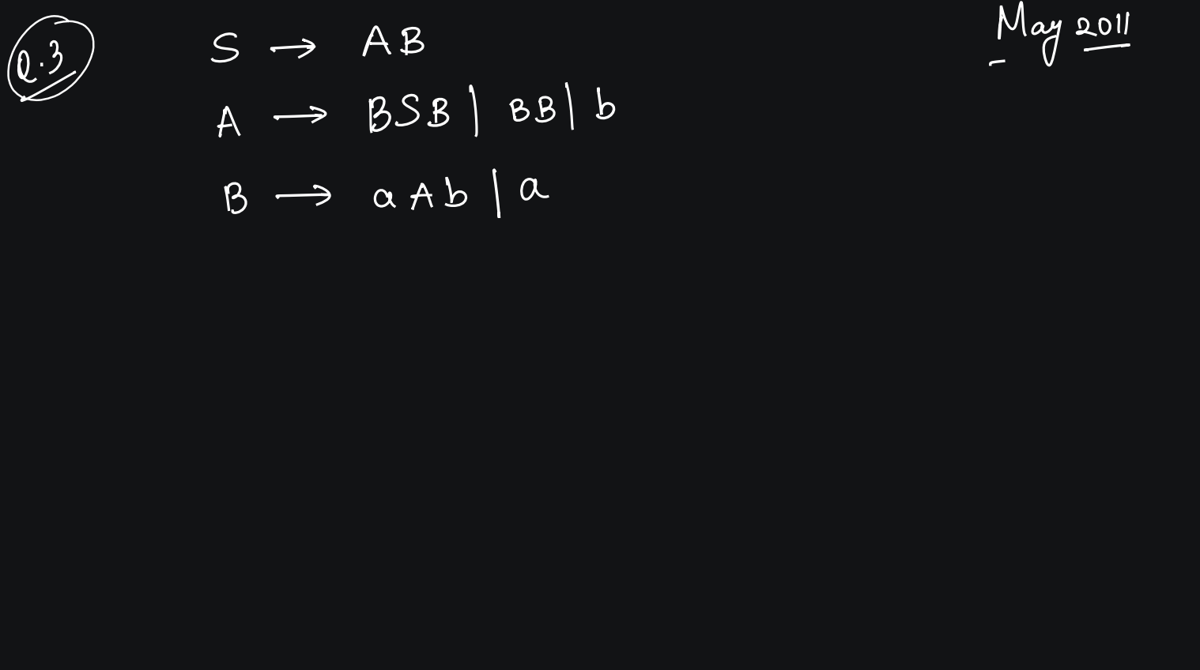

Slide 32
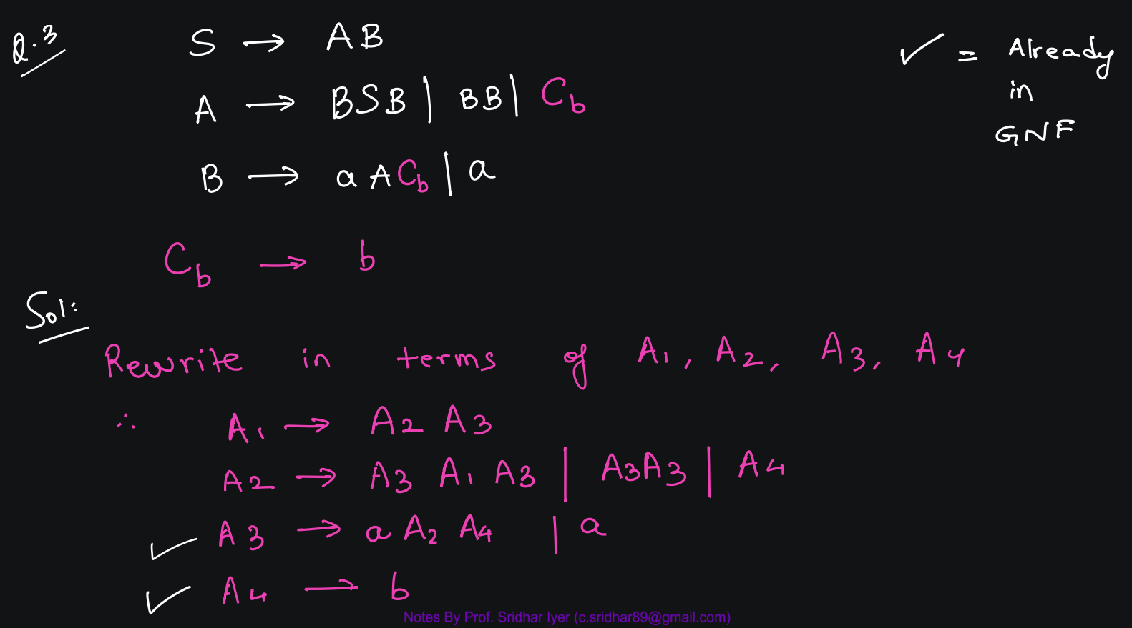

Slide 33
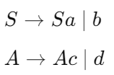
GNF Problems involving Recursion
Problem 1 - Convert the following grammar, with both direct and indirect recursion, to GNF:

Slide 34
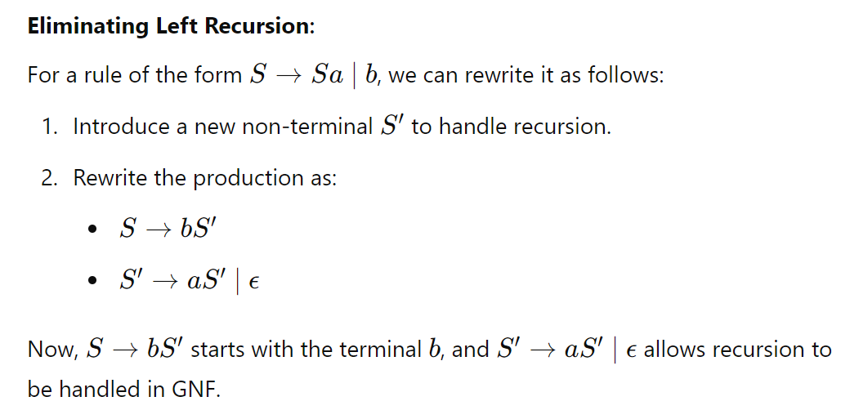
We need to ensure that every production in the grammar starts with a terminal symbol followed by zero or more non-terminal symbols. The recursive productions (like S→Sa) need to be restructured to fit GNF.
Step 1: Handle the Recursion in SSS
The rule S→ Sa | b is directly recursive because S appears on the left side and again as the first symbol on the right side. To handle this, we need to eliminate the recursion.

Slide 35
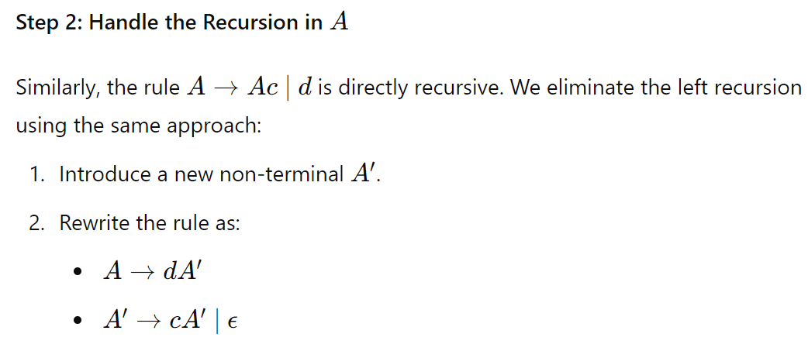

Slide 36
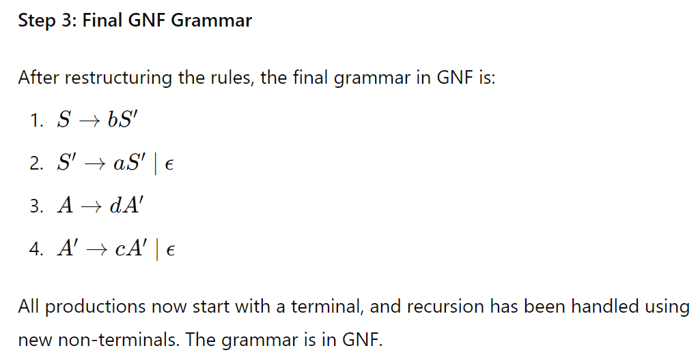
Add an additional step of null transition removal to obtain the final Productions in GNF

Slide 37
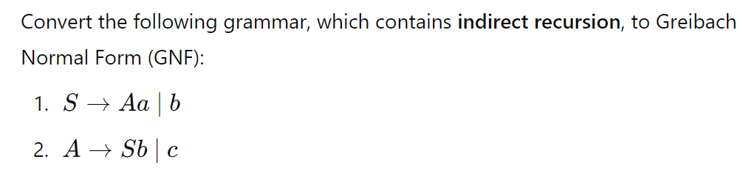
Problem 2 -

Slide 38
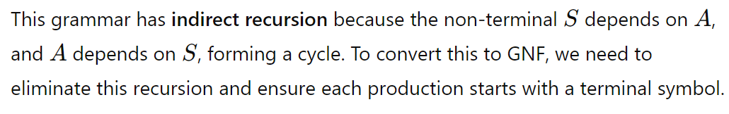
Problem 2 -

Slide 39
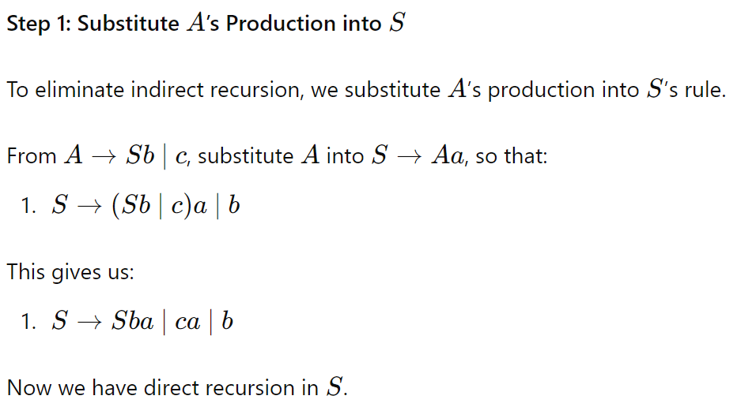
Problem 2 -

Slide 40

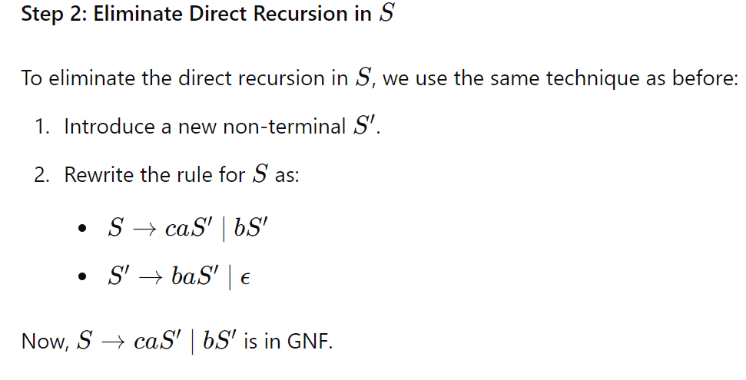
Problem 2 -

Slide 41
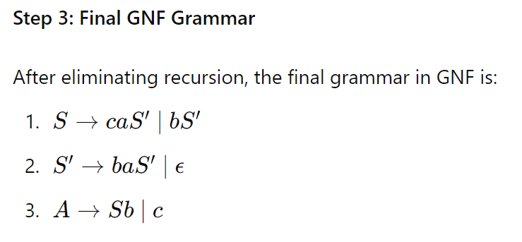
Problem 2 -
Add an additional step of null transition removal to obtain the final Productions in GNF

