Slide 1

FORMAL LANGUAGES AND
AUTOMATA THEORY
Lecture 5:
More Problems on FSM
Regular Languages and Expressions
Prepared By: Sridhar Iyer

Slide 2
Finite State Machines –
PROBLEMS
TYPE 5 – STRINGS CONTAINING
ODD /EVEN SEQUENCE

Slide 3
Finite State Machines –
Type 5 - PROBLEM 1

Slide 4

Finite State Machines – Practice Problems
Q. FSM to accept strings containing ODD number of a's.

Slide 5
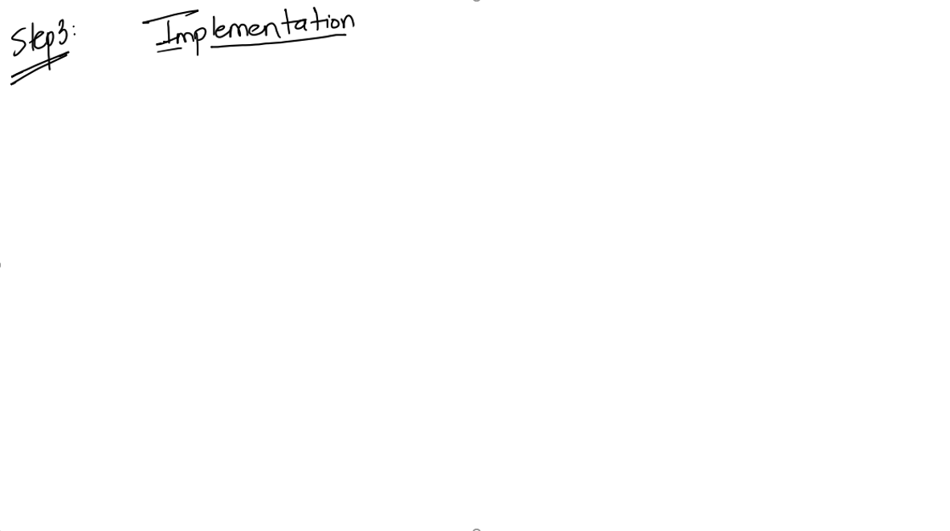
Finite State Machines – Practice Problems

Slide 6

Finite State Machines – Practice Problems

Slide 7
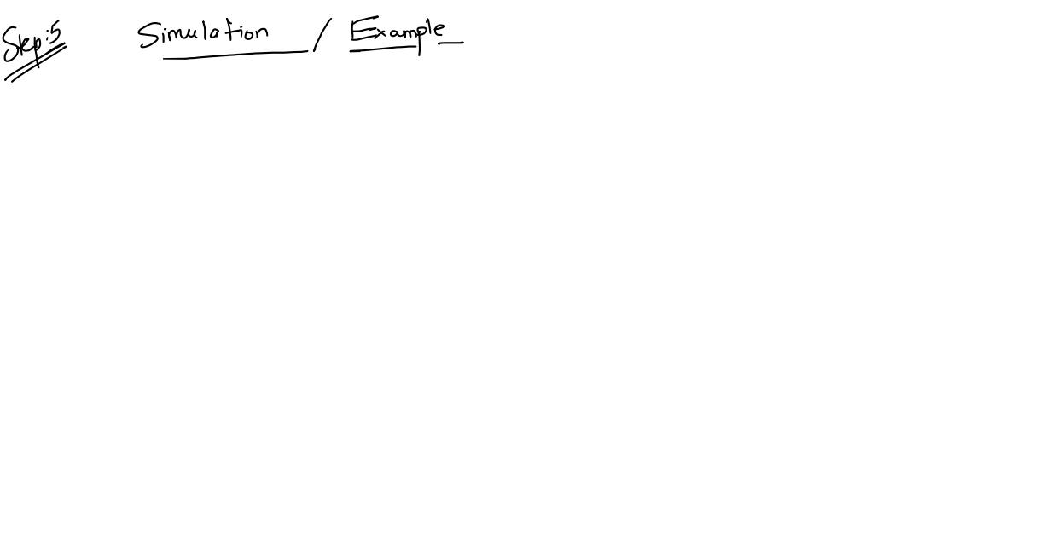
Finite State Machines – Practice Problems

Slide 8
Finite State Machines –
PROBLEMS
TYPE 6 – STRINGS CONTAINING
ODD AND EVEN SEQUENCE

Slide 9
Finite State Machines –
Type 6 - PROBLEM

Slide 10
Finite State Machines – Practice Problems
Q. FSM to accept Strings containing Even number of a's and Odd number of b's.

Slide 11
Finite State Machines – Practice Problems

Slide 12
Finite State Machines – Practice Problems

Slide 13
Finite State Machines – Practice Problems

Slide 14
Finite State Machines –
PROBLEMS
TYPE 7 – STRINGS CONTAINING MIXED SEQUENCE

Slide 15
Finite State Machines –
Type 7 - PROBLEM

Slide 16
Finite State Machines – Practice Problems
Q. FSM to accept strings containing
a) Atleast 3a's
b) Exactly 3 a's
c) Atmost 3 a's

Slide 17
Finite State Machines – Practice Problems

Slide 18
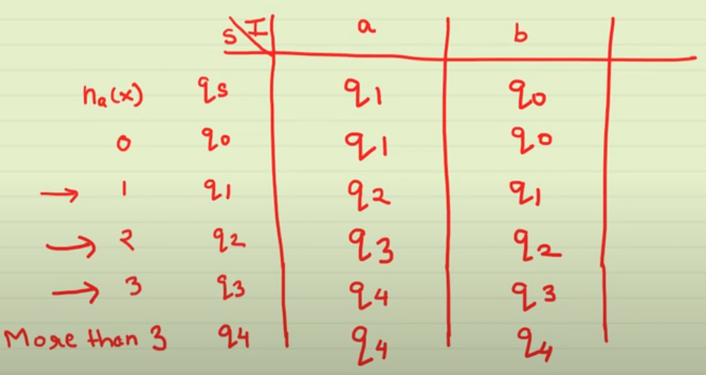
Finite State Machines – Practice Problems

Slide 19
Finite State Machines – Practice Problems

Slide 20
Finite State Machines – Practice Problems

Slide 21
Finite State Machines – Practice Problems

Slide 22
Finite State Machines –
PROBLEMS
TYPE 8 – Misc. Examples

Slide 23
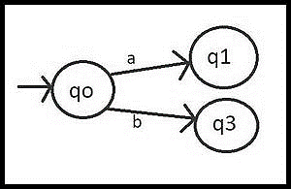
Finite State Machines – Practice Problems
Q. Construct a DFA that either starts with aa or with bb from input (a,b).
Step-1: Take initial state qo, and smallest possible string are aa and bb if qo takes ‘a’ as the first input alphabet it goes to state q1 and if qo takes ‘b’ as the first input alphabet it goes to state q3.

Slide 24
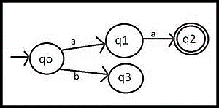
Finite State Machines – Practice Problems
Q. Construct a DFA that either starts with aa or with bb from input (a,b).
Step-2: Now think about state q1, if it takes input alphabet ‘b’, it breaks our condition of ‘aa’ but if takes input alphabet ‘a’ it makes an acceptable string, and now it goes to state q2 which is set to the final state.

Slide 25
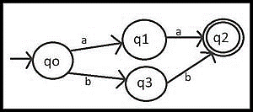
Finite State Machines – Practice Problems
Q. Construct a DFA that either starts with aa or with bb from input (a,b).
Step-3: On state q3 if it takes input alphabet ‘a’, it breaks our condition of ‘bb’ but if takes input alphabet ‘b’ it makes an acceptable string, and now it goes to state q2 which is set to the final state.

Slide 26
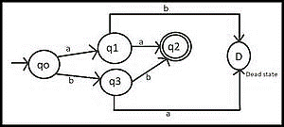
Finite State Machines – Practice Problems
Q. Construct a DFA that either starts with aa or with bb from input (a,b).
Step-4: If input alphabet ‘a’ of state q3 breaks the condition and Input alphabet ‘b’ of state q1 breaks the condition so they go to some dead state(D).

Slide 27
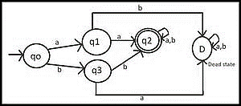
Finite State Machines – Practice Problems
Q. Construct a DFA that either starts with aa or with bb from input (a,b).
Step-5: Till now, our machine accepts strings that starts from ‘aa’ or from ‘bb’ but we also have to take care of all the symbols after the string has begun from ‘aa’ or ‘bb’ and hence we introduce ourselves loops in q2(final state) and D(dead state).

Slide 28
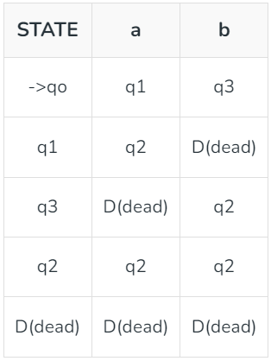
Finite State Machines – Practice Problems
Q. Construct a DFA that either starts with aa or with bb from input (a,b).
Transition table and transition rules for the diagram:
The Finite set of states = {qo, q1, q2, q3, D}
In the transition table, the initial state(qo) is represented by → and the final state is q2 and has two circles.
Set of input alphabets = {a, b}

Slide 29
Module 2
Regular Languages and Expressions

Slide 30
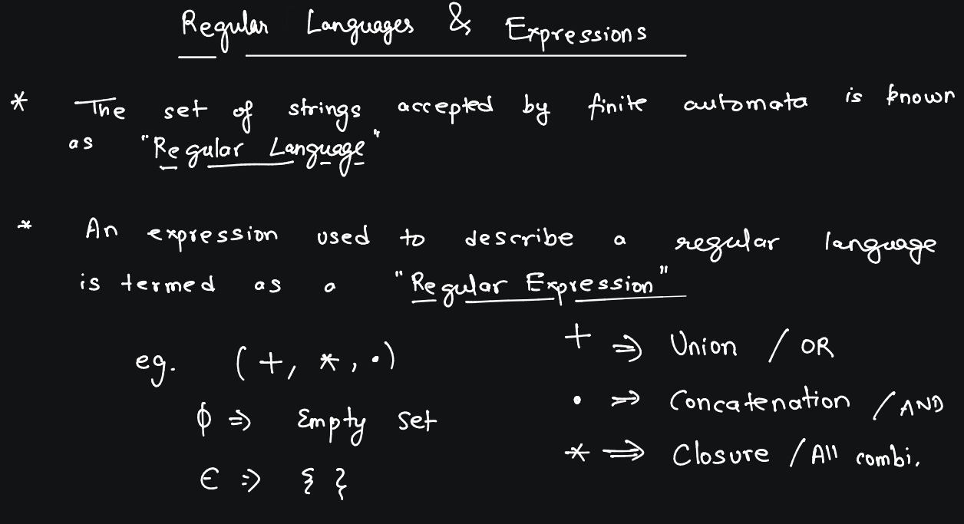

Slide 31
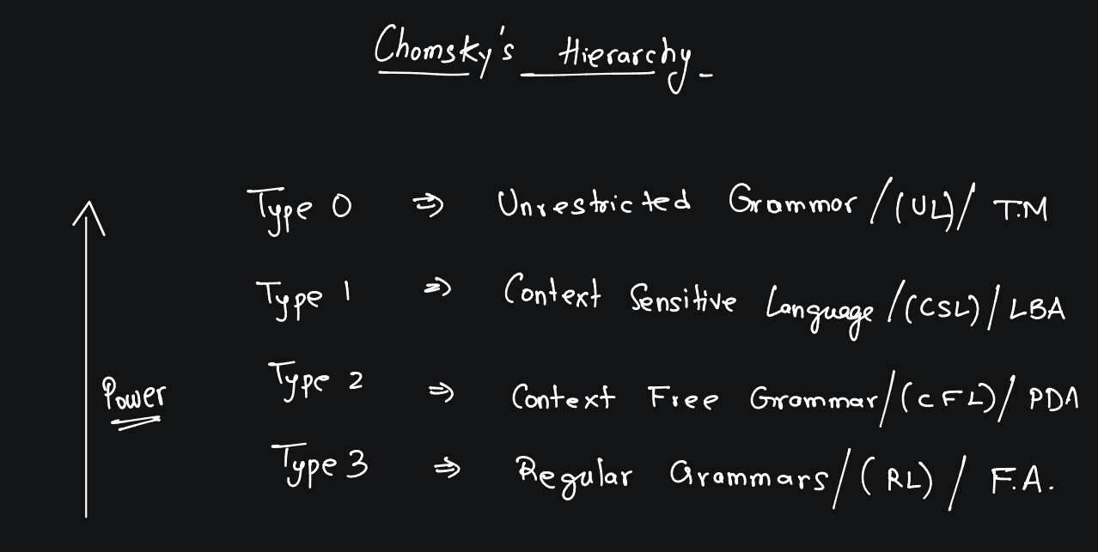

Slide 32
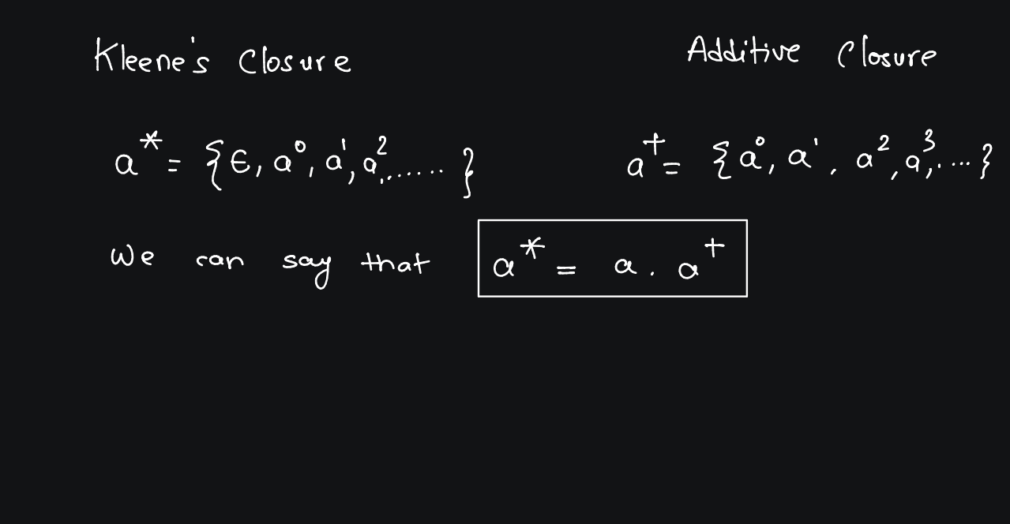

Slide 33
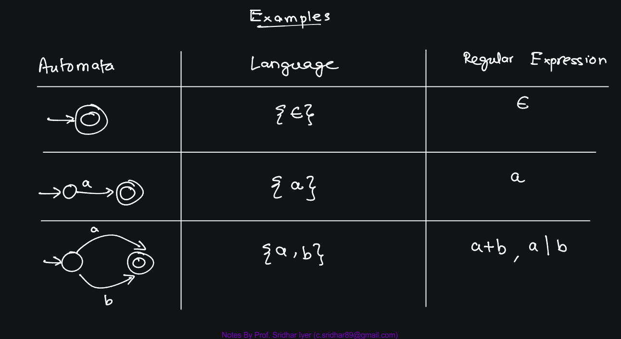

Slide 34
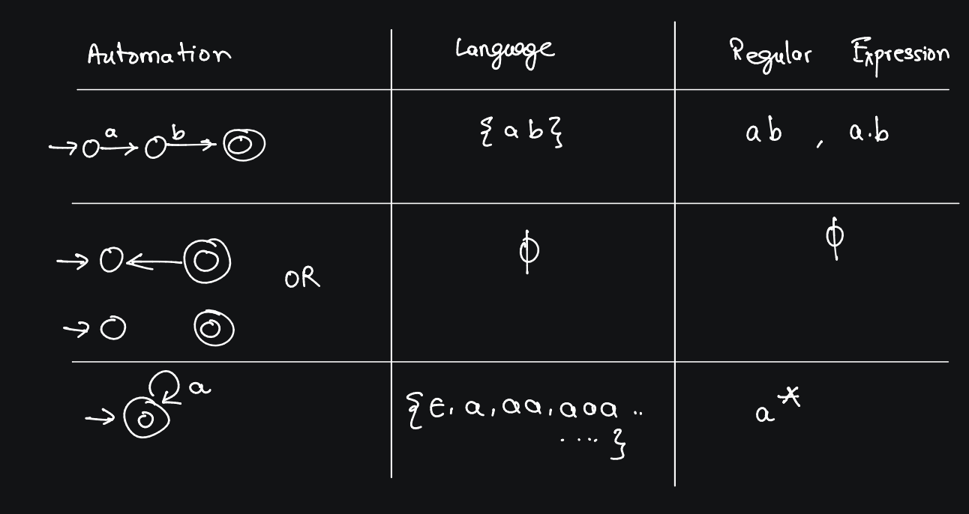

Slide 35
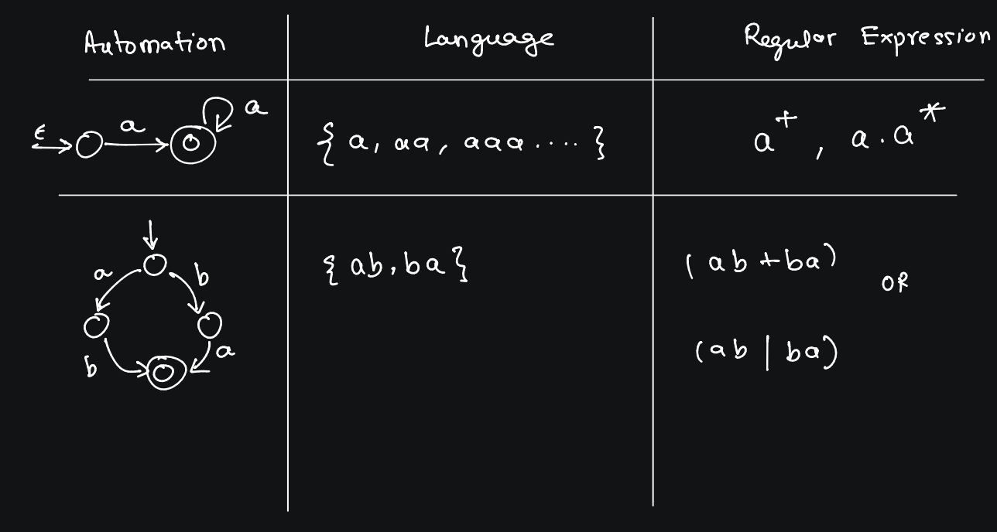

Slide 36
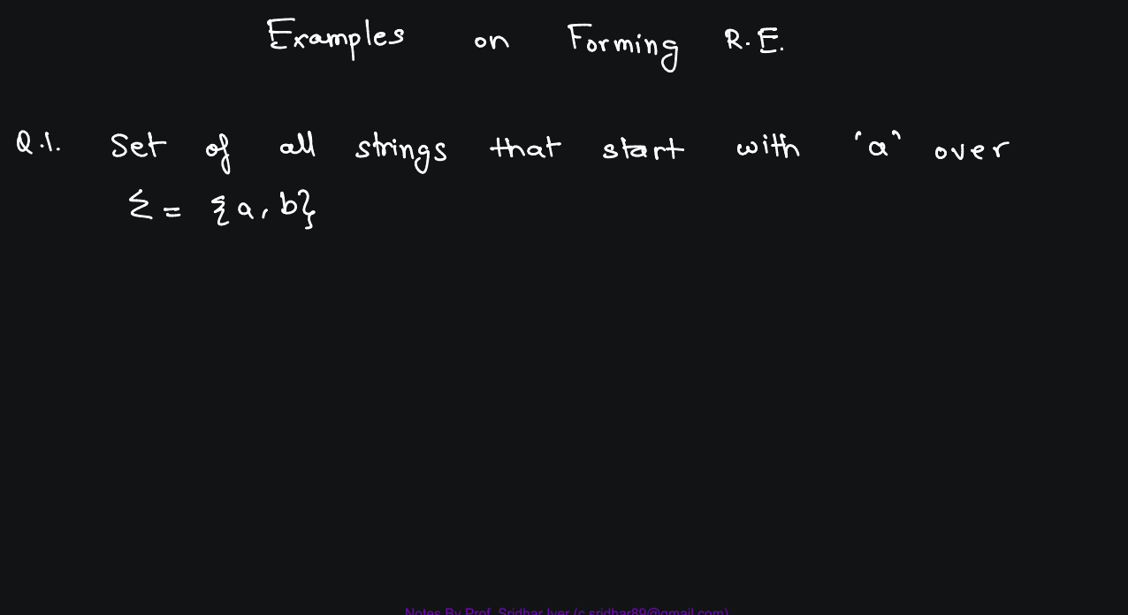

Slide 37
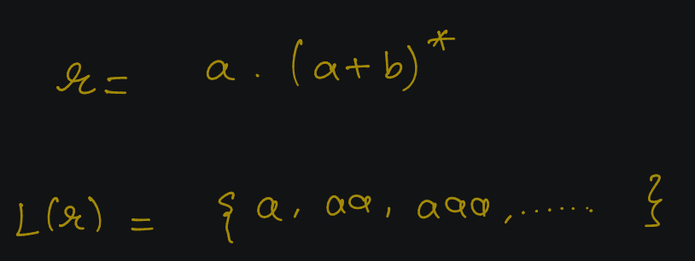

Slide 38
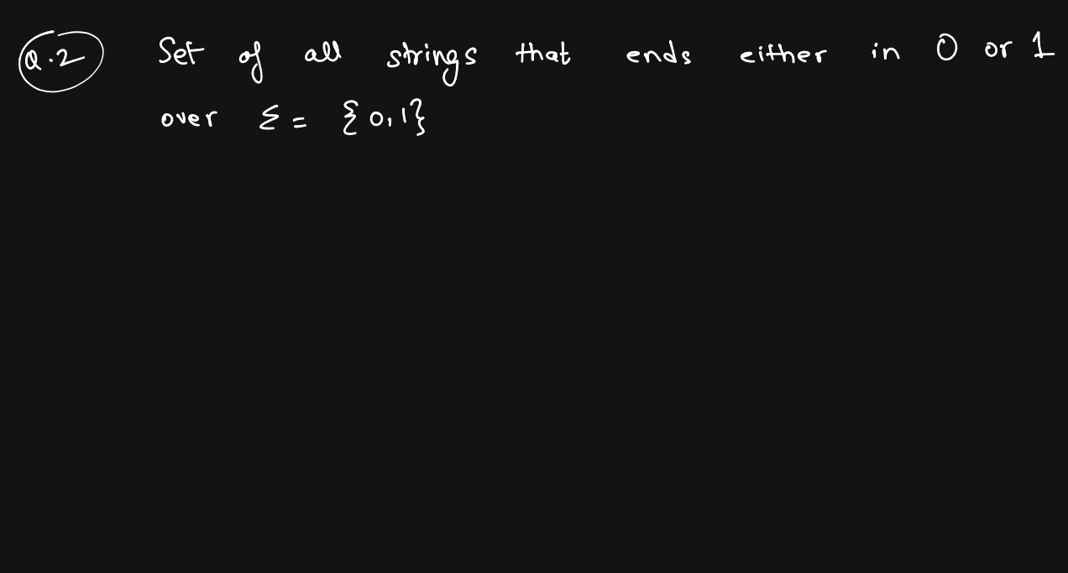

Slide 39
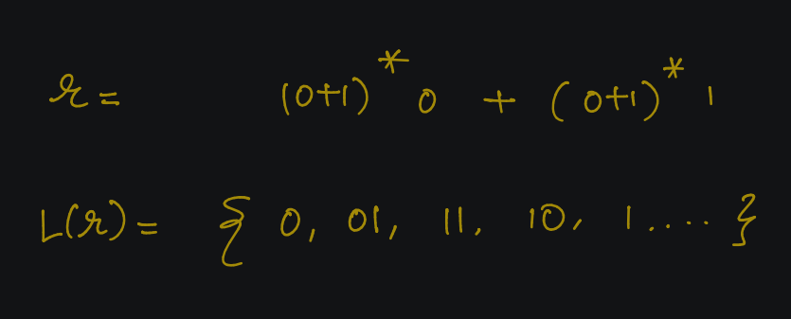

Slide 40
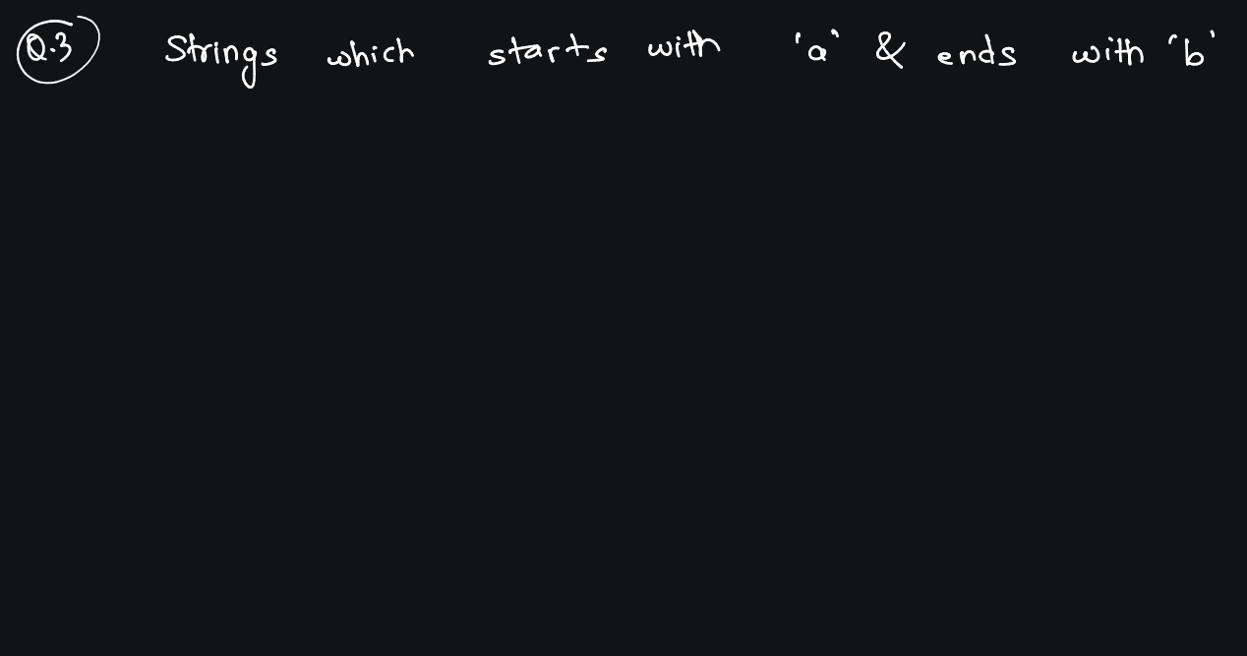

Slide 41
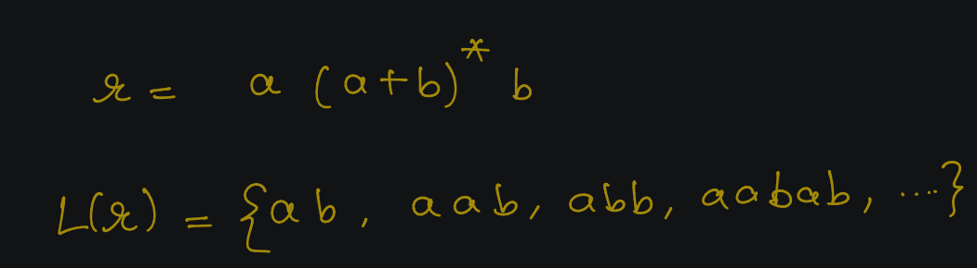

Slide 42
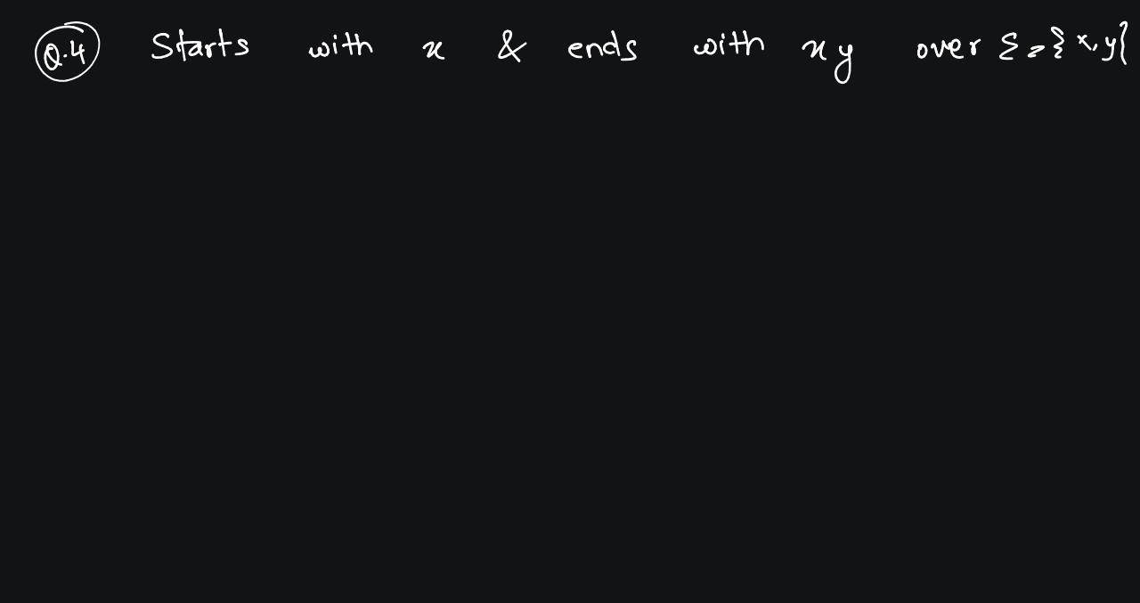

Slide 43
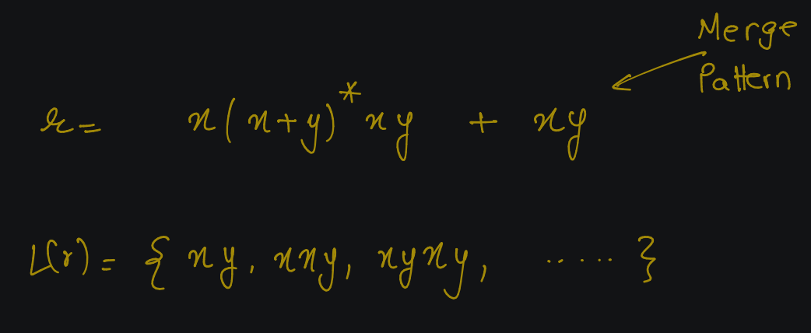

Slide 44
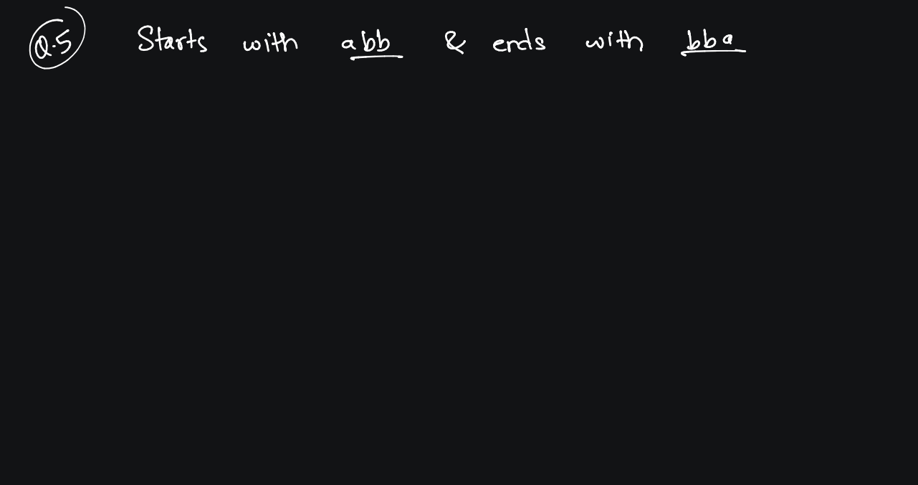

Slide 45
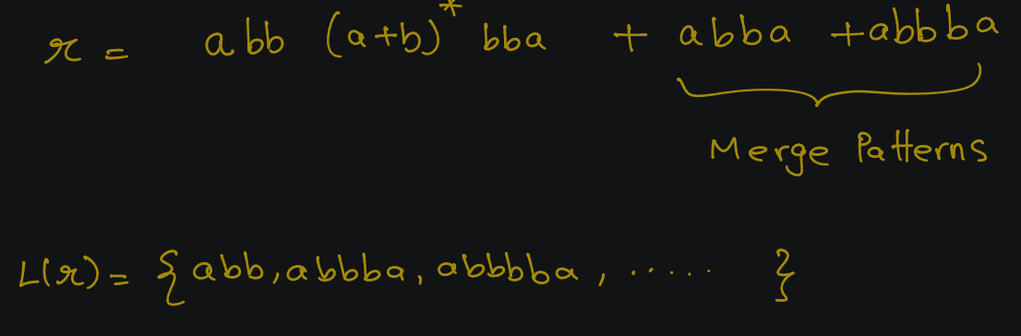

Slide 46
R.E to F.A
Rules of Conversion

Slide 47
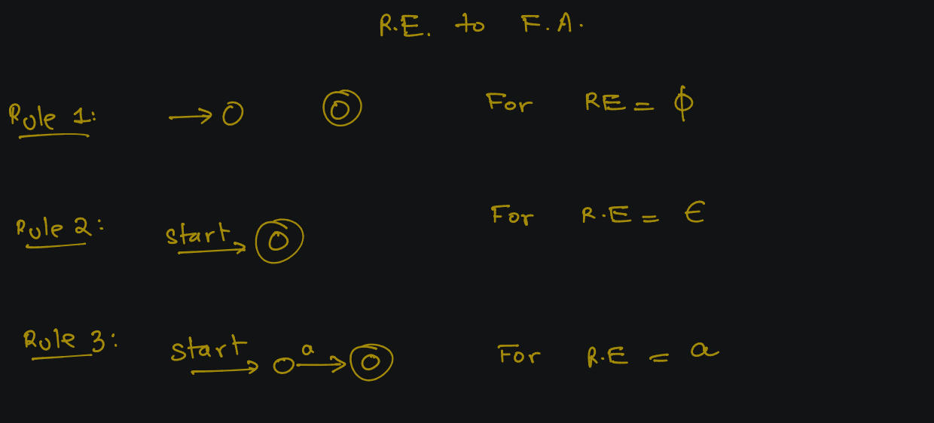

Slide 48
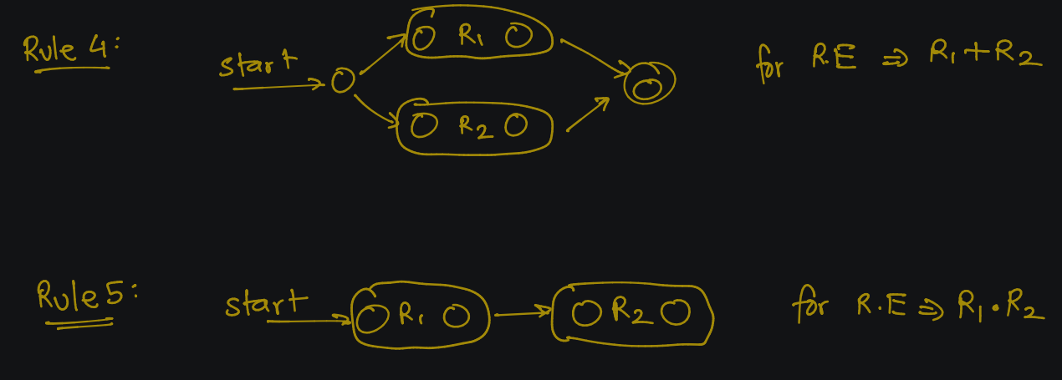

Slide 49


Slide 50
R.E to F.A
Examples

Slide 51
Example - 1

Slide 52
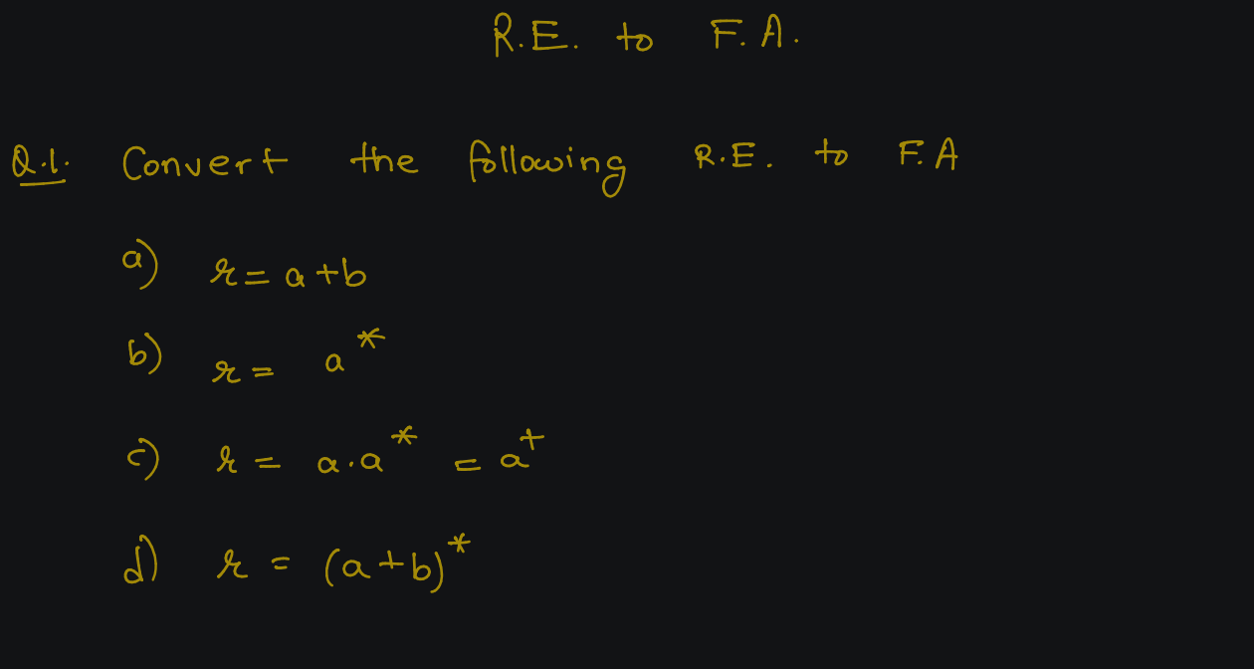

Slide 53
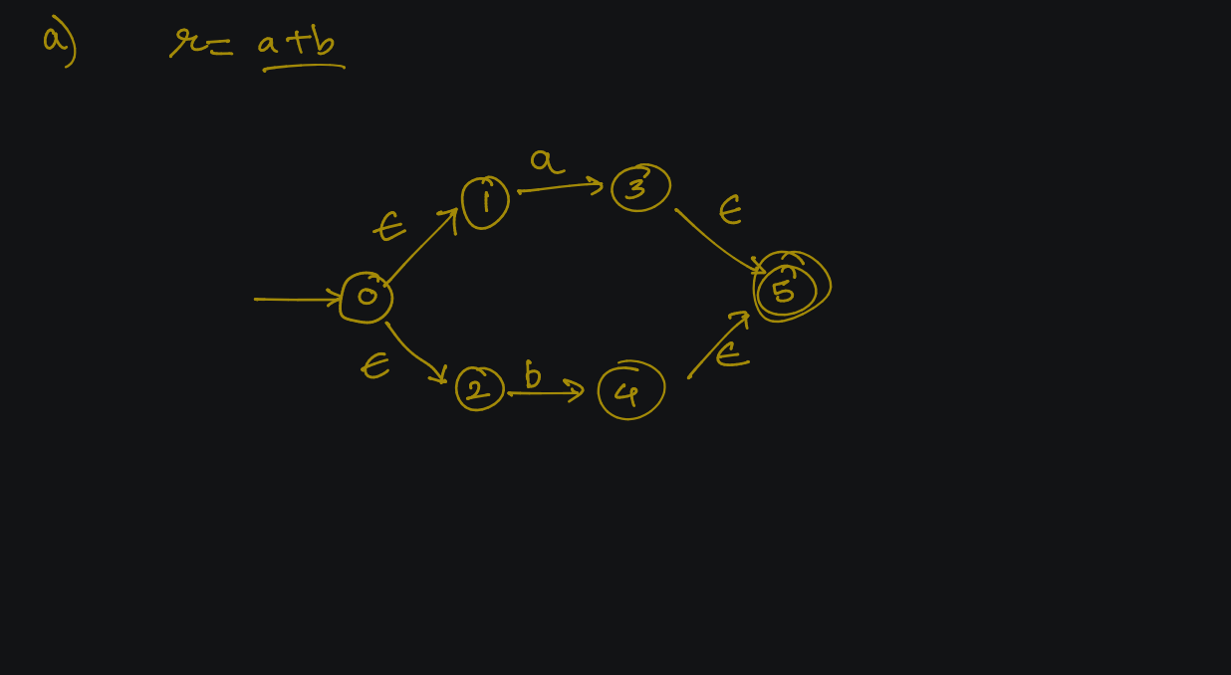

Slide 54
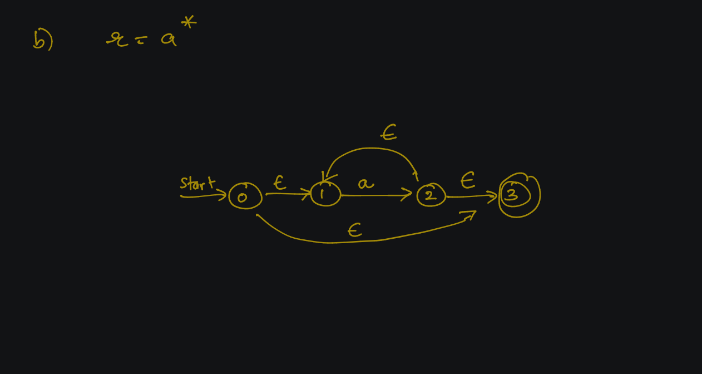

Slide 55
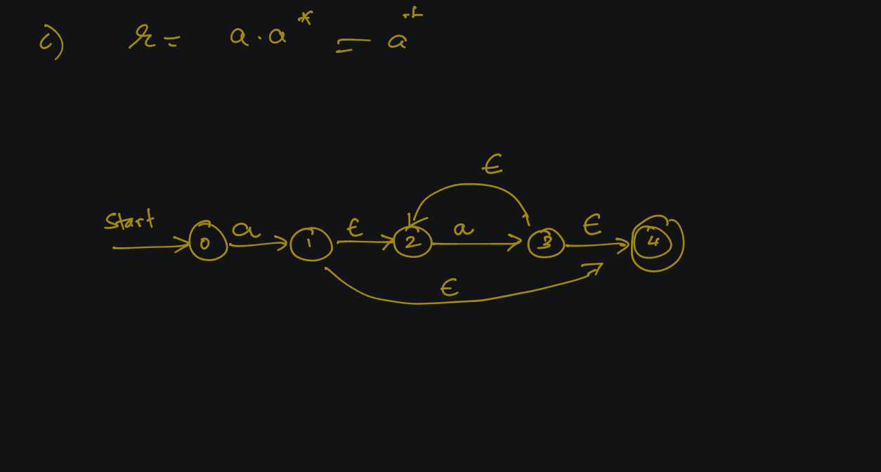

Slide 56
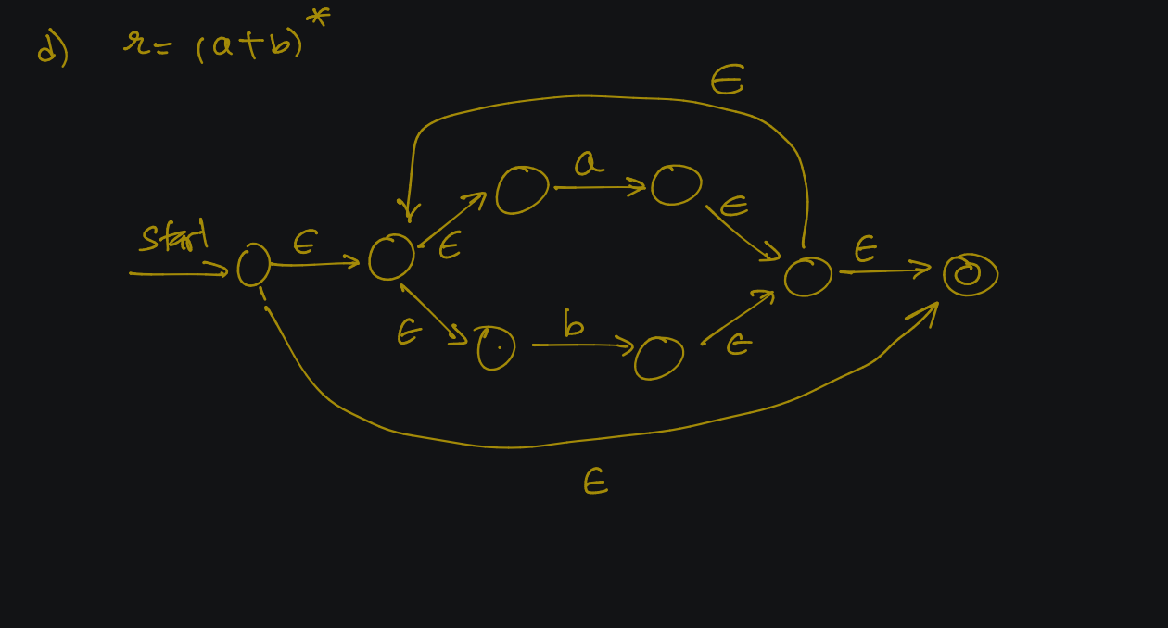

Slide 57
Example - 2

Slide 58
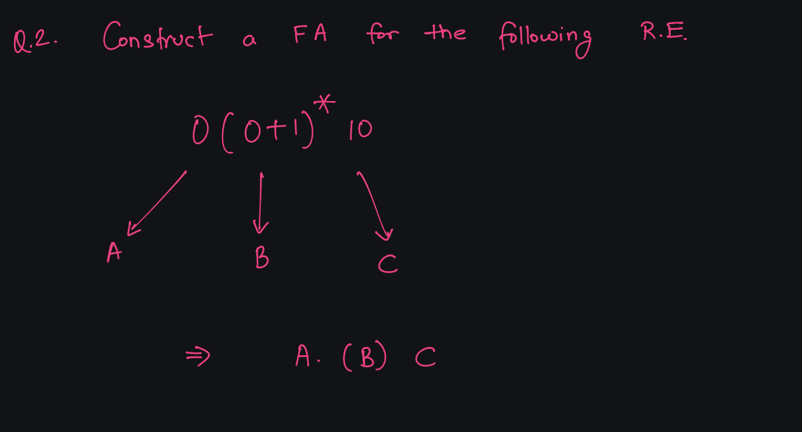

Slide 59
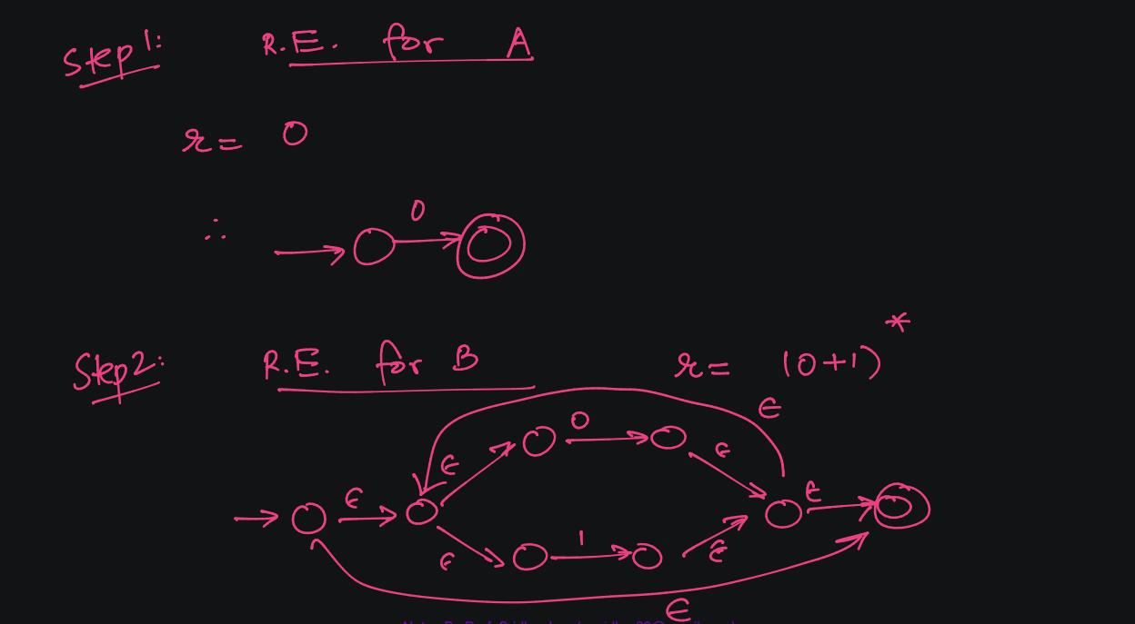

Slide 60
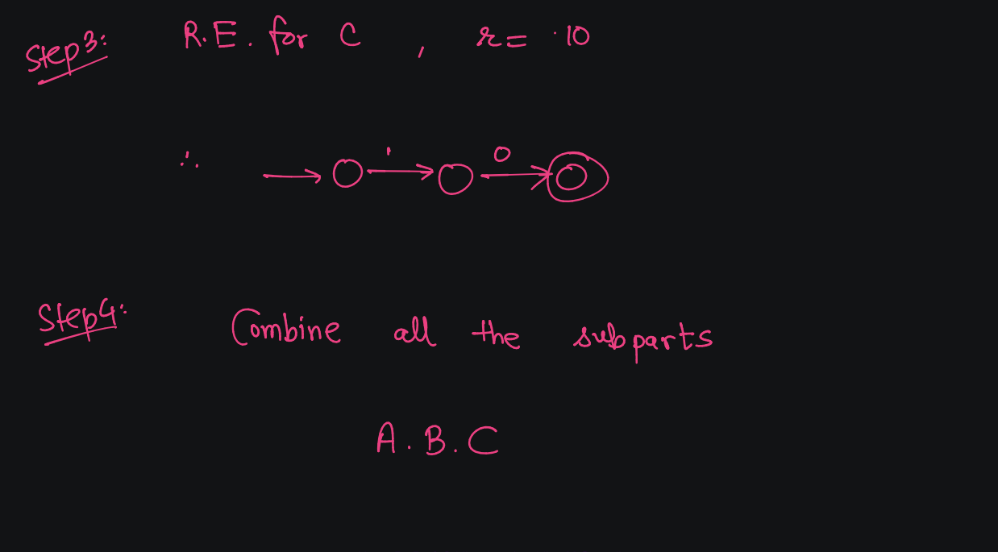

Slide 61
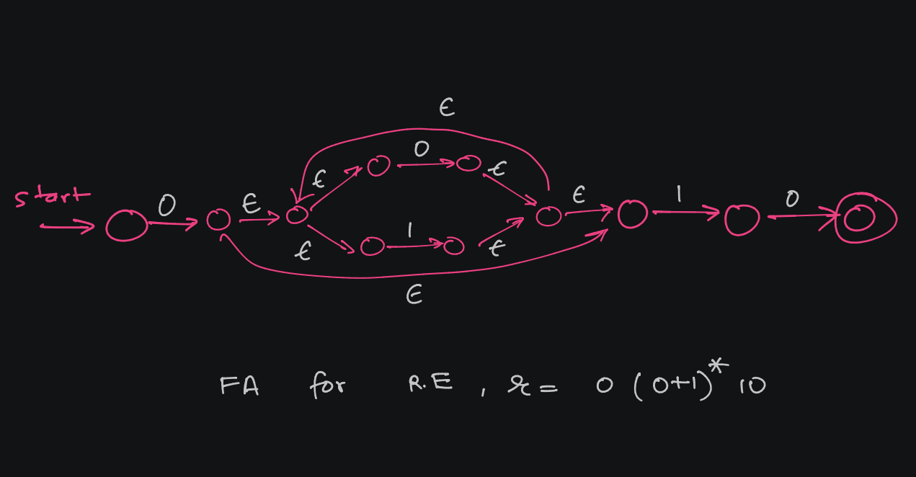

Slide 62
Example - 3

Slide 63
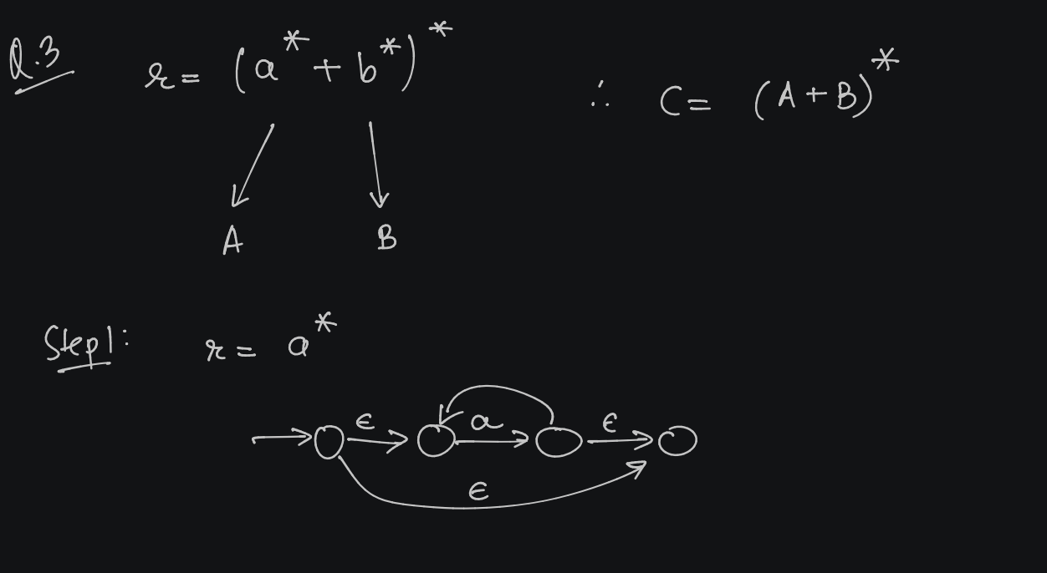

Slide 64
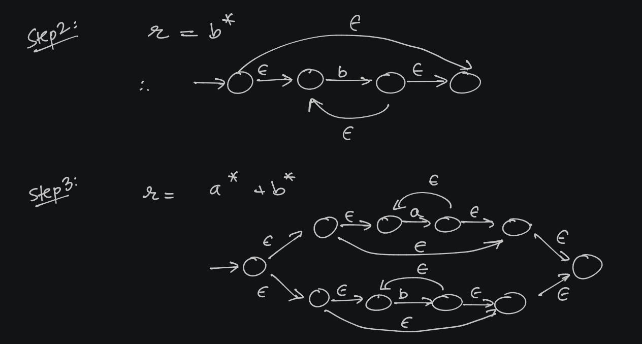

Slide 65
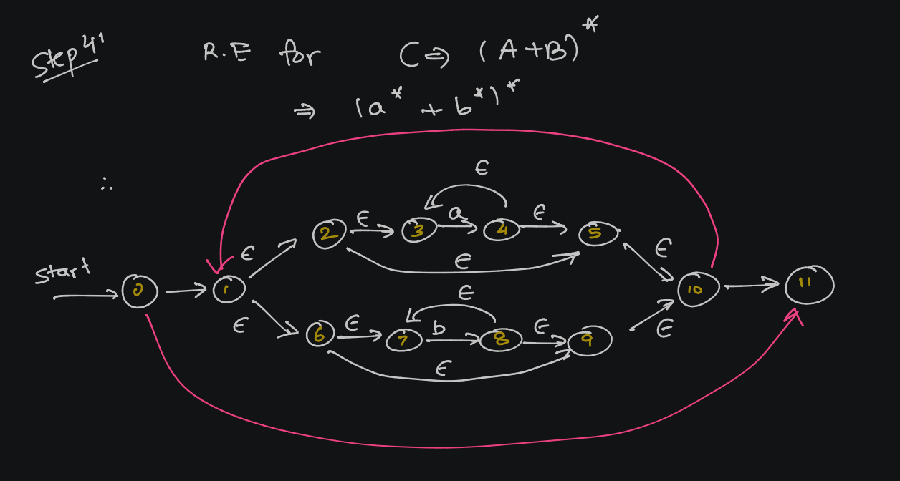

Slide 66
FORMAL LANGUAGES AND
AUTOMATA THEORY
Lecture 6:
Arden’s Theorem (FA to RE)
Prepared By: Sridhar Iyer

Slide 67
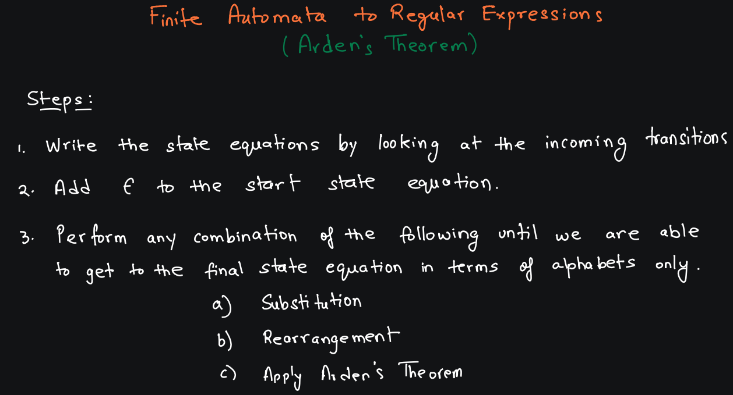

Slide 68
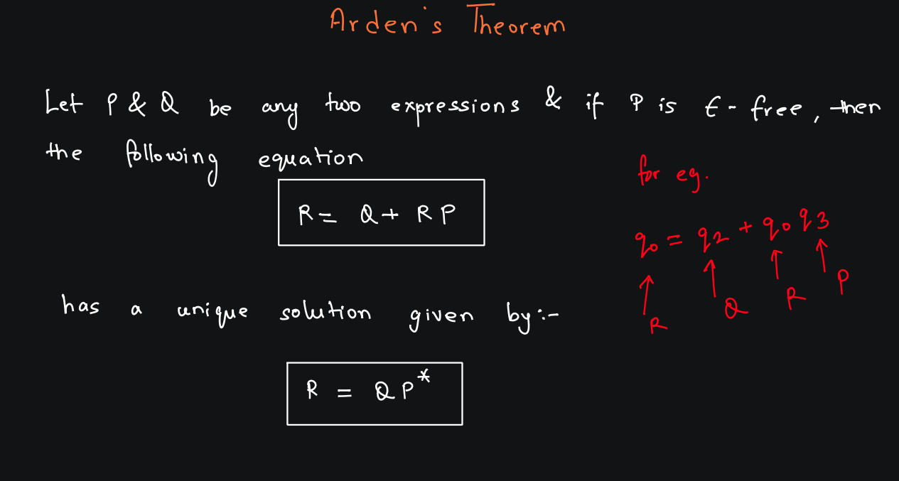

Slide 69
Example - 1

Slide 70
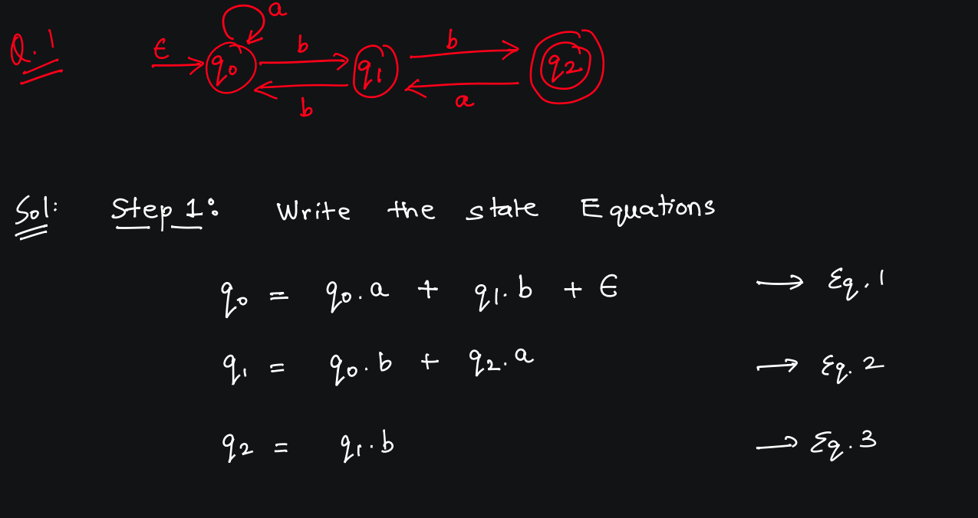

Slide 71
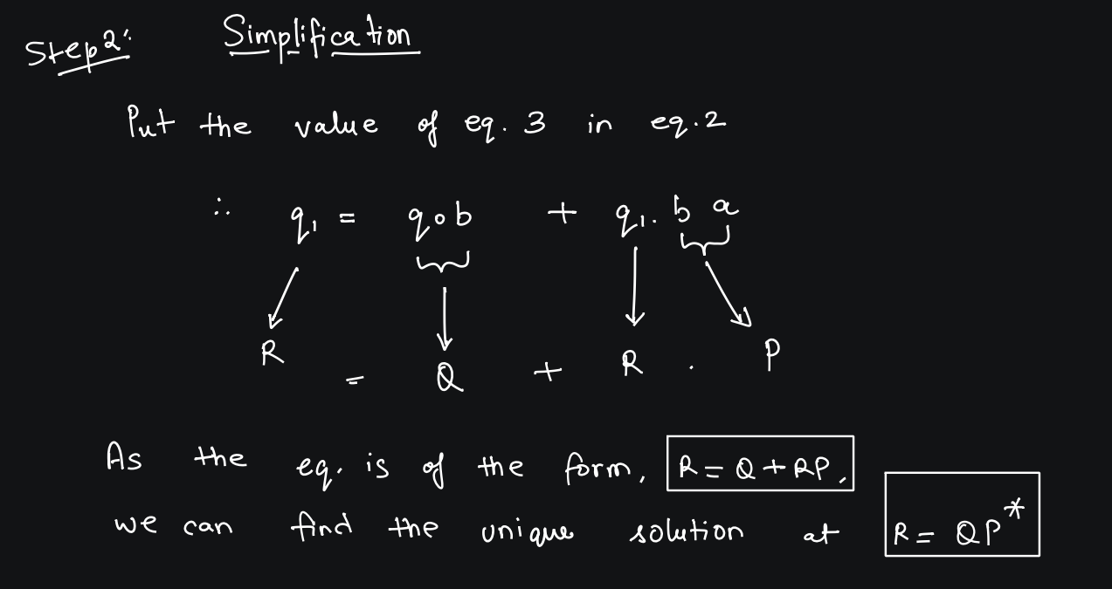

Slide 72
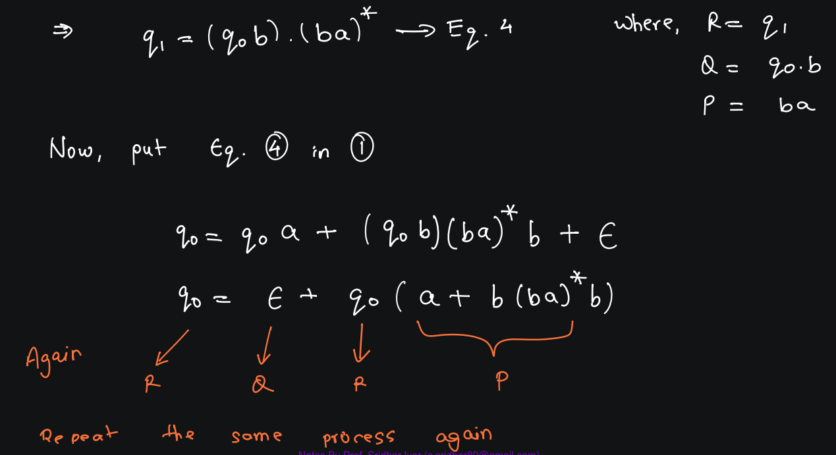

Slide 73
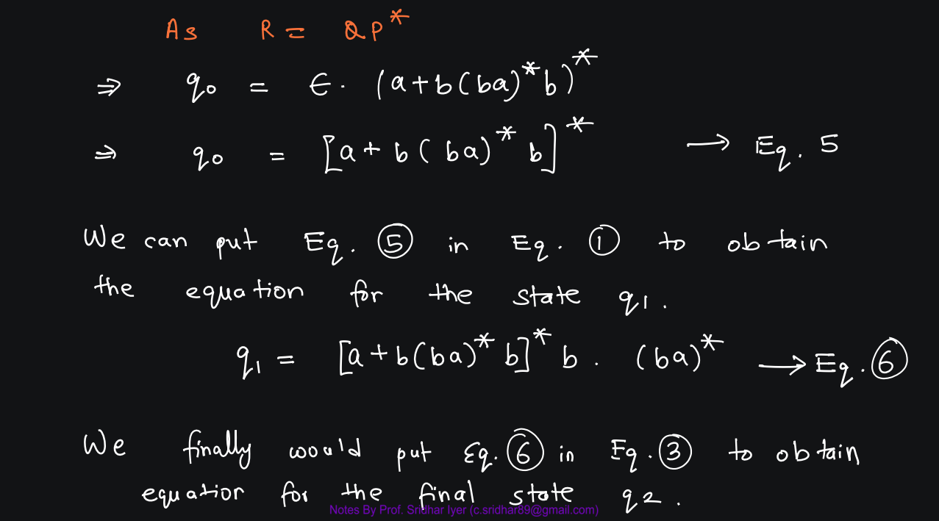

Slide 74
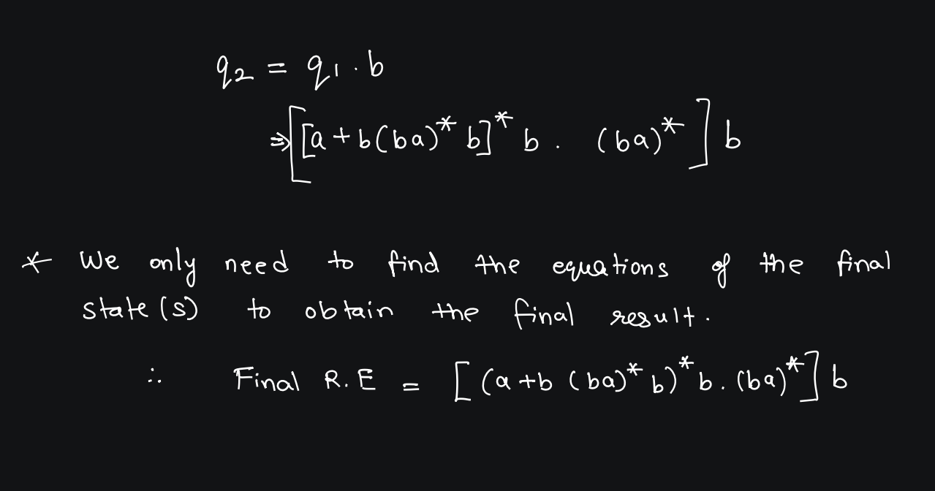

Slide 75
Example - 2

Slide 76
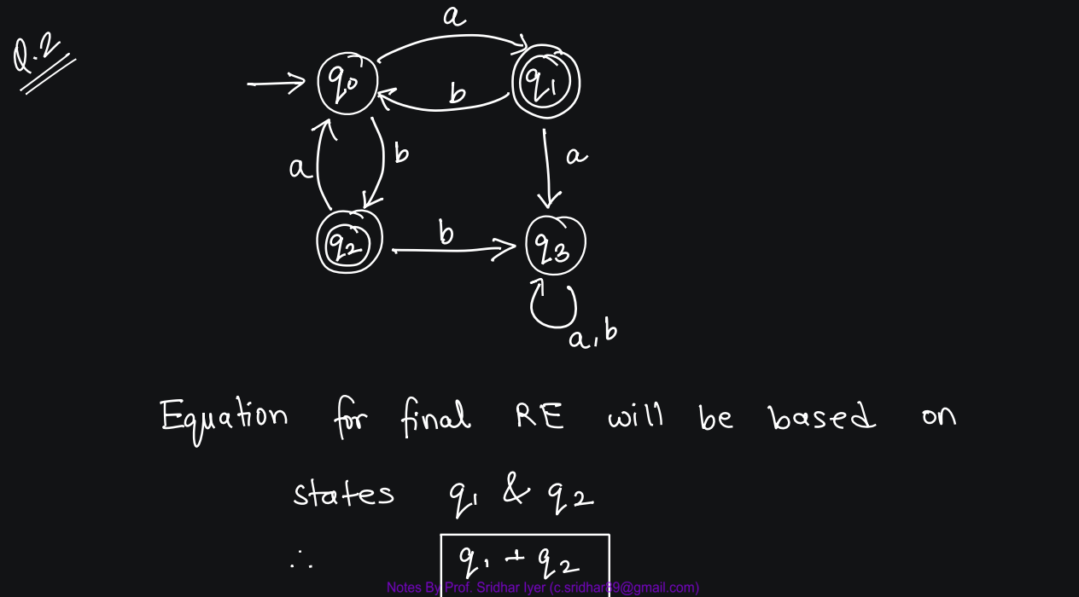

Slide 77
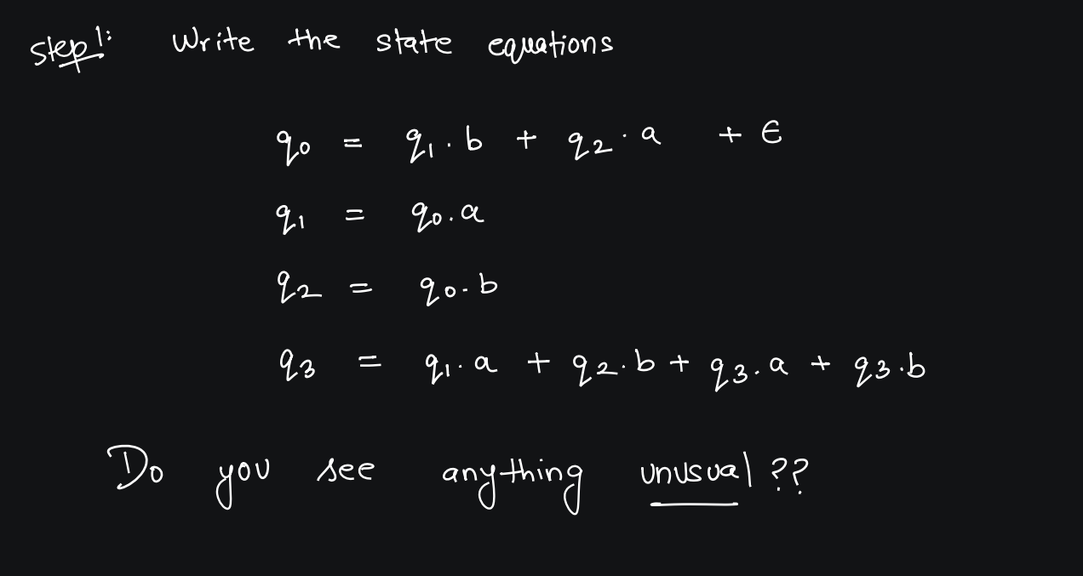

Slide 78
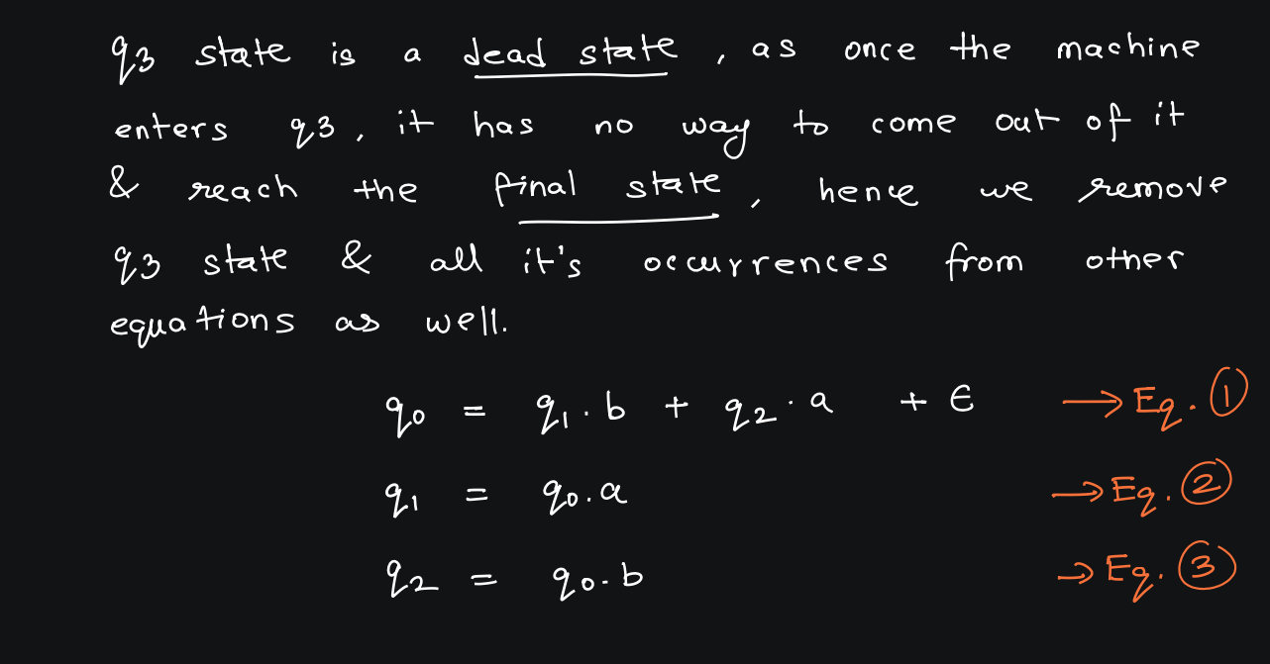

Slide 79
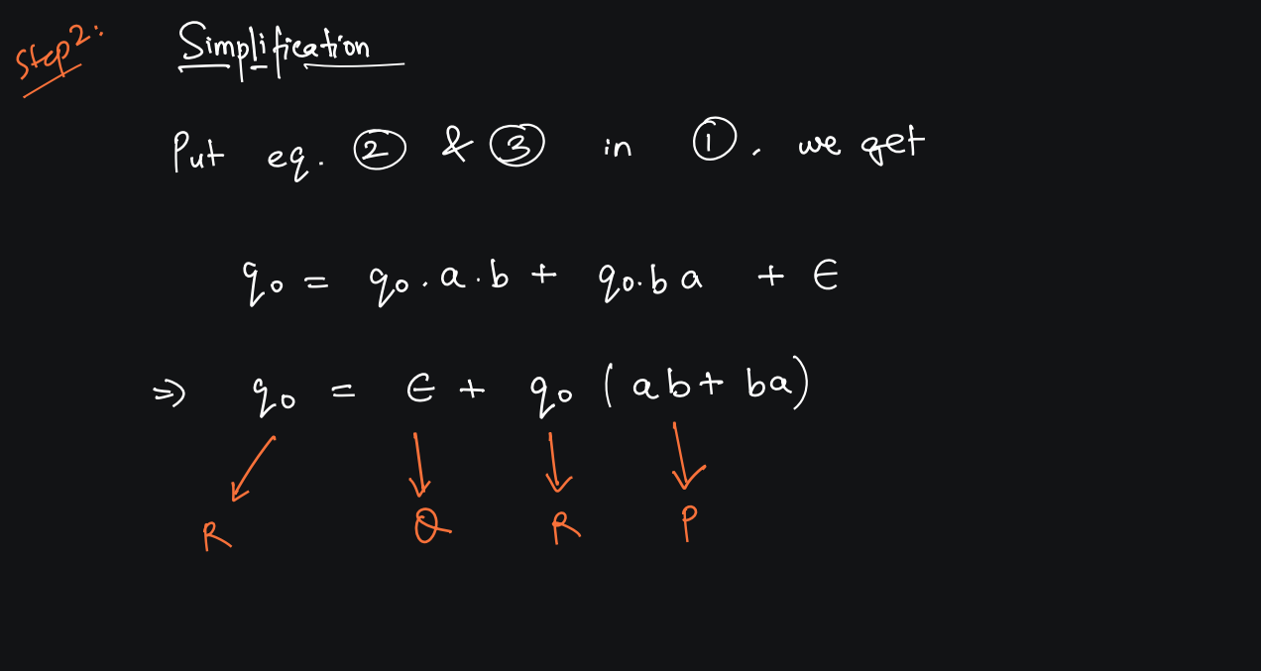

Slide 80


Slide 81


Slide 82
Example - 3

Slide 83


Slide 84


Slide 85


Slide 86


Slide 87


Slide 88


Slide 89
Example – 4 –
Practice Question

Slide 90


Slide 91
Example – 5 –
Practice Question

Slide 92


