Slide 1

FORMAL LANGUAGES AND
AUTOMATA THEORY
Lecture 4 and 5 :
Problems on FSM / FA
Prepared By: Sridhar Iyer

Slide 2
Finite State Machines –
PROBLEMS
TYPE 2 – STRINGS ENDING WITH TYPE - PROBLEMS

Slide 3
Finite State Machines –
Type 2 - PROBLEM 1

Slide 4
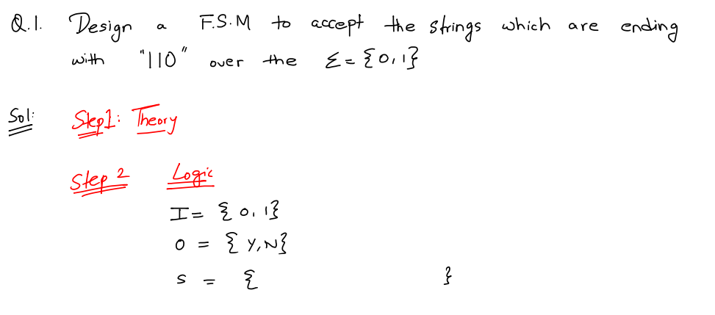
Finite State Machines – Practice Problems

Slide 5
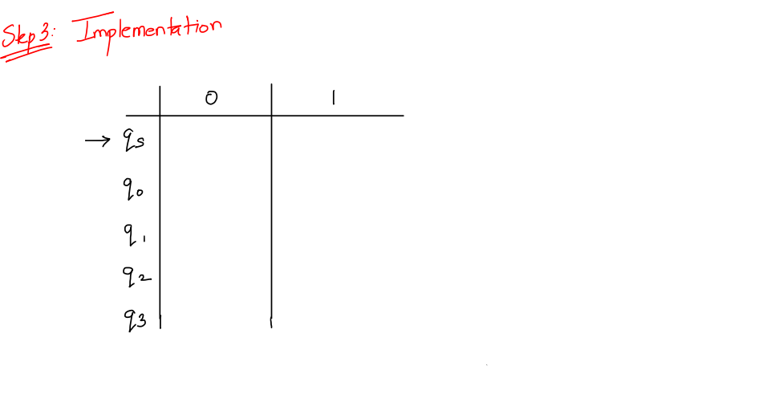
Finite State Machines – Practice Problems

Slide 6
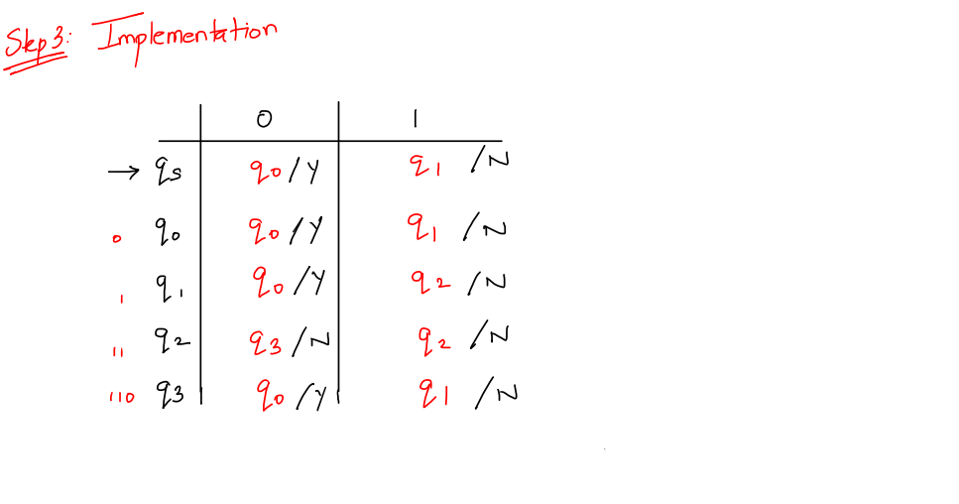
Finite State Machines – Practice Problems

Slide 7
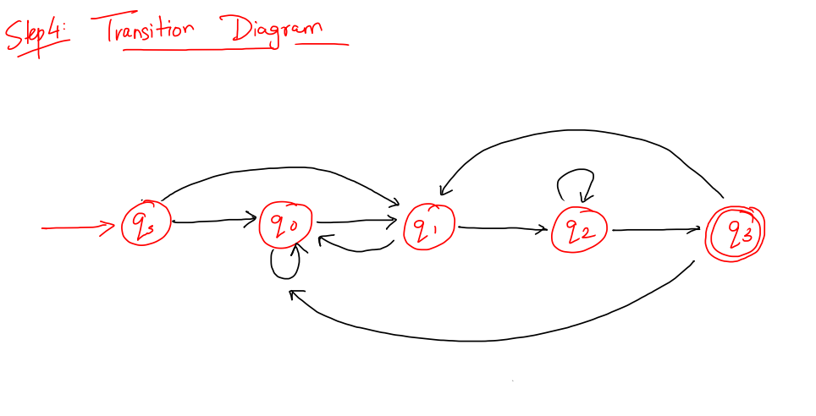
Finite State Machines – Practice Problems

Slide 8
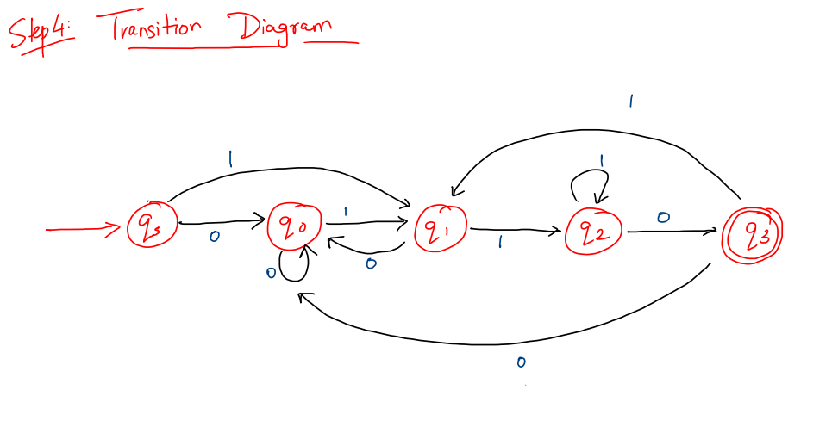
Finite State Machines – Practice Problems

Slide 9
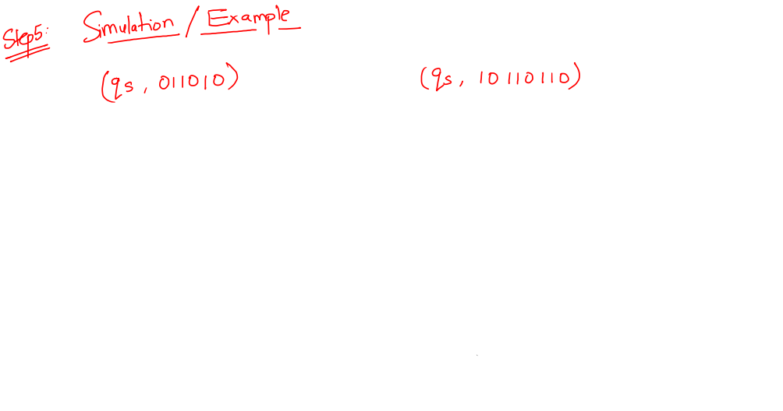
Finite State Machines – Practice Problems

Slide 10
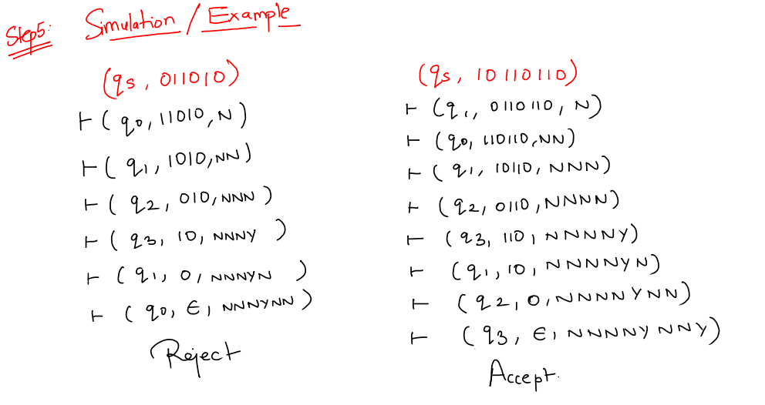
Finite State Machines – Practice Problems

Slide 11
Finite State Machines –
Type 2 - PROBLEM 2

Slide 12
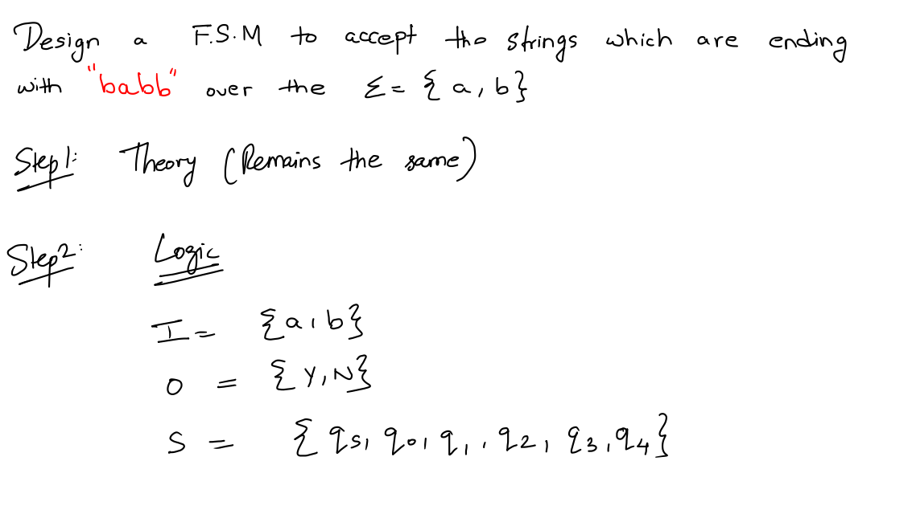
Finite State Machines – Practice Problems

Slide 13
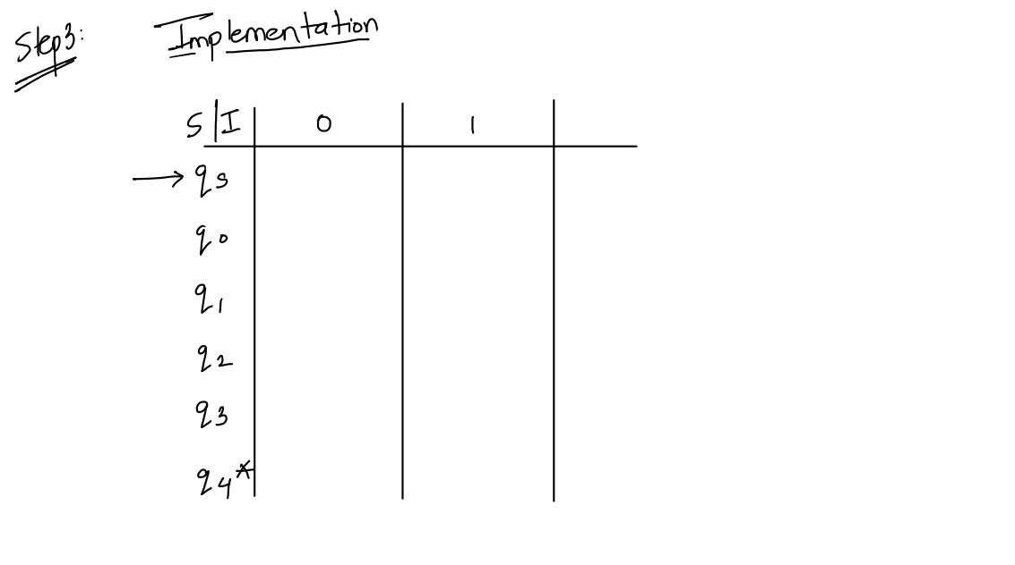
Finite State Machines – Practice Problems

Slide 14
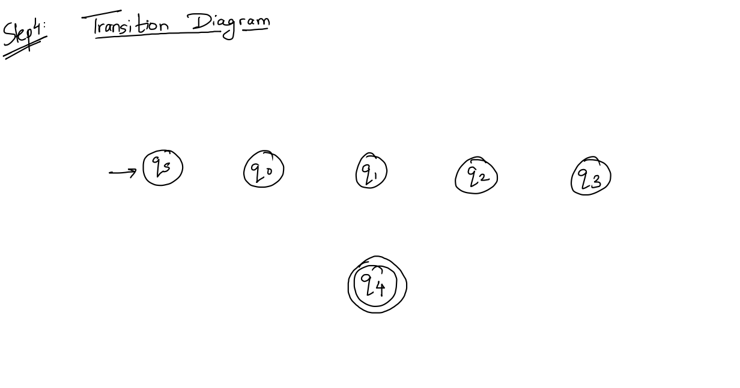
Finite State Machines – Practice Problems

Slide 15

Finite State Machines – Practice Problems

Slide 16
Finite State Machines –
PROBLEMS
TYPE 3 – STRINGS CONTAINING TYPE
(TRAP STATE)

Slide 17
Finite State Machines –
Type 3 - PROBLEM 1

Slide 18
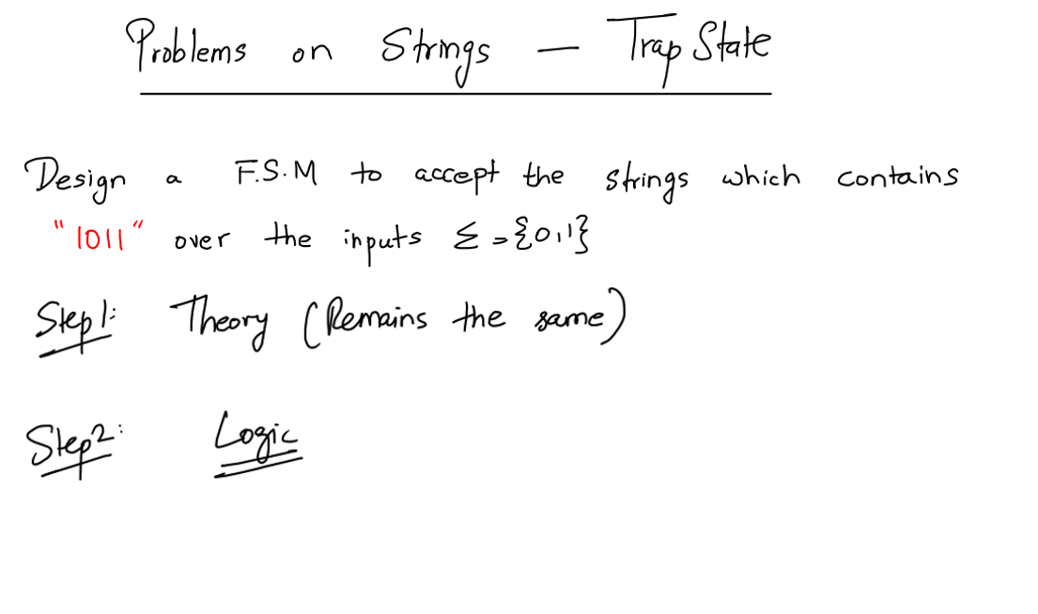
Finite State Machines – Practice Problems

Slide 19

Finite State Machines – Practice Problems

Slide 20

Finite State Machines – Practice Problems

Slide 21
Finite State Machines – Practice Problems

Slide 22
Finite State Machines –
Type 3 - PROBLEM 2
Finite State Machines – Practice Problems
“bba”

Slide 23
Finite State Machines – Practice Problems

Slide 24
Finite State Machines – Practice Problems

Slide 25
Finite State Machines – Practice Problems

Slide 26
Finite State Machines –
PROBLEMS
TYPE 4 – STRINGS NOT CONTAINING TYPE
(DEAD STATE)

Slide 27
Finite State Machines –
Type 4 - PROBLEM 1

Slide 28
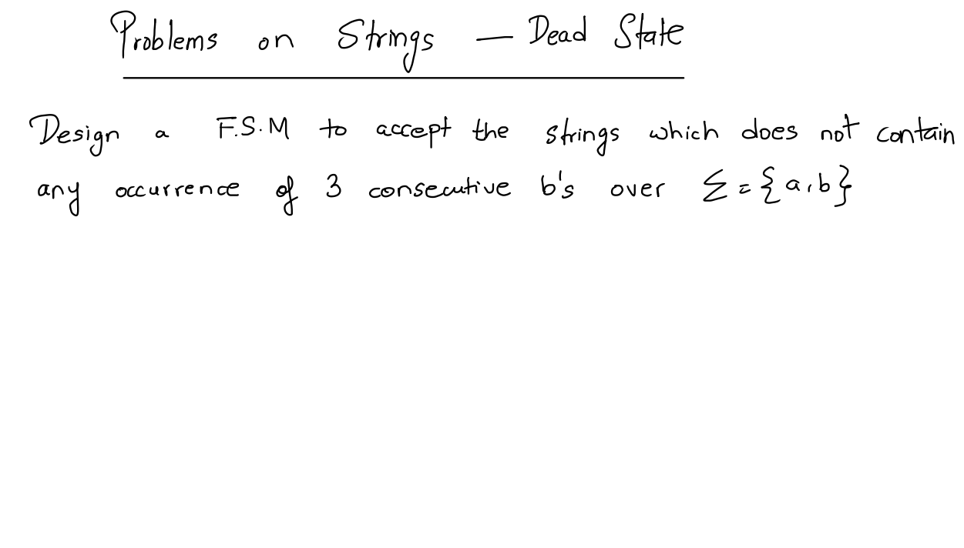
Finite State Machines – Practice Problems

Slide 29
Finite State Machines – Practice Problems

Slide 30
Finite State Machines – Practice Problems

Slide 31
Finite State Machines – Practice Problems

Slide 32
Finite State Machines – Practice Problems

Slide 33
Finite State Machines –
PROBLEMS
TYPE 5 – STRINGS CONTAINING
ODD /EVEN SEQUENCE

Slide 34
Finite State Machines –
Type 5 - PROBLEM 1

Slide 35

Finite State Machines – Practice Problems
Q. FSM to accept strings containing ODD number of a's.

Slide 36
Finite State Machines – Practice Problems

Slide 37
Finite State Machines – Practice Problems

Slide 38
Finite State Machines – Practice Problems

Slide 39
Finite State Machines –
PROBLEMS
TYPE 6 – STRINGS CONTAINING
ODD AND EVEN SEQUENCE

Slide 40
Finite State Machines –
Type 6 - PROBLEM

Slide 41
Finite State Machines – Practice Problems
Q. FSM to accept Strings containing Even number of a's and Odd number of b's.

Slide 42
Finite State Machines – Practice Problems

Slide 43
Finite State Machines – Practice Problems

Slide 44
Finite State Machines – Practice Problems

Slide 45
Finite State Machines –
PROBLEMS
TYPE 7 – STRINGS CONTAINING MIXED SEQUENCE

Slide 46
Finite State Machines –
Type 7 - PROBLEM

Slide 47
Finite State Machines – Practice Problems
Q. FSM to accept strings containing
a) Atleast 3a's
b) Exactly 3 a's
c) Atmost 3 a's

Slide 48
Finite State Machines – Practice Problems

Slide 49
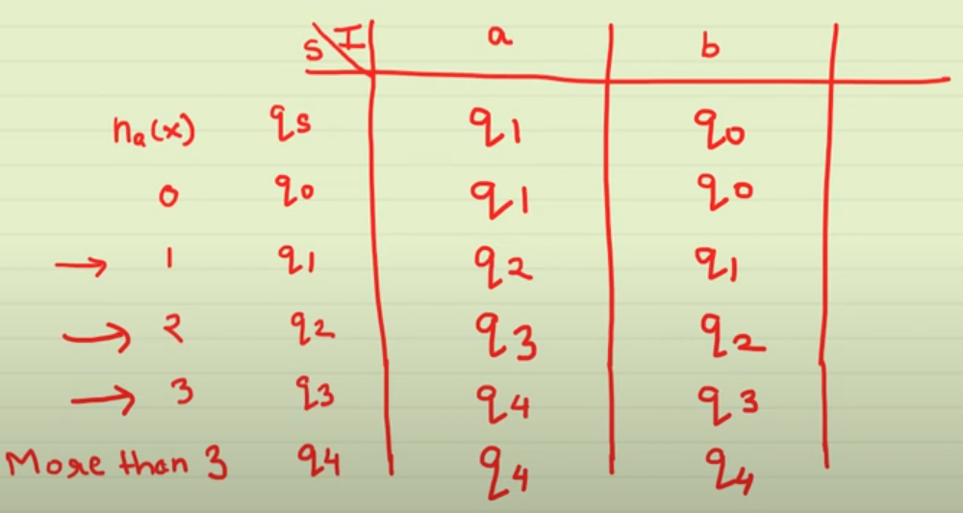
Finite State Machines – Practice Problems

Slide 50
Finite State Machines – Practice Problems

Slide 51
Finite State Machines – Practice Problems

Slide 52
Finite State Machines – Practice Problems

