Slide 1

FORMAL LANGUAGES AND
AUTOMATA THEORY
Lecture 3: Basic Problems on FSM / FA
Prepared By: Sridhar Iyer

Slide 2
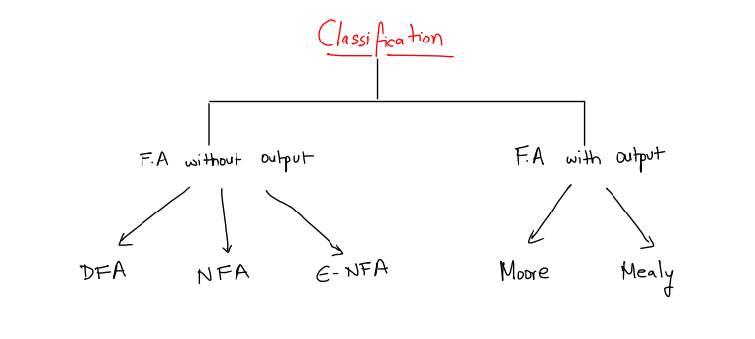
Finite State Machines – Classification

Slide 3
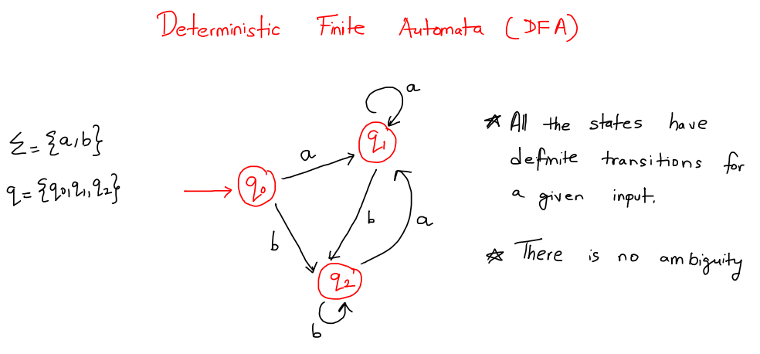
Finite State Machines – Classification

Slide 4
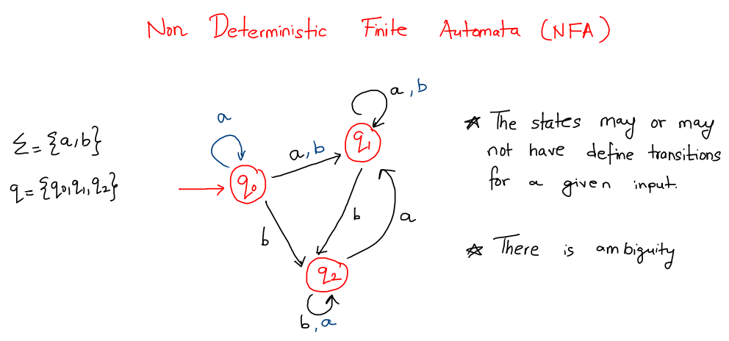
Finite State Machines – Classification

Slide 5
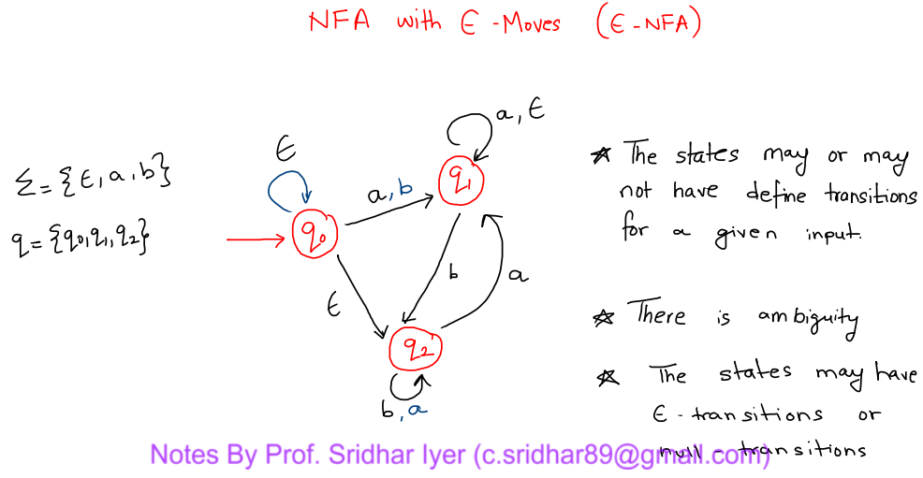
Finite State Machines – Classification

Slide 6
Finite State Machines –
PROBLEMS
TYPE 1 – DIVISIBILITY TYPE PROBLEMS

Slide 7
Finite State Machines –
PROBLEM 1

Slide 8
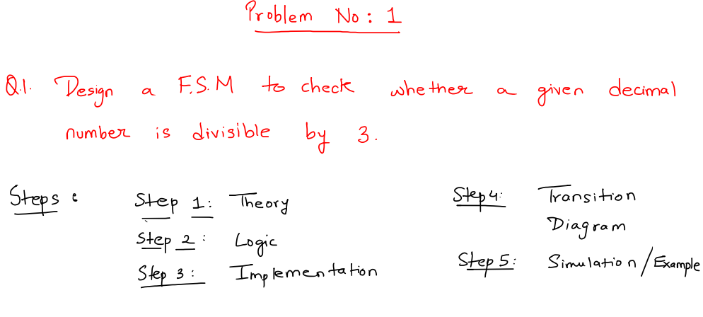
Finite State Machines – Problems on FSM

Slide 9
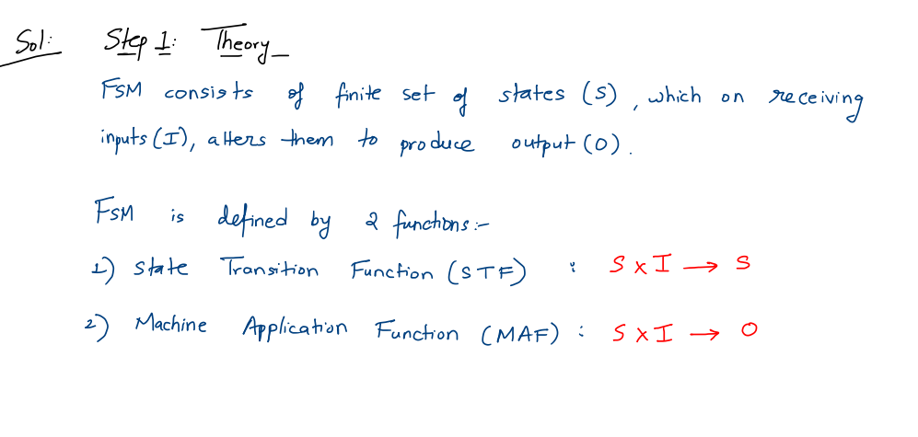
Finite State Machines – Problems on FSM

Slide 10
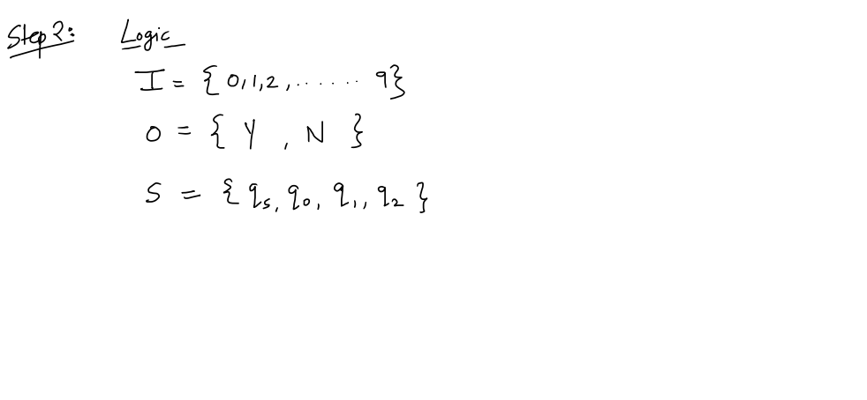
Finite State Machines – Problems on FSM

Slide 11
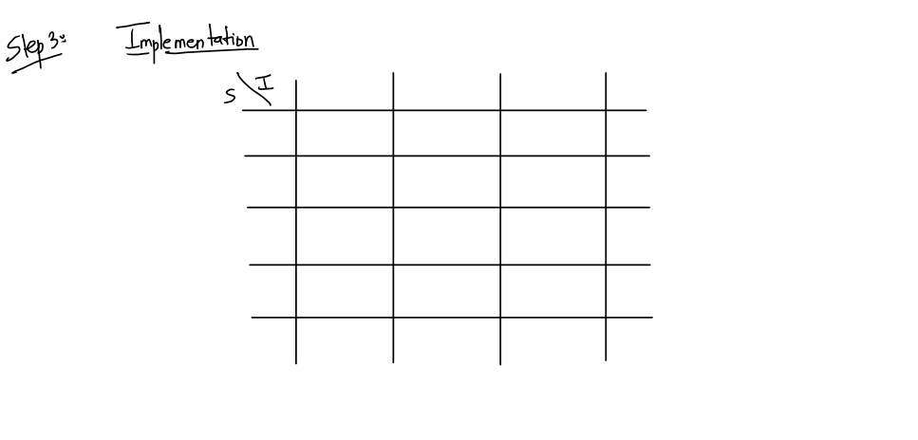
Finite State Machines – Problems on FSM

Slide 12
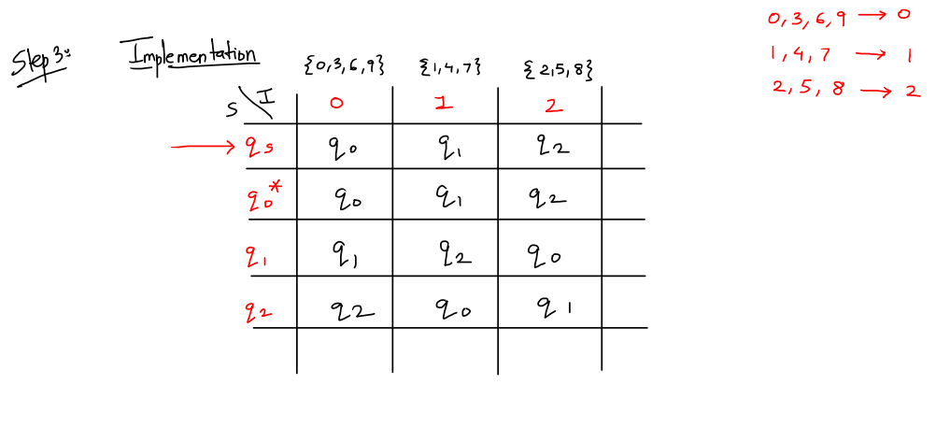
Finite State Machines – Problems on FSM

Slide 13
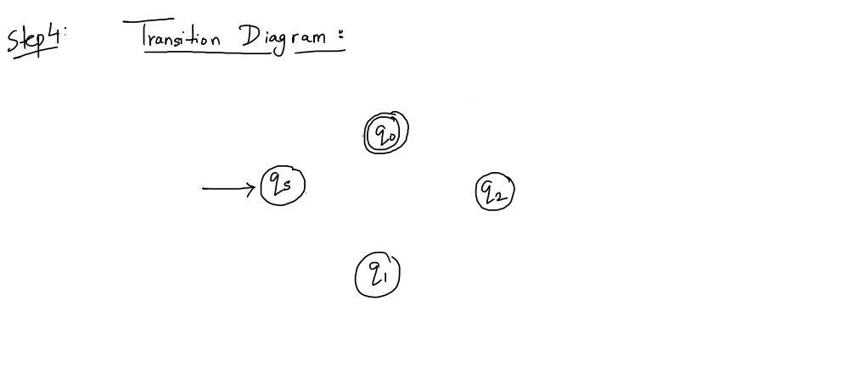
Finite State Machines – Problems on FSM

Slide 14
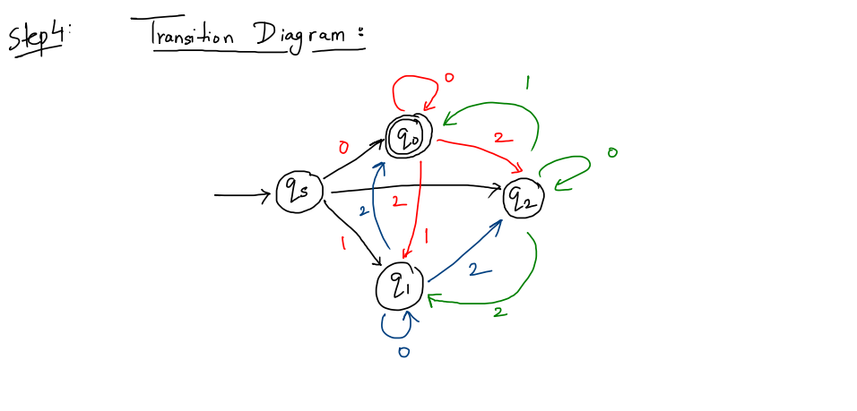
Finite State Machines – Problems on FSM

Slide 15
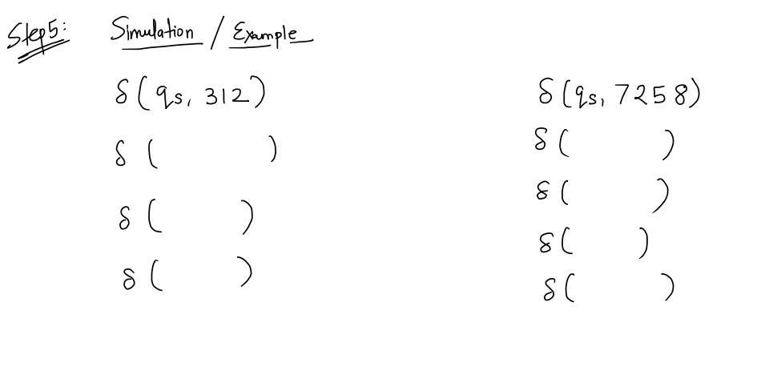
Finite State Machines – Problems on FSM

Slide 16
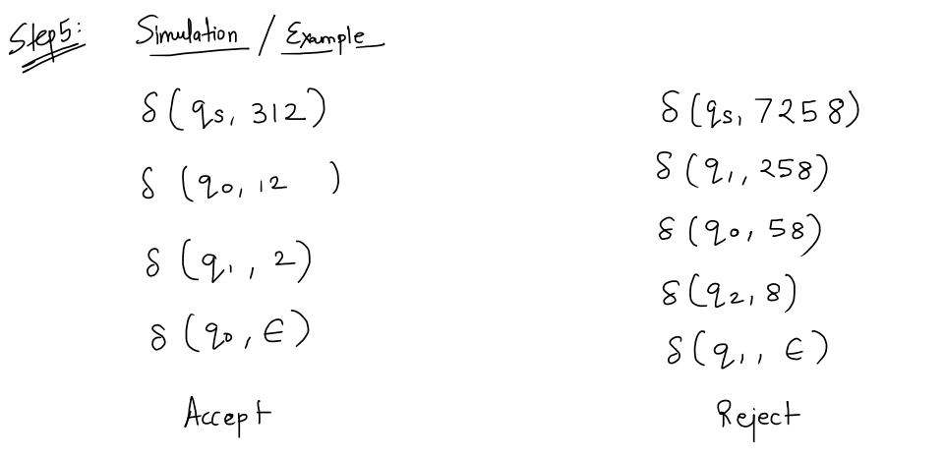
Finite State Machines – Problems on FSM

Slide 17
Finite State Machines –
PROBLEM 2

Slide 18
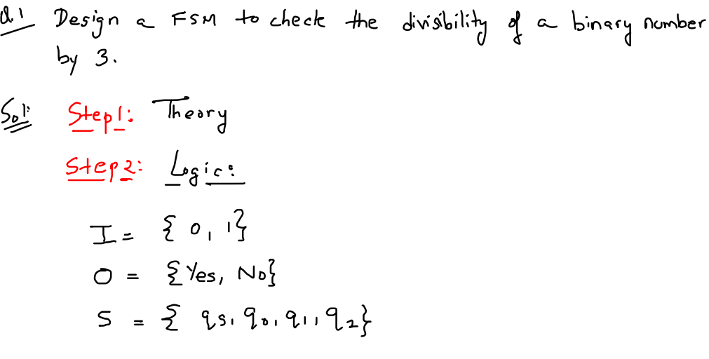
Finite State Machines – Practice Problems

Slide 19
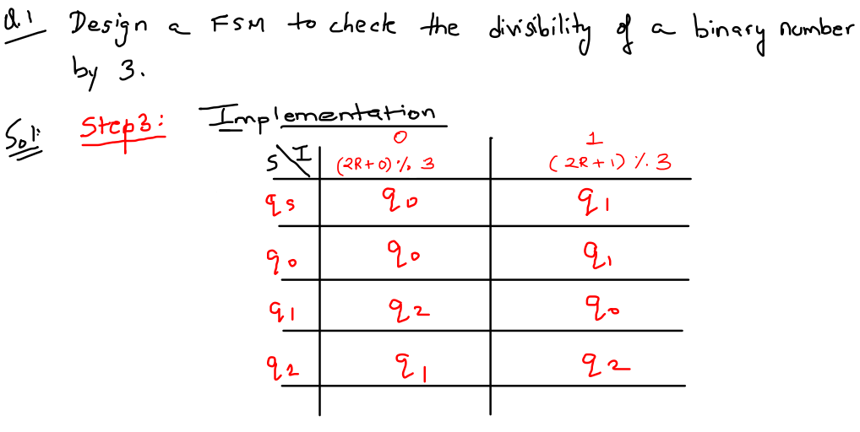
Finite State Machines – Practice Problems

Slide 20
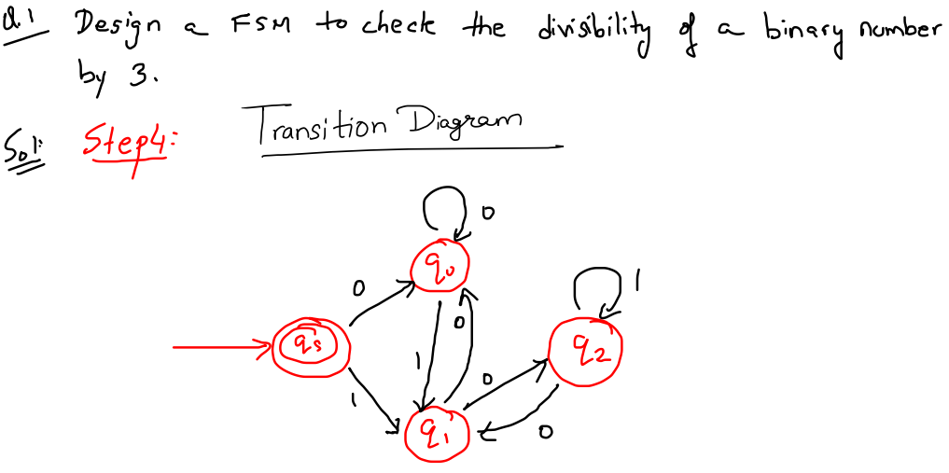
Finite State Machines – Practice Problems

Slide 21
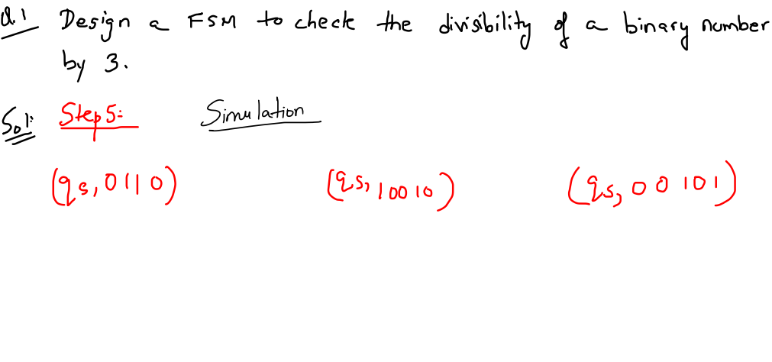
Finite State Machines – Practice Problems

Slide 22
Finite State Machines –
PROBLEMS
TYPE 2 – STRINGS ENDING WITH TYPE PROBLEMS

Slide 23
Finite State Machines –
PROBLEM 1

Slide 24
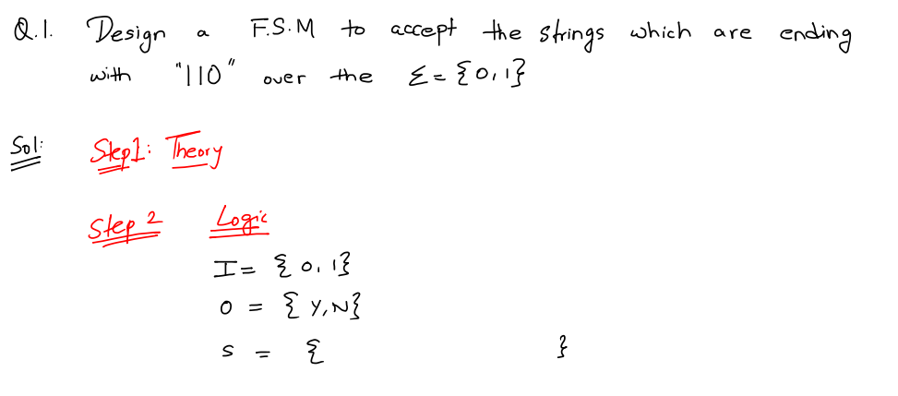
Finite State Machines – Practice Problems

Slide 25
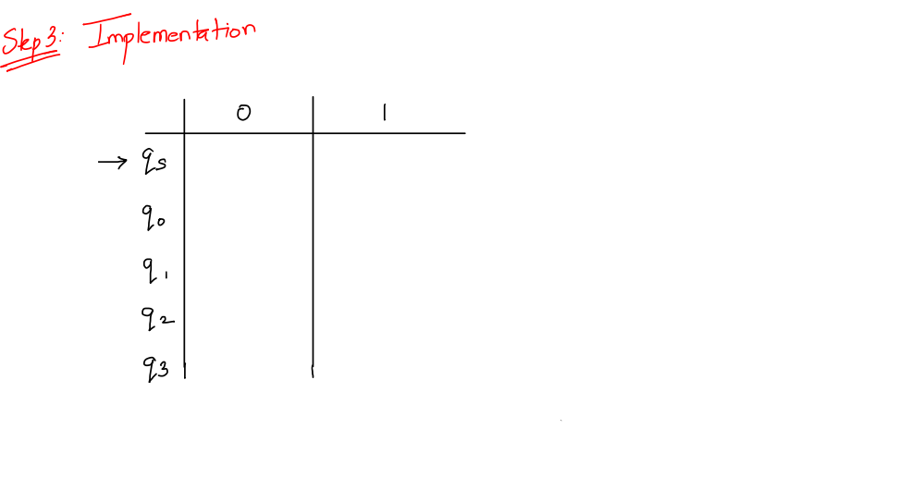
Finite State Machines – Practice Problems

Slide 26
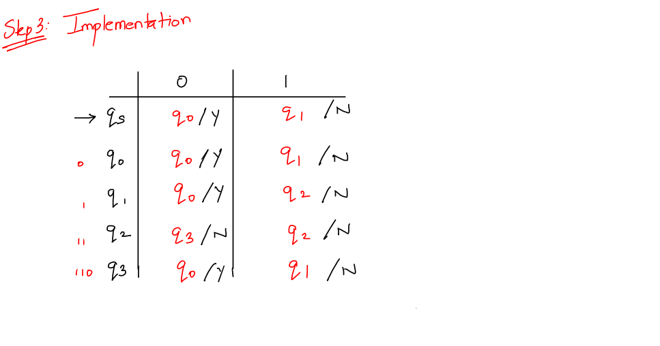
Finite State Machines – Practice Problems

Slide 27
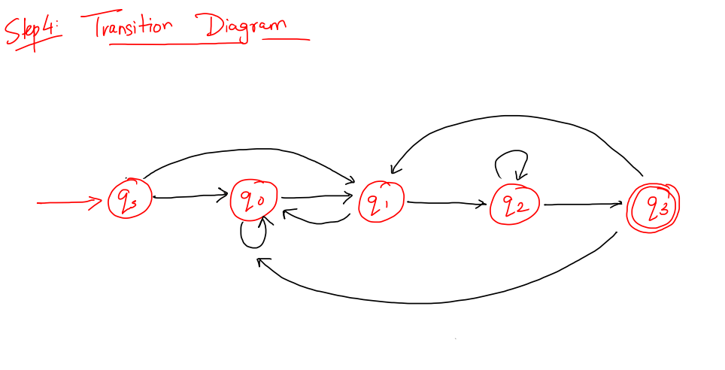
Finite State Machines – Practice Problems

Slide 28
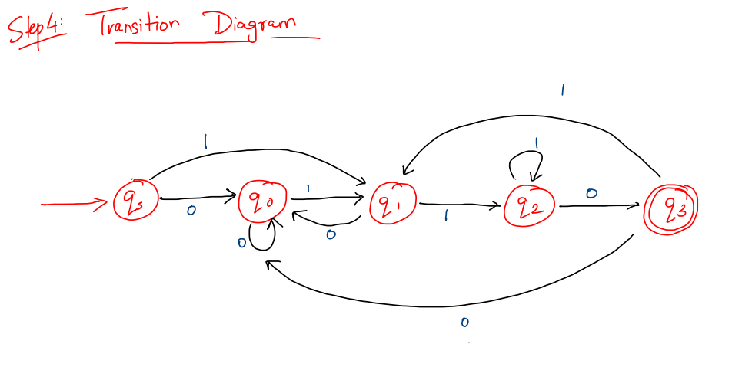
Finite State Machines – Practice Problems

Slide 29
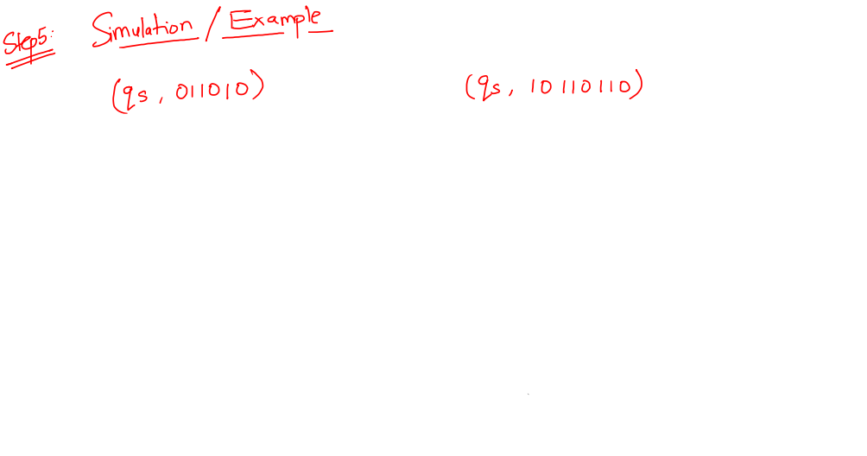
Finite State Machines – Practice Problems

Slide 30
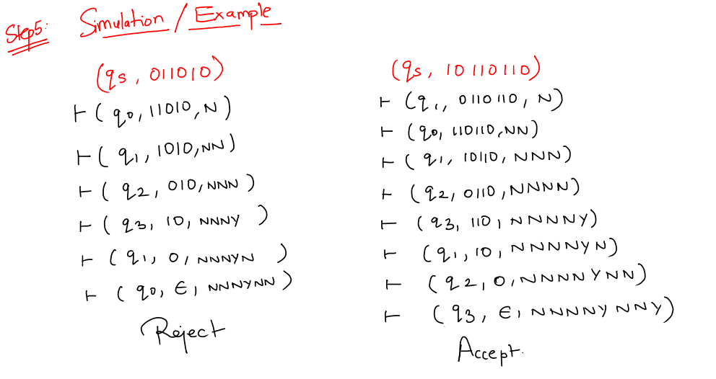
Finite State Machines – Practice Problems

Slide 31
Finite State Machines –
PROBLEM 2

Slide 32
Finite State Machines – Practice Problems

