Slide 1

FORMAL LANGUAGES AND
AUTOMATA THEORY
Lecture 2: Basics of FSM
Prepared By: Sridhar Iyer

Slide 2
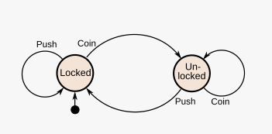
Introduction to Finite State Machines (FSM)
A finite-state machine (FSM) or finite-state automaton (FSA, plural: automata), finite automaton, or simply a state machine, is a mathematical model of computation.
It is an abstract machine that can be in exactly one of a finite number of states at any given time. The FSM can change from one state to another in response to some inputs; the change from one state to another is called a transition.
An FSM is defined by a list of its states, its initial state, and the inputs that trigger each transition.
Finite-state machines are of two types – deterministic finite-state machines and non-deterministic finite-state machines.
A system where particular inputs cause particular changes in state can be represented using finite state machines. This example describes the various states of a turnstile. Inserting a coin into a turnstile will unlock it, and after the turnstile has been pushed, it locks again. Inserting a coin into an unlocked turnstile, or pushing against a locked turnstile will not change its state.

Slide 3
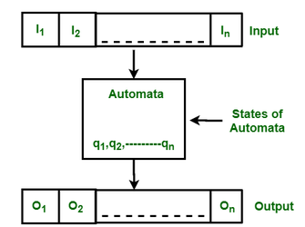
Introduction to Finite State Machines (FSM)
A finite-state machine (FSM) or finite-state automaton (FSA, plural: automata), finite automaton, or simply a state machine, is a mathematical model of computation.
It is an abstract machine that can be in exactly one of a finite number of states at any given time. The FSM can change from one state to another in response to some inputs; the change from one state to another is called a transition.
An FSM is defined by a list of its states, its initial state, and the inputs that trigger each transition.
Finite-state machines are of two types – deterministic finite-state machines and non-deterministic finite-state machines.
A system where particular inputs cause particular changes in state can be represented using finite state machines. This example describes the various states of a turnstile. Inserting a coin into a turnstile will unlock it, and after the turnstile has been pushed, it locks again. Inserting a coin into an unlocked turnstile, or pushing against a locked turnstile will not change its state.

Slide 4
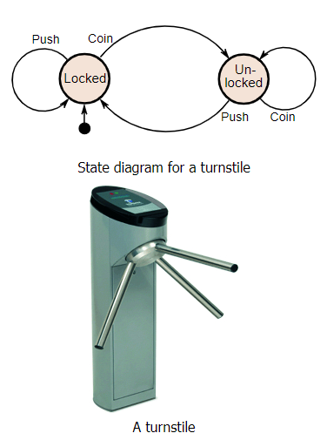
Finite State Machines – Example
An example of a simple mechanism that can be modeled by a state machine is a turnstile. Initially the arms are locked, blocking the entry, preventing patrons from passing through.
Depositing a coin or token in a slot on the turnstile unlocks the arms, allowing a single customer to push through. After the customer passes through, the arms are locked again until another coin is inserted.
Considered as a state machine, the turnstile has two possible states: Locked and Unlocked.
There are two possible inputs that affect its state: putting a coin in the slot (coin) and pushing the arm (push).
In the locked state, pushing on the arm has no effect; no matter how many times the input push is given, it stays in the locked state. Putting a coin in – that is, giving the machine a coin input – shifts the state from Locked to Unlocked.
In the unlocked state, putting additional coins in has no effect; that is, giving additional coin inputs does not change the state. However, a customer pushing through the arms, giving a push input, shifts the state back to Locked.

Slide 5
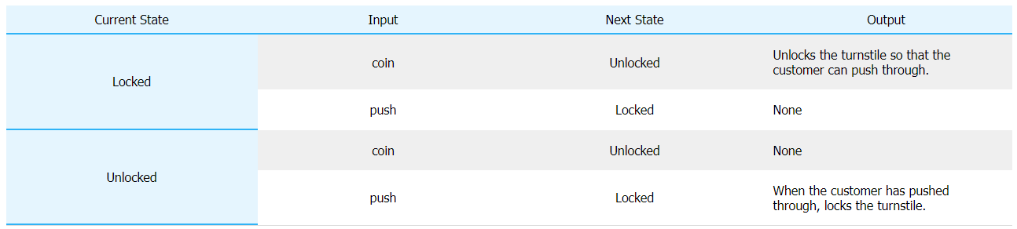
Finite State Machines – Example
The turnstile state machine can be represented by a state-transition table, showing for each possible state, the transitions between them (based upon the inputs given to the machine) and the outputs resulting from each input:
The turnstile state machine can also be represented by a directed graph called a state diagram (LEFT). Each state is represented by a node (circle). Edges (arrows) show the transitions from one state to another. Each arrow is labeled with the input that triggers that transition. An input that doesn't cause a change of state (such as a coin input in the Unlocked state) is represented by a circular arrow returning to the original state. The arrow into the Locked node from the black dot indicates it is the initial state.

Slide 6
Finite State Machines – Types
There are two types of finite state machines (FSMs):
  Deterministic Finite State machines, often called deterministic finite automata, and
  Non-Deterministic Finite State Machines, often called non-deterministic finite automata.
By definition, deterministic finite automata recognize, or accept, regular languages, and a language is regular if a deterministic finite automaton accepts it.
FSMs are usually taught using languages made up of binary strings that follow a particular pattern. Both regular and non-regular languages can be made out of binary strings.
An example of a binary string language is: the language of all strings that have a 0 as the first character. In this language, 001, 010, 0, and 01111 are valid strings (along with many others), but strings like 111, 10000, 1, and 11001100 (along with many others) are not in this language.

Slide 7
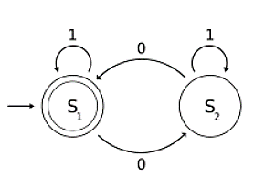
Finite State Machines – Deterministic Finite Automata
A deterministic finite automaton (DFA) is described by a five-element tuple: (Q,Σ,δ,q0,F)
  Q = a finite set of states
  Σ = a finite, nonempty input alphabet
  δ = a series of transition functions
  q0 = the starting state
  F = the set of accepting states
There must be exactly one transition function for every input symbol in Σ from each state
DFAs can be represented by diagrams of this form:

Slide 8
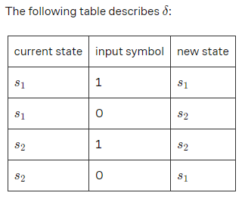
Finite State Machines – Deterministic Finite Automata
Write a description of the DFA shown. Describe in words what it does.
Q={s 1,s 2}
Σ={0,1}
q0​=s1​
F=s1
This DFA recognizes all strings that have an even number of 0’s (and any number of 1’s). This means that if you run any input string that has an even number of 0’s, the string will finish in the accepting state. If you run a string with an odd number of 0’s, the string will finish in s2, which is not an accepting state.

Slide 9
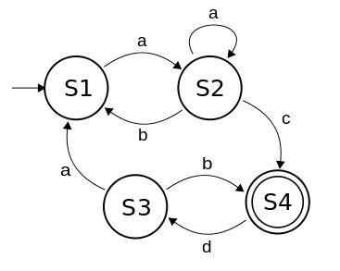
Finite State Machines – Deterministic Finite Automata
Q.1 What string cannot be generated by the finite state machine below?
Q.2 Draw a diagram for a DFA that recognizes the following language: The language of all strings that end with a 1.
1) abacdaac
2) abac
3) aaaaac
4) aaaacd

Slide 10
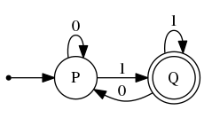
Finite State Machines – Deterministic Finite Automata
Q.1 What string cannot be generated by the finite state machine below?
Q.2 Draw a diagram for a DFA that recognizes the following language: The language of all strings that end with a 1.
Correct Answer
1) abacdaac
2) abac
3) aaaaac
4) aaaacd

Slide 11
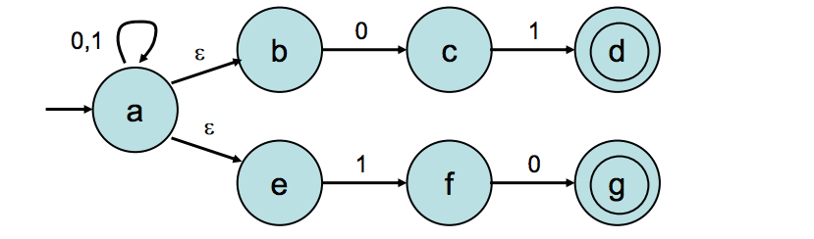
Finite State Machines – Non Deterministic Finite Automata
A Non deterministic finite automaton (NFA) is described by a five-element tuple: (Q,Σ,δ,q0,F)
  Q = a finite set of states
  Σ = a finite, nonempty input alphabet
  δ = a series of transition functions
  q0 = the starting state
  F = the set of accepting states
Unlike DFAs, NFAs are not required to have transition functions for every symbol in Σ and there can be multiple transition functions in the same state for the same symbol. Additionally, NDFAs can use null transitions, which are indicated by ϵ. Null transitions allow the machine to jump from one state to another without having to read a symbol.
An NFA accepts a string x if there exists a path that is compatible with that string that ends in an accept state.

Slide 12
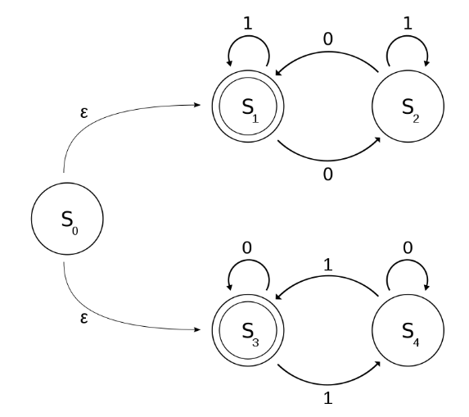
Finite State Machines – Deterministic Finite Automata
Q.1 What string cannot be generated by the finite state machine below?
Q.2 Draw a diagram for the NFA that describes the following language: The language of all strings that end with a 1.
a) 1
b) 01001
c) 1011101
d) 1000
e) 0

Slide 13
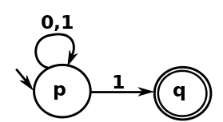
Finite State Machines – Deterministic Finite Automata
Q.1 What string cannot be generated by the finite state machine below?
Q.2 Draw a diagram for the NFA that describes the following language: The language of all strings that end with a 1.
a) 1
b) 01001
c) 1011101
d) 1000
e) 0
Correct Answer

Slide 14
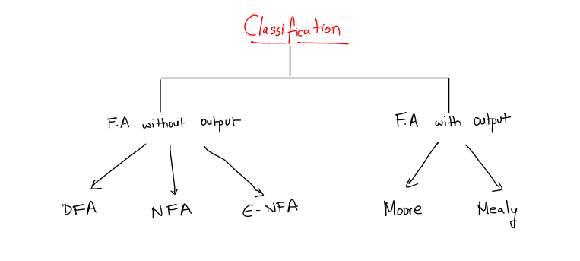
Finite State Machines – Classification

Slide 15
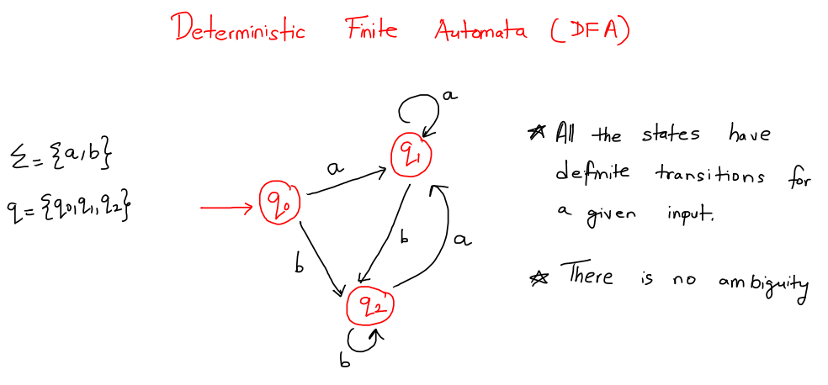
Finite State Machines – Classification

Slide 16
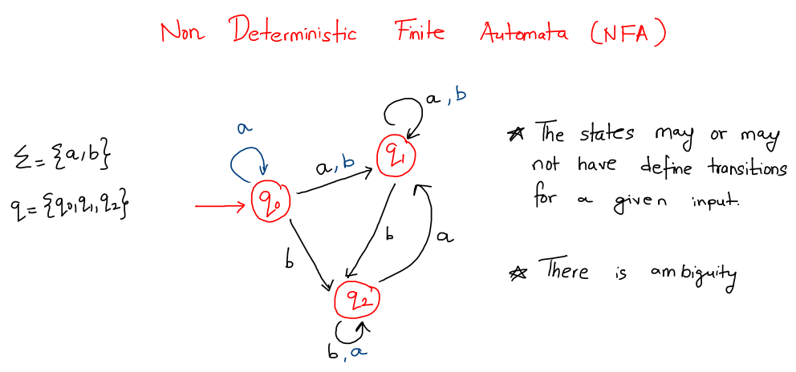
Finite State Machines – Classification

Slide 17
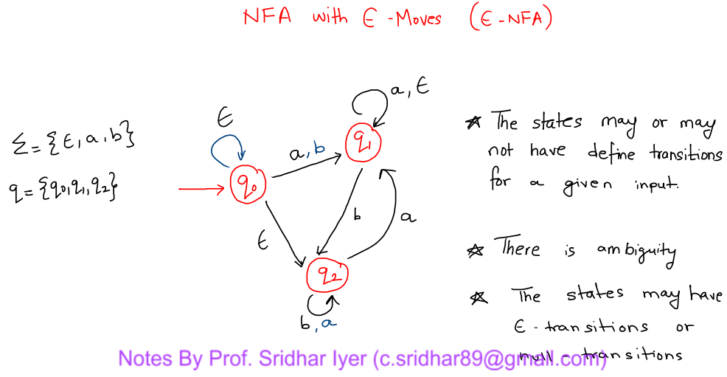
Finite State Machines – Classification

