Slide 1

FORMAL LANGUAGES AND
AUTOMATA THEORY
Lecture 12:
FA with Outputs
(Moore Machines and Conversions )
Prepared By: Sridhar Iyer

Slide 2
Introduction

Slide 3
Finite automata may have outputs corresponding to each transition. There are two types of finite state machines that generate output −
Mealy Machine
Moore machine

Slide 4
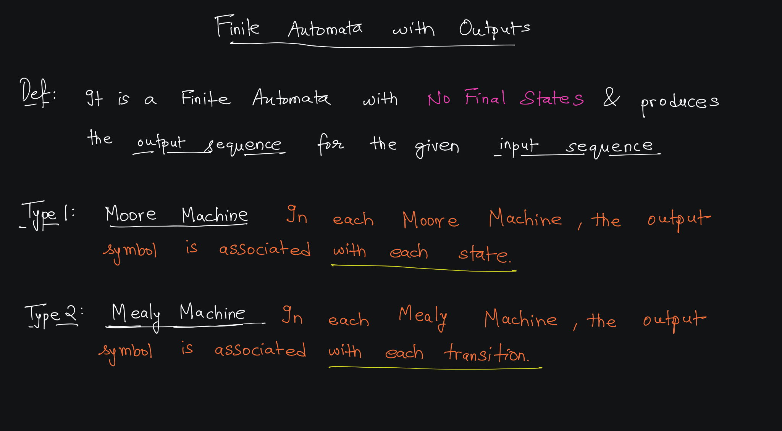

Slide 5
Mealy Machine

Slide 6
Mealy Machine:
A Mealy Machine is an FSM whose output depends on the present state as well as the present input.
It can be described by a 6 tuple (Q, ∑, O, δ, X, q₀) where −
  Q is a finite set of states.
  ∑ is a finite set of symbols called the input alphabet.
  O is a finite set of symbols called the output alphabet.
  δ is the input transition function where δ: Q × ∑ → Q
  X is the output transition function where X: Q × ∑ → O
  q₀ is the initial state from where any input is processed (q₀ ∈ Q).

Slide 7
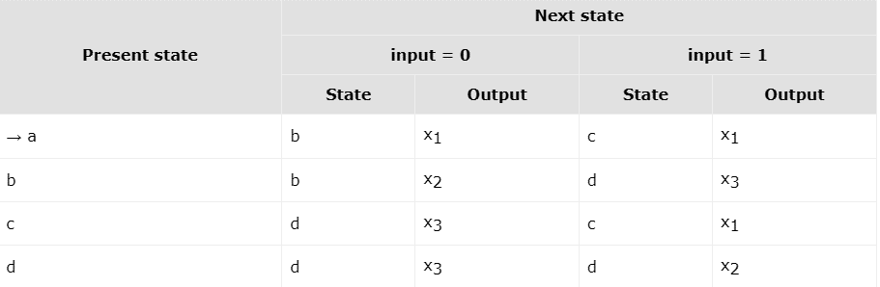
The state transition table of a Mealy Machine is shown below −

Slide 8
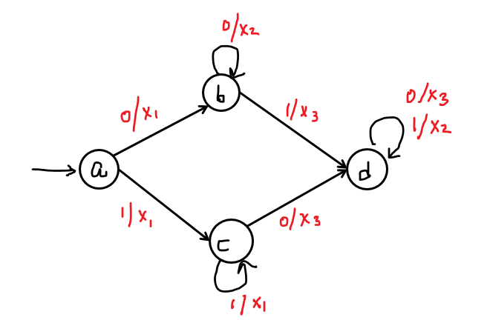
The state diagram of the Mealy Machine is −

Slide 9
Example 1
Mealy Machines

Slide 10

(Q, ∑, O, δ, X, q₀)
∑ = { 0, 1}
  δ = Q × ∑ → Q
  qo = {qo}
  Q = { ………. }
O = { X,Y}
  X = Q × ∑ → O

Slide 11
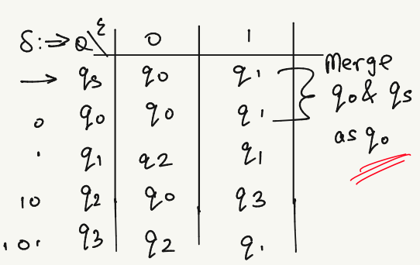
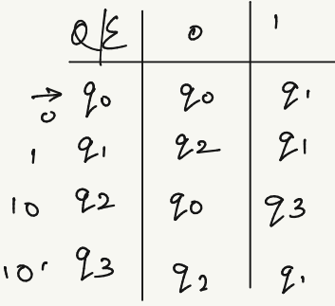

Slide 12
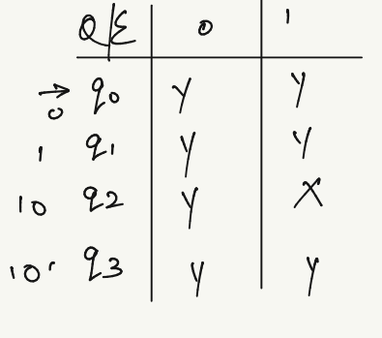

Slide 13
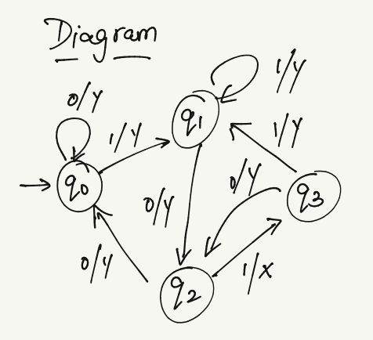

Slide 15
Example 2

Slide 16



Slide 17
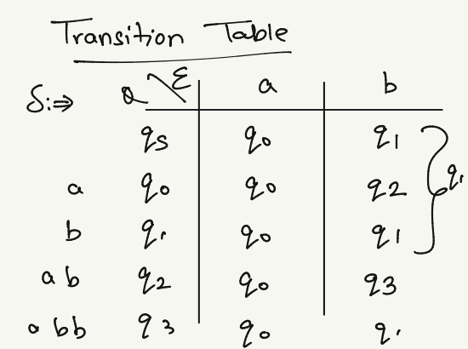
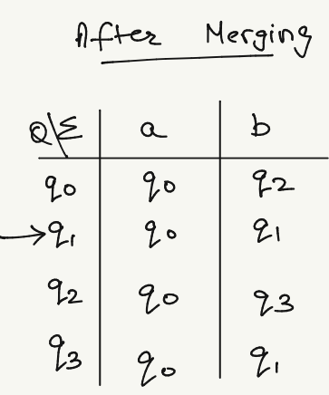

Slide 18
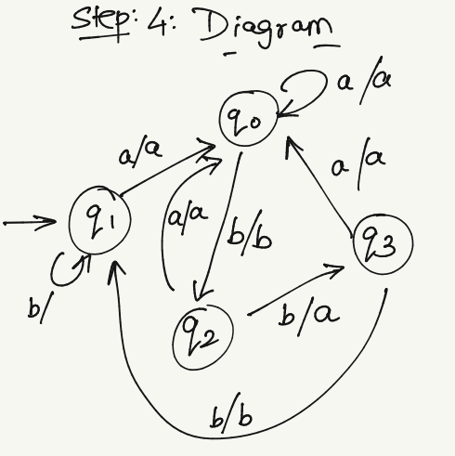
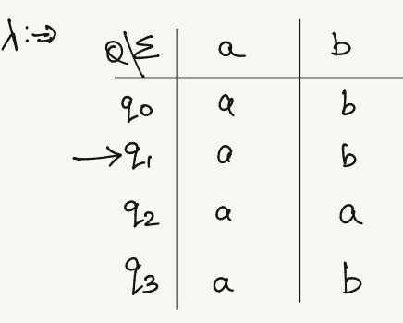

Slide 19
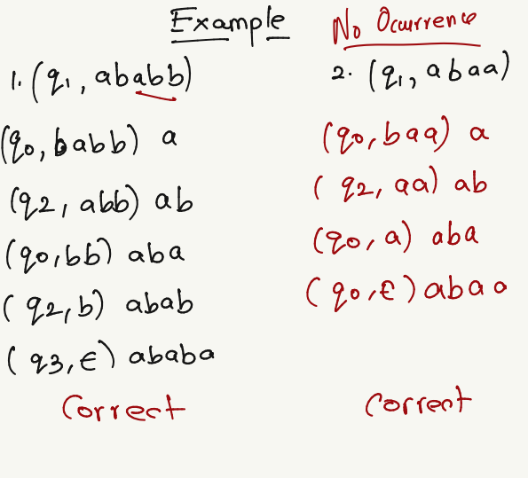

Slide 20
Example 3

Slide 21
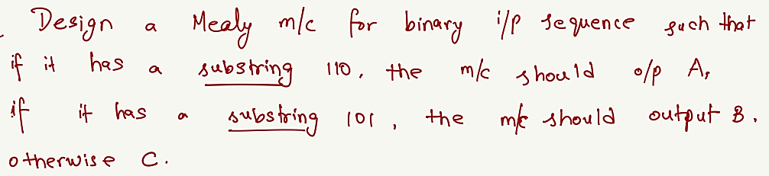

Slide 22
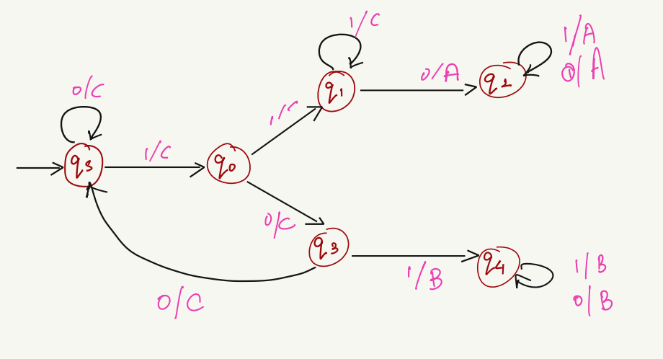


Slide 24
Moore Machine

Slide 25
Moore Machine:
Moore machine is an FSM whose outputs depend on only the present state.
A Moore machine can be described by a 6 tuple (Q, ∑, O, δ, X, q₀) where −
  Q is a finite set of states.
  ∑ is a finite set of symbols called the input alphabet.
  O is a finite set of symbols called the output alphabet.
  δ is the input transition function where δ: Q × ∑ → Q
  X is the output transition function where X: Q → O
  q₀ is the initial state from where any input is processed (q₀ ∈ Q).

Slide 26
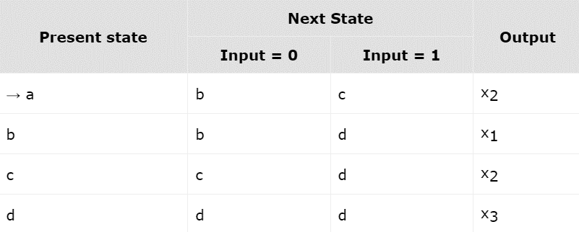
The state transition table of a Moore Machine is shown below −

Slide 27
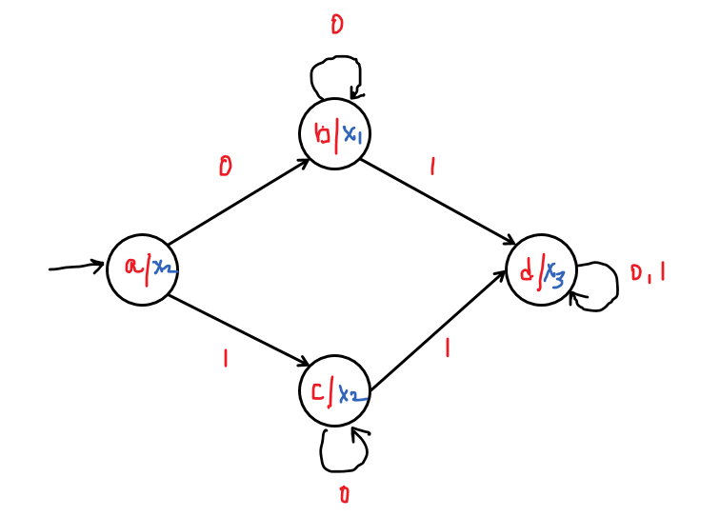
The state diagram of the Moore Machine is −

Slide 28
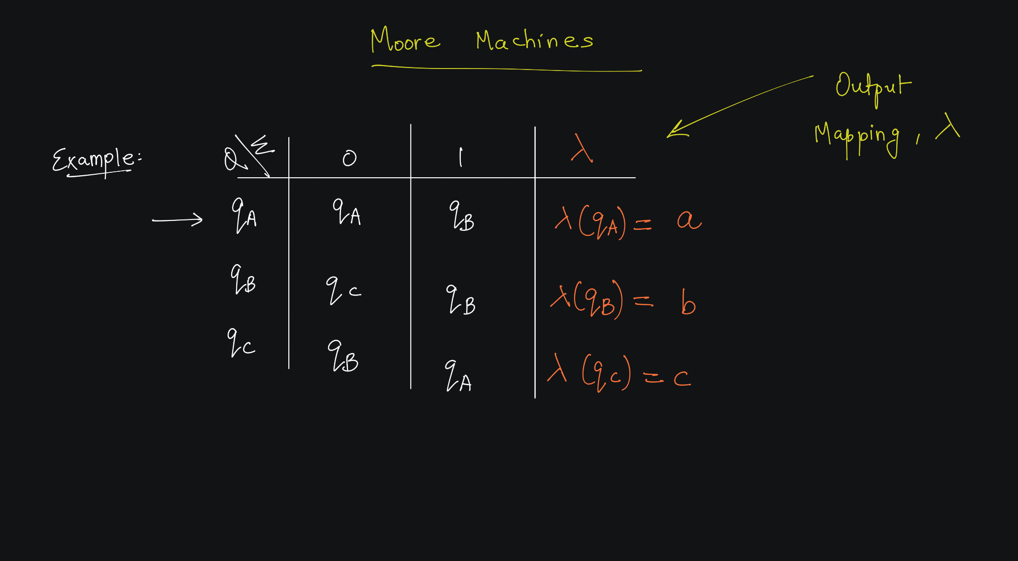

Slide 29
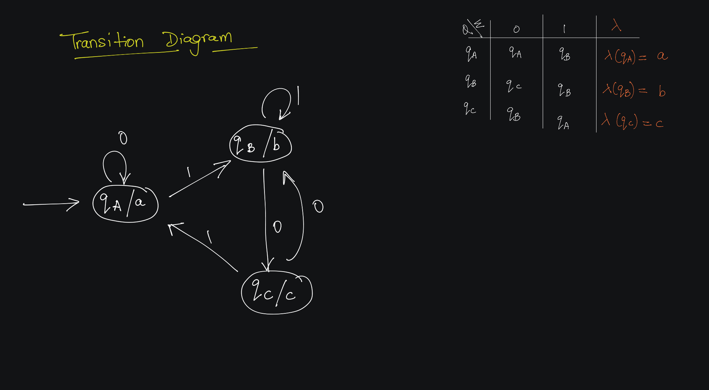

Slide 30
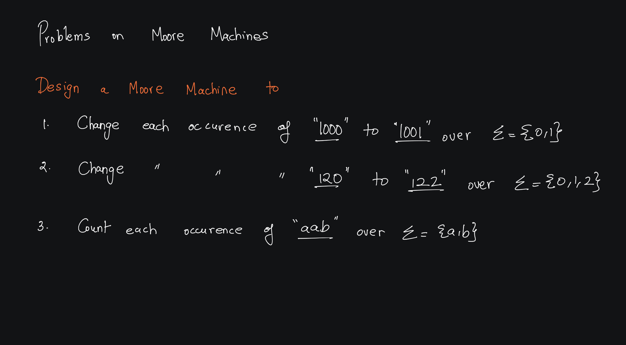

Slide 31
Example 1
Moore Machines

Slide 32
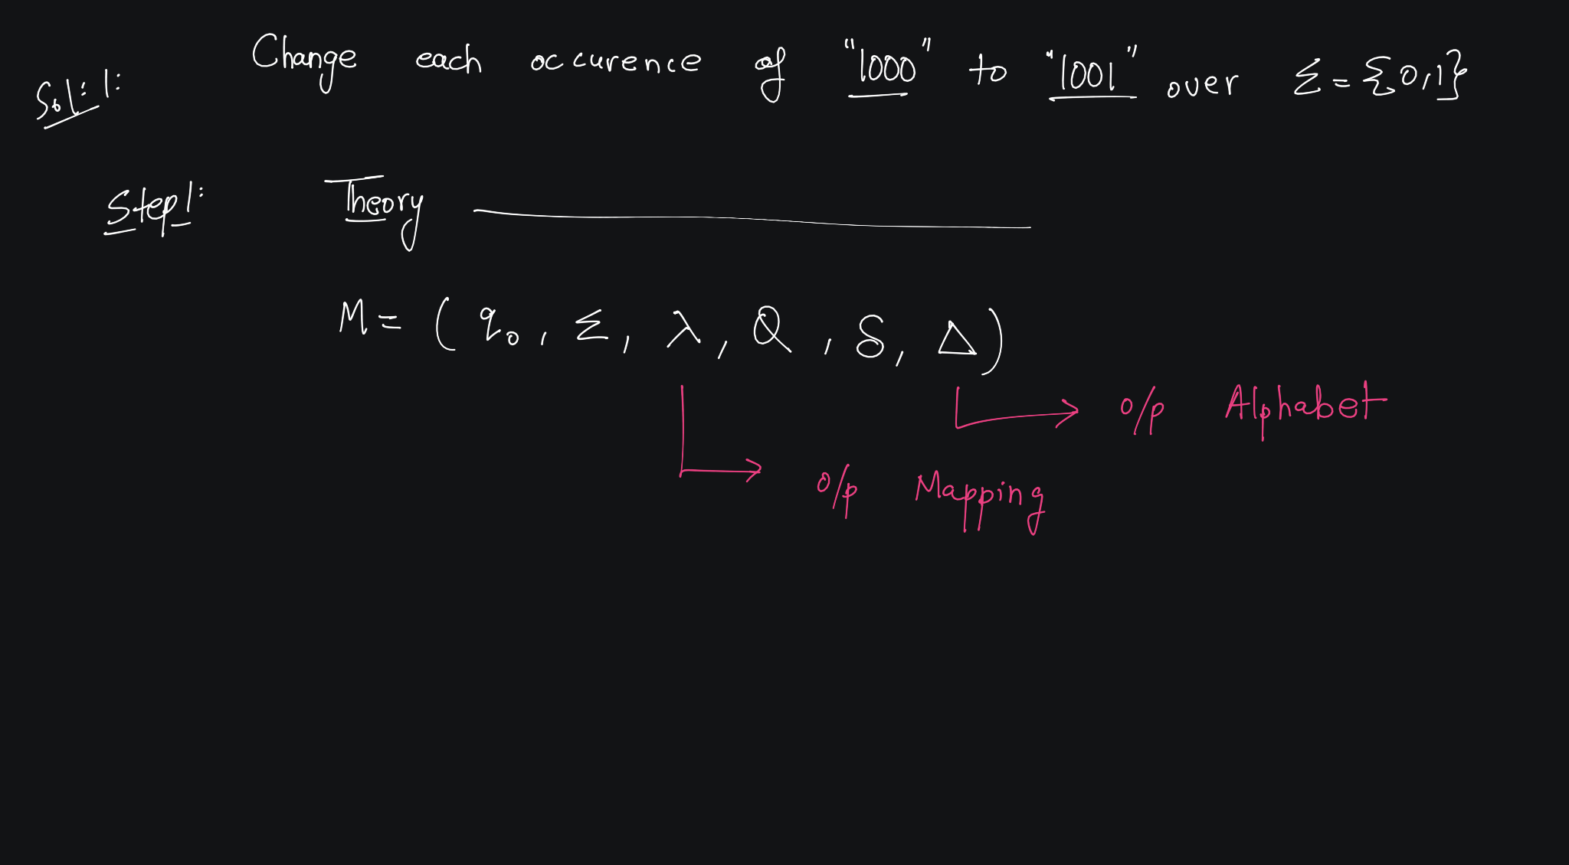


Slide 33
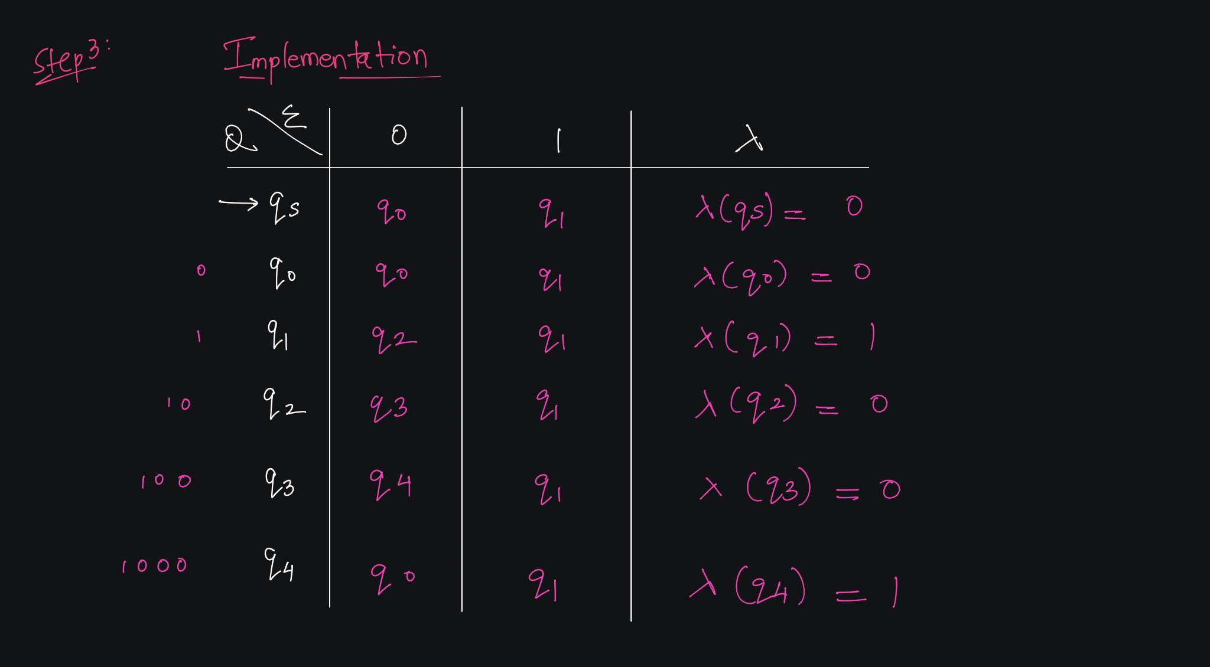

Slide 34
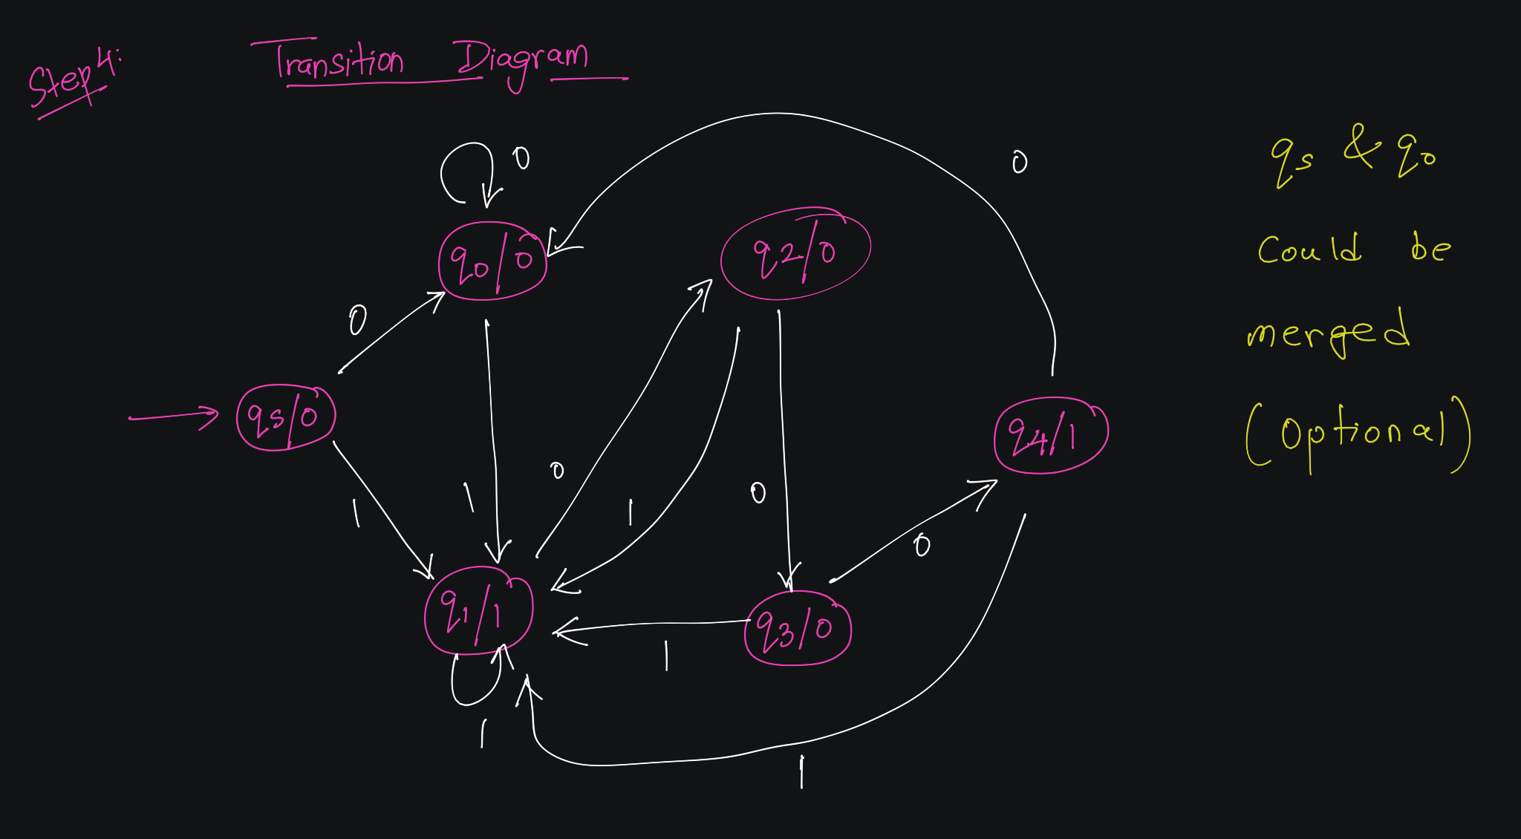

Slide 35
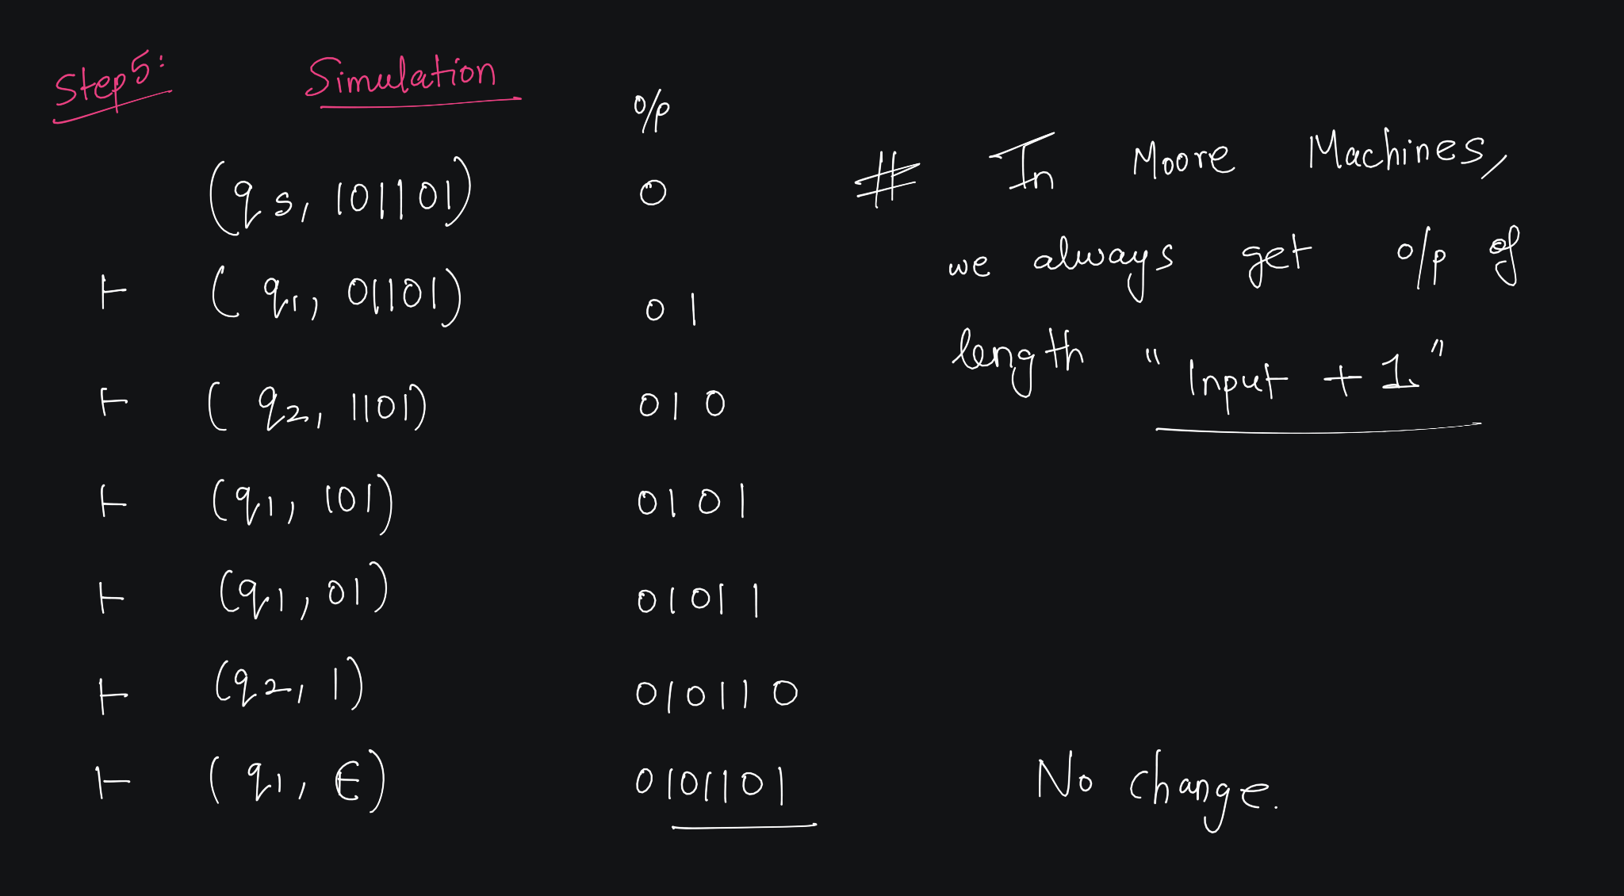

Slide 36
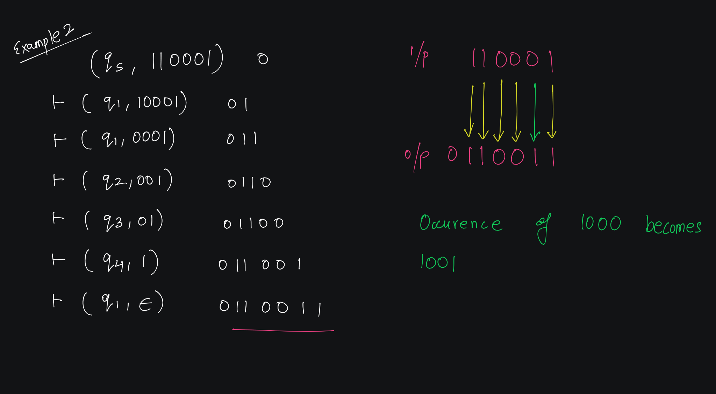

Slide 37
Example 2

Slide 38
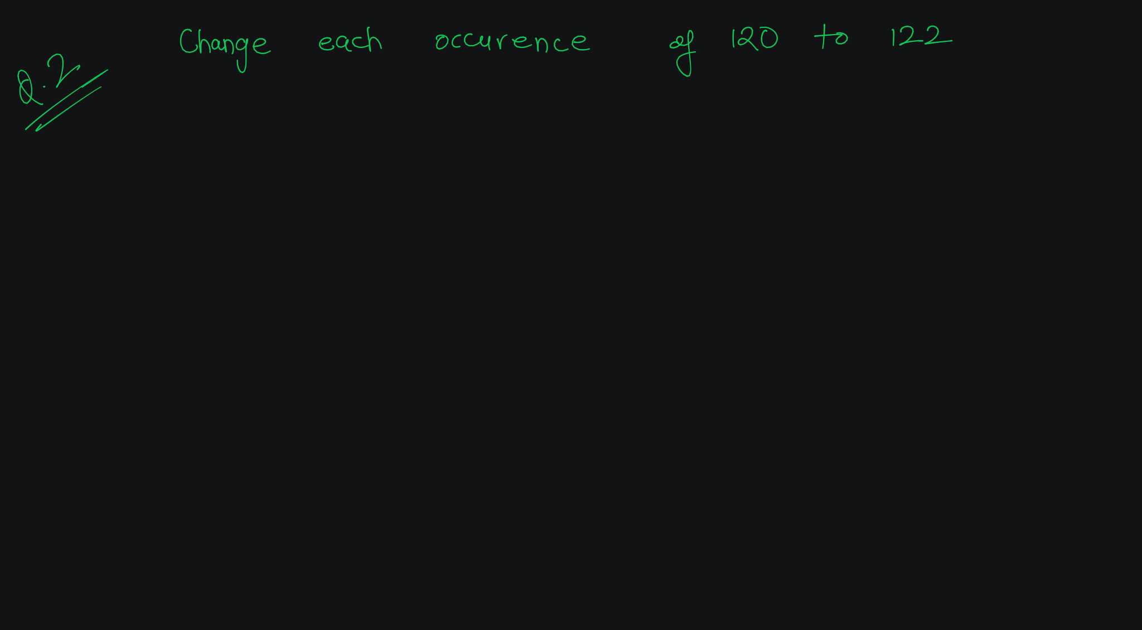

Slide 39
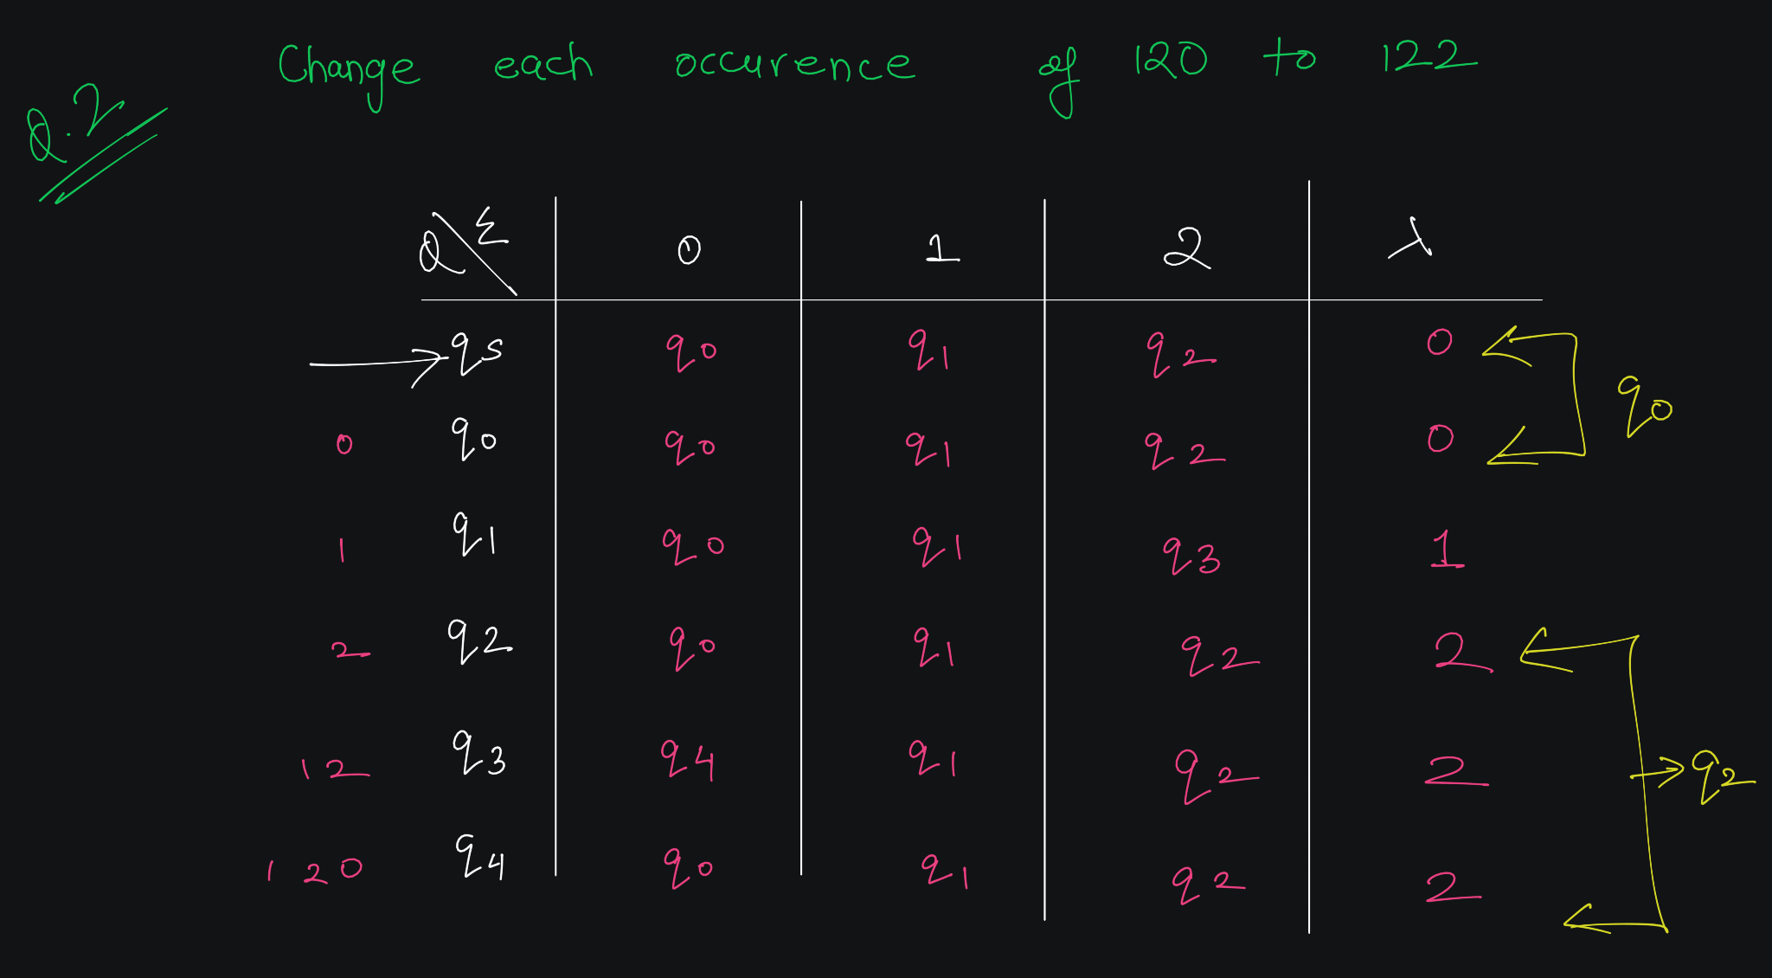

Slide 40
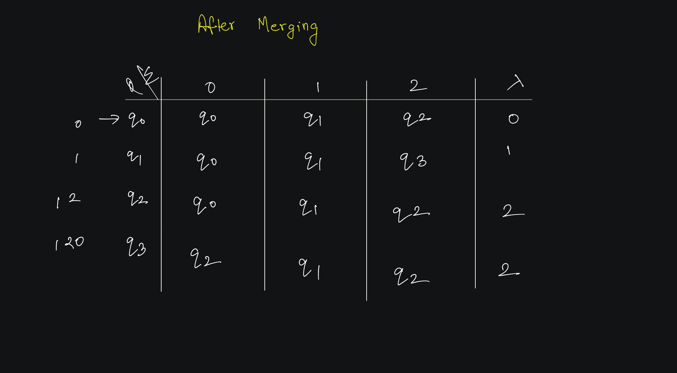

Slide 41
Example 3

Slide 42
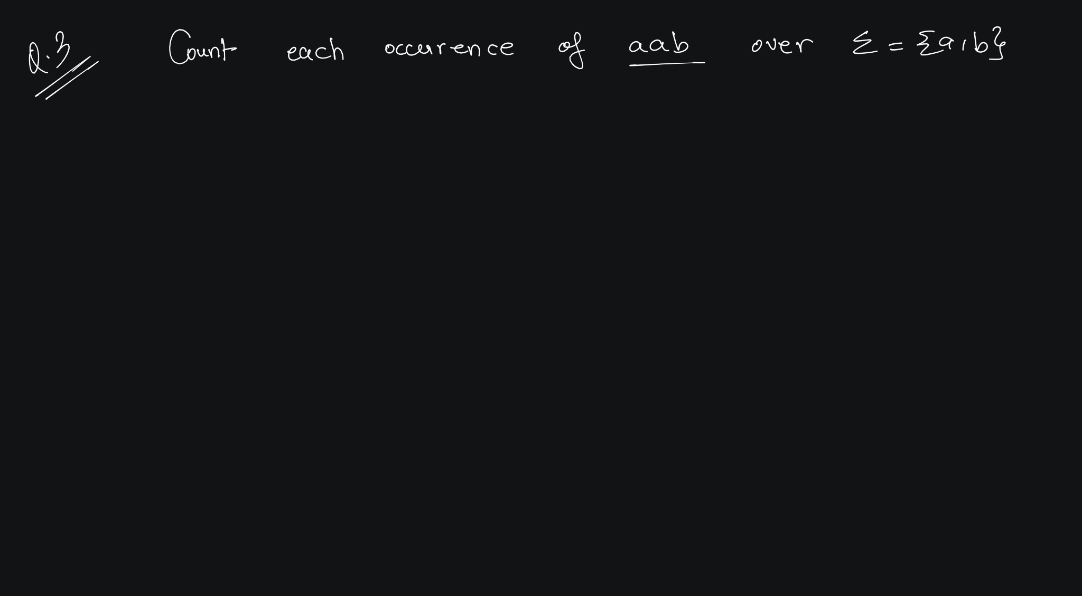

Slide 43
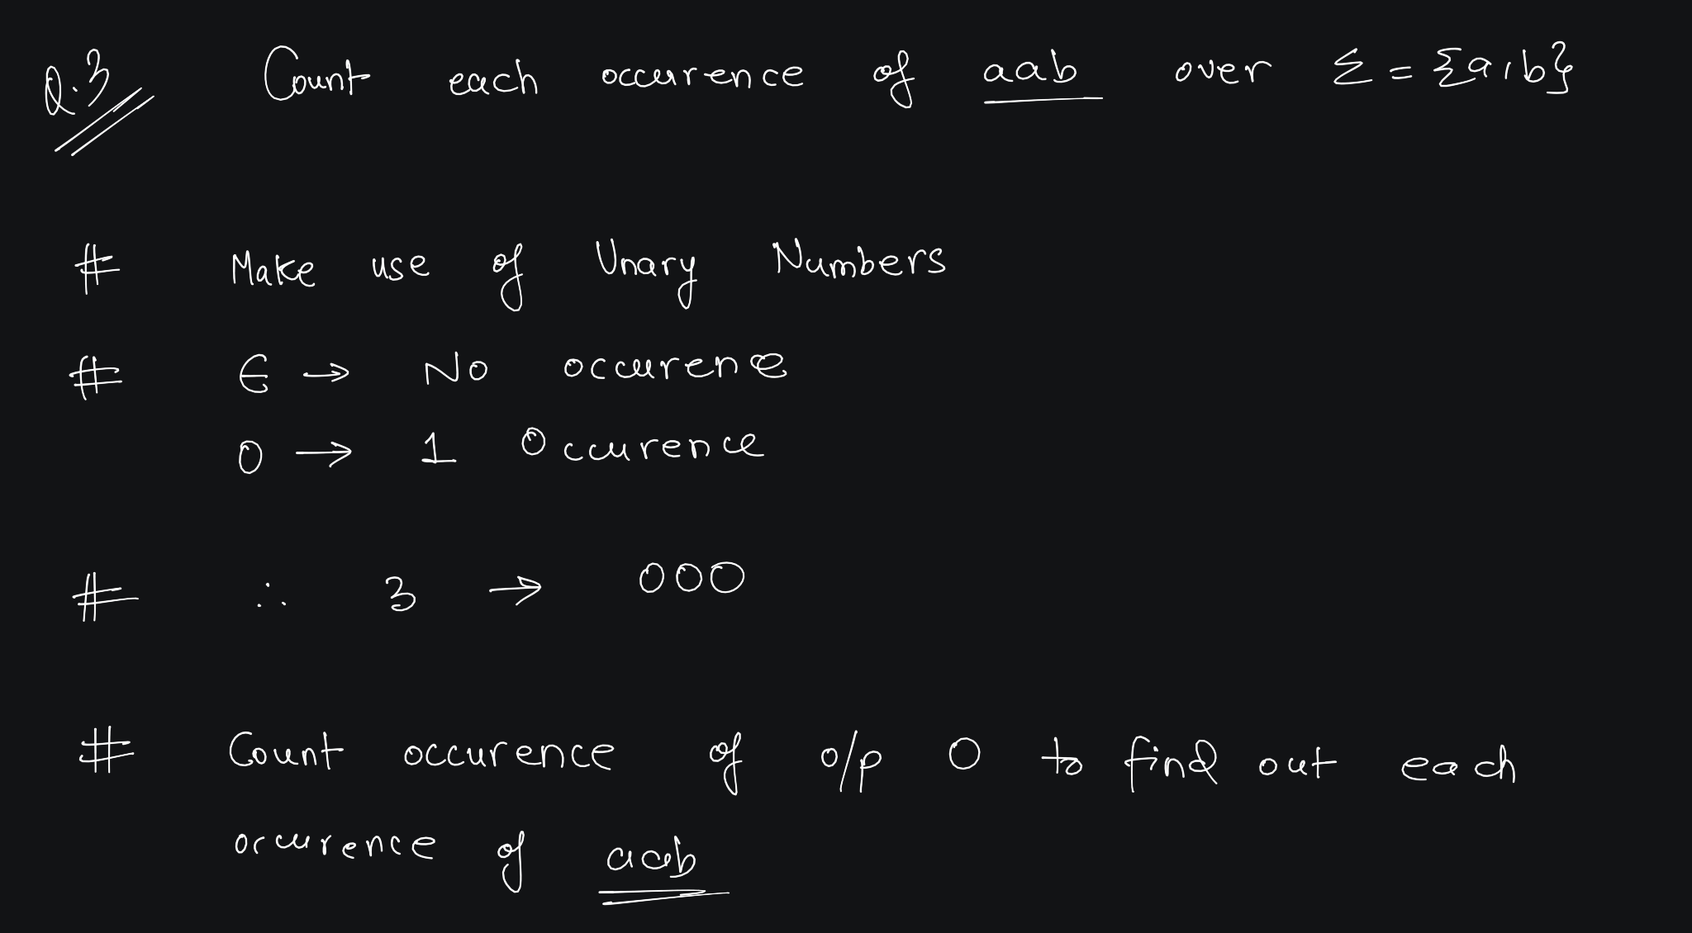

Slide 44
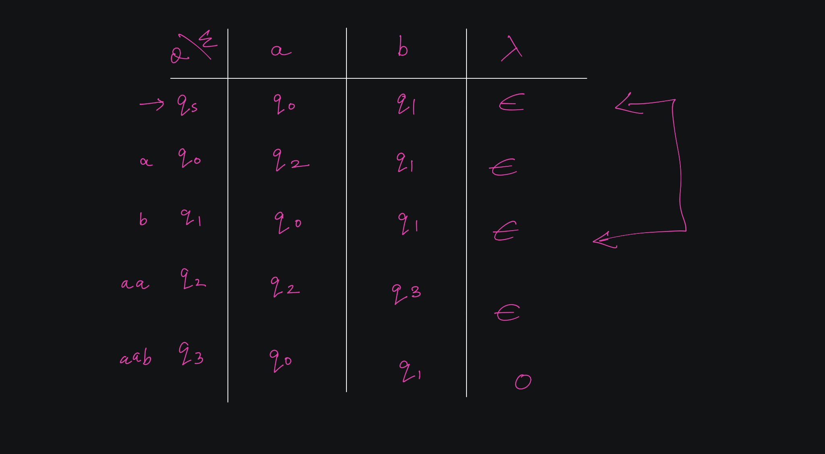

Slide 45
Mealy vs Moore Machine

Slide 46
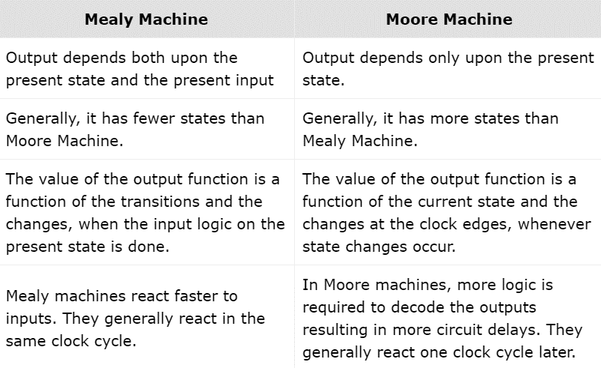
Mealy Machine vs. Moore Machine
The following table highlights the points that differentiate a Mealy Machine from a Moore Machine

Slide 47
Conversion From Mealy Machine to Moore Machines

Slide 48
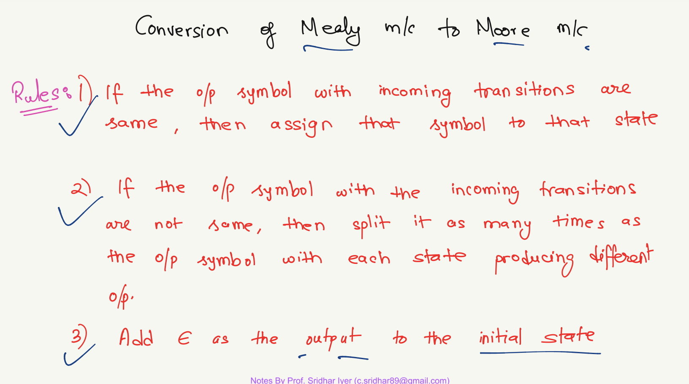

Slide 49
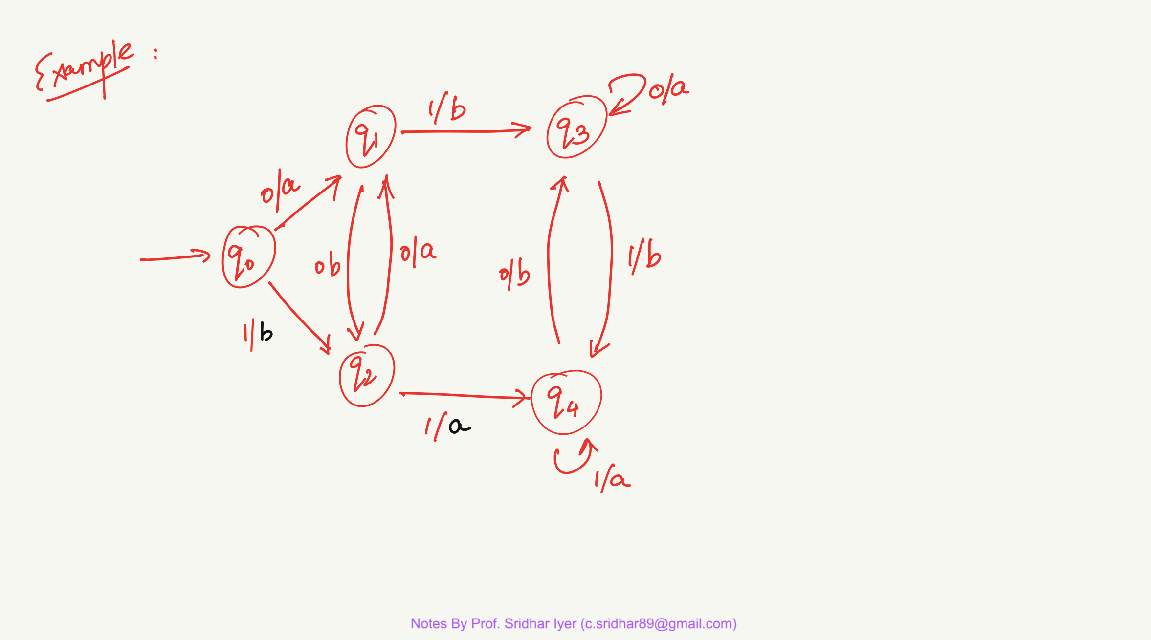

Slide 51
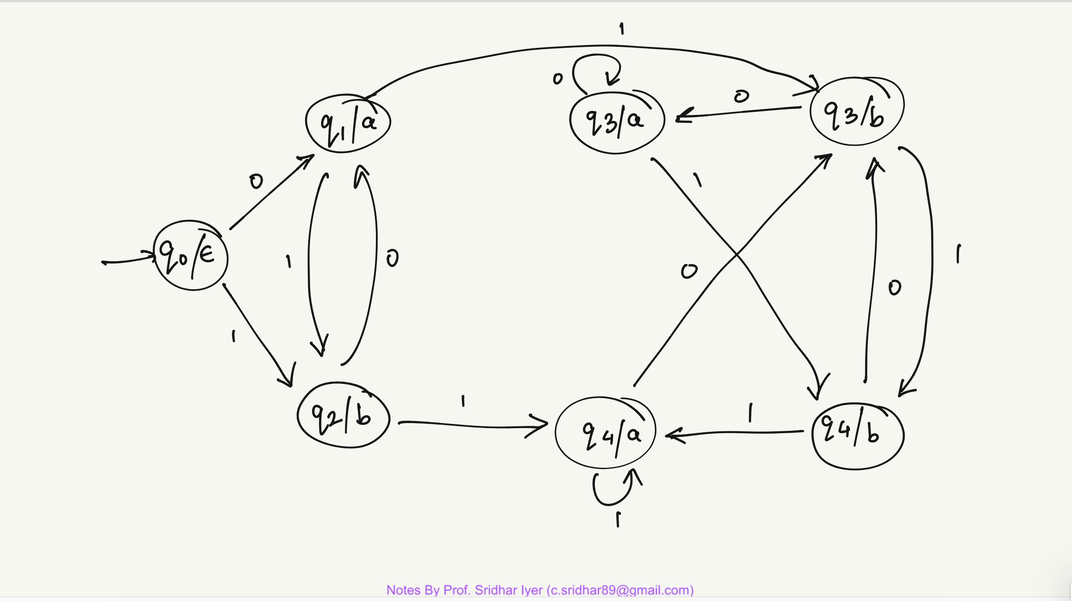

Slide 52
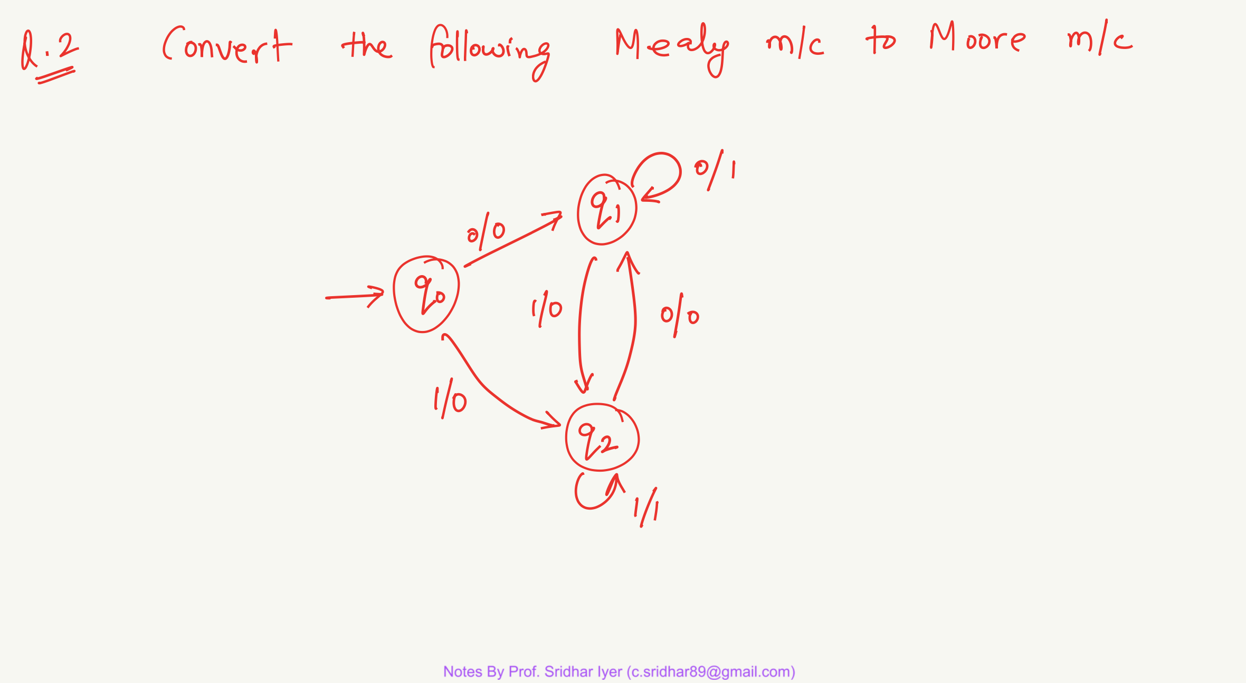

Slide 54
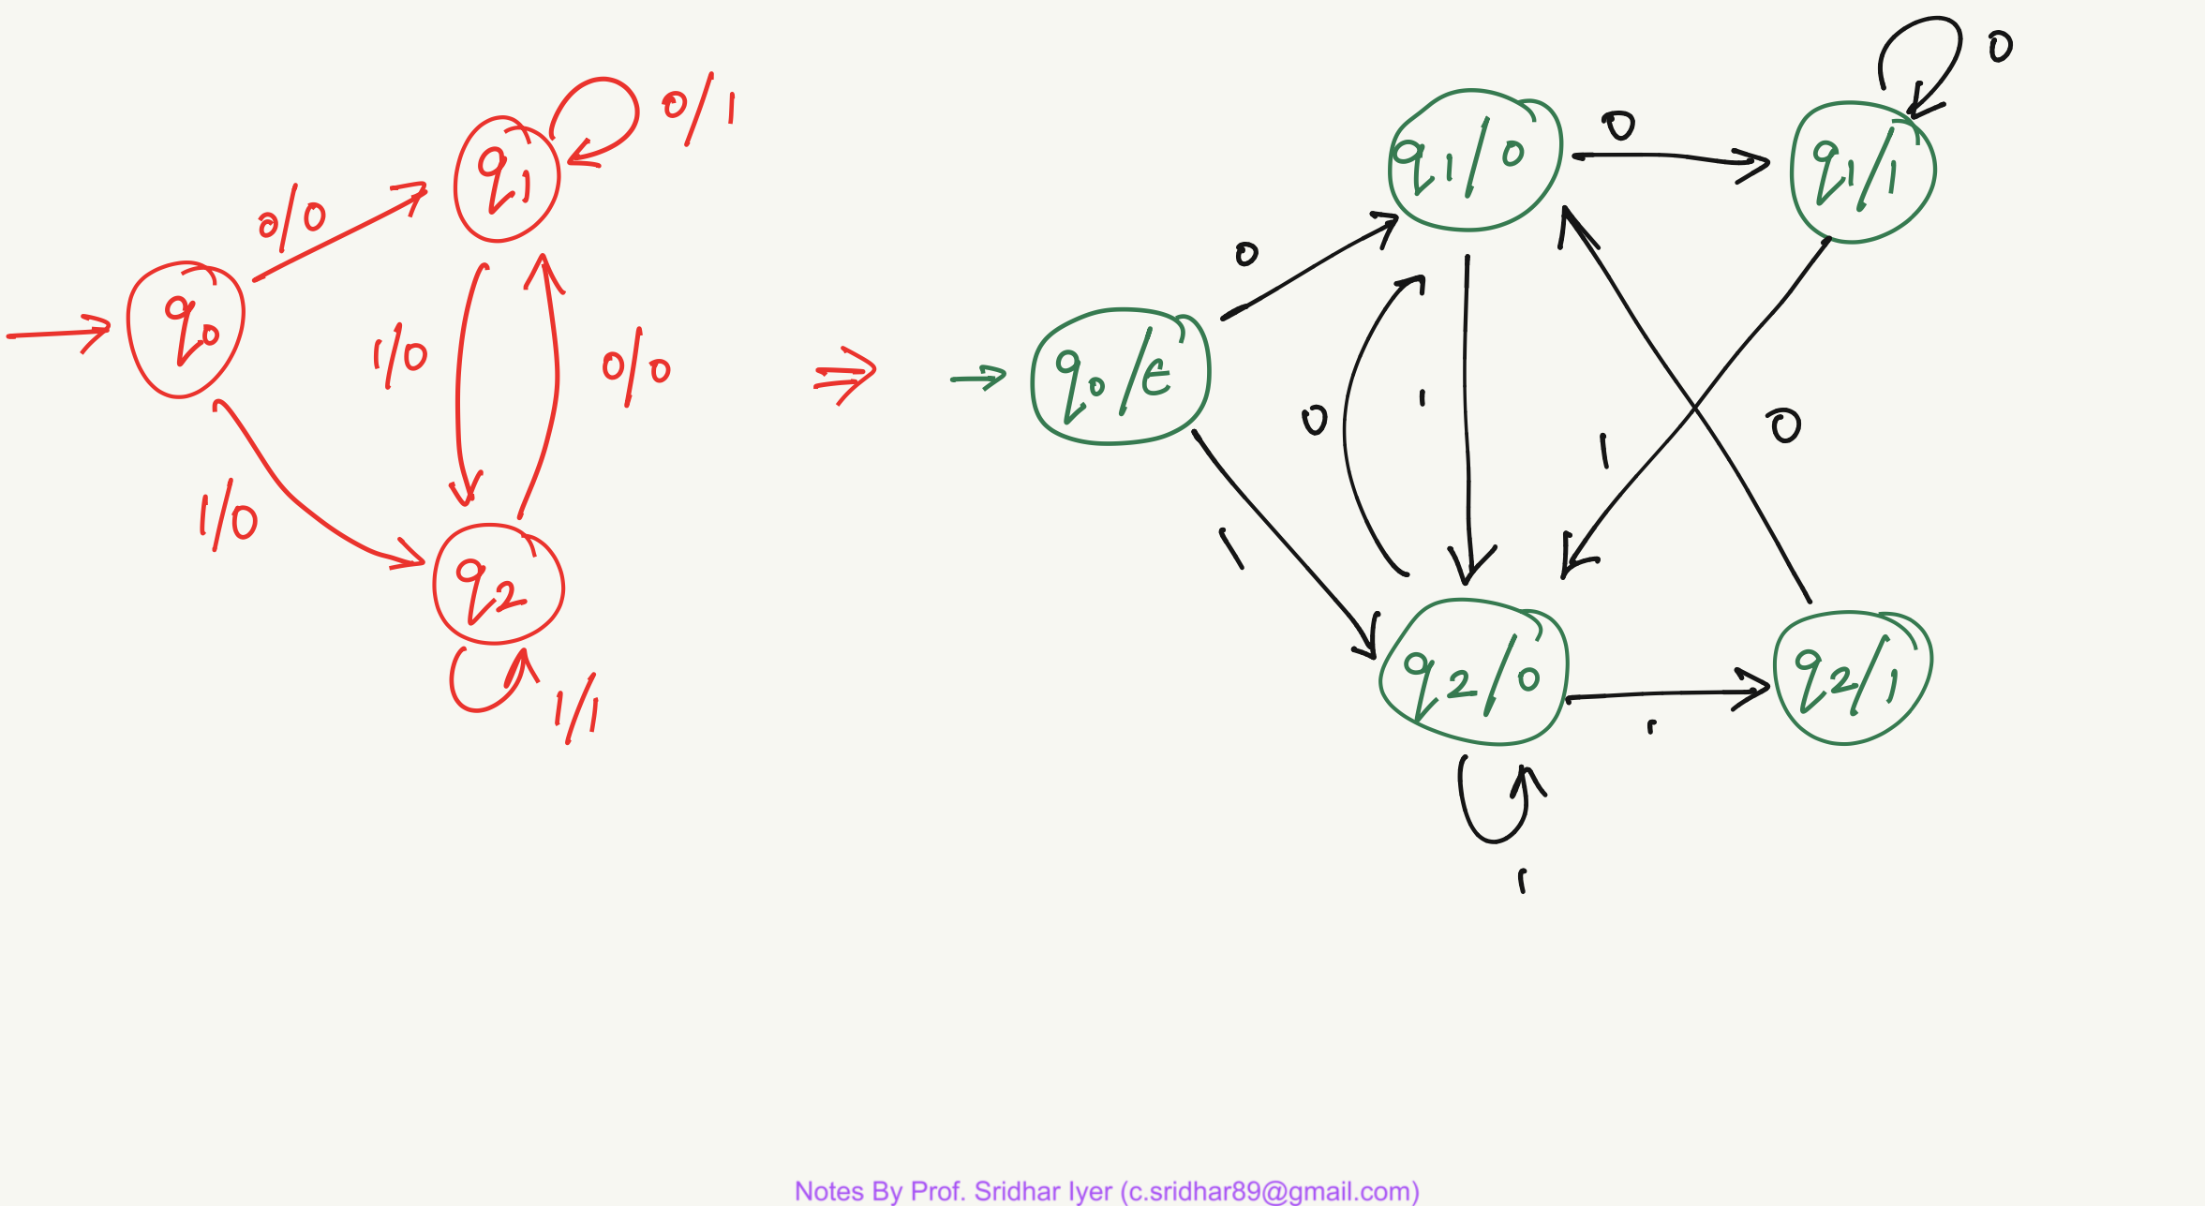

Slide 55
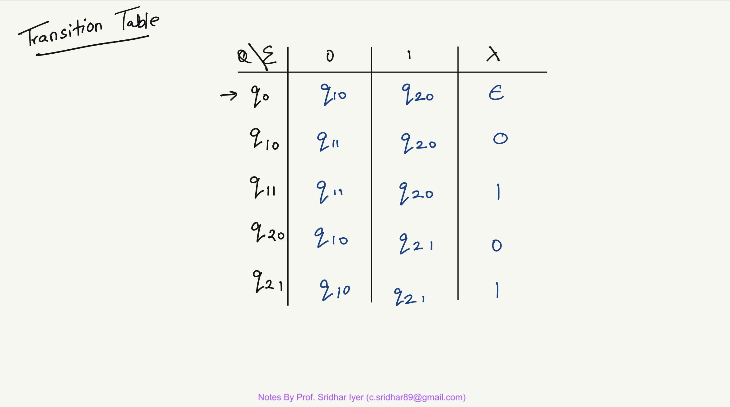

Slide 56
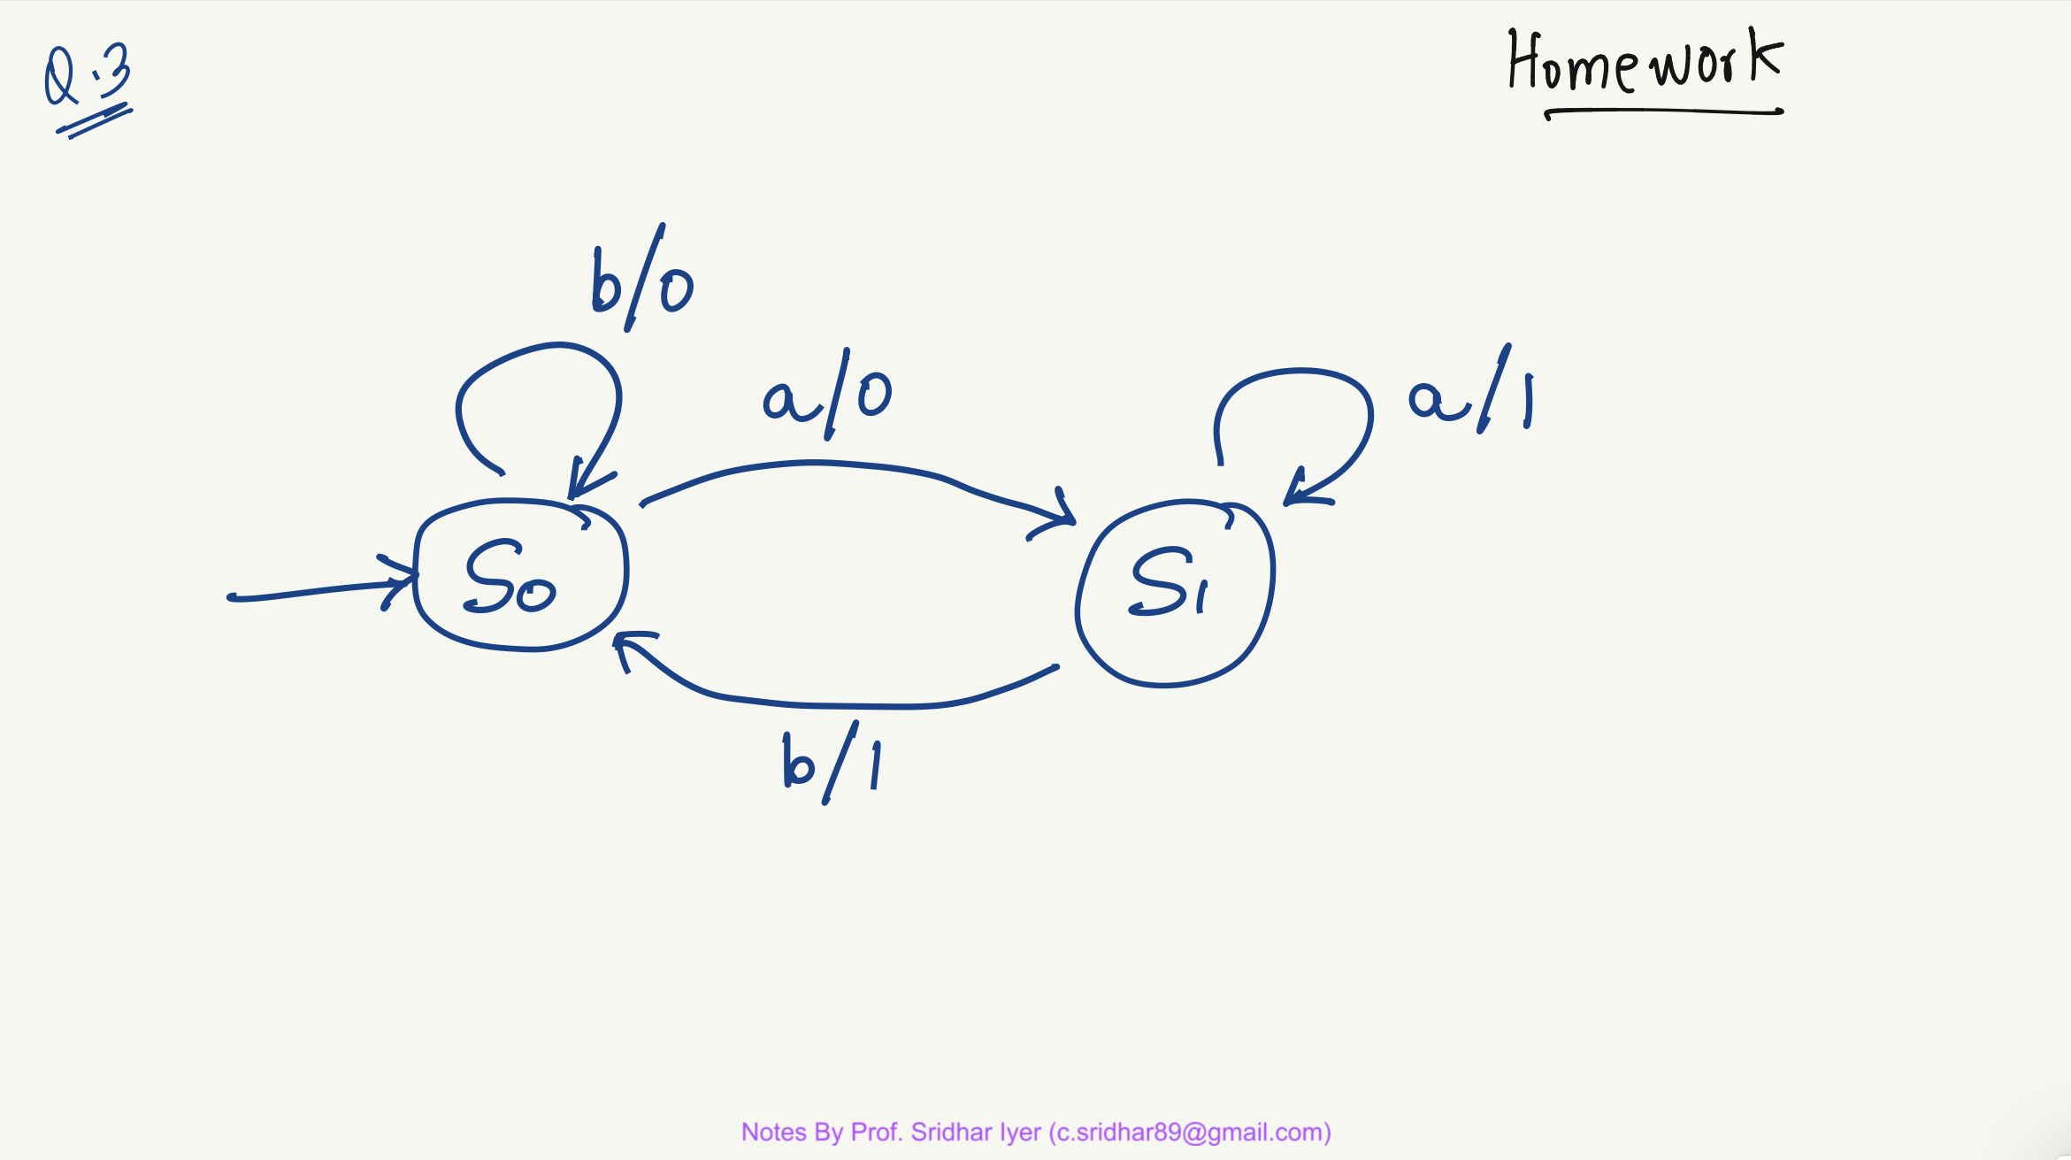

Slide 58
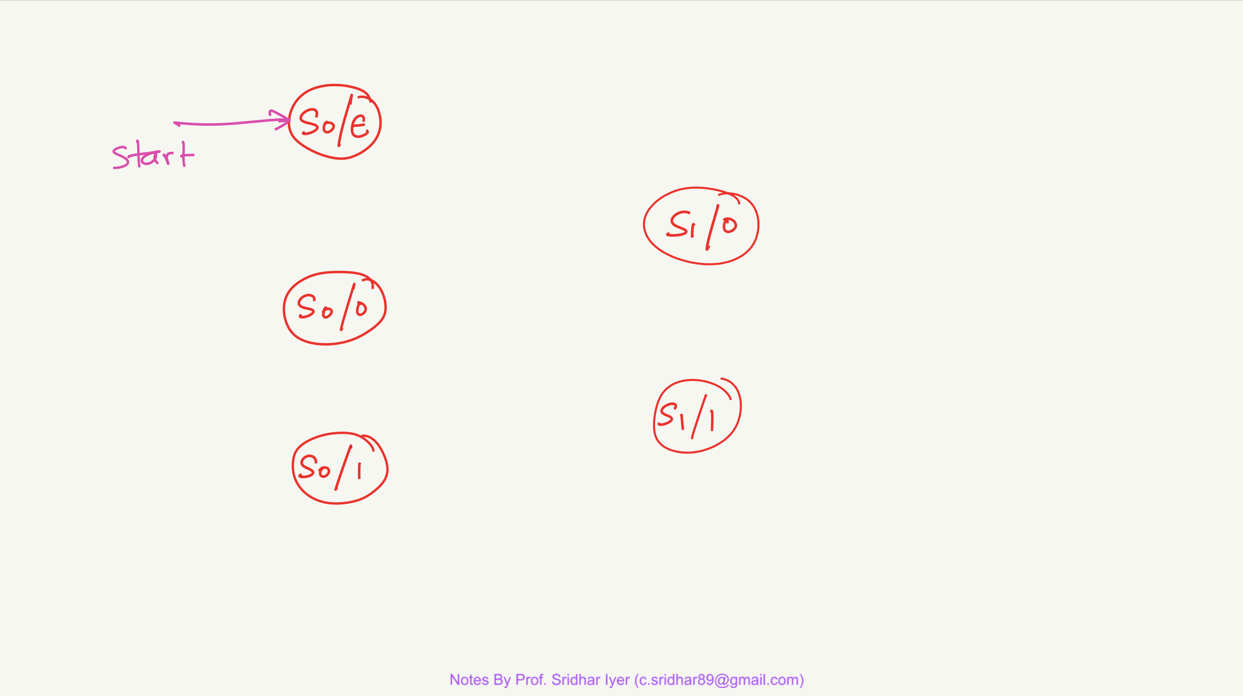

Slide 59
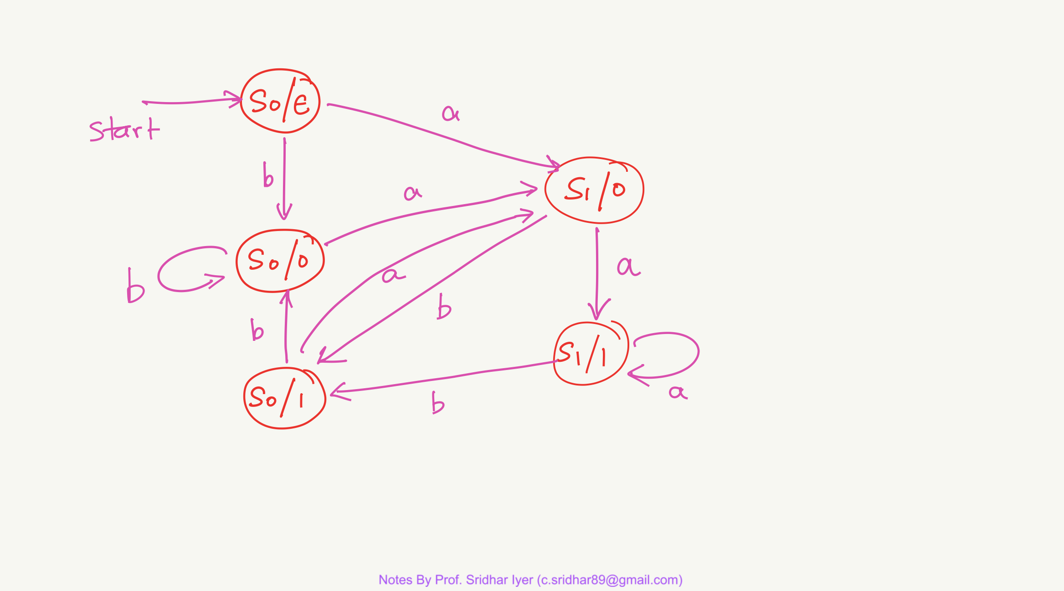

Slide 60
Conversion From Moore Machine to Mealy Machines

Slide 61
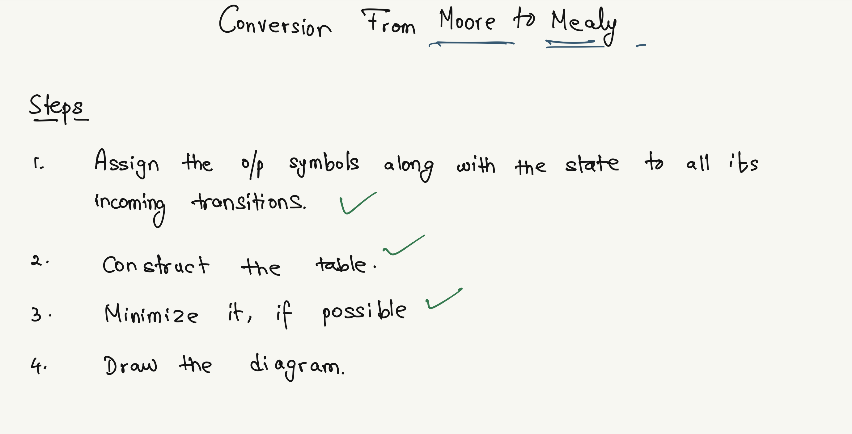

Slide 62
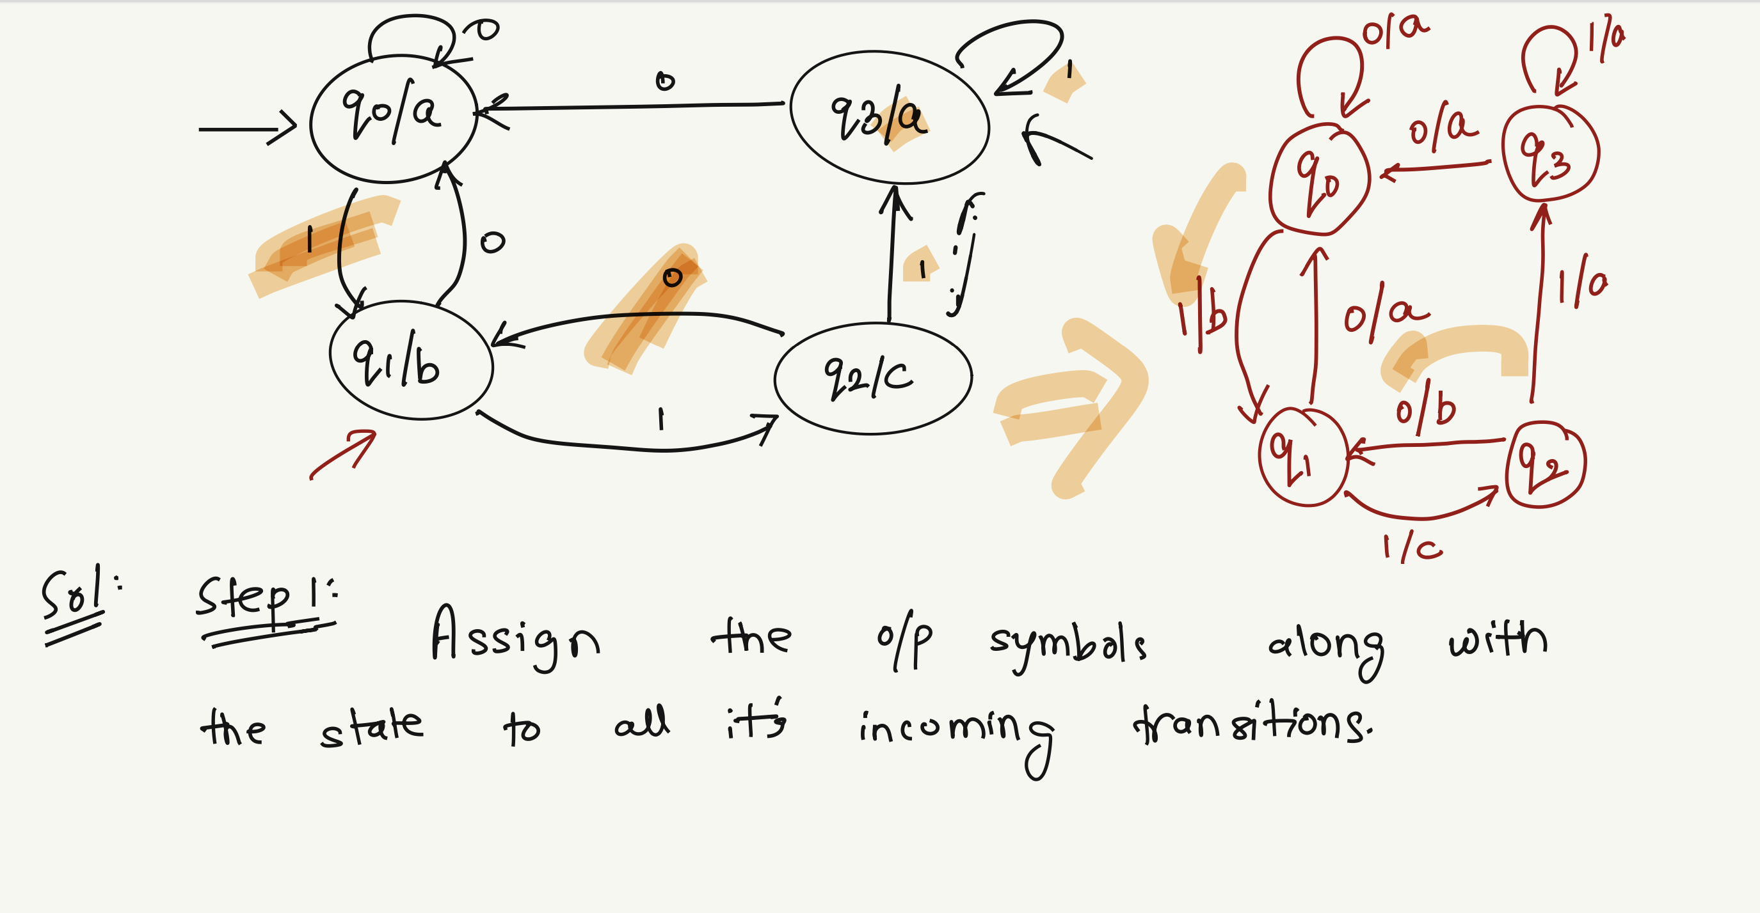

Slide 63
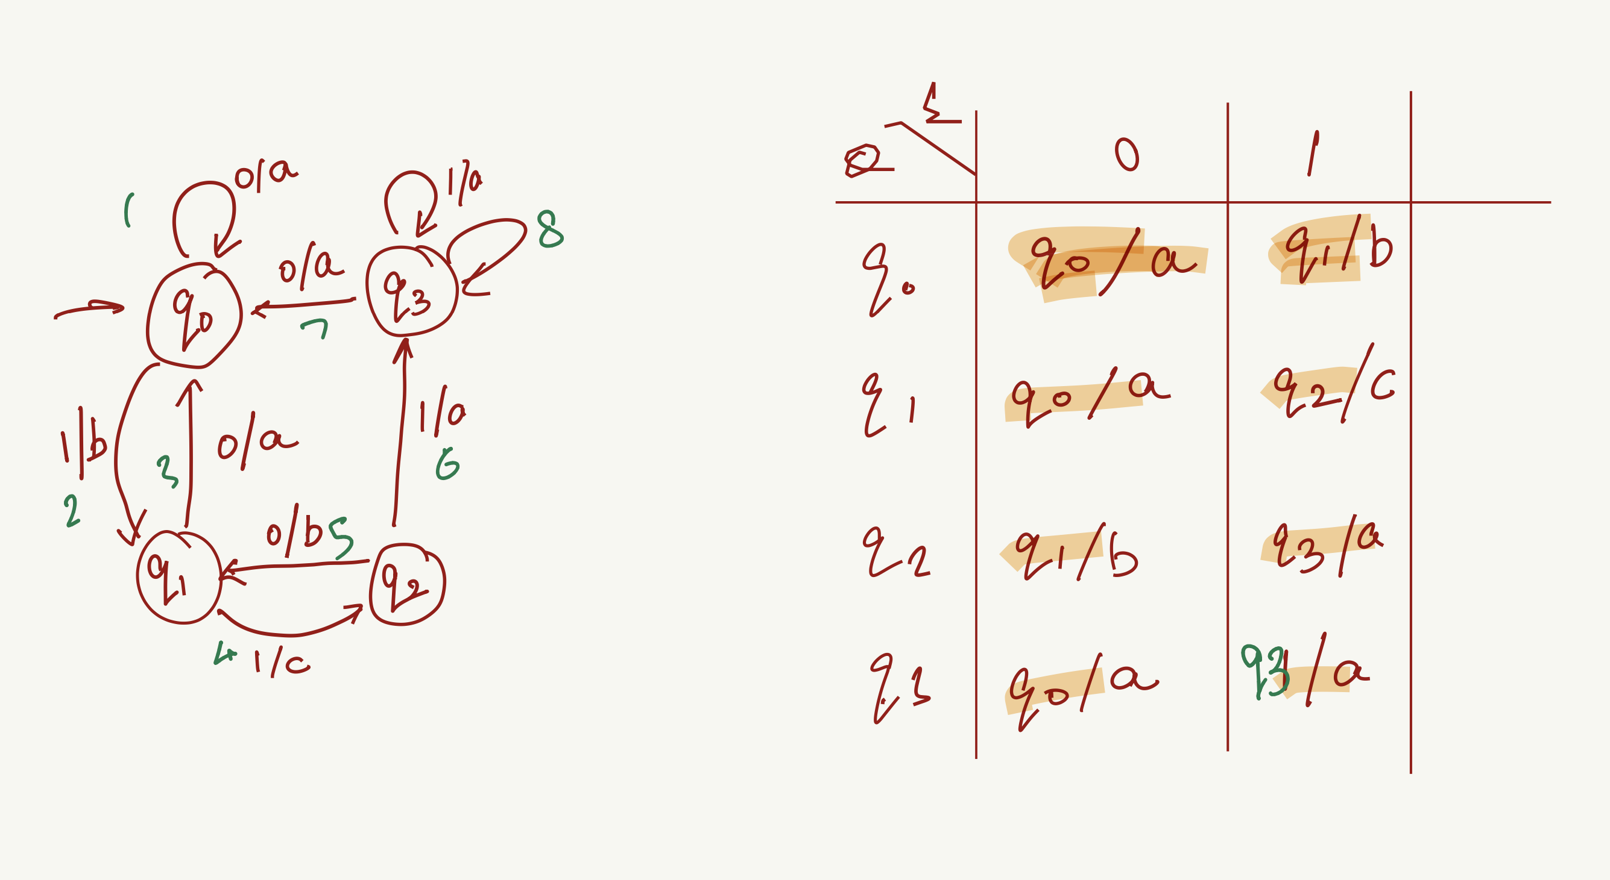


Slide 64
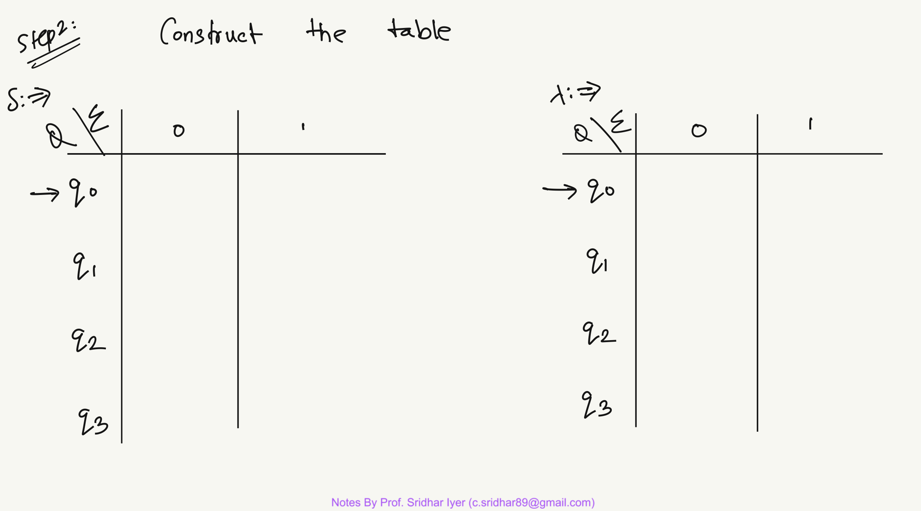

Slide 65
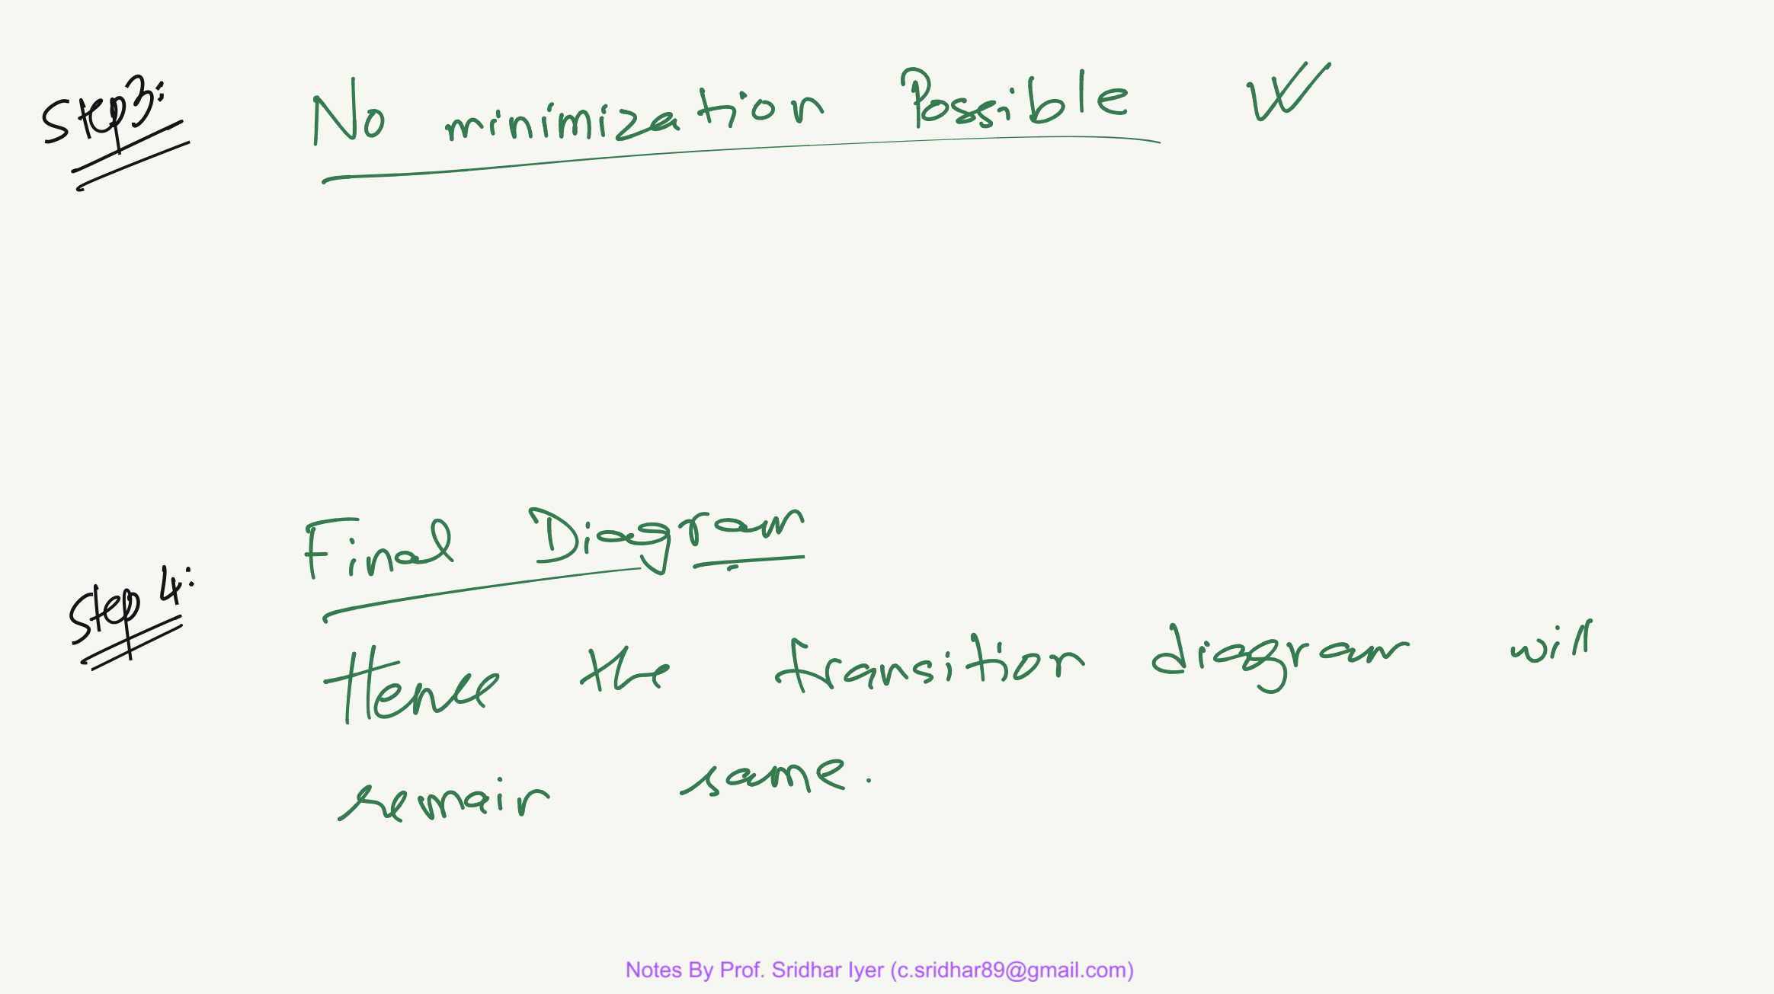

Slide 67
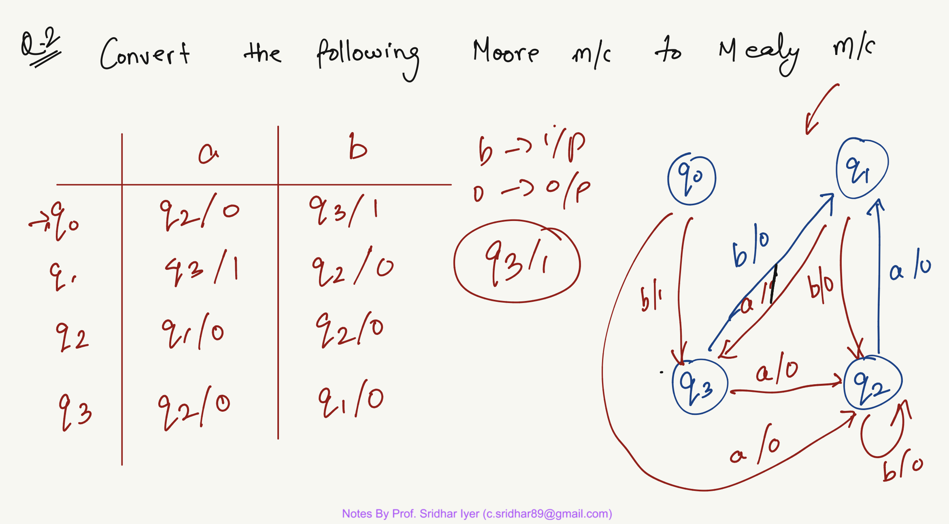


Slide 69
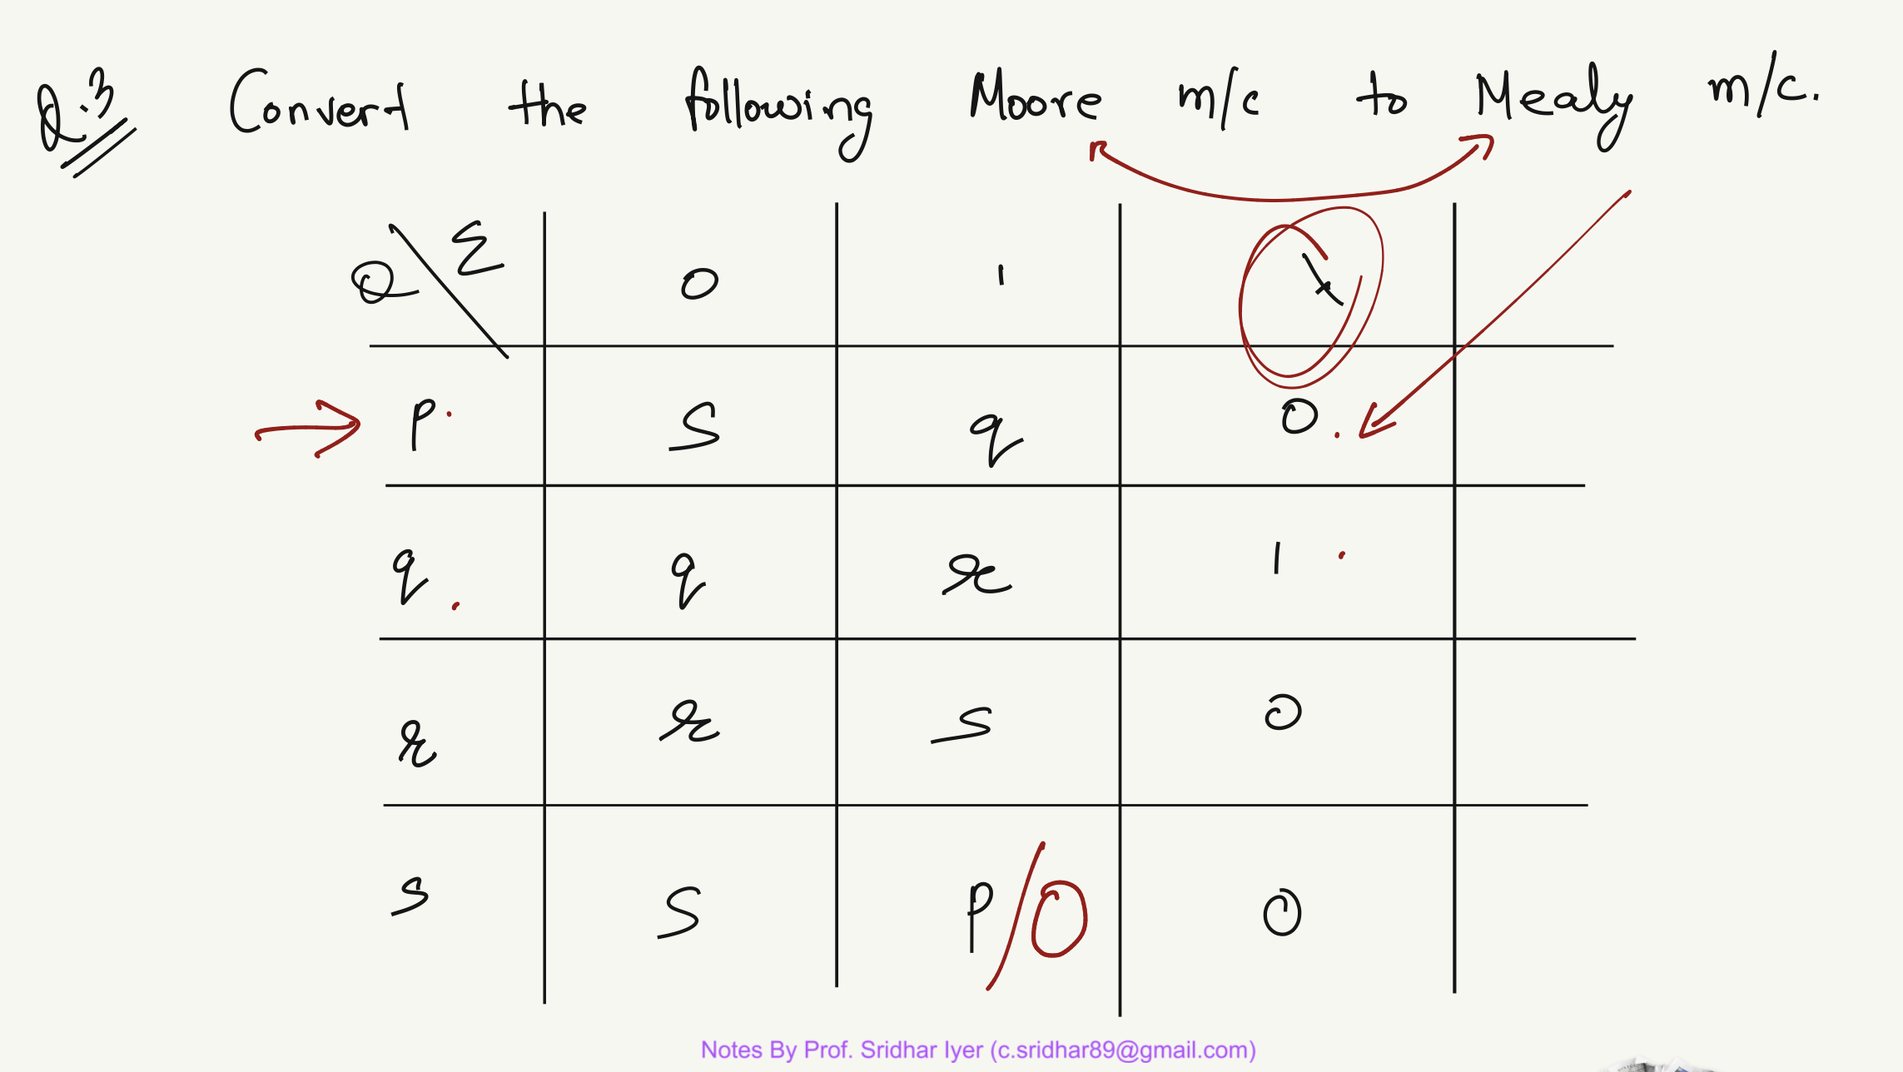


λ

Slide 70
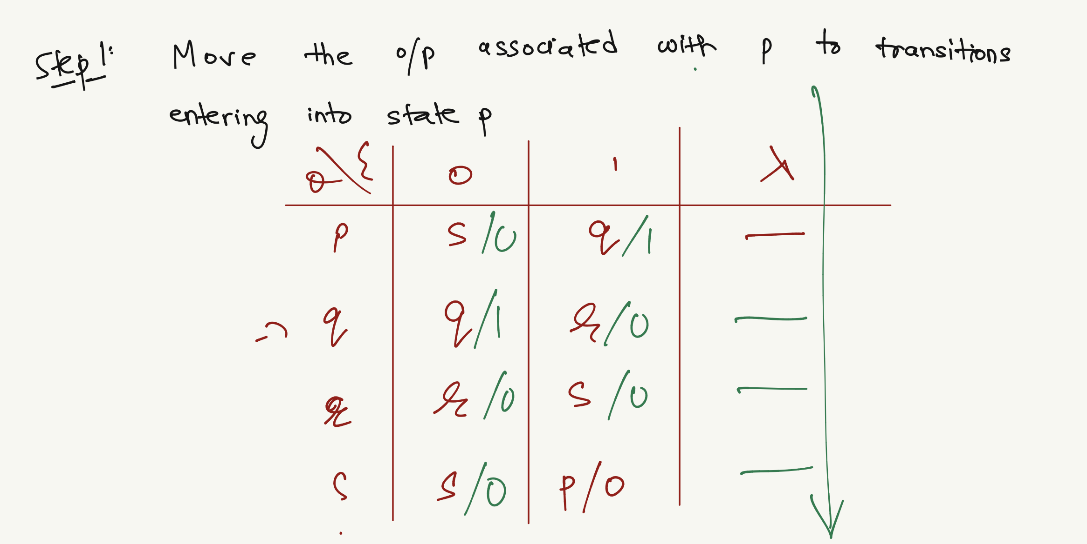


Slide 71
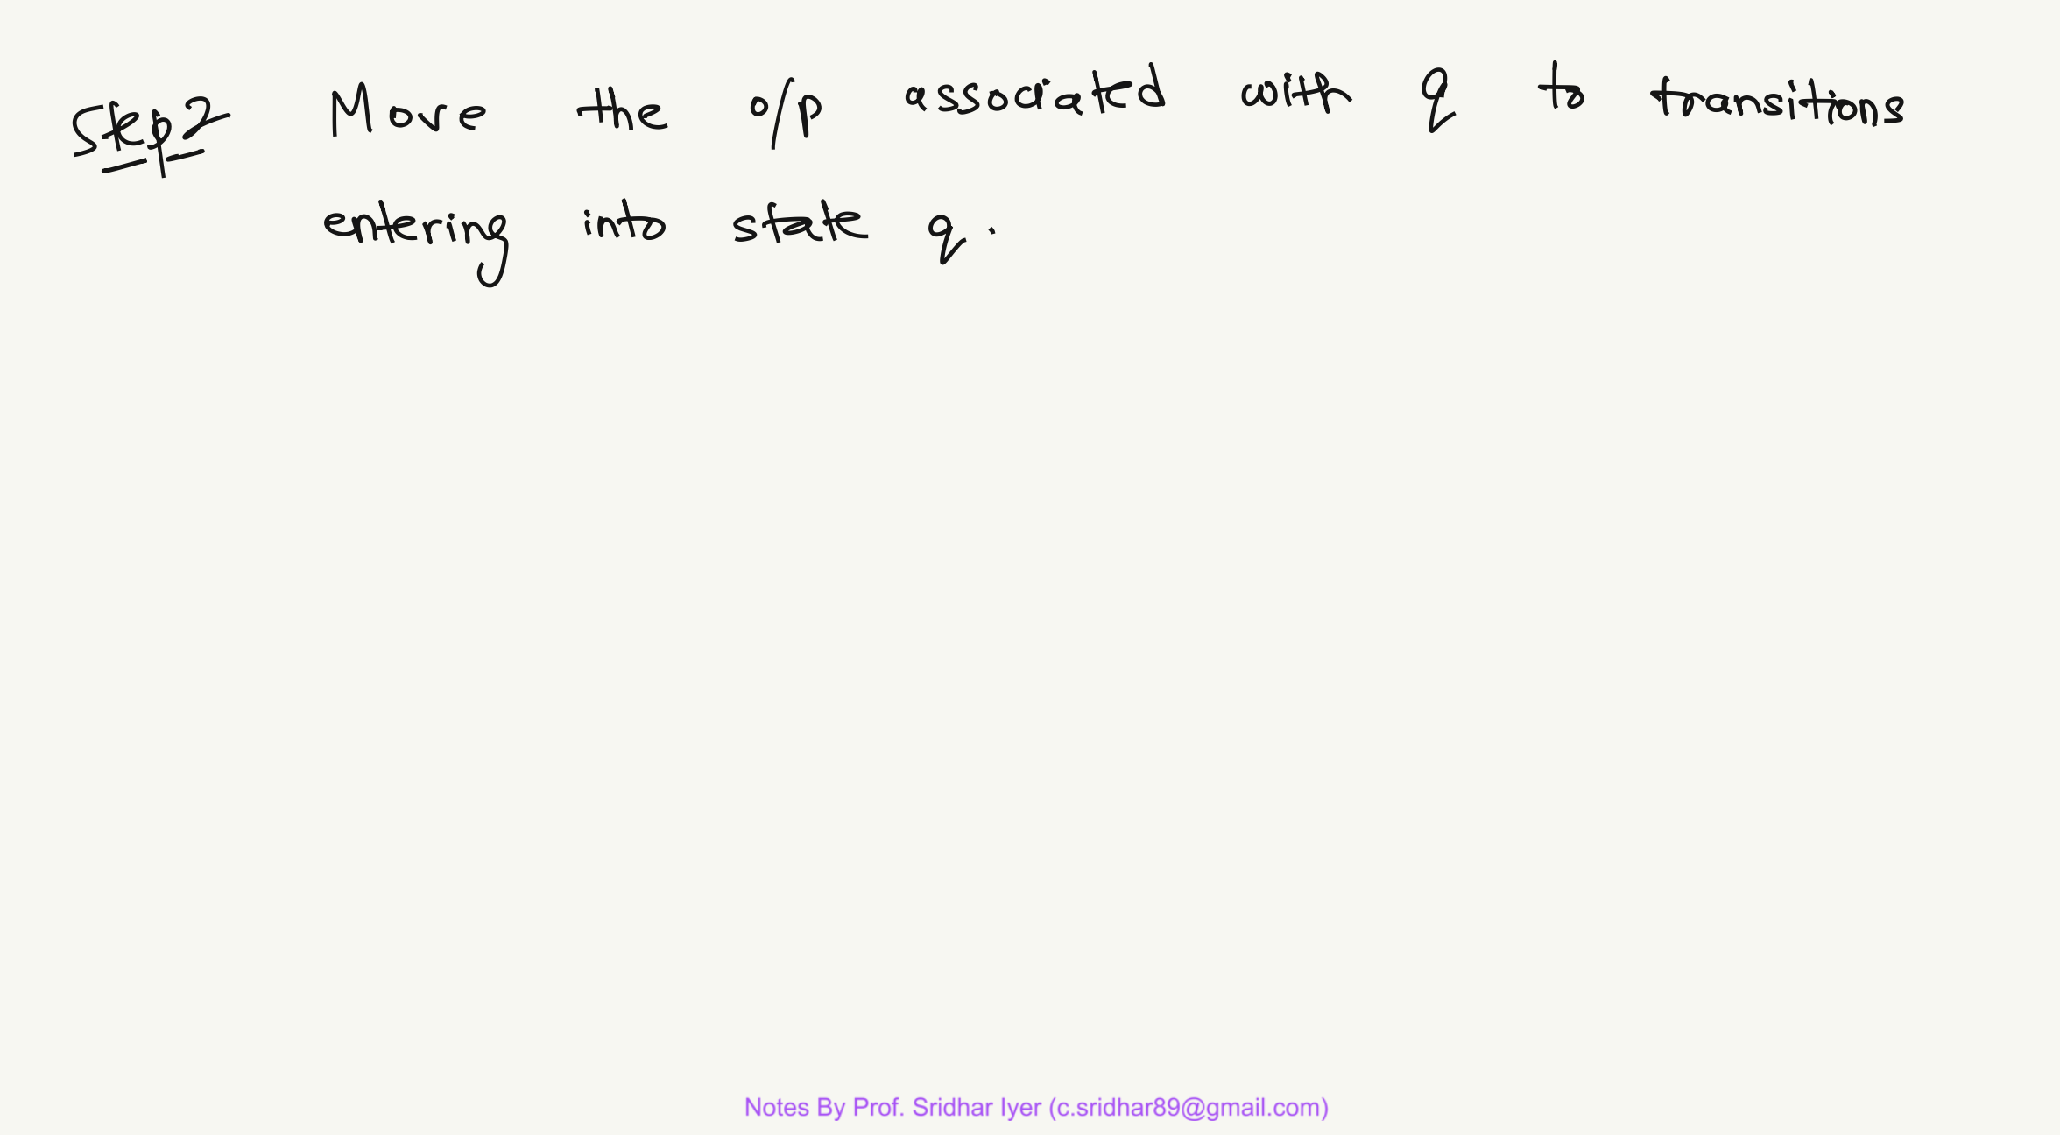

Slide 72


Slide 73


Slide 74
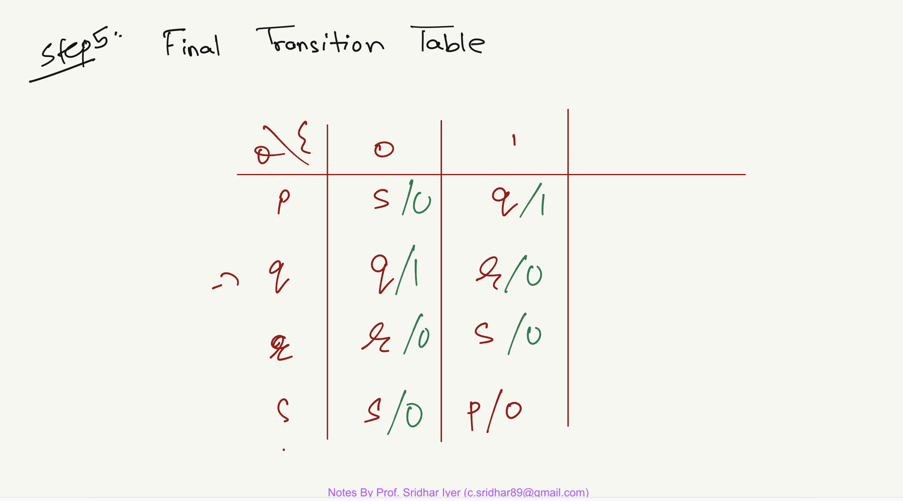

Slide 75


