Slide 1

FORMAL LANGUAGES AND
AUTOMATA THEORY
Lecture 11:
FA with Outputs
(Moore and Mealy Machines)
Prepared By: Sridhar Iyer

Slide 2
Introduction

Slide 3
Finite automata may have outputs corresponding to each transition. There are two types of finite state machines that generate output −
Mealy Machine
Moore machine

Slide 4
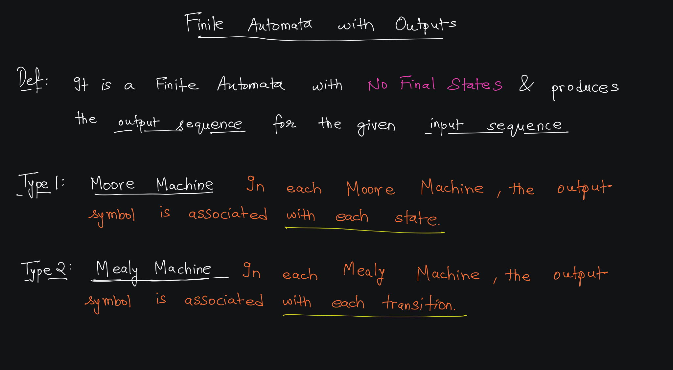

Slide 5
Mealy Machine

Slide 6
Mealy Machine:
A Mealy Machine is an FSM whose output depends on the present state as well as the present input.
It can be described by a 6 tuple (Q, ∑, O, δ, X, q₀) where −
  Q is a finite set of states.
  ∑ is a finite set of symbols called the input alphabet.
  O is a finite set of symbols called the output alphabet.
  δ is the input transition function where δ: Q × ∑ → Q
  X is the output transition function where X: Q × ∑ → O
  q₀ is the initial state from where any input is processed (q₀ ∈ Q).

Slide 7
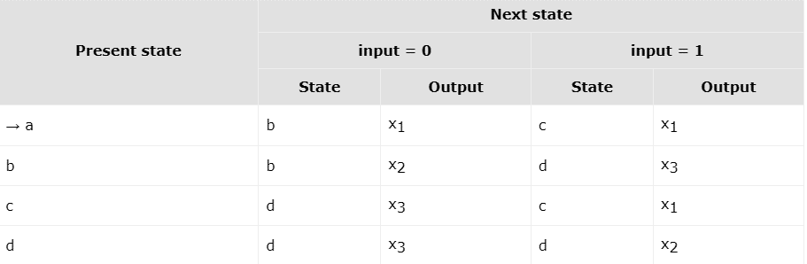
The state transition table of a Mealy Machine is shown below −

Slide 8
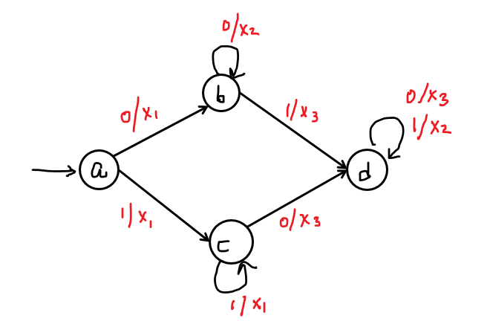
The state diagram of the Mealy Machine is −

Slide 9
Example 1
Mealy Machines

Slide 10

(Q, ∑, O, δ, X, q₀)
∑ = { 0, 1}
  δ = Q × ∑ → Q
  qo = {qo}
  Q = { ………. }
O = { X,Y}
  X = Q × ∑ → O

Slide 11
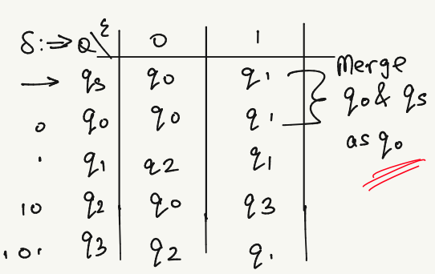
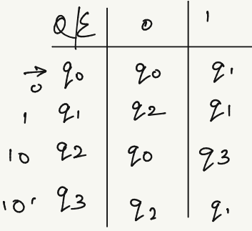

Slide 12
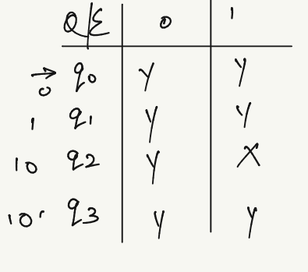

Slide 13
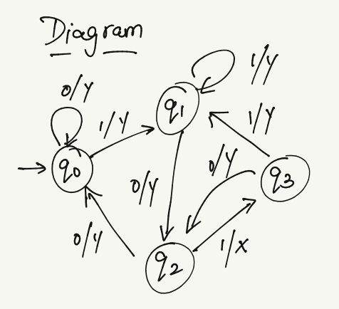

Slide 15
Example 2

Slide 16



Slide 17
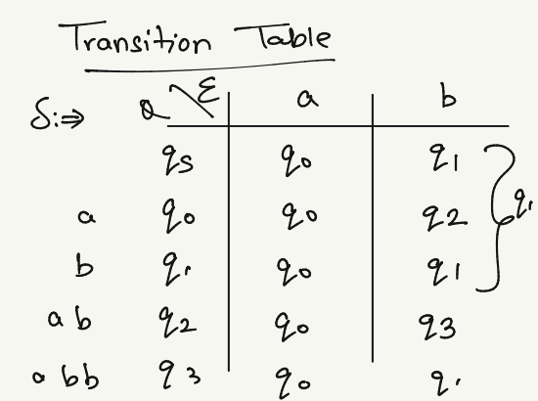
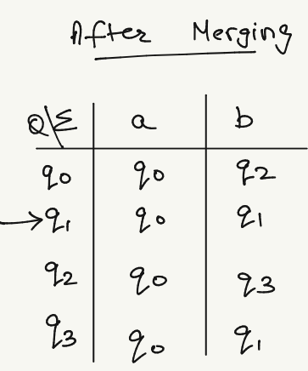

Slide 18
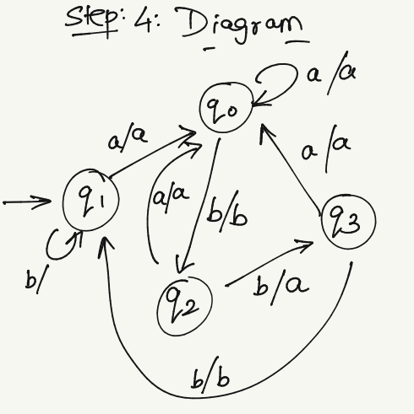
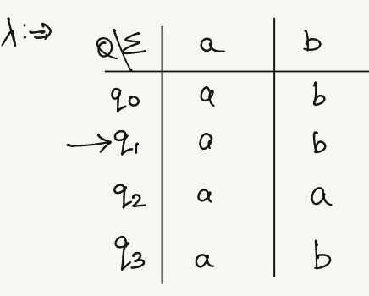

Slide 19
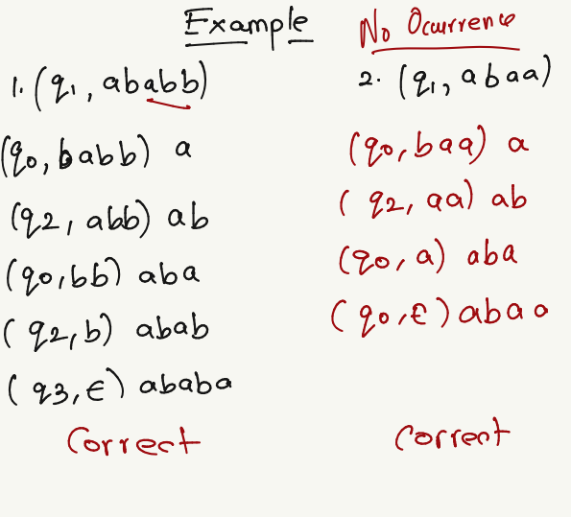

Slide 20
Example 3

Slide 21
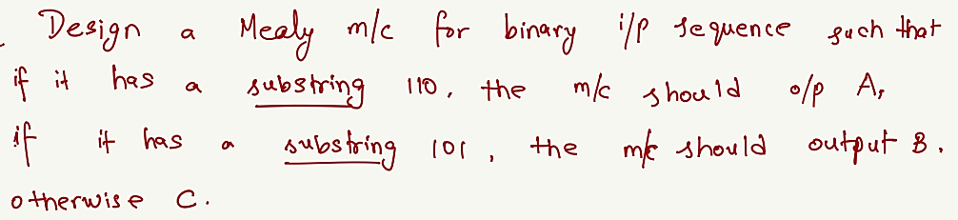

Slide 22
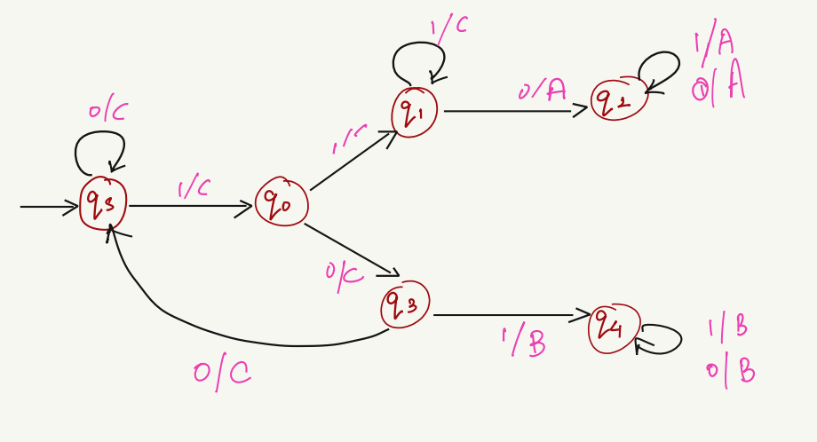


Slide 24
Moore Machine

Slide 25
Moore Machine:
Moore machine is an FSM whose outputs depend on only the present state.
A Moore machine can be described by a 6 tuple (Q, ∑, O, δ, X, q₀) where −
  Q is a finite set of states.
  ∑ is a finite set of symbols called the input alphabet.
  O is a finite set of symbols called the output alphabet.
  δ is the input transition function where δ: Q × ∑ → Q
  X is the output transition function where X: Q → O
  q₀ is the initial state from where any input is processed (q₀ ∈ Q).

Slide 26
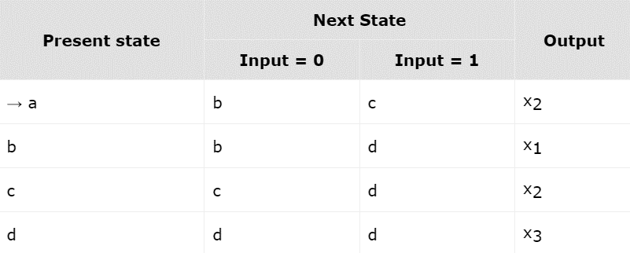
The state transition table of a Moore Machine is shown below −

Slide 27
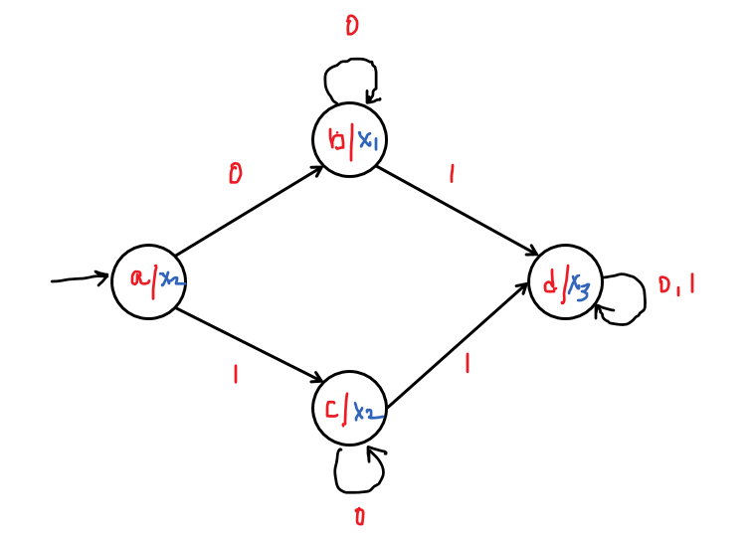
The state diagram of the Moore Machine is −

Slide 28
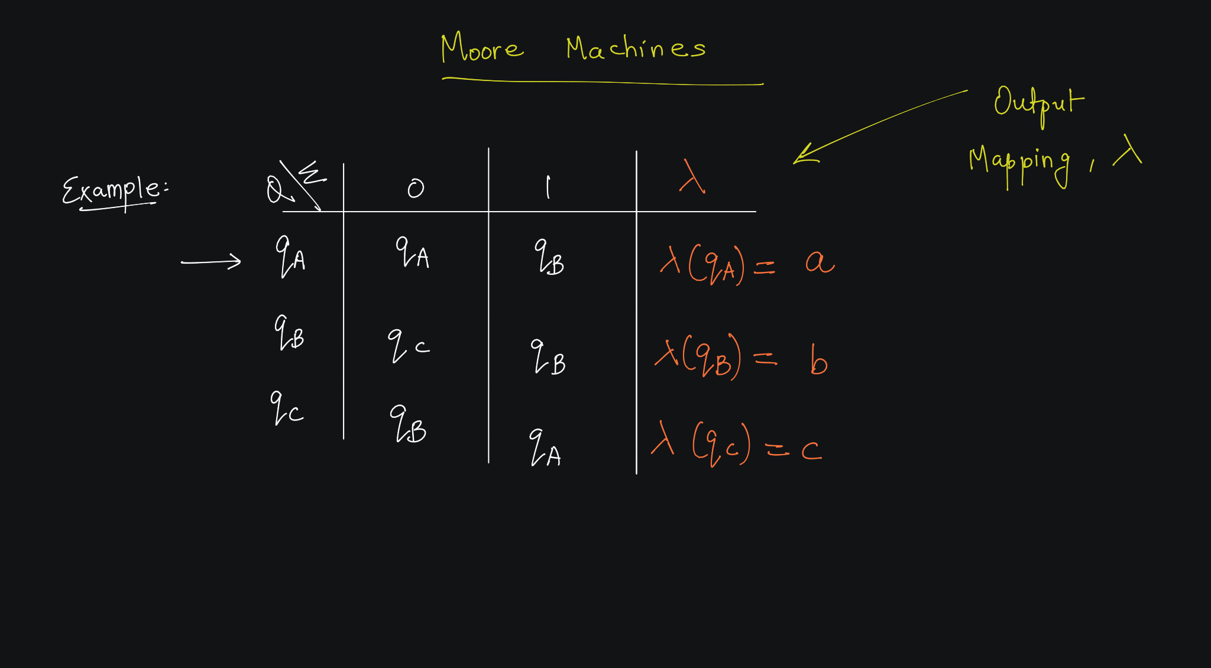

Slide 29
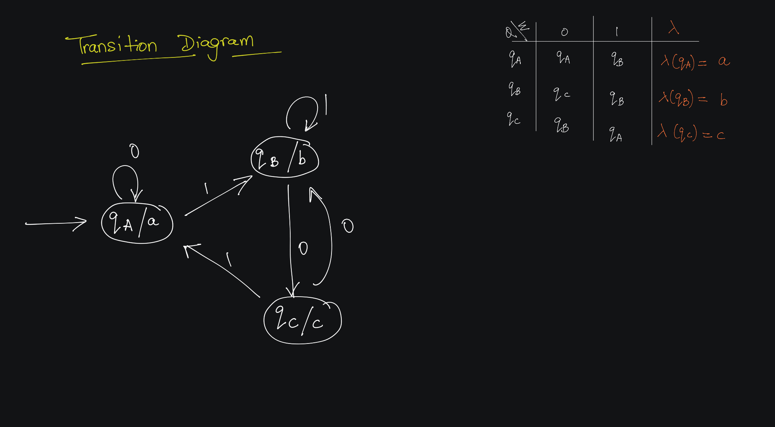

Slide 30
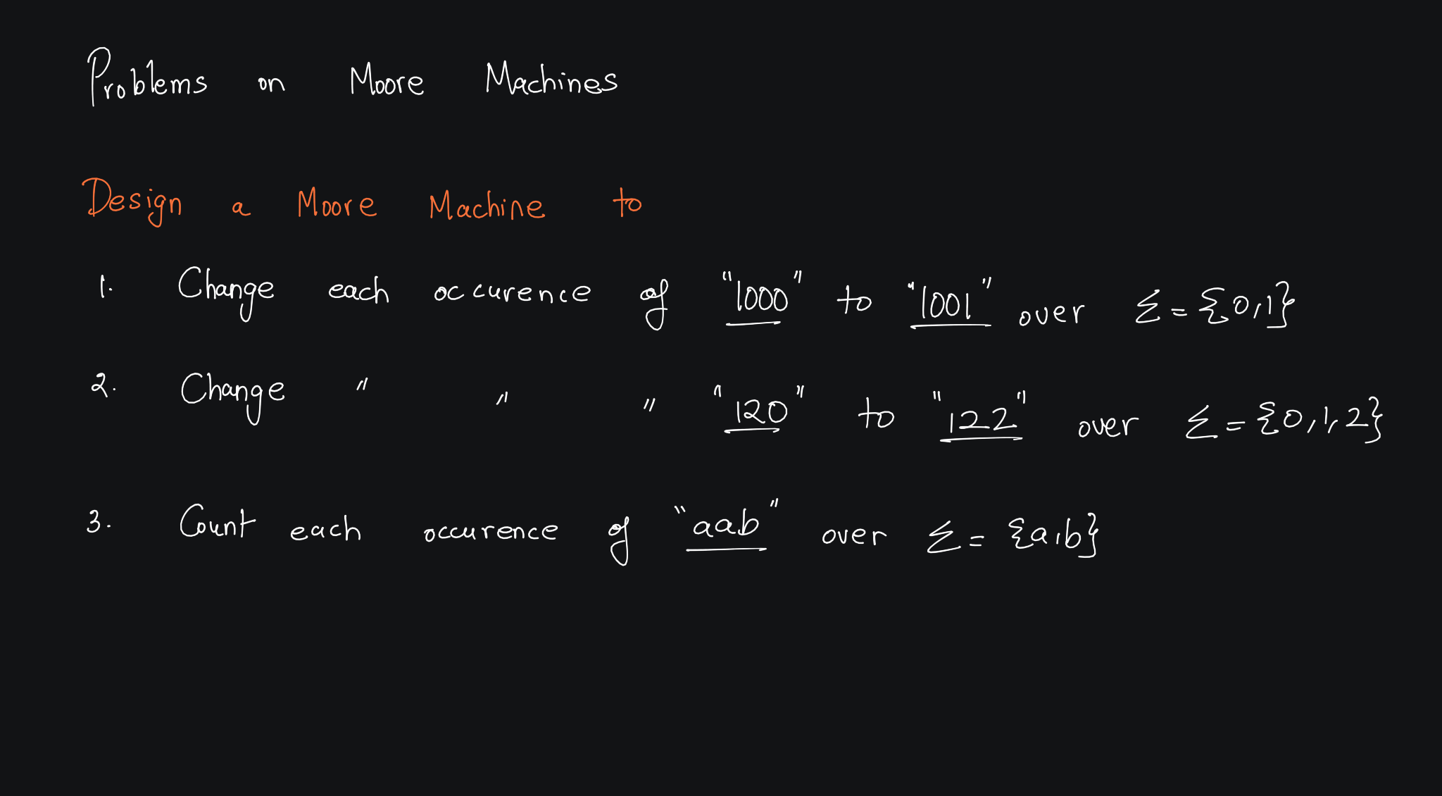

Slide 31
Example 1
Moore Machines

Slide 32
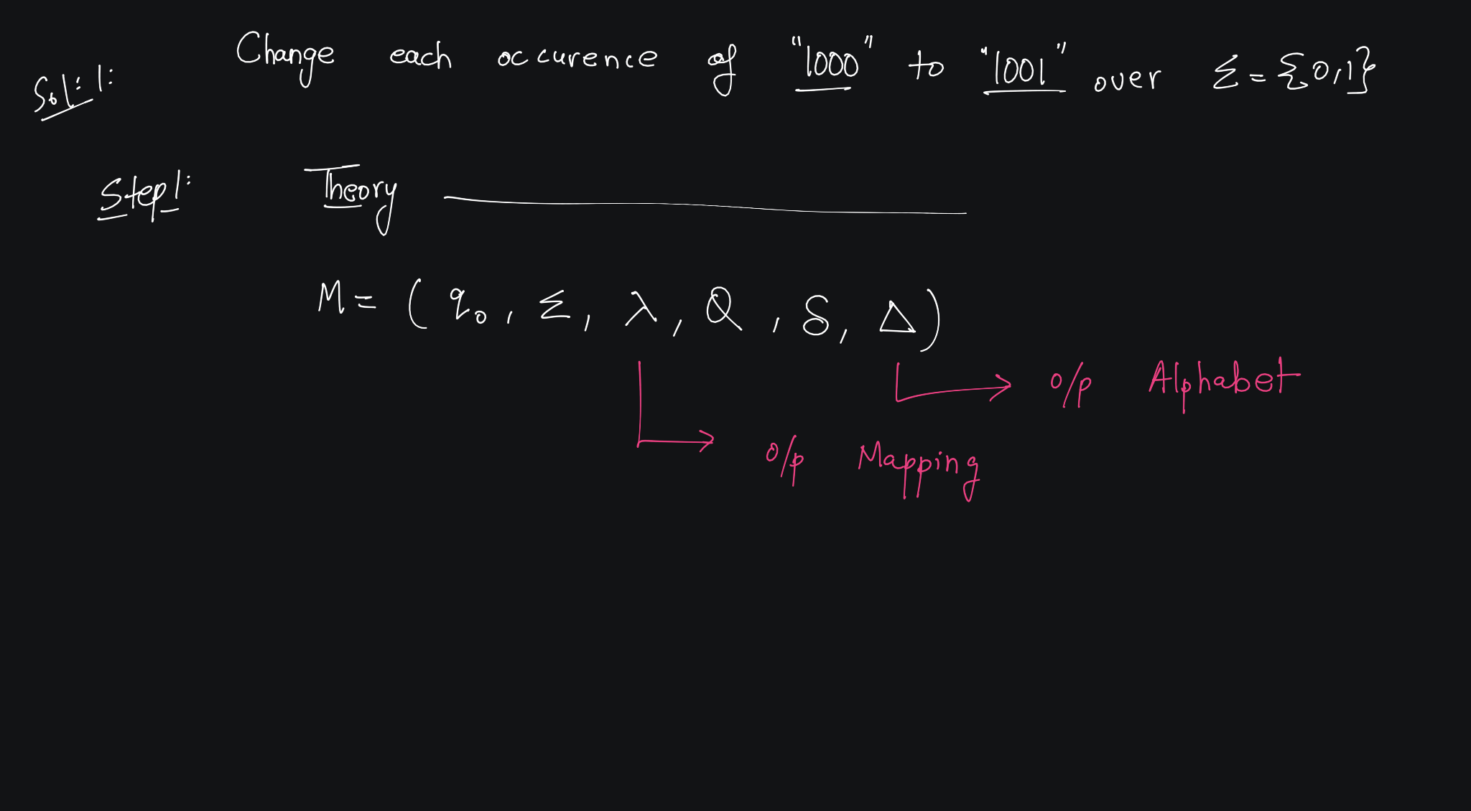


Slide 33
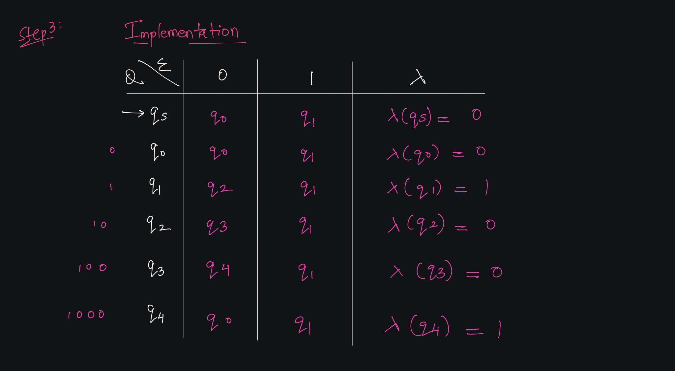

Slide 34
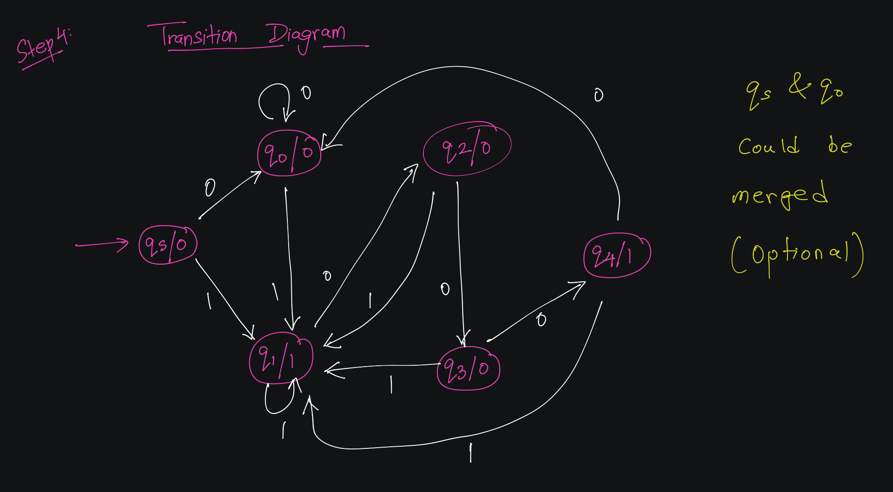

Slide 35
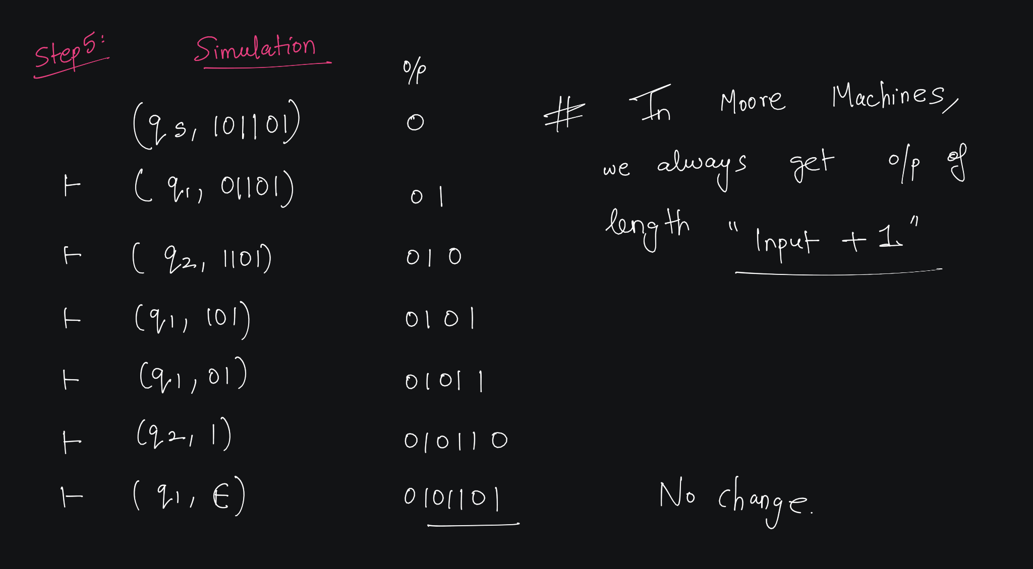

Slide 36
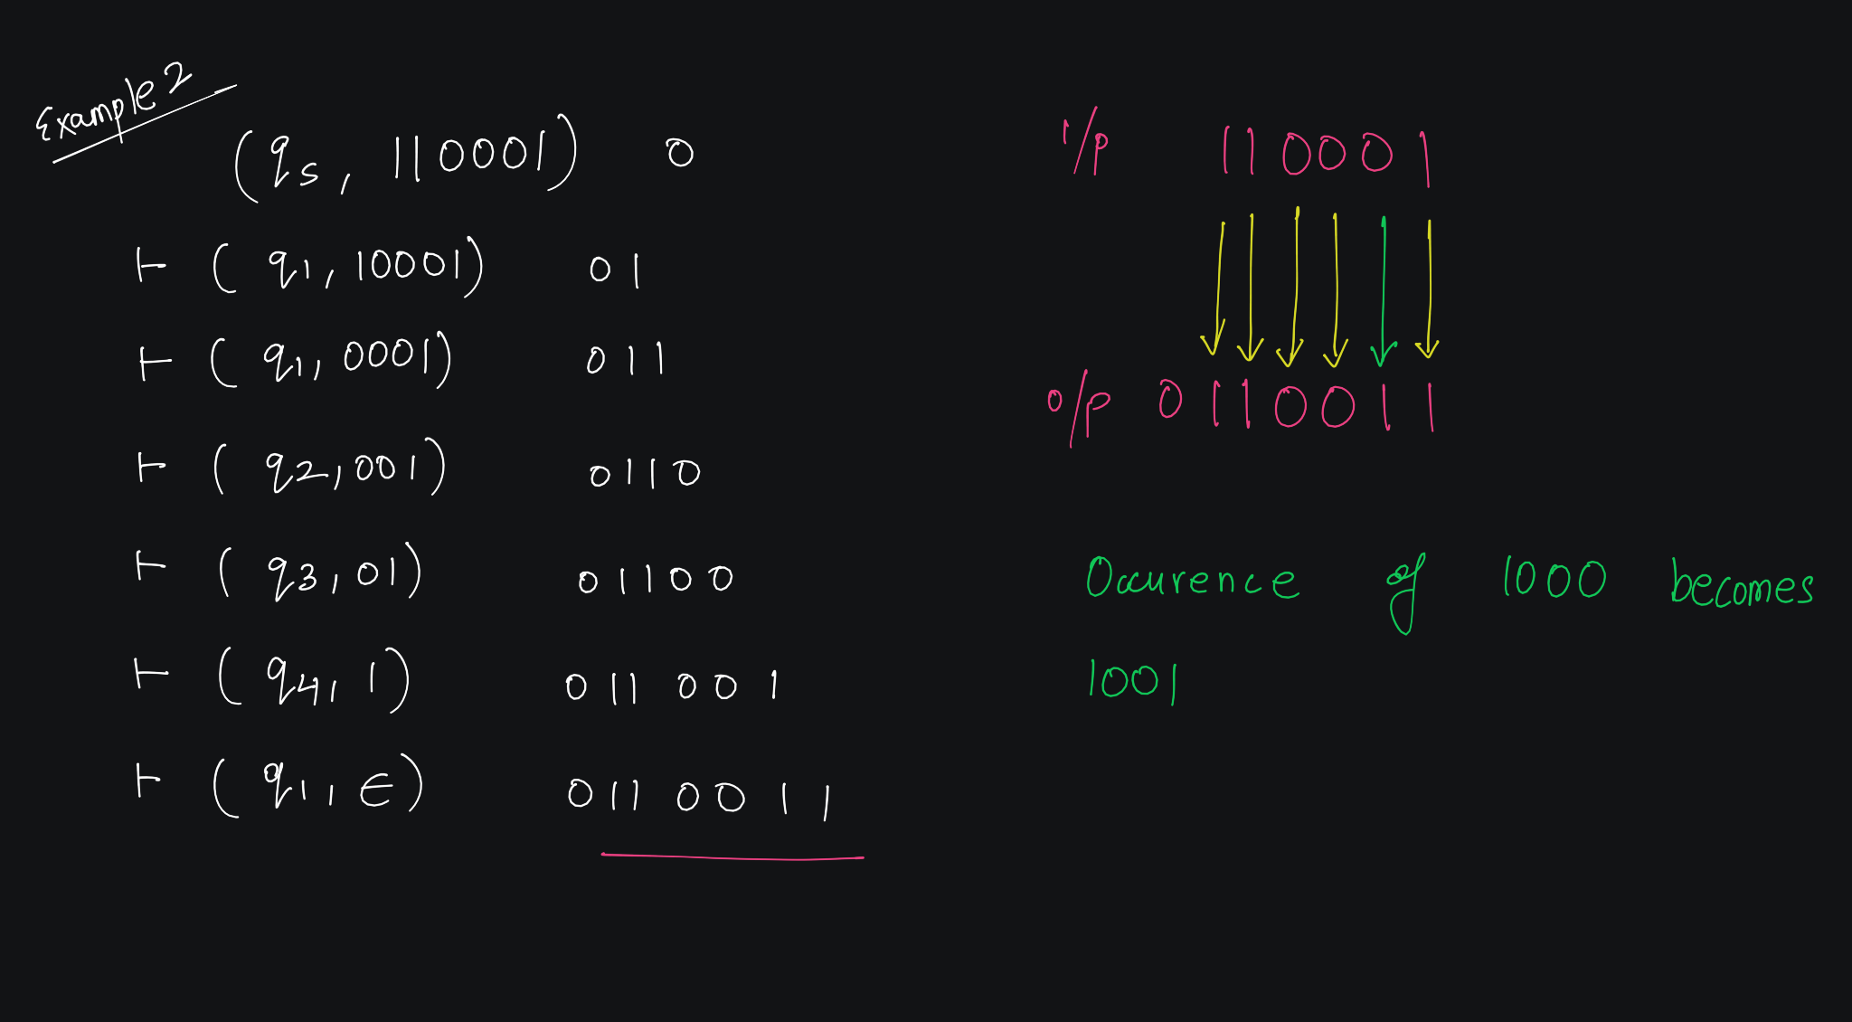

Slide 37
Example 2

Slide 38
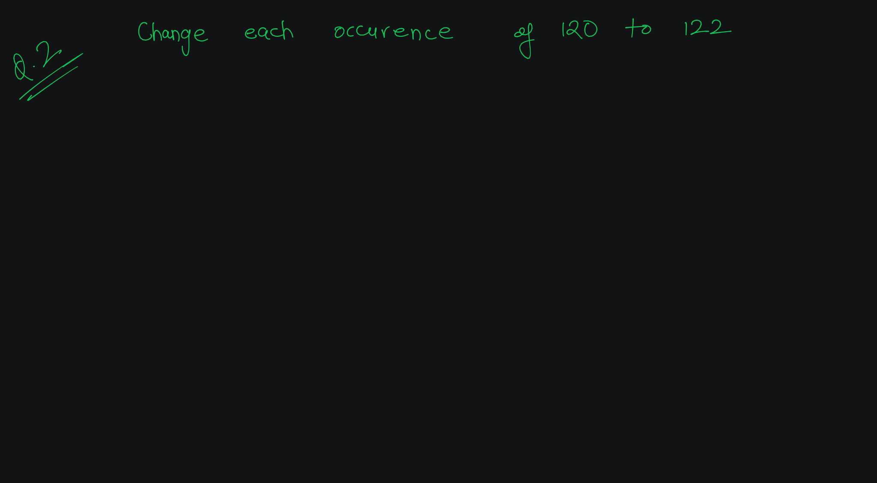

Slide 39
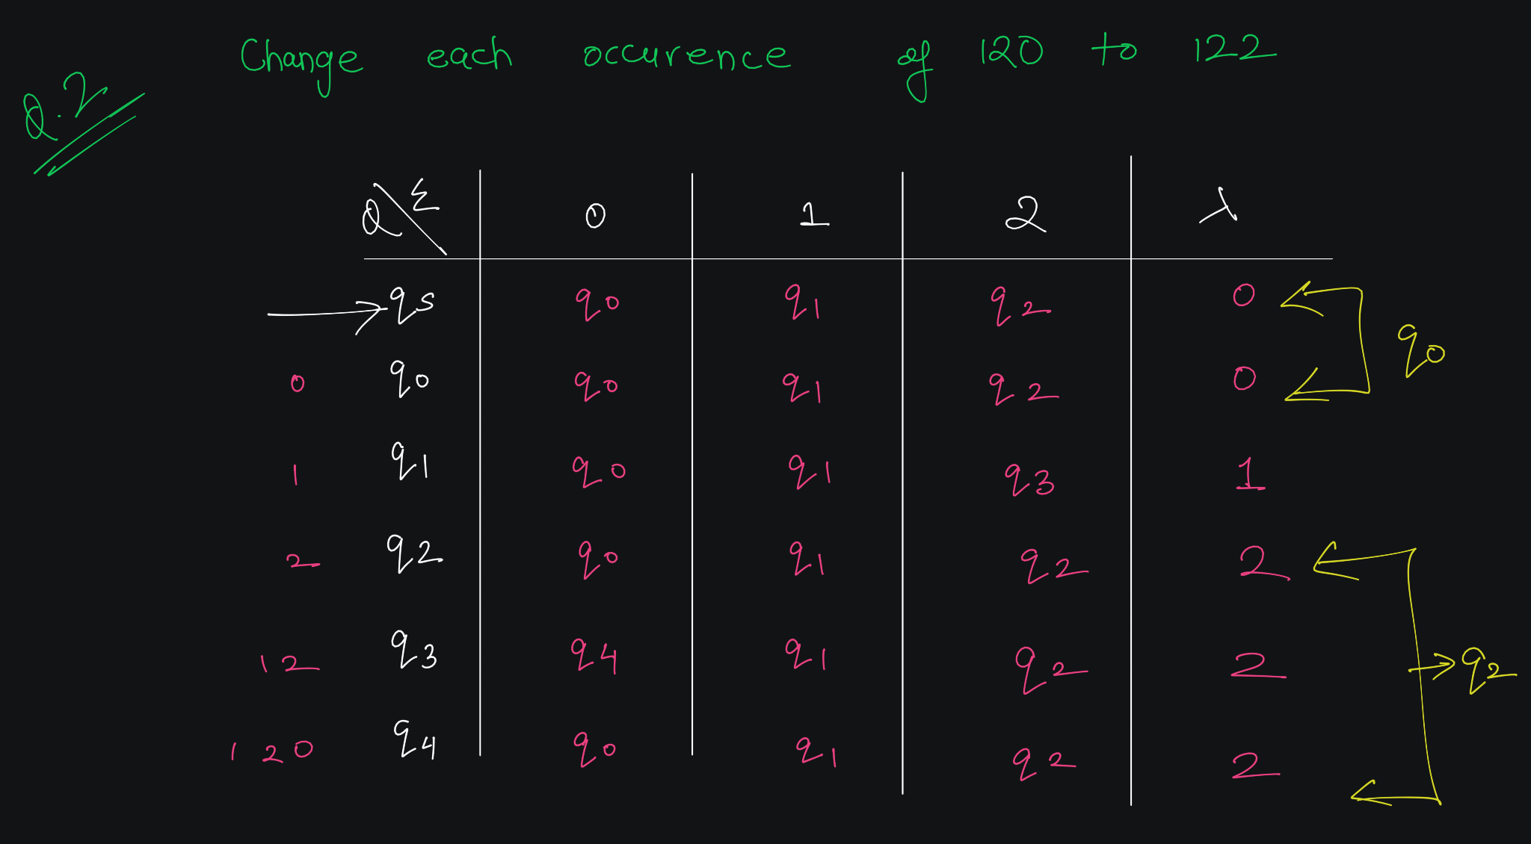

Slide 40
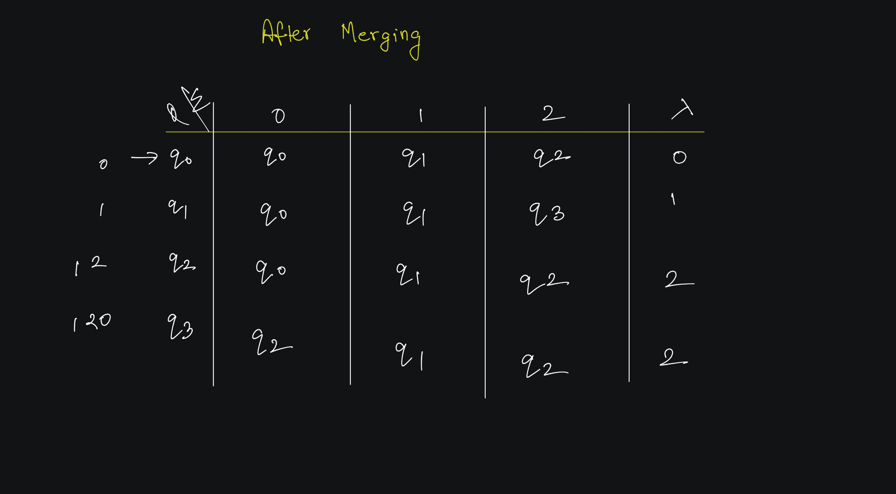

Slide 41
Example 3

Slide 42
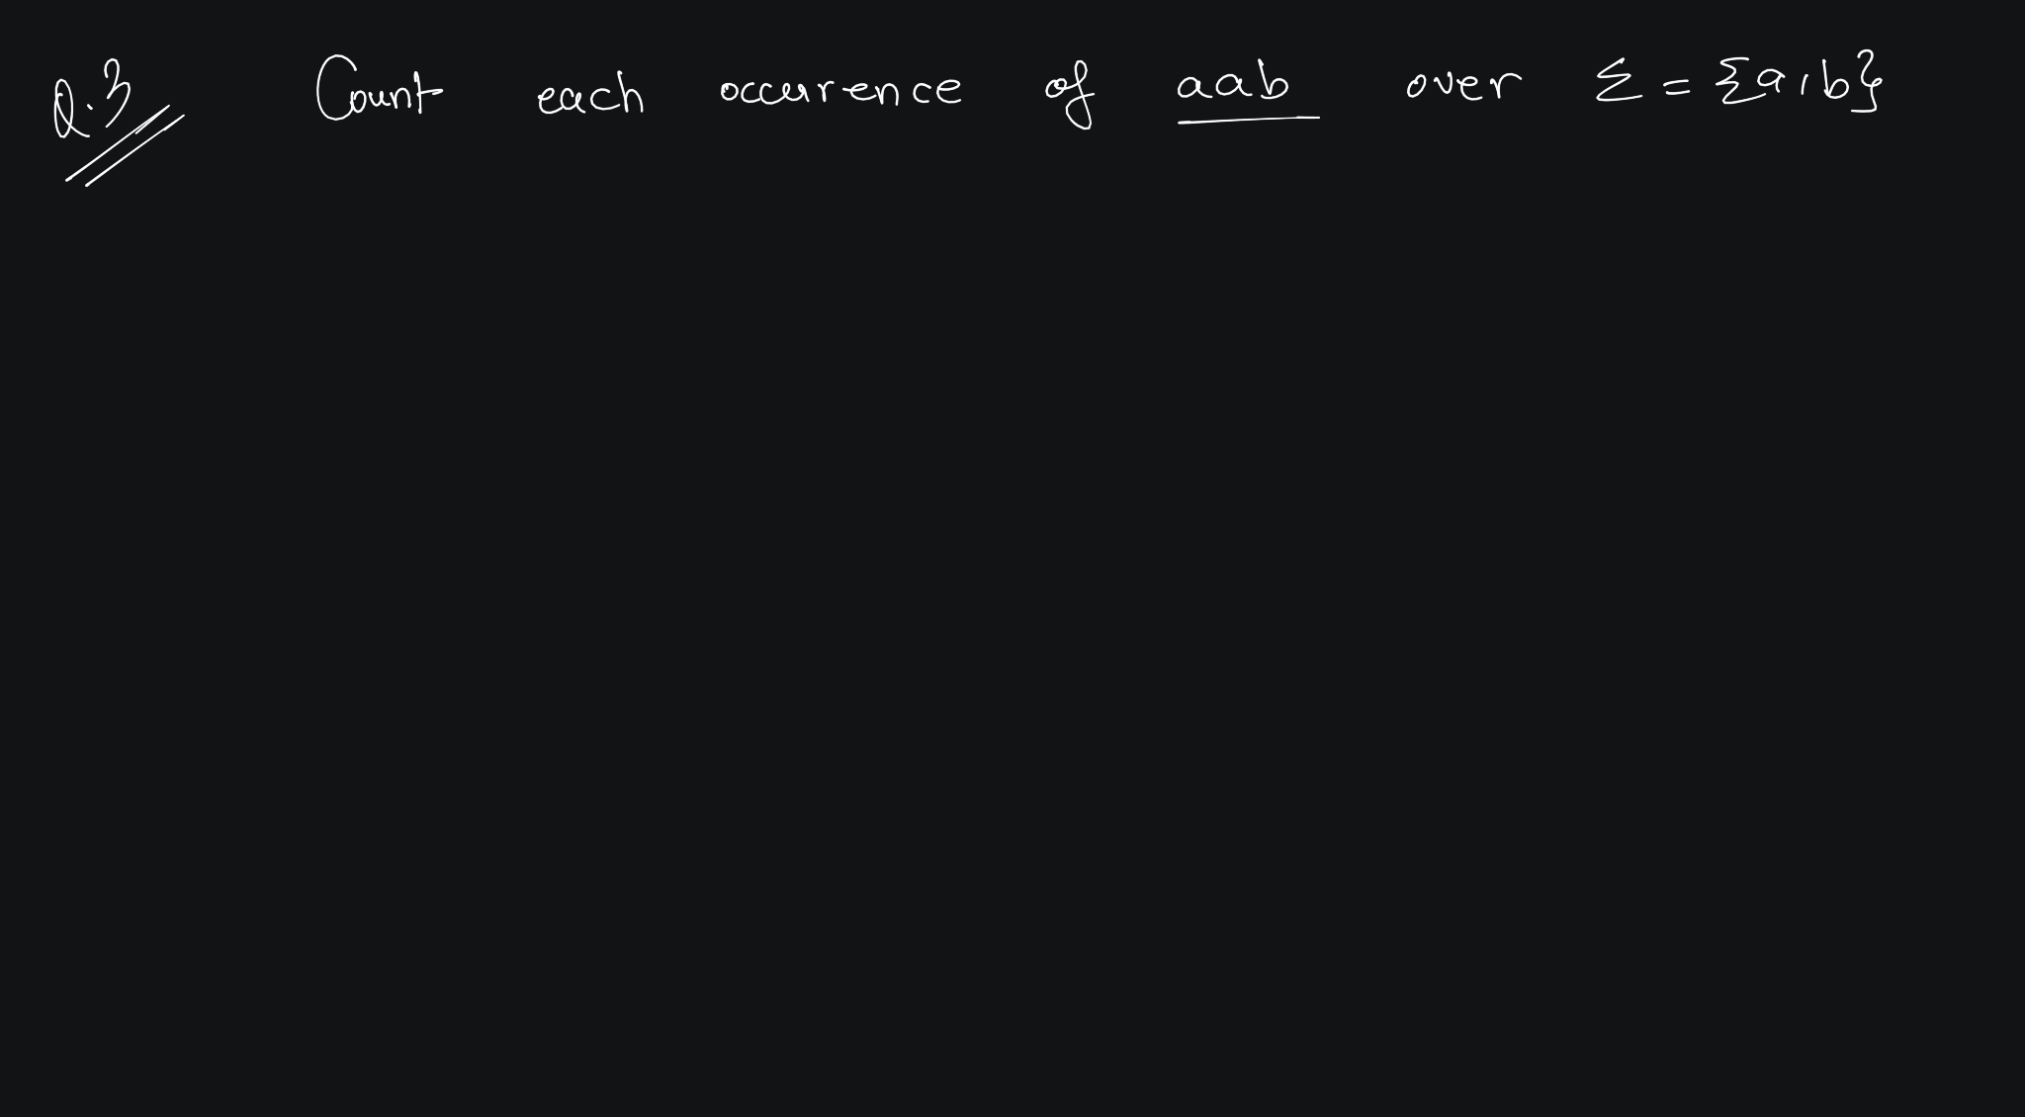

Slide 43
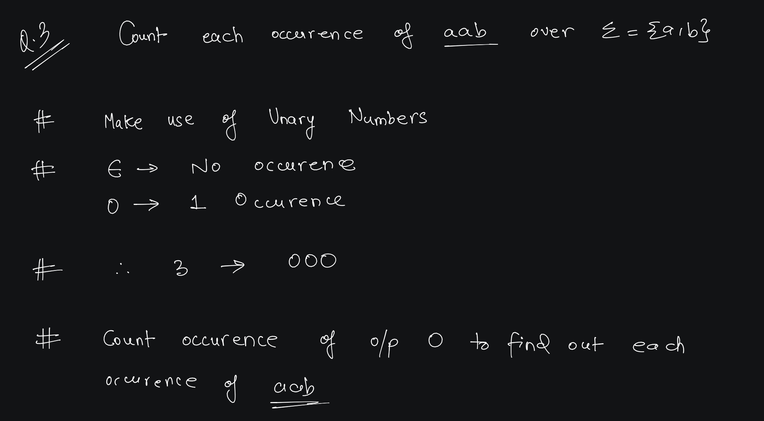

Slide 44
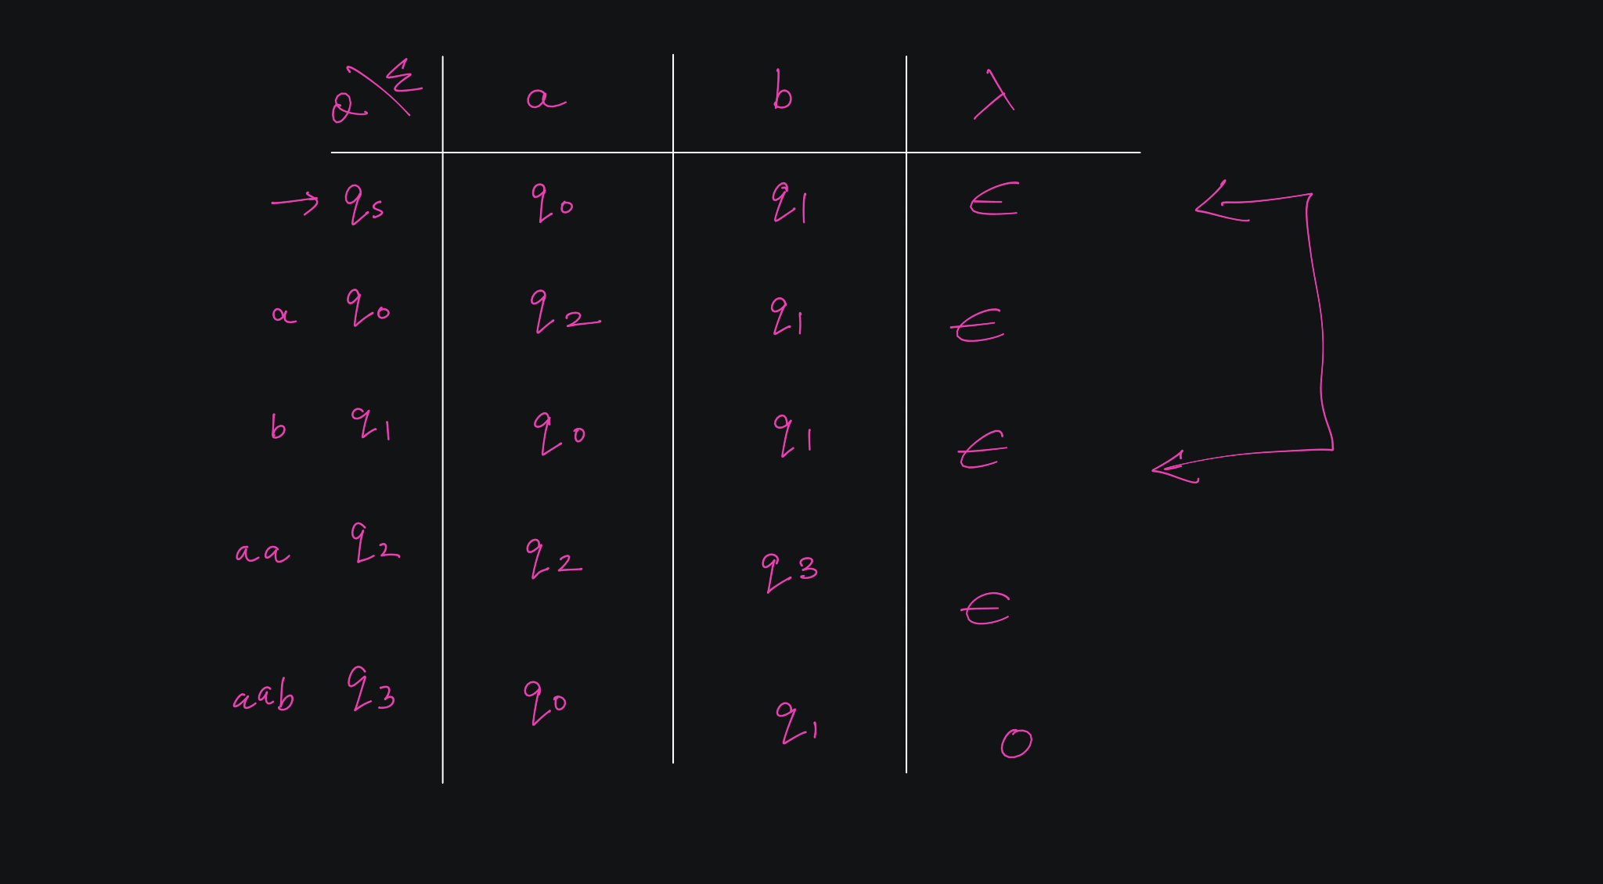

Slide 45
Mealy vs Moore Machine

Slide 46
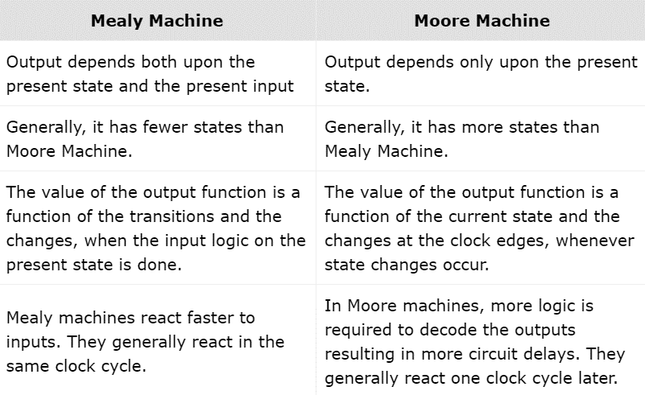
Mealy Machine vs. Moore Machine
The following table highlights the points that differentiate a Mealy Machine from a Moore Machine

