Slide 1

FORMAL LANGUAGES AND
AUTOMATA THEORY
Lecture 10:
DFA to NFA – Subset Generation
Prepared By: Sridhar Iyer

Slide 2
Direct Method
(Subset Generation Method)

Slide 3
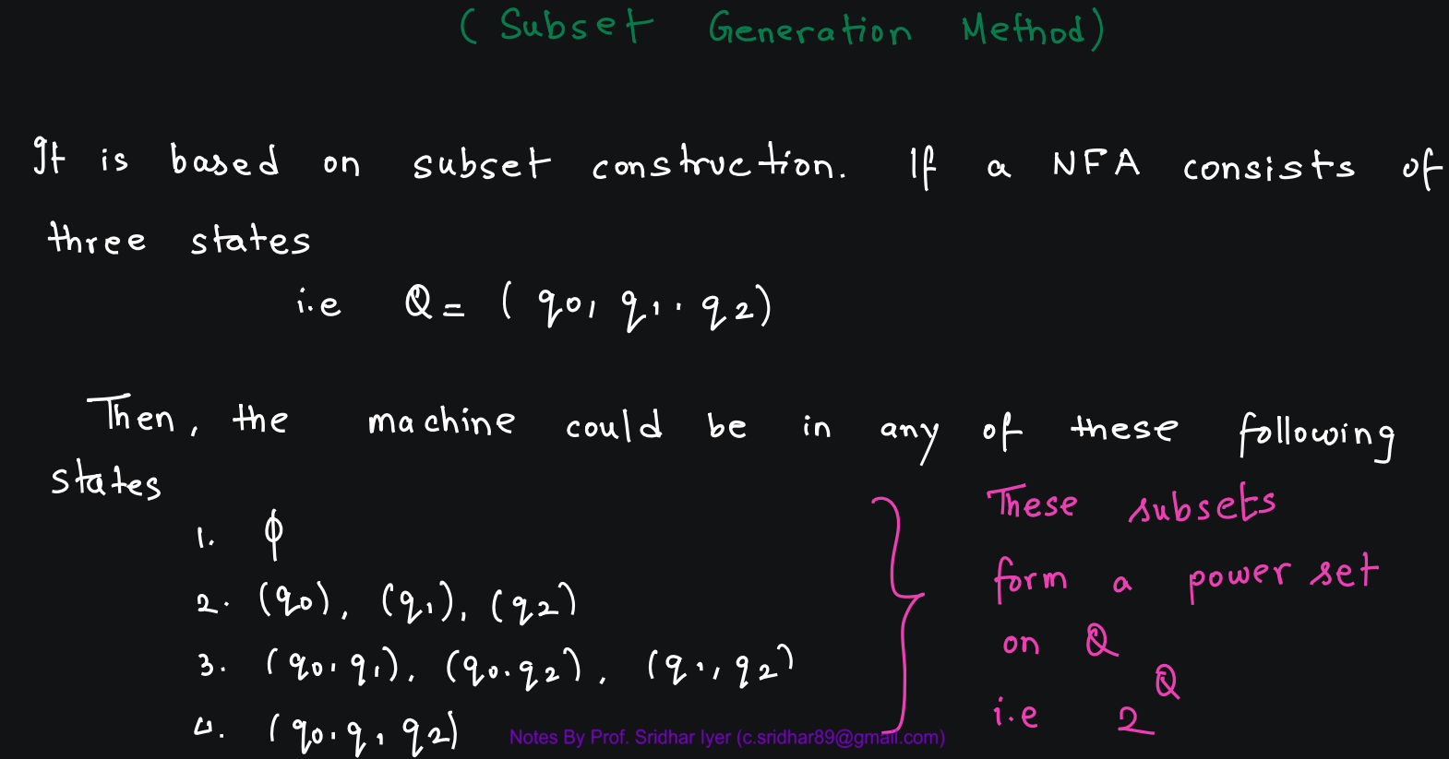

Slide 4
Example - 1

Slide 5
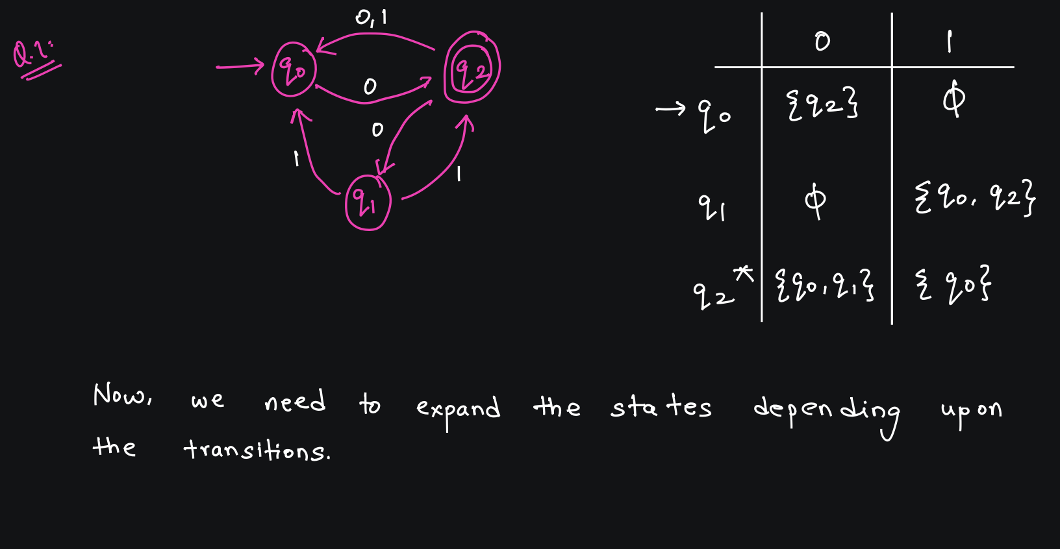

Slide 6
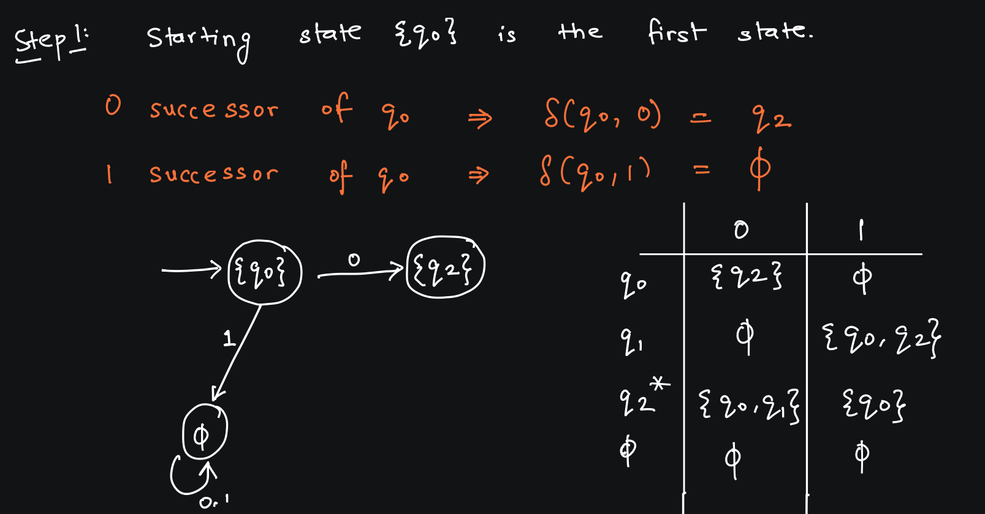

Slide 7
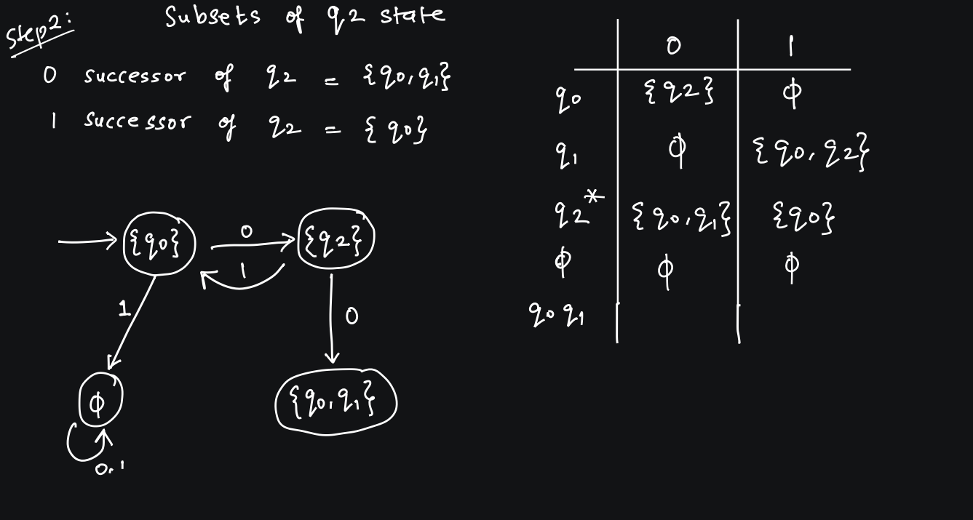

Slide 8
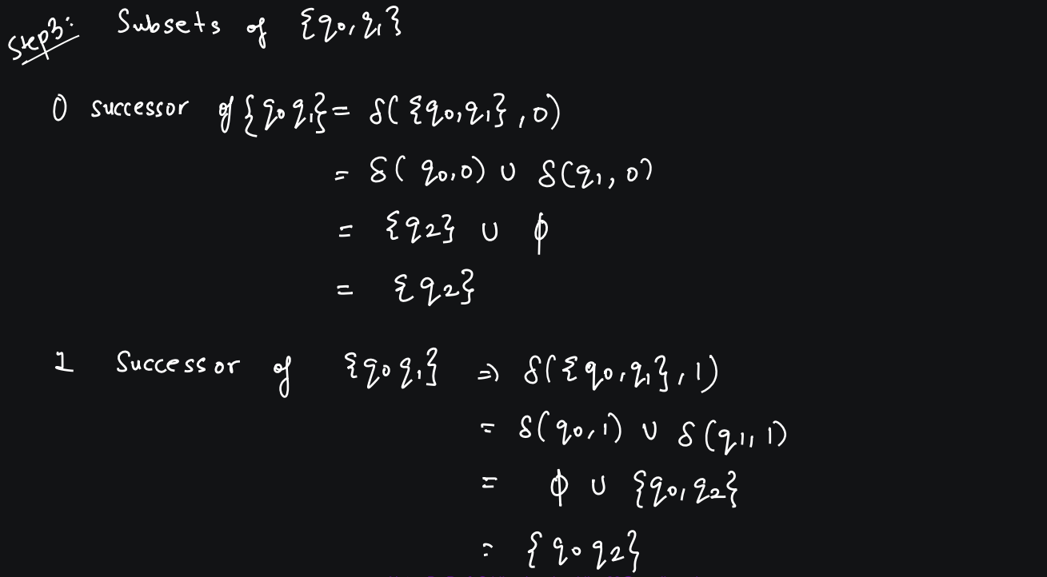

Slide 9
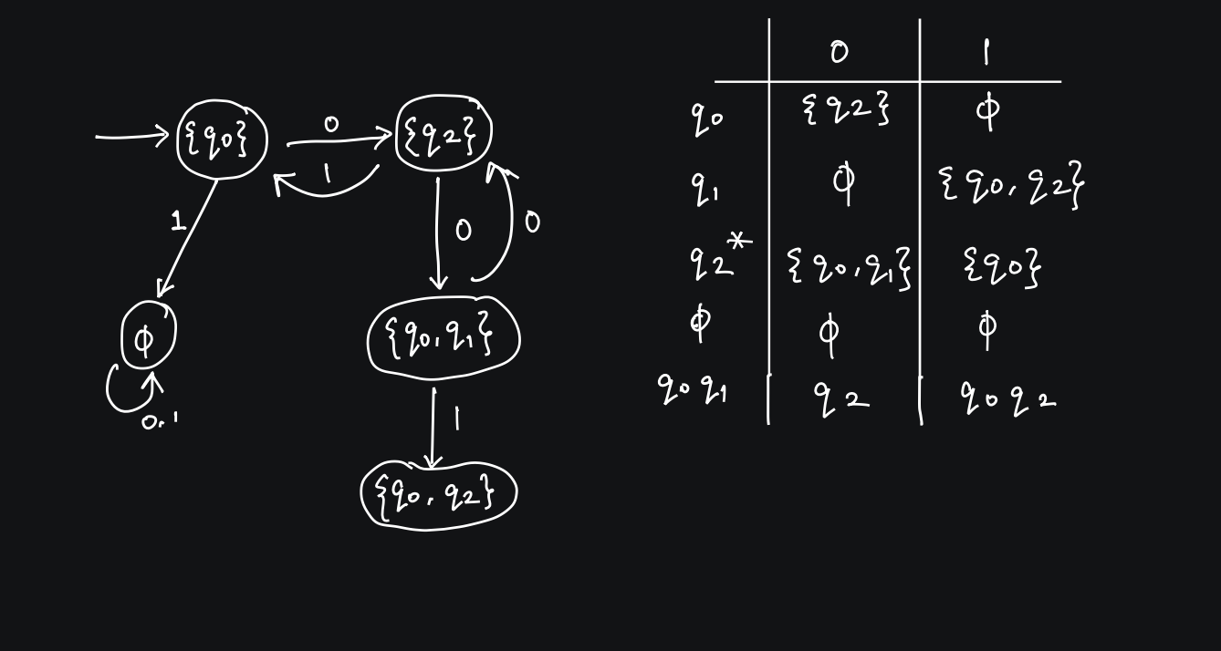

Slide 10
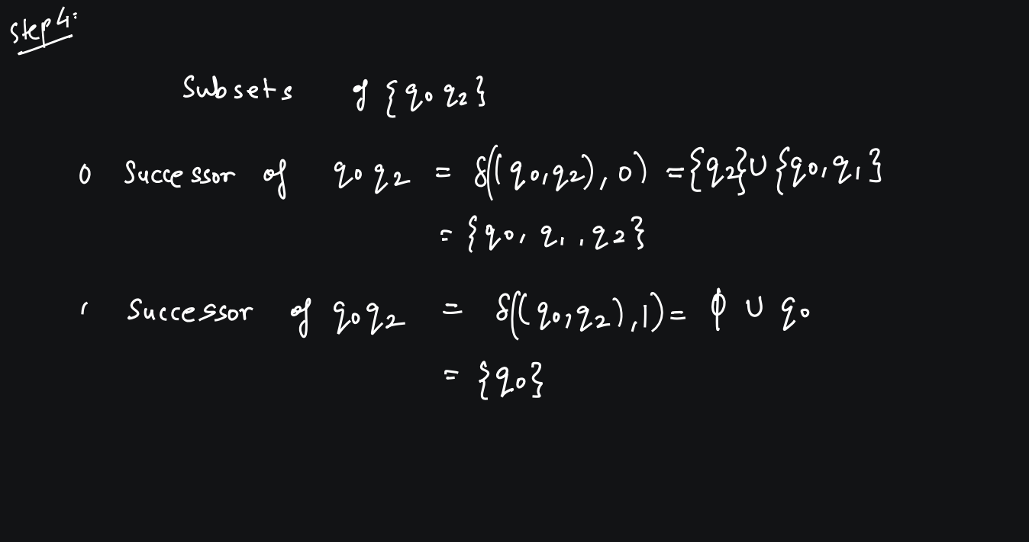

Slide 11
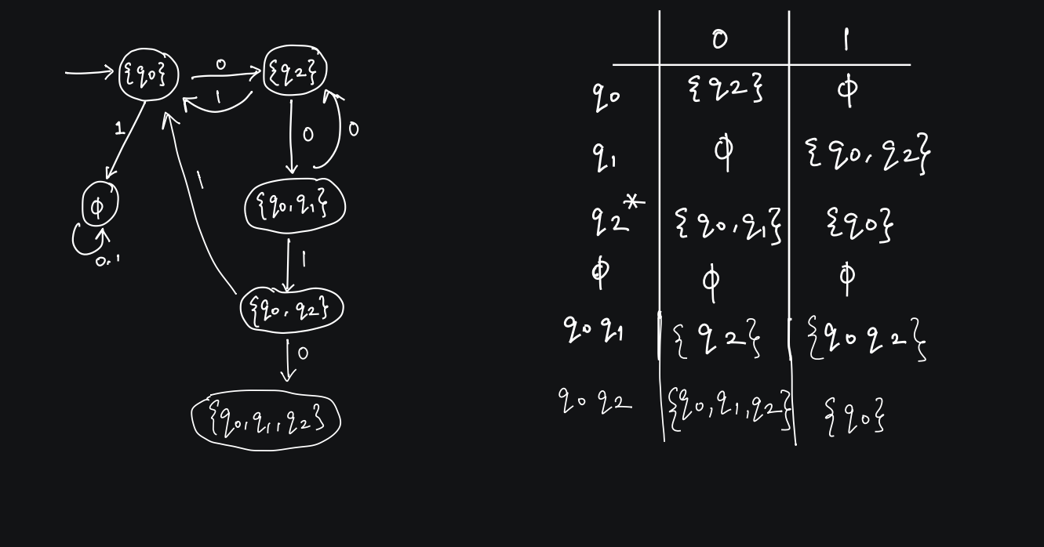

Slide 12
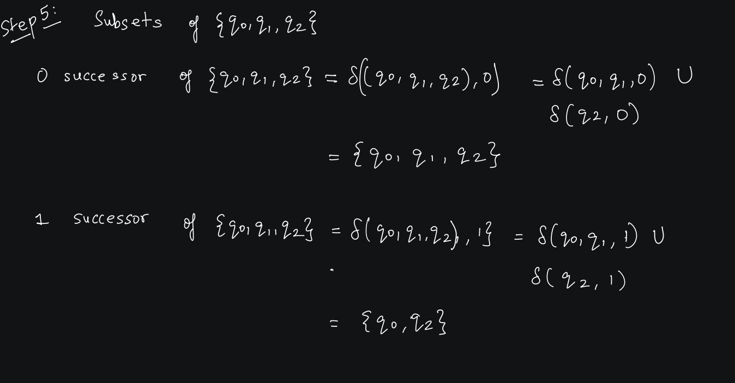

Slide 13
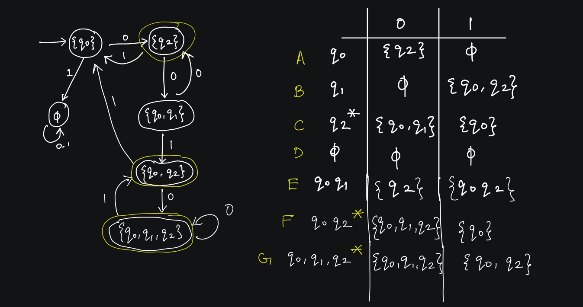

Slide 14
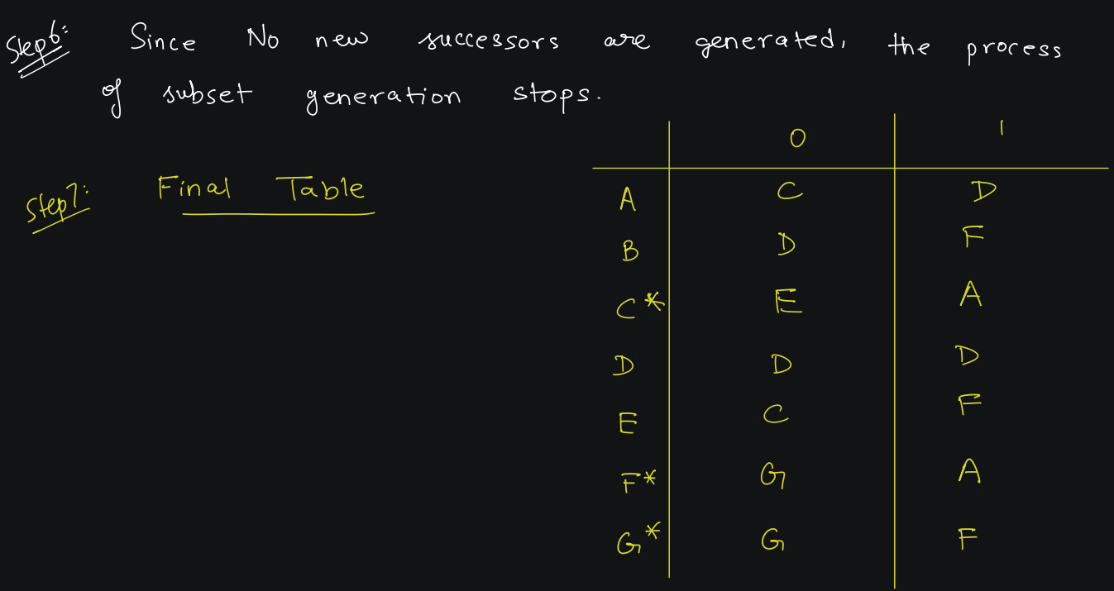

Slide 15
Practice Questions

Slide 16
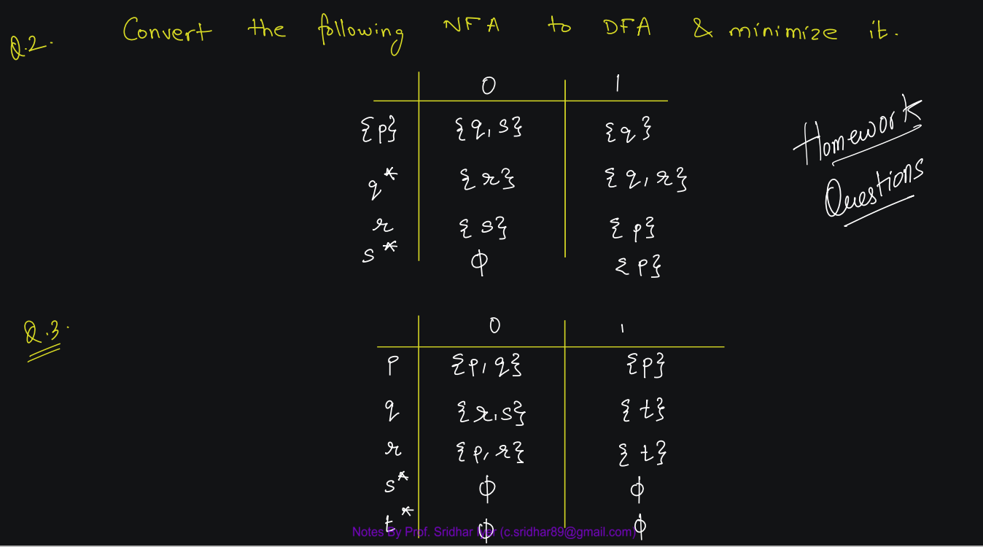

Slide 17
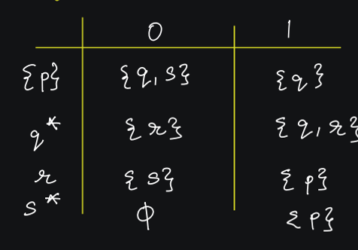

Slide 22
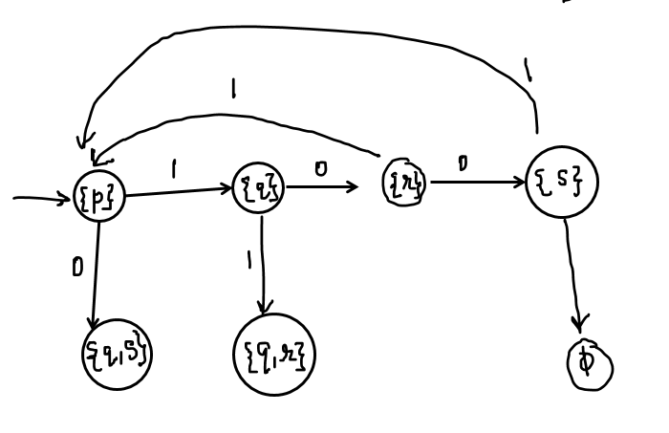

Slide 28
Box Method
(Myhill Nerode Theorem)

Slide 29
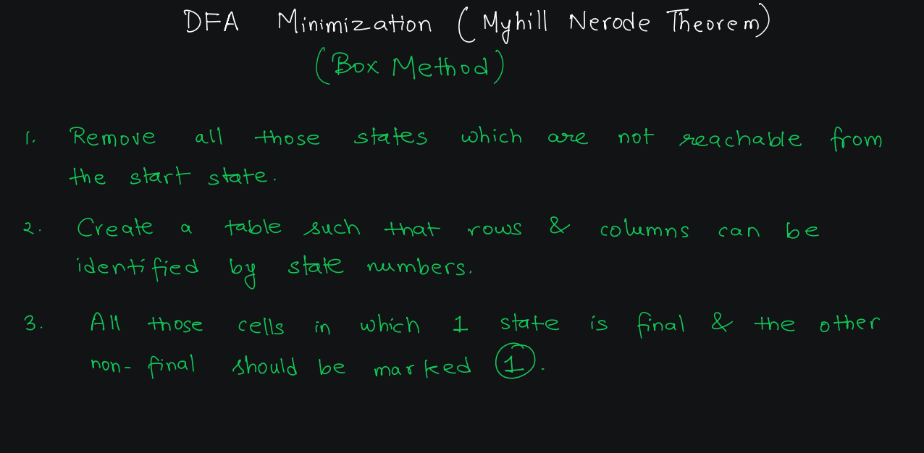

Slide 30
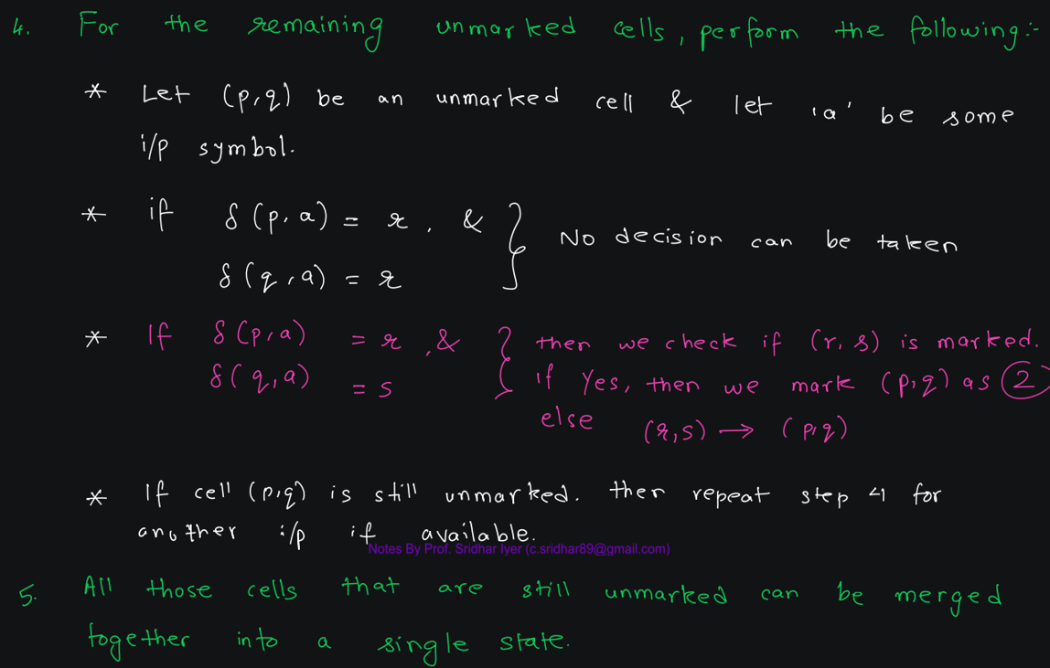

Slide 31
Example 1

Slide 32
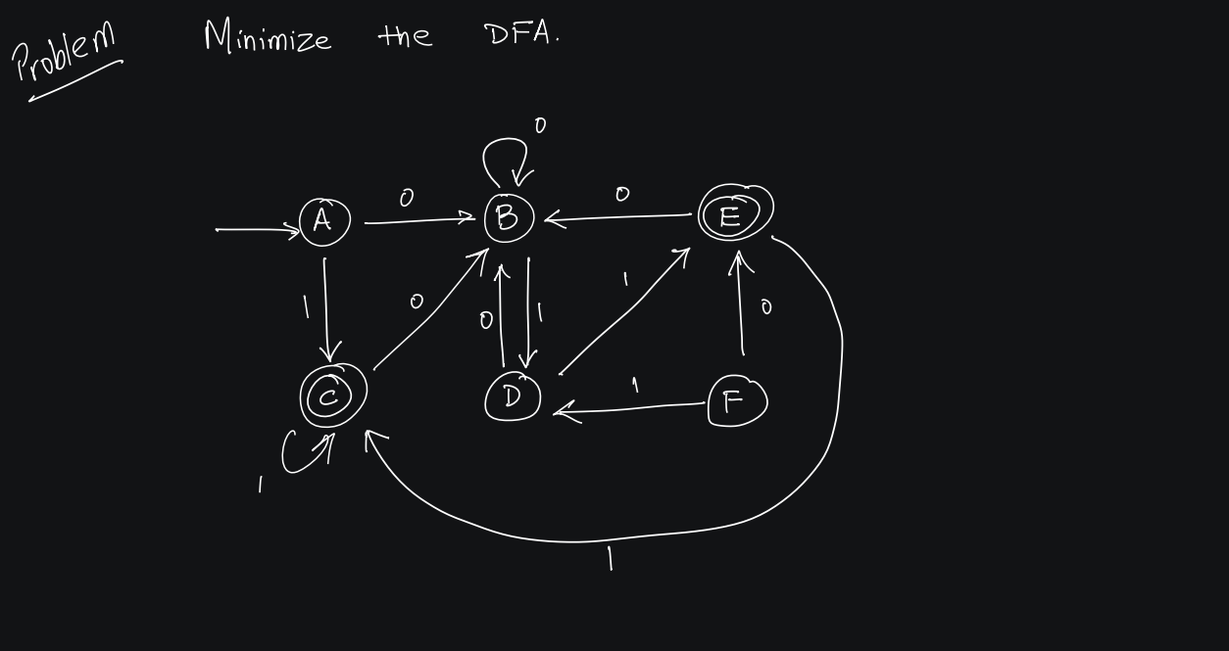

Slide 33
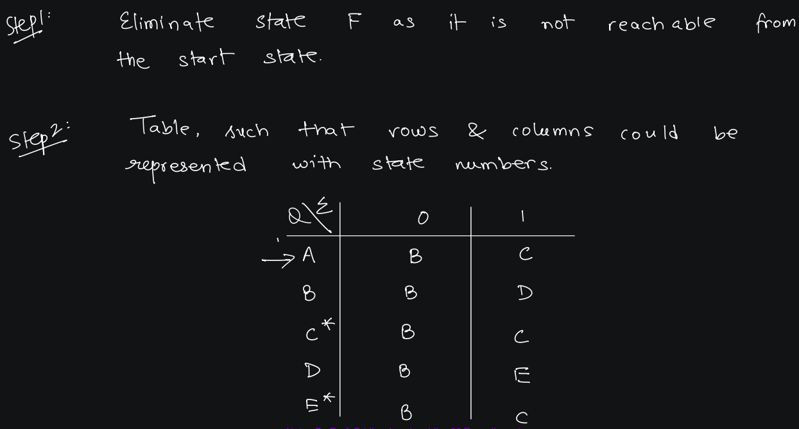

Slide 34
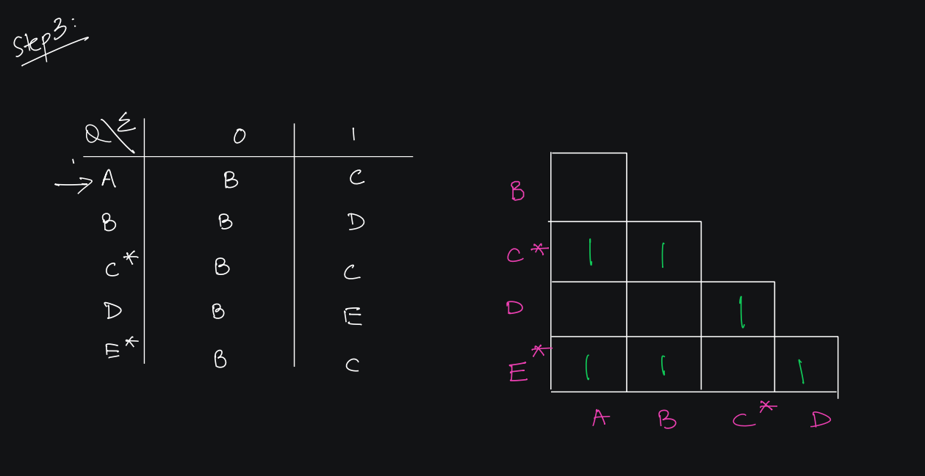

Slide 35
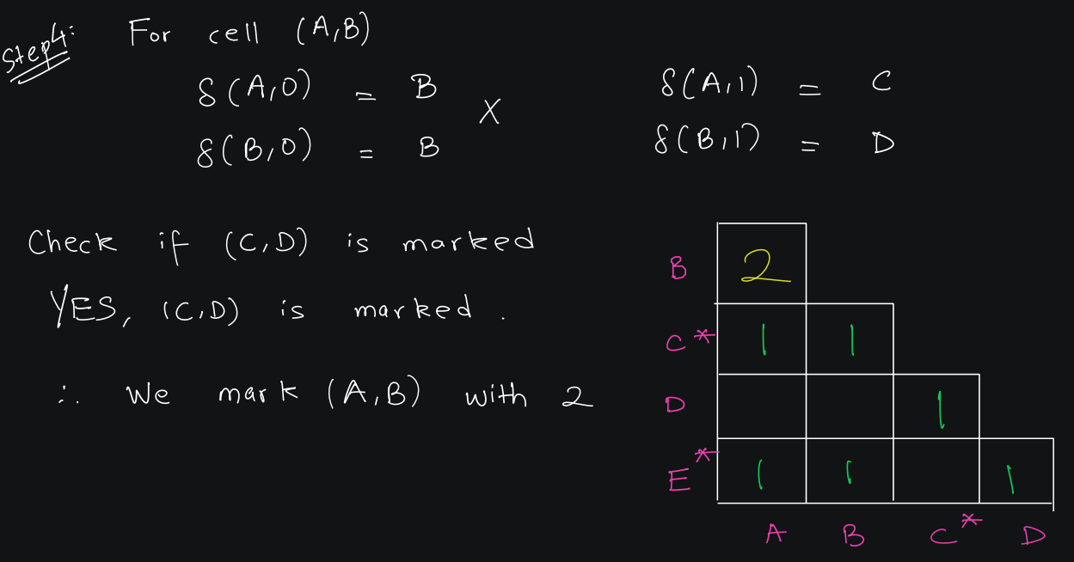

Slide 36
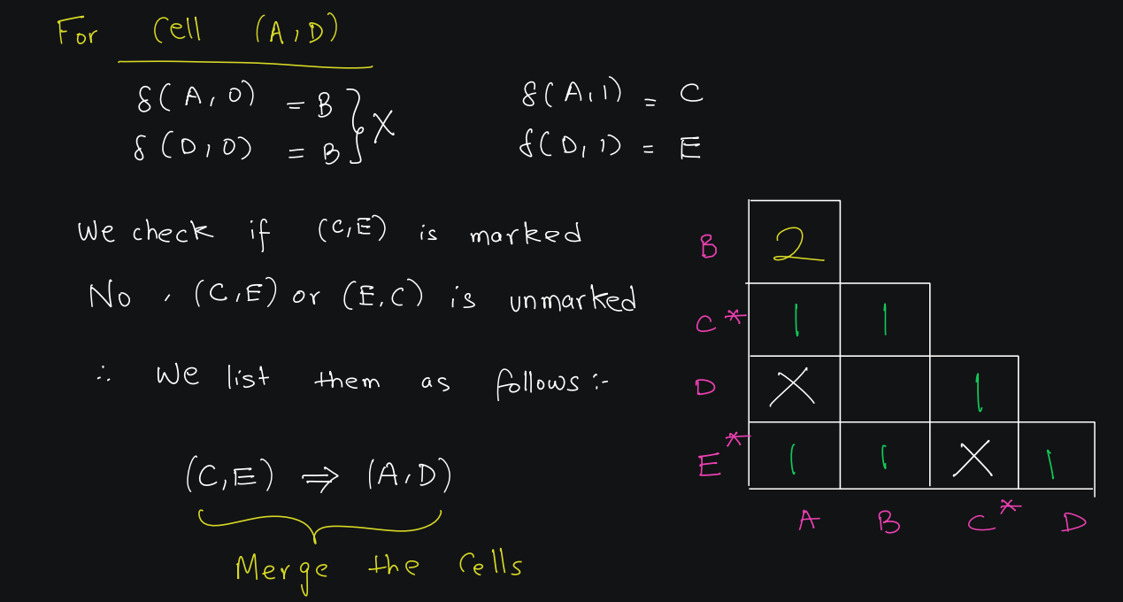

Slide 37
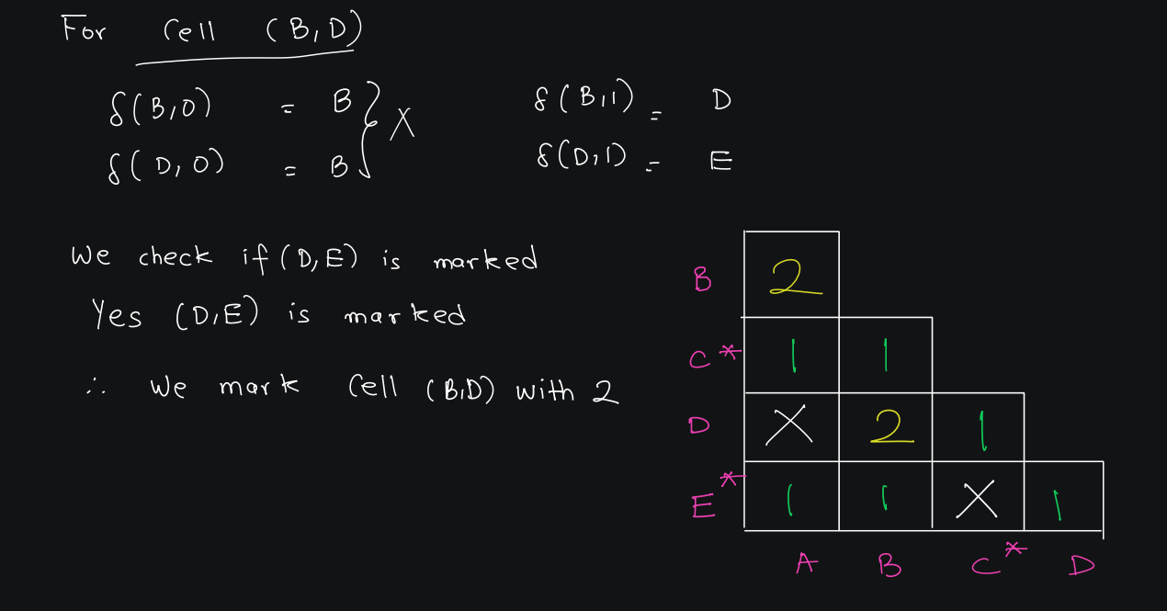

Slide 38
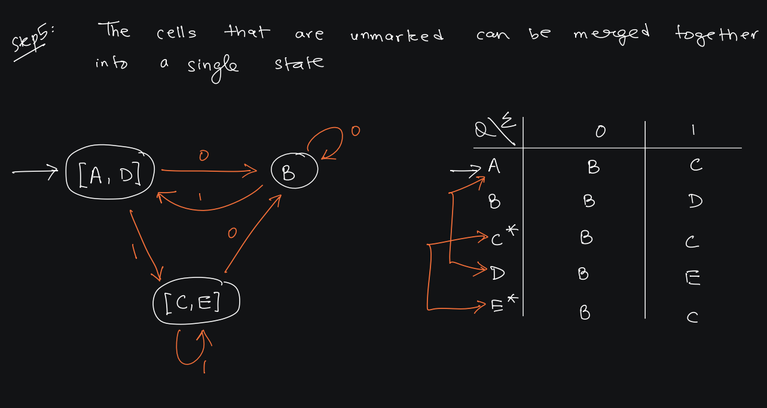

Slide 39
Example 2

Slide 40
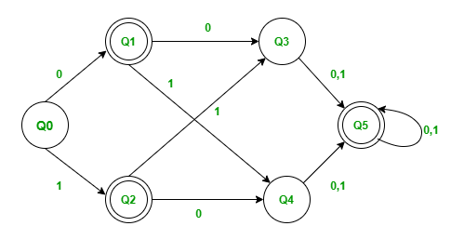
Minimize the DFA using Myhill Nerode Theorem

Slide 41
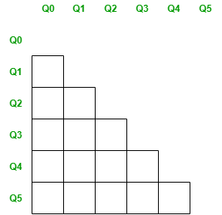
Step-1: Create the pairs of all the states involved in DFA.

Slide 42
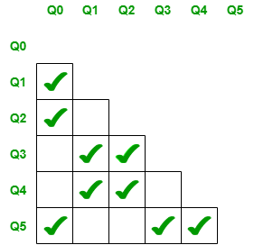
Step-2: Mark all the pairs (Qa,Qb) such a that Qa is Final state and Qb is Non-Final State.

Slide 43
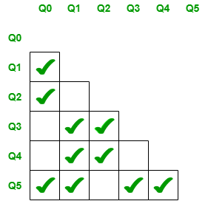
Step-3: If there is any unmarked pair (Qa,Qb) such a that δ(Qa,x) and δ(Qb,x) is marked, then mark (Qa,Qb). Here x is a input symbol. Repeat this step until no more marking can be made.
Check for the unmarked pair Q2,Q1
  Check when x=0 : δ(Q2,0) = Q4 and δ(Q1,0) = Q3, check if the pair Q4,Q3 is marked and no it is not marked.
  Check when x=1 : δ(Q2,1) = Q3 and δ(Q1,1) = Q4, check if the pair Q4,Q3 is marked and no it is not marked.
  Hence we cannot mark the pair Q2,Q1.
Check for the unmarked pair Q3,Q0
  Check when x=0 : δ(Q3,0) = Q5 and δ(Q0,0) = Q1, check if the pair Q5,Q1 is marked and no it is not marked.
  Check when x=1 : δ(Q3,1) = Q5 and δ(Q0,1) = Q2, check if the pair Q5,Q2 is marked and no it is not marked.
  Hence we cannot mark the pair Q3,Q0.
Check for the unmarked pair Q4,Q0
  Check when x=0 : δ(Q4,0) = Q5 and δ(Q0,0) = Q1, check if the pair Q5,Q1 is marked and no it is not marked.
  Check when x=1 : δ(Q4,1) = Q5 and δ(Q0,1) = Q2, check if the pair Q5,Q2 is marked and no it is not marked.
  Hence we cannot mark the pair Q4,Q0.
Check for the unmarked pair Q4,Q3
  Check when x=0 : δ(Q4,0) = Q5 and δ(Q3,0) = Q5, Such pair of state Q5,Q5 don’t exists.
  Check when x=1 : δ(Q4,1) = Q5 and δ(Q3,1) = Q5, Such pair of state Q5,Q5 don’t exists.
  Hence we cannot mark the pair Q4,Q3.
Check for the unmarked pair Q5,Q1
  Check when x=0 : δ(Q5,0) = Q5 and δ(Q1,0) = Q3, check if the pair Q5,Q3 is marked and yes it is marked.
  Hence we can mark the pair Q5,Q1.

Slide 44
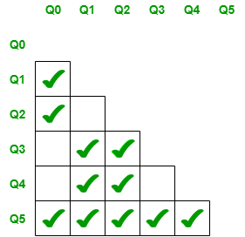
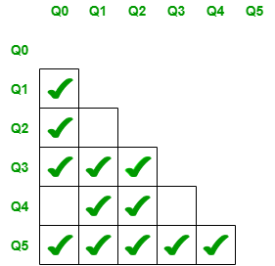
Check for the unmarked pair Q5,Q2
  Check when x=0 : δ(Q5,0) = Q5 and δ(Q2,0) = Q4, check if the pair Q5,Q4 is marked and yes it is marked.
  Hence we can mark the pair Q5,Q2.
We have checked for all the unmarked pairs but don’t need to stop here we need to continue this process until no more markings can be made.
Check for the unmarked pair Q2,Q1
  Check when x=0 : δ(Q2,0) = Q4 and δ(Q1,0) = Q3, check if the pair Q4,Q3 is marked and no it is not marked.
  Check when x=1 : δ(Q2,1) = Q3 and δ(Q1,1) = Q4, check if the pair Q4,Q3 is marked and no it is not marked.
  Hence we cannot mark the pair Q2,Q1.
Check for the unmarked pair Q3,Q0
  Check when x=0 : δ(Q3,0) = Q5 and δ(Q0,0) = Q1, check if the pair Q5,Q1 is marked and yes it is marked.
  Hence we can mark the pair Q3,Q0.

Slide 45
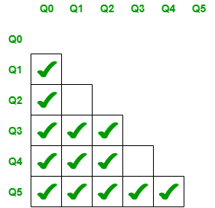
Check for the unmarked pair Q4,Q0
  Check when x=0 : δ(Q4,0) = Q5 and δ(Q0,0) = Q1, check if the pair Q5,Q1 is marked and yes it is marked.
  Hence we cannot mark the pair Q4,Q0.
Check for the unmarked pair Q4,Q3
  Check when x=0 : δ(Q4,0) = Q5 and δ(Q3,0) = Q5, Such pair of state Q5,Q5 don’t exists.
  Check when x=1 : δ(Q4,1) = Q5 and δ(Q3,1) = Q5, Such pair of state Q5,Q5 don’t exists.
  Hence we cannot mark the pair Q4,Q3
Now even though we repeat the procedure we cannot mark the pairs Q2,Q1(since Q4,Q3 is not marked) and Q4,Q3(since Q5,Q5 such pair of states does not exists.). Hence we stop here

Slide 46
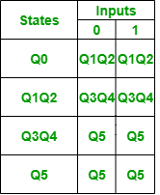

Step-4: Combine all the unmarked pairs and make them as a single state in the minimized DFA.
The unmarked Pairs are Q2,Q1 and Q4,Q3 hence we combine them.
Following is the Minimized DFA with Q1Q2 and Q3Q4 as the combined states.
Transition table for Minimized DFA

