Slide 1

FORMAL LANGUAGES AND
AUTOMATA THEORY
Third Year Computer Engineering
DJS22CEC504

Slide 2

FLOW OF CONTENTS
·
·
·
·
·

Slide 3
What is Theory of Computation (TOC)?
The Theory of Computation is a branch of computer science that aims to understand the nature of computation - the systematic application of mathematical and logical methods to describe and model algorithms, computational processes and their efficiency.
This includes the design of computing machines, understanding the limitations of computation, classifying problems based on their complexity, and the study of automata and formal languages.

Slide 4
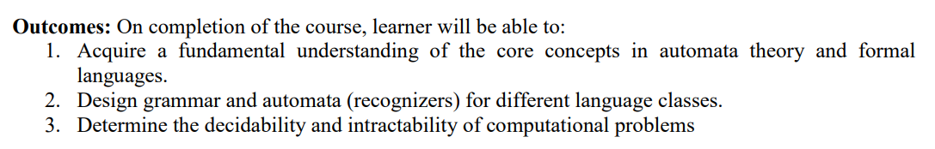
COURSE OUTCOMES

Slide 5
SYLLABUS
Module 1: Fundamentals

Slide 6
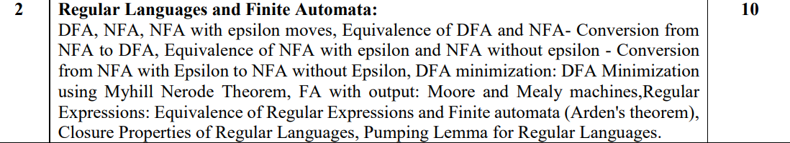
SYLLABUS
Module 2: Regular Languages and Finite Automata

Slide 7
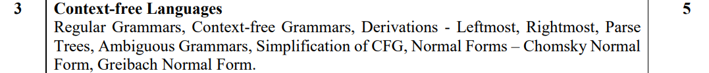
SYLLABUS
Module 3: Context-free Languages

Slide 8
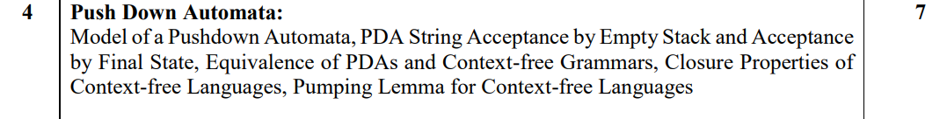
SYLLABUS
Module 4: Push Down Automata

Slide 9
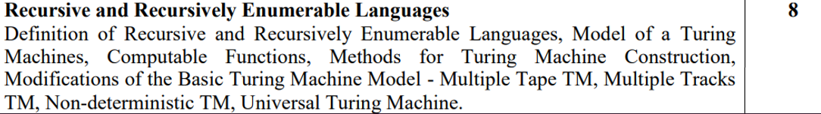
SYLLABUS
Module 5: Recursive and Recursively Enumerable Languages

Slide 10
SYLLABUS
Module 5: Decidability and Undecidability

Slide 11
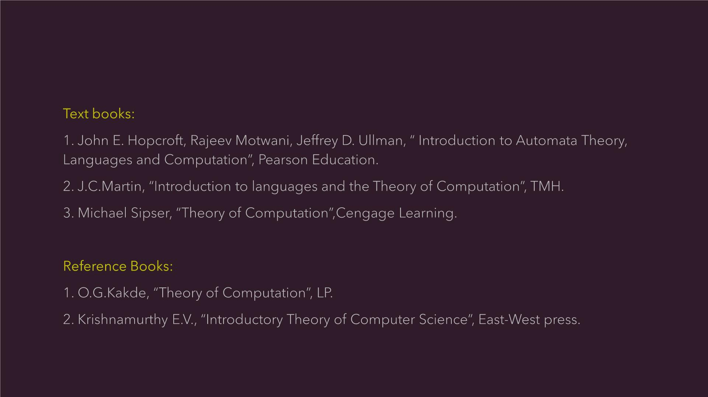
BOOKS RECOMMENDED

Slide 12
What is Automata in Theory of Computation?
Automata in the theory of computation refers to abstract self-driven computing devices or systems that follow a predetermined sequence of operations automatically.
They are mathematical models of machines which perform computations on an input by moving through a series of states or configurations according to a set of rules.
Basic types of automata include Finite Automata (FA), Pushdown Automata (PDA), and Turing machines. The study of automata helps us understand the computational aspects of problems.

Slide 13
How important is Theory of Computation?
The Theory of Computation is incredibly important as it lays the foundation for computer science by determining what problems can and cannot be solved by computation.
It helps in understanding the limits of what computers can do, thereby guiding the design of algorithms, data structures, and software.
Moreover, it is essential in the development of efficient solutions and new computational models. Overall, it greatly contributes to technological advancements and problem-solving strategies.

Slide 14
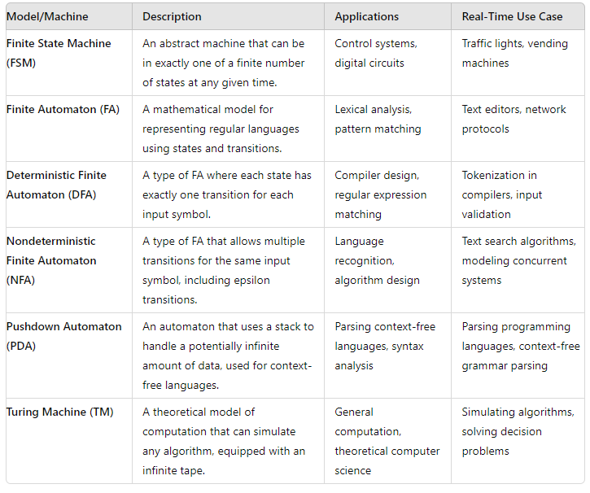
Applications of TOC
Real-Time Use Cases:
Finite State Machine (FSM):
  Traffic Lights: FSMs are used to control the sequence of traffic lights, ensuring orderly transitions between states (e.g., red, yellow, green).
Finite Automaton (FA):
  Text Editors: FAs are used for syntax highlighting and pattern matching, helping identify keywords and syntax errors in real-time.
Deterministic Finite Automaton (DFA):
  Tokenization in Compilers: DFAs are used to tokenize input source code into a stream of tokens, which are then used in the syntax analysis phase.

Slide 15
Applications of TOC
Real-Time Use Cases:
Nondeterministic Finite Automaton (NFA):
  Text Search Algorithms: NFAs are utilized in algorithms like the Thompson construction for regular expression matching, allowing efficient search patterns in texts.
Pushdown Automaton (PDA):
  Parsing Programming Languages: PDAs are employed in the syntax analysis phase of compilers to parse the structure of programming languages based on context-free grammars.
Turing Machine (TM):
  Simulating Algorithms: TMs can simulate any computational process, making them a fundamental model for understanding the limits of what can be computed. They are used in theoretical computer science to prove the decidability and undecidability of problems.

Slide 16
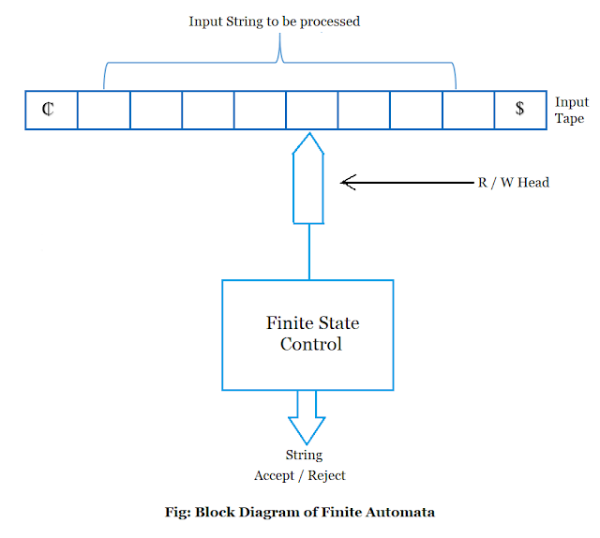
Few Examples
A Finite Automata

Slide 17
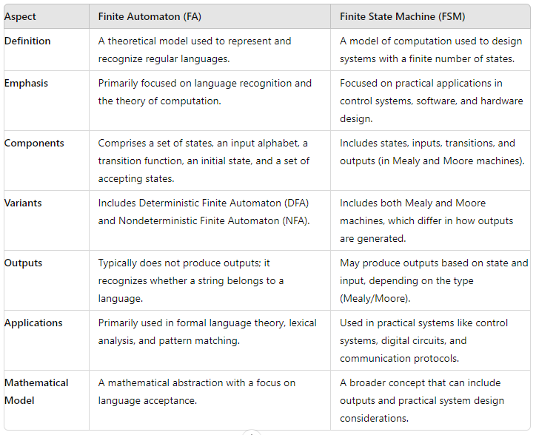
Finite Automata Vs Finite State Machines
Finite Automaton (FA) is generally used in the context of formal language theory and computational theory. It's a mathematical model that accepts or rejects strings of symbols and recognizes languages.
Finite State Machine (FSM) is a broader concept often used in engineering and practical applications. It can include additional features like outputs and is used to model and design systems that transition between states based on inputs.
In summary, while FA and FSM have overlapping concepts, FAs are more theoretical and focused on language recognition, whereas FSMs are more practical and can include additional features like outputs for modeling real-world systems.

Slide 18
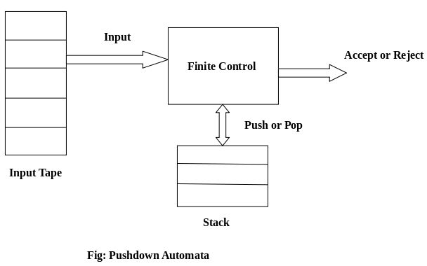
Few Examples
A Push Down Automata

Slide 19
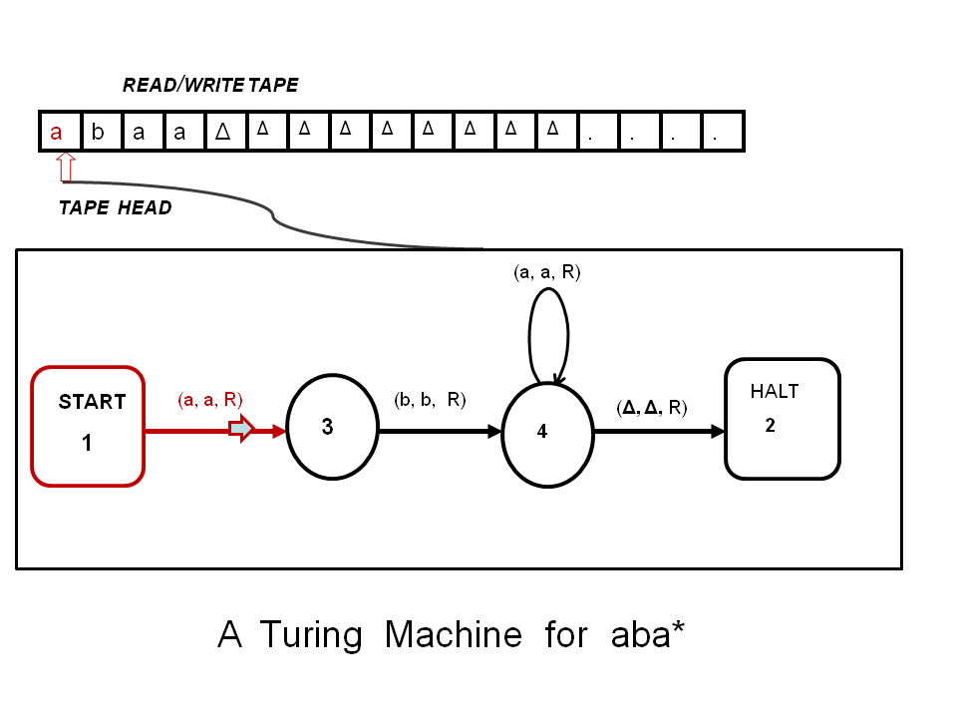
Few Examples
A Turing Machine

Slide 20
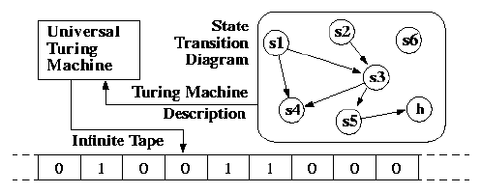
Few Examples
An Universal Turing Machine

