Slide 1
React JS
By: Prof. Sridhar Iyer
B.E, M.E, C.E.H, PhD (Pursuing)
Dept. of Computer Engineering
Dwarkadas J. Sanghvi College of Engineering

Slide 2


Slide 3
React Components
Components are independent and reusable bits of code. They serve the same purpose as JavaScript functions, but work in isolation and return HTML via a render() function.
Components come in two types,
  Class components
  Function components

Slide 4
Create a Class Component
When creating a React component, the component's name must start with an upper case letter.
The component has to include the extends React.Component statement, this statement creates an inheritance to React.Component, and gives your component access to React.Component's functions.
The component also requires a render() method, this method returns HTML.

Slide 5
Example
Create a Class component called Car
  class Car extends React.Component {
  render() {
  return <h2>Hi, I am a Car!</h2>;
  }
  }
Now your React application has a component called Car, which returns a <h2> element.
To use this component in your application, use similar syntax as normal HTML: <Car />

Slide 6
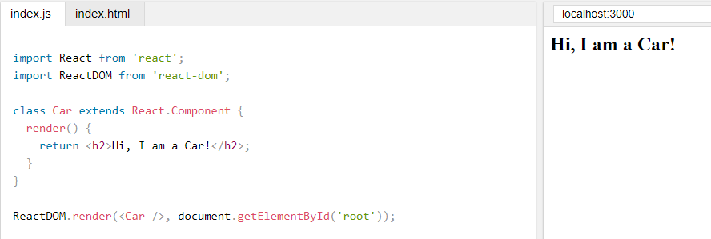

Slide 7
Create a Function Component
A Function component also returns HTML, and behaves pretty much the same way as a Class component, but Class components have some additions
Example
Create a Function component called Car
  function Car() {
  return <h2>Hi, I am also a Car!</h2>;
  }
Once again your React application has a Car component.

Slide 8
import React from 'react';
import ReactDOM from 'react-dom';
export default function Example1() {
return (
<div>
<h4> Example 1</h4>
<p>I Love JSX!</p>
</div>
);
}

Slide 9
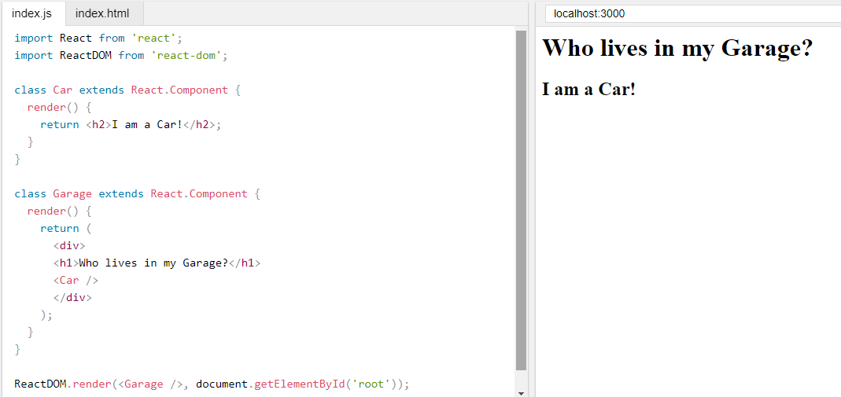
Components in Components

Slide 10
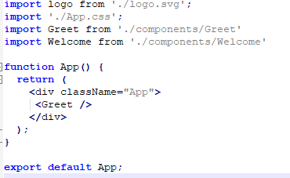
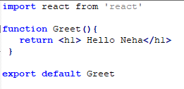

Example
Greet.js a functional component
In src folder inside the folder components
Import in App.js

Slide 11
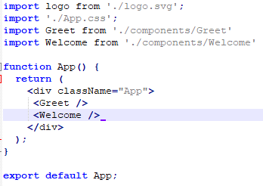
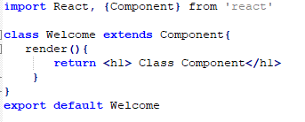

Example
Welcome.js is a class component
Inside the folder components
Import in App.js

Slide 12


Slide 13
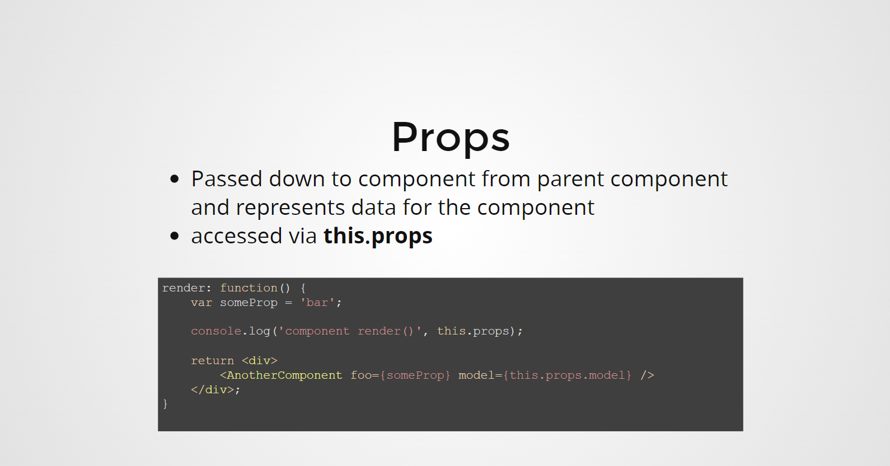

Slide 14
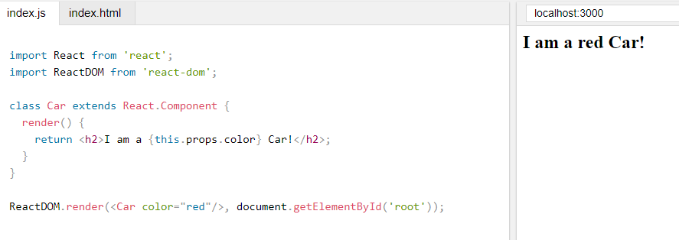
Props
Another way of handling component properties is by using props.
Props are like function arguments, and you send them into the component as attributes.

Slide 15
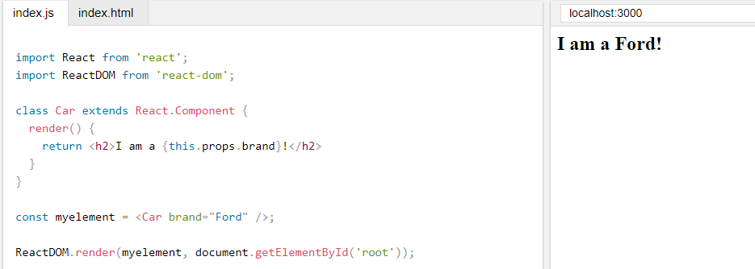
React Props
Props are arguments passed into React components.
Props are passed to components via HTML attributes.
React Props are like function arguments in JavaScript and attributes in HTML.
To send props into a component, use the same syntax as HTML attributes

Slide 16
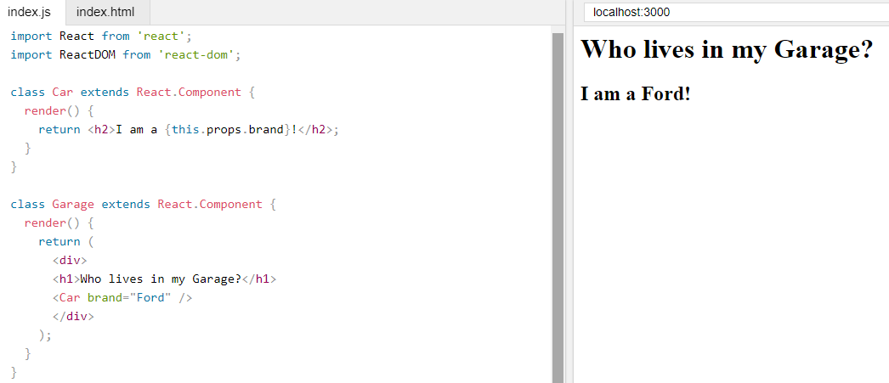
Pass Data
Props are also how you pass data from one component to another, as parameters.

Slide 17
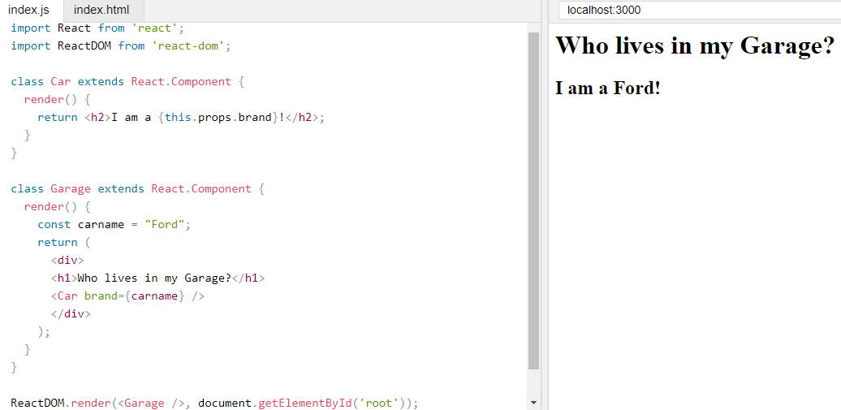
If you have a variable to send, and not a string as in the example above, you just put the variable name inside curly brackets:

Slide 18
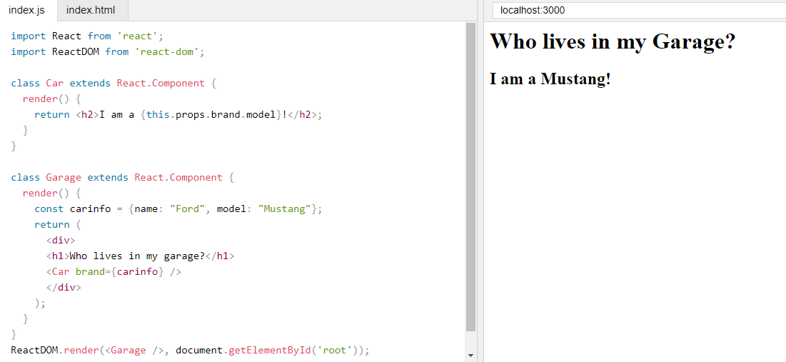

Slide 19
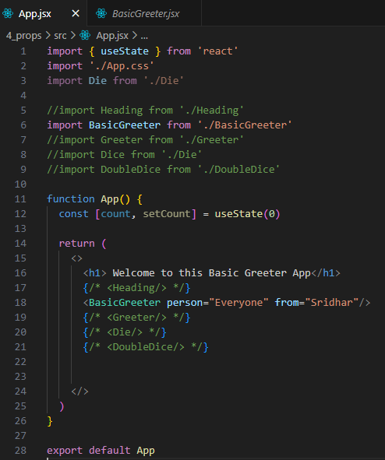
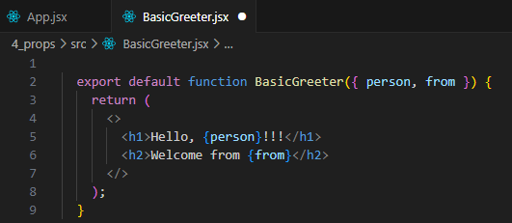

Basic Greeter App

Slide 20
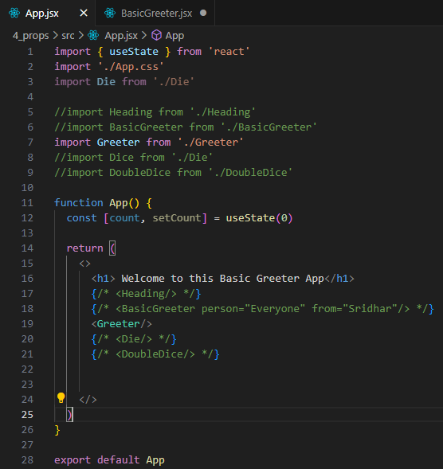
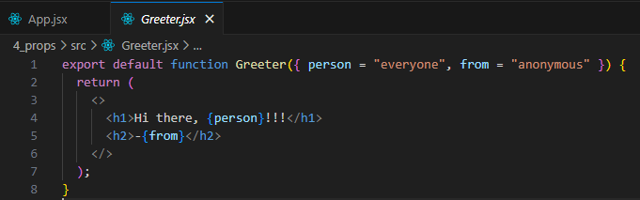

Advanced Greeter App

Slide 21
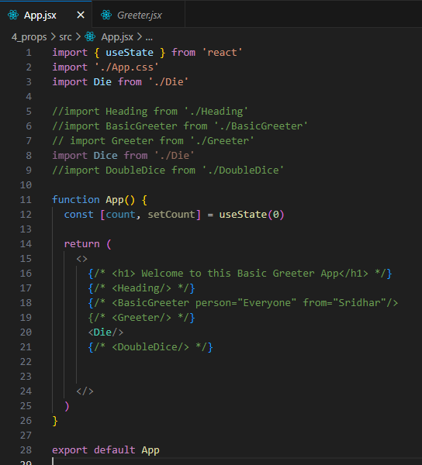
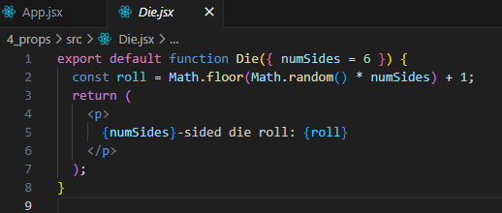

Die App

Slide 22
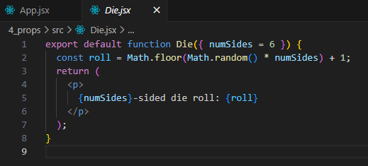

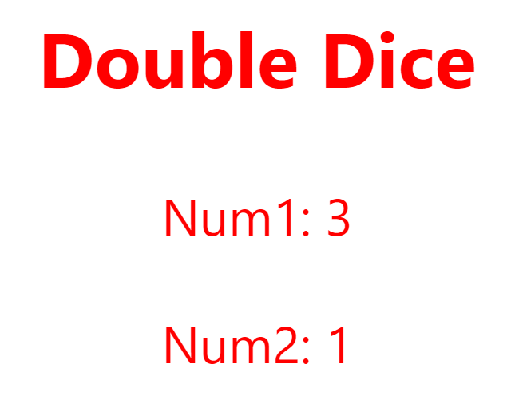
Double Dice App

Slide 23


Slide 24
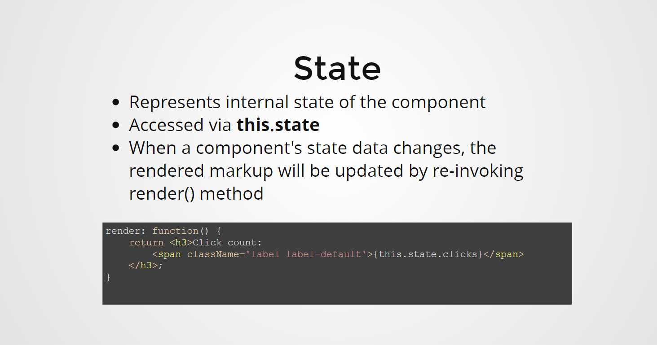

Slide 25
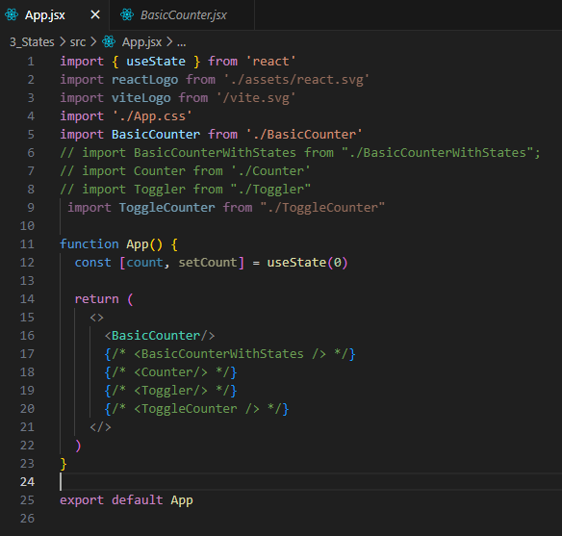
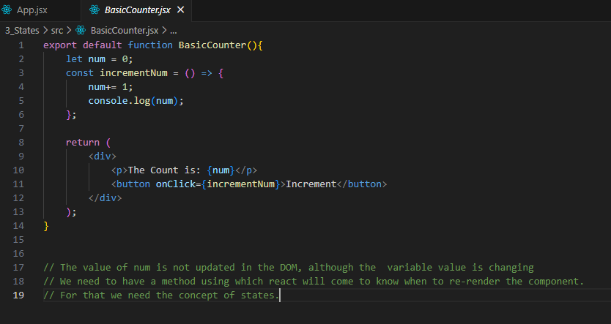
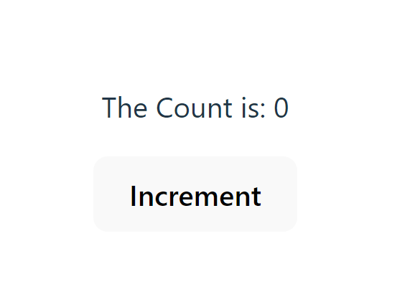
Basic Counter Example

Slide 26
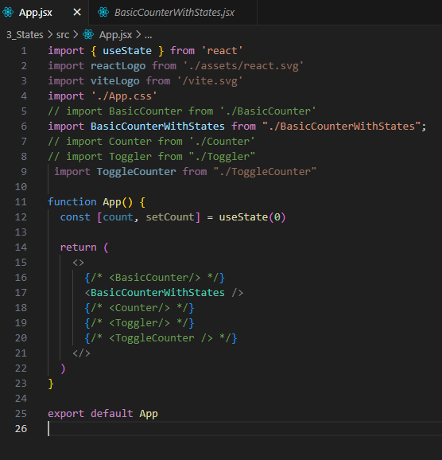
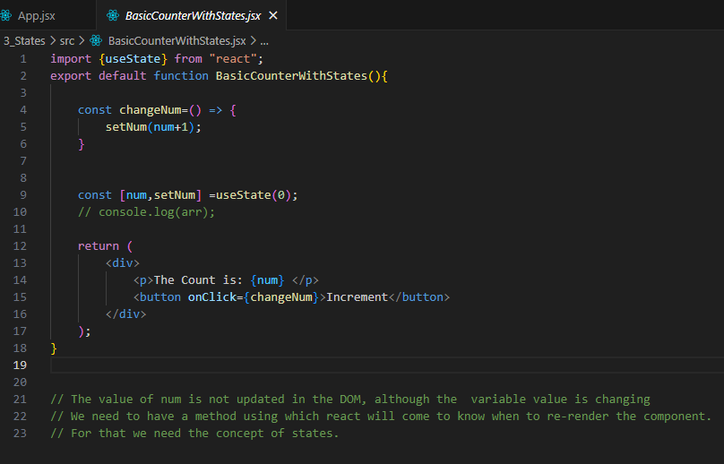
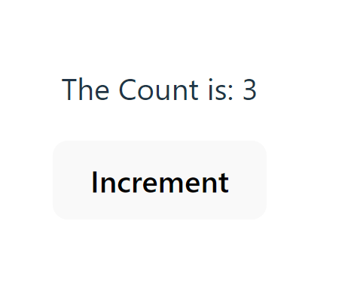
Basic Counter with State Example

Slide 27
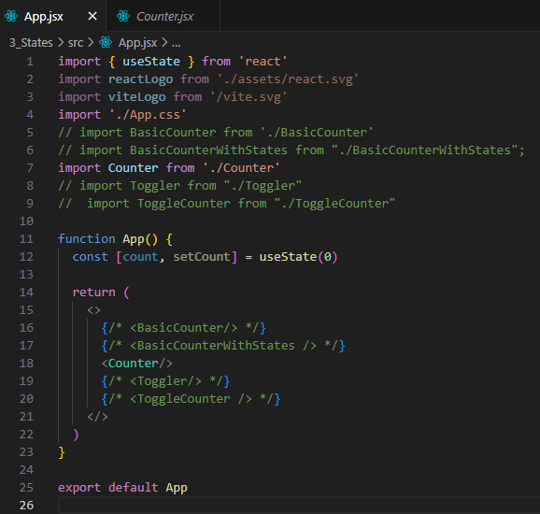
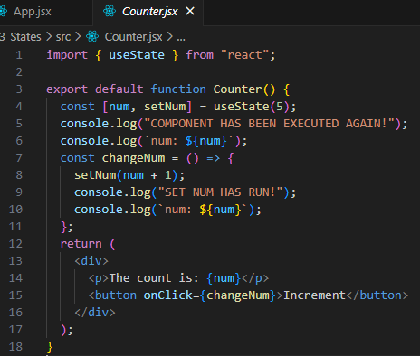
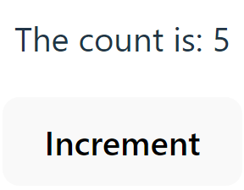
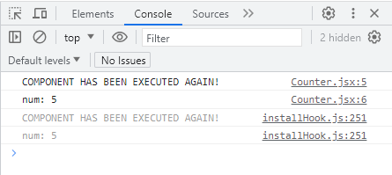
Counter Example

Slide 28
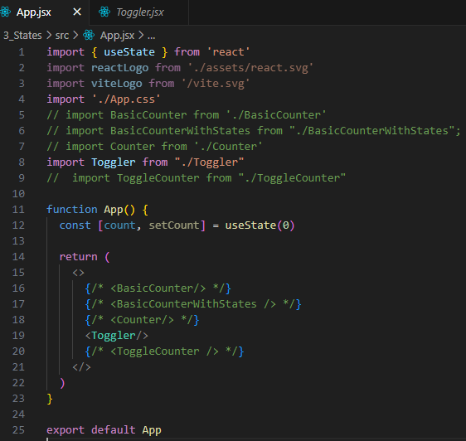
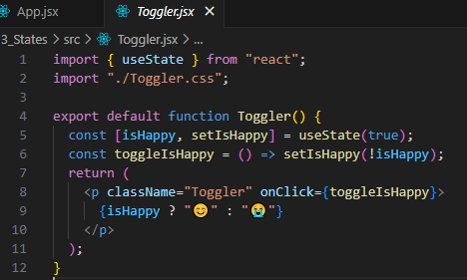


Toggler Example

Slide 29
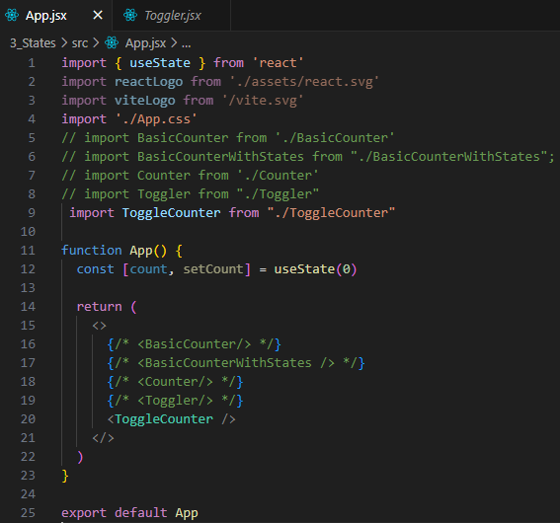

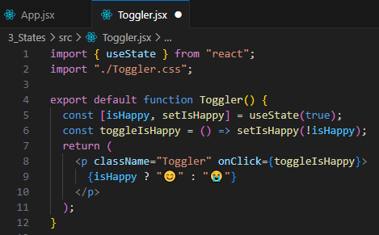
Toggle Counter Example

Slide 30


Slide 31
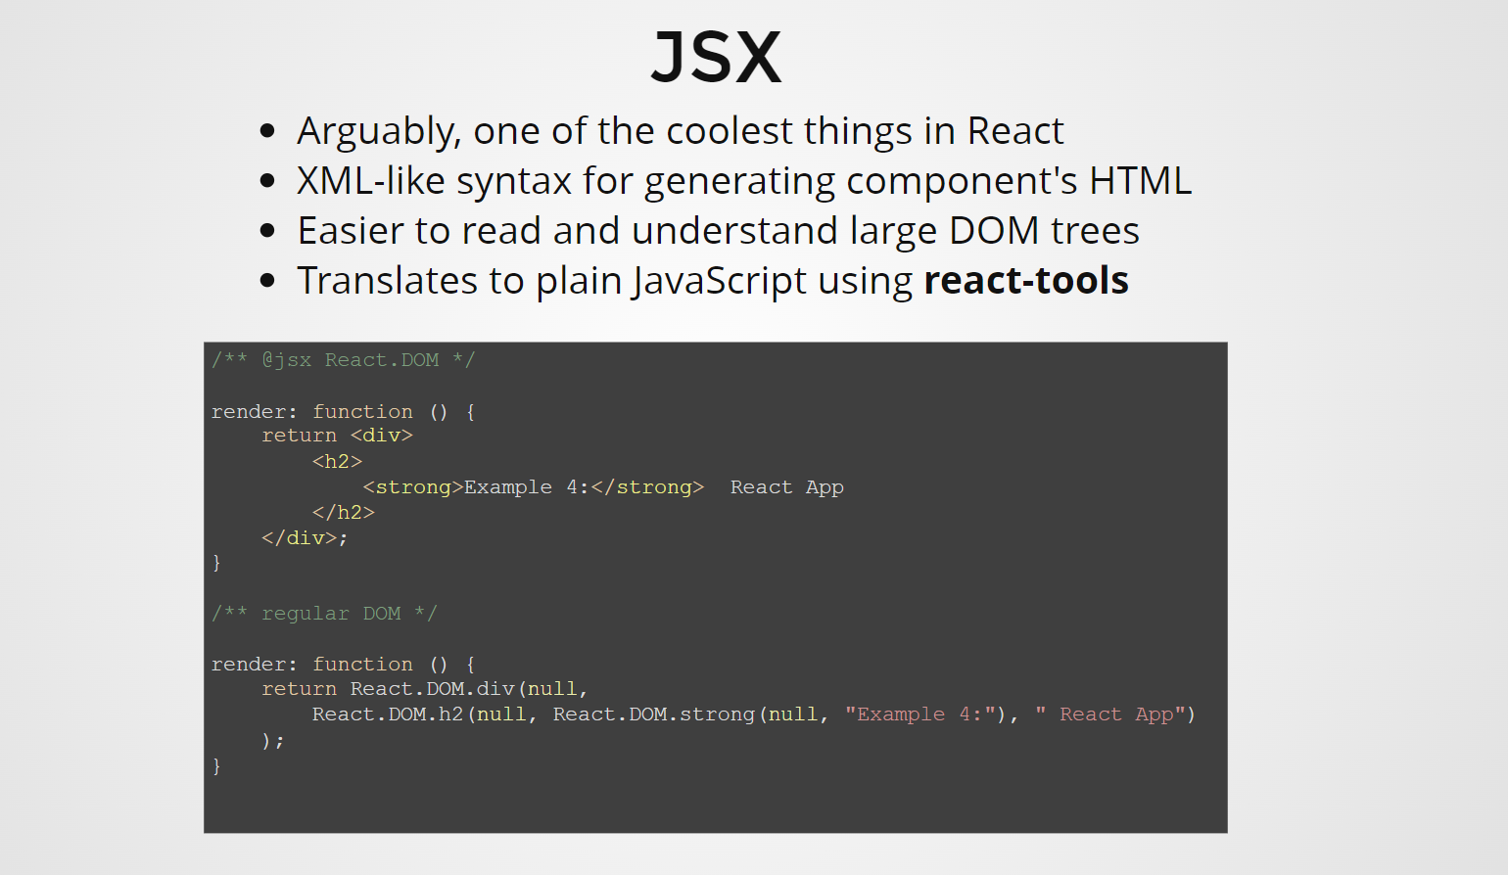

Slide 32


Slide 33
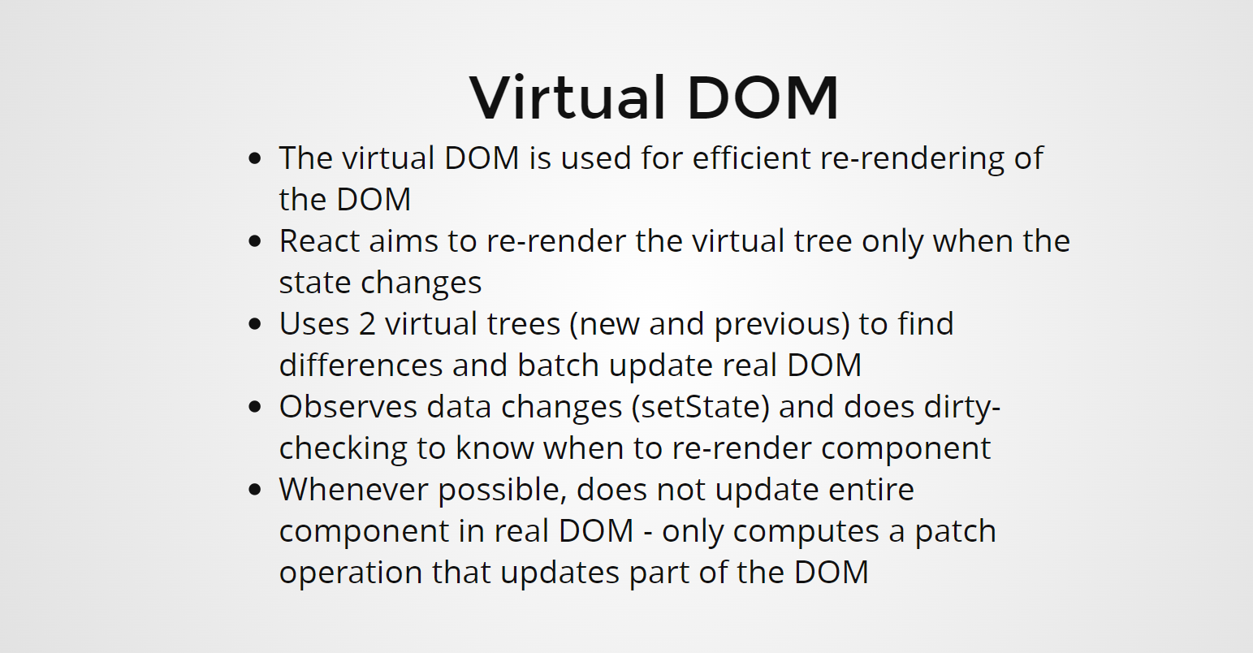

Slide 34
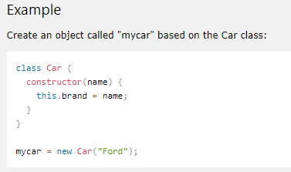
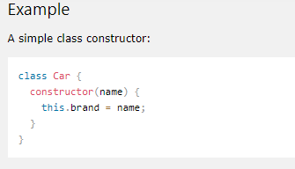
Classes
ES6 introduced classes.
A class is a type of function, but instead of using the keyword function to initiate it, we use the keyword class, and the properties are assigned inside a constructor() method.

Slide 35
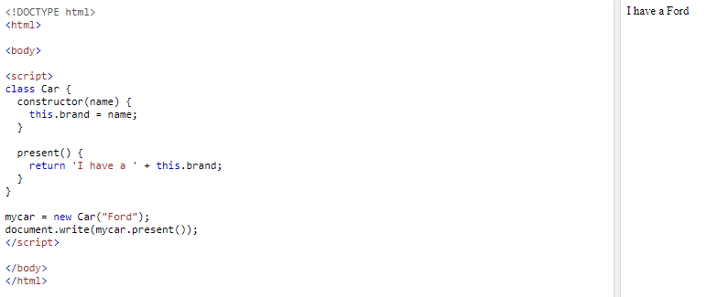
Method in Classes

Slide 36
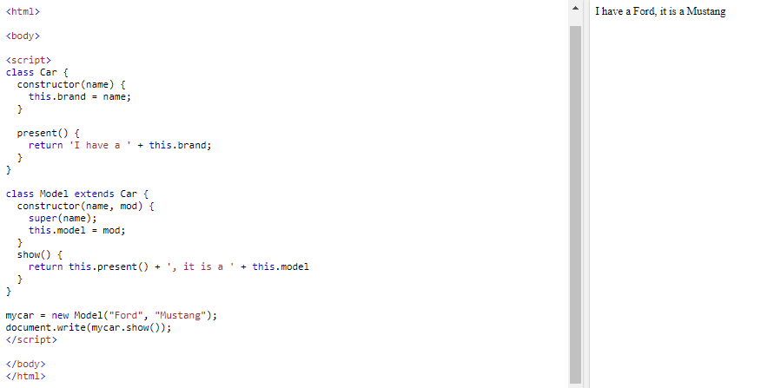
Class Inheritance
To create a class inheritance, use the extends keyword.
A class created with a class inheritance inherits all the methods from another class

Slide 37
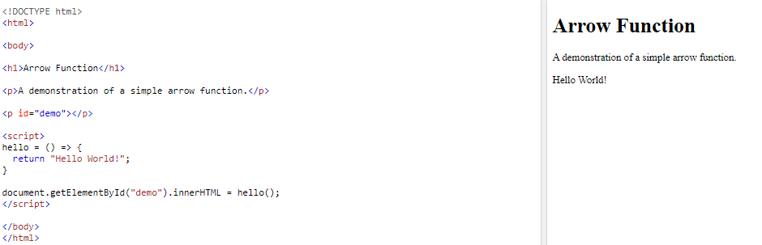
Arrow Functions
Arrow functions were introduced in ES6.
Arrow functions allow us to write shorter function syntax

Slide 38
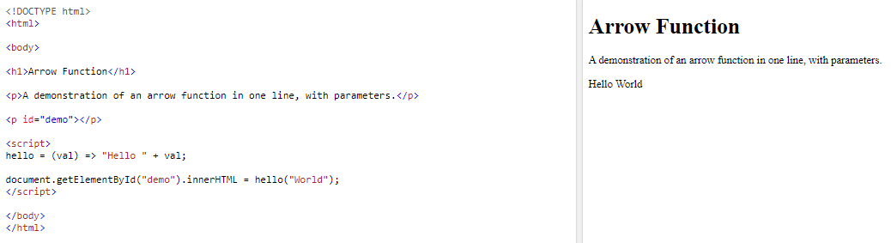
Arrow Function With Parameters:

Slide 39
this keyword
The handling of this is also different in arrow functions compared to regular functions.
In short, with arrow functions there are no binding of this.
In regular functions the this keyword represented the object that called the function, which could be the window, the document, a button or whatever.
With arrow functions, the this keyword always represents the object that defined the arrow function.

Slide 40
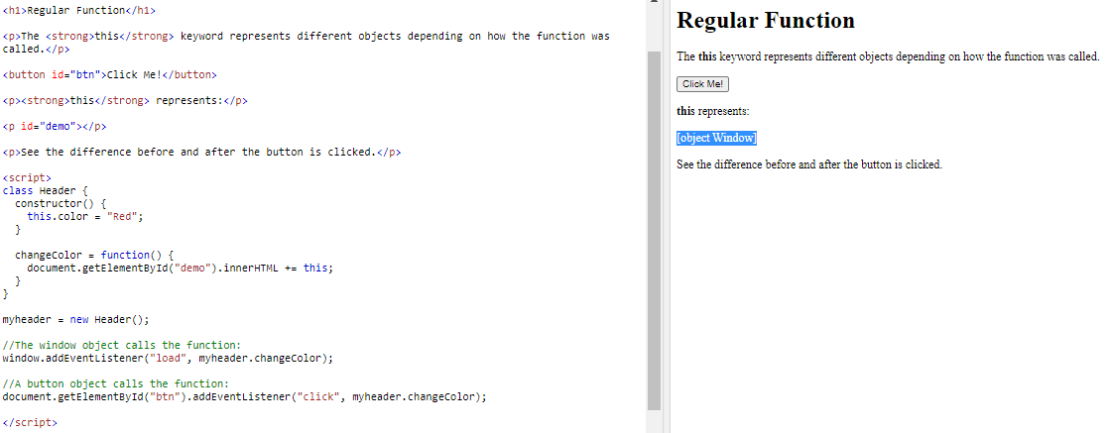
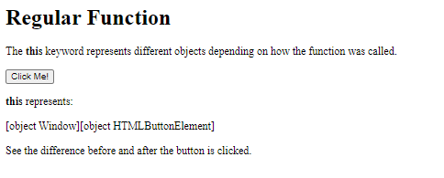
Example
With a regular function, this represents the object that called the function

Slide 41
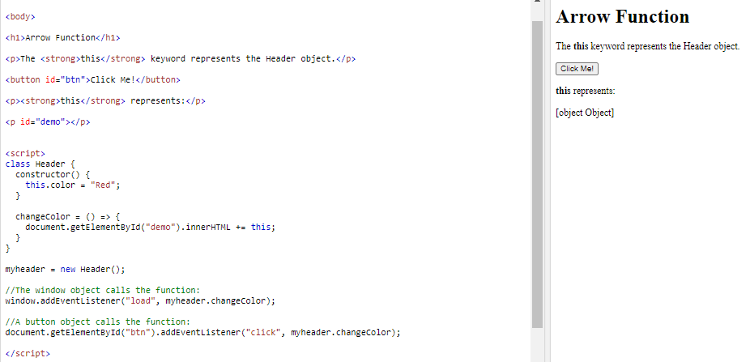
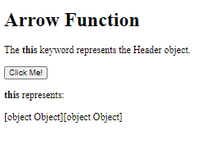
With an arrow function, this represents the Header object no matter who called the function:

Slide 42
React Render HTML
React's goal is in many ways to render HTML in a web page.
React renders HTML to the web page by using a function called ReactDOM.render().
The ReactDOM.render() function takes two arguments, HTML code and an HTML element.
The purpose of the function is to display the specified HTML code inside the specified HTML element

Slide 43
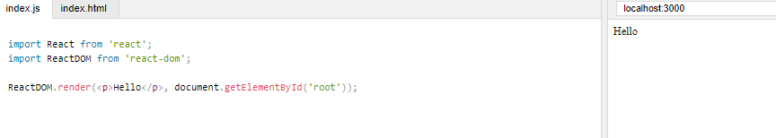
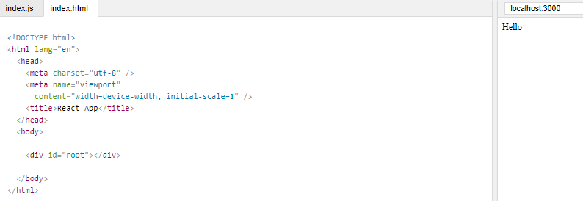
Example
Display a paragraph inside the "root" element:

Slide 44
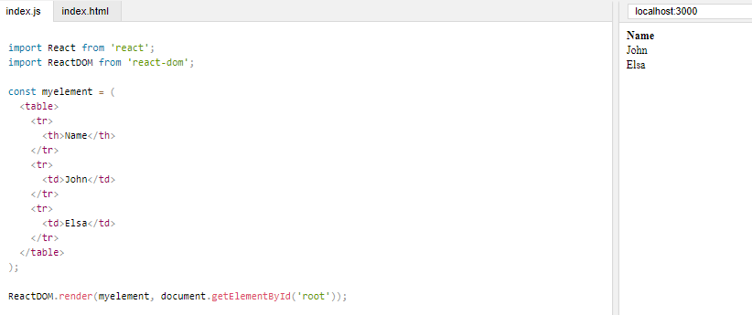
The HTML Code
Create a variable that contains HTML code and display it in the root node:

Slide 45


The Root Node
The root node is the HTML element where you want to display the result.
It is like a container for content managed by React.
It does NOT have to be a <div> element and it does NOT have to have the id='root':

Slide 46
React JSX
JSX stands for JavaScript XML.
JSX allows us to write HTML in React.
JSX makes it easier to write and add HTML in React.
JSX allows us to write HTML elements in JavaScript and place them in the DOM without any createElement() and/or appendChild() methods.
JSX converts HTML tags into react elements.

Slide 47

Example
Uses JSX

Slide 48

Example
Not use JSX

Slide 49

Expressions in JSX
With JSX you can write expressions inside curly braces { }.
The expression can be a React variable, or property, or any other valid JavaScript expression. JSX will execute the expression and return the result

Slide 50

Inserting a Large Block of HTML
To write HTML on multiple lines, put the HTML inside parentheses

Slide 51

One Top Level Element
The HTML code must be wrapped in ONE top level element.
So if you like to write two headers, you must put them inside a parent element, like a div element

Slide 52

Elements Must be Closed
JSX follows XML rules, and therefore HTML elements must be properly closed.

Slide 53
React State
React components has a built-in state object.
The state object is where you store property values that belongs to the component.
When the state object changes, the component re-renders.

Slide 54

Creating the state Object
The state object is initialized In the constructor

Slide 55

The state object can contain as many properties as you like:

Slide 56

Using the state Object
Refer to the state object anywhere in the component by using the this.state.propertyname syntax

Slide 57
Changing the state Object
To change a value in the state object, use the this.setState() method.
When a value in the state object changes, the component will re-render, meaning that the output will change according to the new value(s).

Slide 58


Example

Slide 59
React Lifecycle
Each component in React has a lifecycle which you can monitor and manipulate during its three main phases.
The three phases are:
  Mounting,
  Updating
  Unmounting.

Slide 60
Mounting
Mounting means putting elements into the DOM.
React has four built-in methods that gets called, in this order, when mounting a component:
  constructor()
  getDerivedStateFromProps()
  render()
  componentDidMount()
The render() method is required and will always be called, the others are optional and will be called if you define them.

Slide 61
constructor
The constructor() method is called before anything else, when the component is initiated, and it is the natural place to set up the initial state and other initial values.
The constructor() method is called with the props, as arguments, and you should always start by calling the super(props) before anything else, this will initiate the parent's constructor method and allows the component to inherit methods from its parent (React.Component).

Slide 62

Example
The constructor method is called, by React, every time you make a component:

Slide 63
getDerivedStateFromProps
The getDerivedStateFromProps() method is called right before rendering the element(s) in the DOM.
This is the natural place to set the state object based on the initial props.
It takes state as an argument, and returns an object with changes to the state.

Slide 64

Example
The getDerivedStateFromProps method is called right before the render method:

Slide 65

render
The render() method is required, and is the method that actually outputs the HTML to the DOM.

Slide 66
componentDidMount
The componentDidMount() method is called after the component is rendered.
This is where you run statements that requires that the component is already placed in the DOM.

Slide 67

Example
https://www.w3schools.com/react/showreact.asp?filename=demo2_react_lifecycle_componentdidmount

Slide 68
Updating
The next phase in the lifecycle is when a component is updated.
A component is updated whenever there is a change in the component's state or props.
React has five built-in methods that gets called, in this order, when a component is updated:
  getDerivedStateFromProps()
  shouldComponentUpdate()
  render()
  getSnapshotBeforeUpdate()
  componentDidUpdate()
The render() method is required and will always be called, the others are optional and will be called if you define them.

Slide 69
getDerivedStateFromProps
Also at updates the getDerivedStateFromProps method is called. This is the first method that is called when a component gets updated.
This is still the natural place to set the state object based on the initial props.
The following example has a button that changes the favorite color to blue, but since the getDerivedStateFromProps() method is called, which updates the state with the color from the favcol attribute, the favorite color is still rendered as yellow:

Slide 70

Example

Slide 71

shouldComponentUpdate
In the shouldComponentUpdate() method you can return a Boolean value that specifies whether React should continue with the rendering or not.
The default value is true.

Slide 72


Example
Return true

Slide 73

render
The render() method is of course called when a component gets updated, it has to re-render the HTML to the DOM, with the new changes.
The example below has a button that changes the favorite color to blue:

Slide 74
getSnapshotBeforeUpdate
In the getSnapshotBeforeUpdate() method you have access to the props and state before the update, meaning that even after the update, you can check what the values were before the update.
If the getSnapshotBeforeUpdate() method is present, you should also include the componentDidUpdate() method, otherwise you will get an error.

Slide 75

Example

Slide 76
componentDidUpdate
The componentDidUpdate method is called after the component is updated in the DOM.
In the following example:
  When the component is mounting it is rendered with the favorite color "red".
  When the component has been mounted, a timer changes the state, and the color becomes "yellow".
  This action triggers the update phase, and since this component has a componentDidUpdate method, this method is executed and writes a message in the empty DIV element:

Slide 77

Example

Slide 78
Unmounting
The next phase in the lifecycle is when a component is removed from the DOM, or unmounting as React likes to call it.
React has only one built-in method that gets called when a component is unmounted:
  componentWillUnmount()

Slide 79
componentWillUnmount
The componentWillUnmount method is called when the component is about to be removed from the DOM.
https://www.w3schools.com/react/showreact.asp?filename=demo2_react_lifecycle_componentwillunmount

Slide 80
React Events
Just like HTML, React can perform actions based on user events.
React has the same events as HTML: click, change, mouseover etc.
Adding Events
  React events are written in camelCase syntax:
    onClick instead of onclick.
  React event handlers are written inside curly braces:
    onClick={shoot} instead of onClick="shoot()".

Slide 81

Example

Slide 82


Event Handlers
A good practice is to put the event handler as a method in the component class:

Slide 83
Bind this
For methods in React, the this keyword should represent the component that owns the method.
That is why you should use arrow functions. With arrow functions, this will always represent the object that defined the arrow function.

Slide 84


Example

Slide 85
Why Arrow Functions?
In class components, the this keyword is not defined by default, so with regular functions the this keyword represents the object that called the method, which can be the global window object, a HTML button, or whatever.
If you must use regular functions instead of arrow functions you have to bind this to the component instance using the bind() method:

Slide 86

Example

Slide 87


Passing Arguments
If you want to send parameters into an event handler, you have two options:
  1. Make an anonymous arrow function:

Slide 88

2. Bind the event handler to this.
  Note that the first argument has to be this

Slide 89

React Forms

Slide 90
Handling Forms
Handling forms is about how you handle the data when it changes value or gets submitted.
In HTML, form data is usually handled by the DOM.
In React, form data is usually handled by the components.
When the data is handled by the components, all the data is stored in the component state.
You can control changes by adding event handlers in the onChange attribute

Slide 91

Example

Slide 92
Conditional Rendering
If you do not want to display the h1 element until the user has done any input, you can add an if statement.
Look at the example below and note the following:
  1. We create an empty variable, in this example we call it header.
  2. We add an if statement to insert content to the header variable if the user has done any input.
  3. We insert the header variable in the output, using curly brackets.

Slide 93


Example

Slide 94

Submitting Forms

Slide 95
Multiple Input Fields
You can control the values of more than one input field by adding a name attribute to each element.
When you initialize the state in the constructor, use the field names.
To access the fields in the event handler use the event.target.name and event.target.value syntax.
To update the state in the this.setState method, use square brackets [bracket notation] around the property name.

Slide 96


Example

Slide 97

Validating Form Input
You can validate form input when the user is typing or you can wait until the form gets submitted.
when the user is typing

Slide 98

Validation at form submit:
  event.preventDefault() to prevent the form from actually being submitted

Slide 99

Adding Error Message
Error messages in alert boxes can be annoying, so let's make an error message that is empty by default, but displays the error when the user inputs anything invalid

Slide 100
Textarea
The textarea element in React is slightly different from ordinary HTML.
In HTML the value of a textarea was the text between the start tag <textarea> and the end tag </textarea>, in React the value of a textarea is placed in a value attribute

Slide 101

Example

Slide 102
Select
A drop down list, or a select box, in React is also a bit different from HTML.
in HTML, the selected value in the drop down list was defined with the selected attribute:
In React, the selected value is defined with a value attribute on the select tag:

Slide 103

Example

Slide 104
Lists and Keys
Rendering Multiple Components
You can build collections of elements and include them in JSX using curly braces {}.
Below, we loop through the numbers array using the JavaScript map() function. We return a <li> element for each item. Finally, we assign the resulting array of elements to listItems
We can include entire listItems array inside the <ul> element and render it on DOM

Slide 105


Example

Slide 106

Basic List Component
Usually you would render lists inside a component.
We can refactor the previous example into a component that accepts an array of numbers and outputs a list of elements.
When you run this code, you’ll be given a warning that a key should be provided for list items. A “key” is a special string attribute you need to include when creating lists of elements.

Slide 107

Example
Using Keys

Slide 108



Keys
Keys help React identify which items have changed, are added, or are removed. Keys should be given to the elements inside the array to give the elements a stable identity:
The best way to pick a key is to use a string that uniquely identifies a list item among its siblings. Most often you would use IDs from your data as keys:
When you don’t have stable IDs for rendered items, you may use the item index as a key as a last resort:

Slide 109
Keys Must Only Be Unique Among Siblings
Keys used within arrays should be unique among their siblings. However they don’t need to be globally unique. We can use the same keys when we produce two different arrays

Slide 110


Example

Slide 111
Lifting State Up
Often, several components need to reflect the same changing data. We recommend lifting the shared state up to their closest common ancestor.
In this section, we will create a temperature calculator that calculates whether the water would boil at a given temperature.
We will start with a component called BoilingVerdict. It accepts the celsius temperature as a prop, and prints whether it is enough to boil the water:

Slide 112






Example

Slide 113
Adding a Second Input
Our new requirement is that, in addition to a Celsius input, we provide a Fahrenheit input, and they are kept in sync.
We can start by extracting a TemperatureInput component from Calculator. We will add a new scale prop to it that can either be "c" or "f":

Slide 114




Example

Slide 115


Writing Conversion Functions
These two functions convert numbers
We will write another function that takes a string temperature and a converter function as arguments and returns a string. We will use it to calculate the value of one input based on the other input.

Slide 116
Lifting State Up
Currently, both TemperatureInput components independently keep their values in the local state:

Slide 117
However, we want these two inputs to be in sync with each other. When we update the Celsius input, the Fahrenheit input should reflect the converted temperature, and vice versa.
In React, sharing state is accomplished by moving it up to the closest common ancestor of the components that need it. This is called “lifting state up”. We will remove the local state from the TemperatureInput and move it into the Calculator instead.
If the Calculator owns the shared state, it becomes the “source of truth” for the current temperature in both inputs. It can instruct them both to have values that are consistent with each other. Since the props of both TemperatureInput components are coming from the same parent Calculator component, the two inputs will always be in sync.

Slide 118

Example

Slide 119



The inputs stay in sync because their values are computed from the same state:

