Slide 1
Advanced React JS
By: Prof. Sridhar Iyer
B.E, M.E, C.E.H, PhD (Pursuing)
Dept. of Computer Engineering
Dwarkadas J. Sanghvi College of Engineering

Slide 2
Topics
Hooks (useState, useEffect, useContext, etc.)
Redux for state management
Routing with React Router

Slide 3
React Hooks
React Hooks are functions that allow you to "hook into" React state and lifecycle features from functional components.
They enable you to use state and other React features without writing class components.
In this explanation, we'll delve into several commonly used React Hooks, including useState, useEffect, useContext, useReducer, and custom hooks, providing detailed and well commented code examples for each

Slide 4
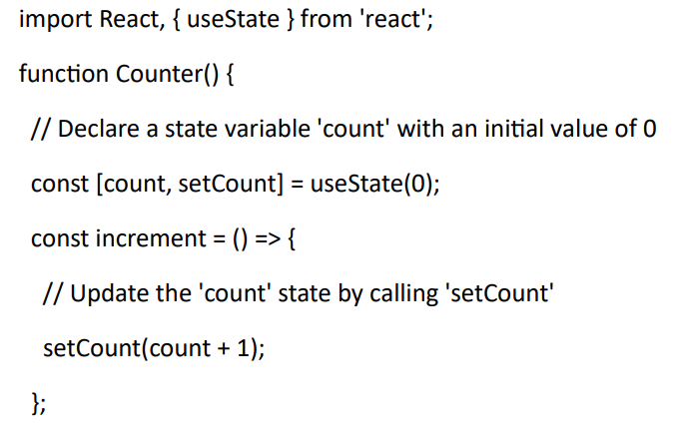
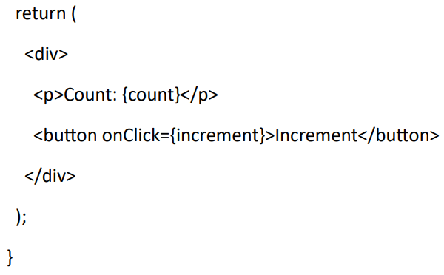
1. `useState` Hook
The `useState` Hook allows you to add state to functional components. It returns an array with the current state value and a function to update it.

Slide 5
1. `useState` Hook
1. We import React and the `useState` Hook.
2. Inside the `Counter` functional component, we declare a state variable `count` and a function `setCount` to update it using the `useState` Hook. The initial value of `count` is set to 0.
3. When the "Increment" button is clicked, the `increment` function is called, which uses `setCount` to update the `count` state.

Slide 6
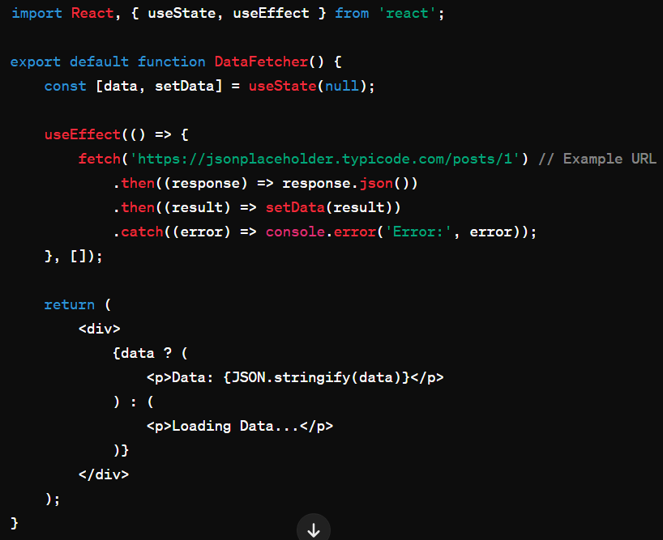
2. `useEffect` Hook:
The `useEffect` Hook enables you to perform side effects in functional components. It takes two arguments: a function representing the effect and an optional array of dependencies.

Slide 7
2. `useEffect` Hook:
1. We import React, the `useState` and `useEffect` Hooks
2. Inside the `DataFetcher` component, we declare a state variable `data` using `useState` to store the fetched data.
3. We use `useEffect` to fetch data from an API when the component mounts. The effect function is called after the component has rendered. The empty dependency array (`[]`) means this effect runs once on mount.
4. When data is fetched successfully, we update the `data` state with the fetched result. If there's an error, we log it to the console.

Slide 8
3. `useContext` Hook:
The `useContext` Hook allows you to access a context value that has been created using `React.createContext`. It enables you to share values like themes, authentication status, or any other global data across your component tree.

Slide 9
3. `useContext` Hook:
1. We create a context called `ThemeContext` using `React.createContext`.
2. In the `App` component, we wrap the `Toolbar` component with `ThemeContext.Provider` and provide a value of "light" for the theme.
3. In the `Toolbar` component, we access the theme value from the context using the `useContext` Hook.

Slide 10
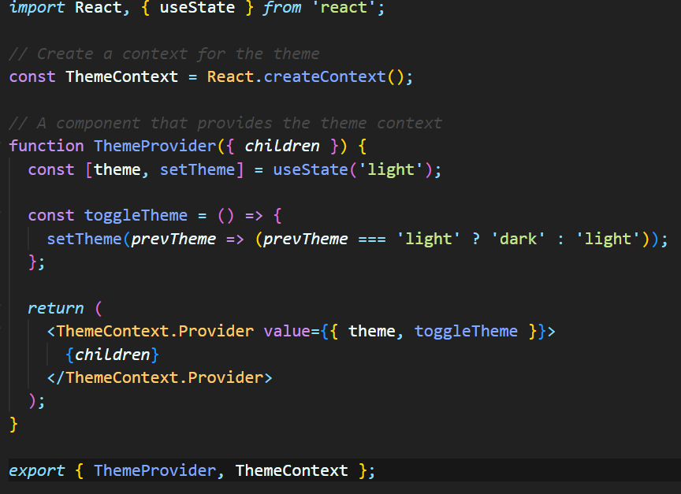
ThemeProvider.jsx

Slide 11
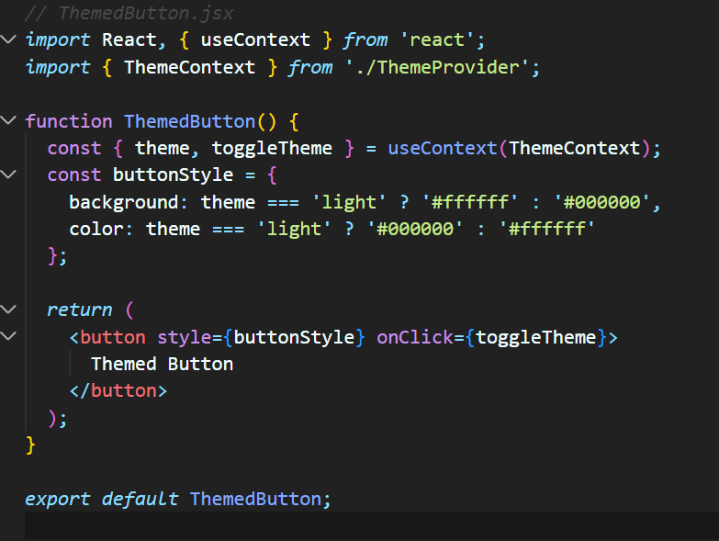
ThemedButton.jsx

Slide 12
App.jsx
import { ThemeProvider, ThemeContext } from './ThemeProvider';
import ThemedButton from './ThemedButton’;
<ThemeProvider>
<div>
<ThemedButton />
</div>
</ThemeProvider>

Slide 13
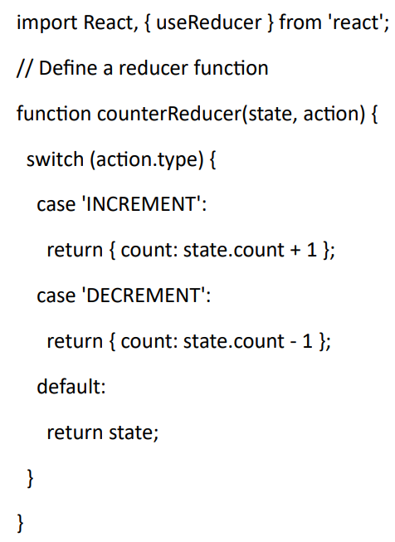
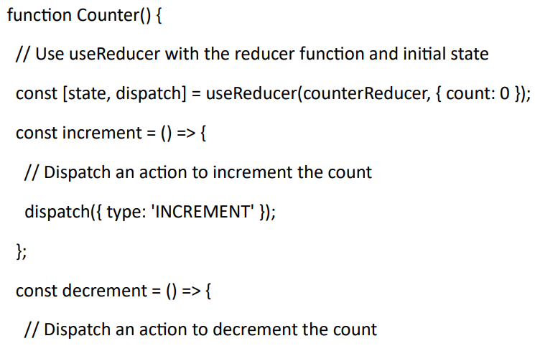
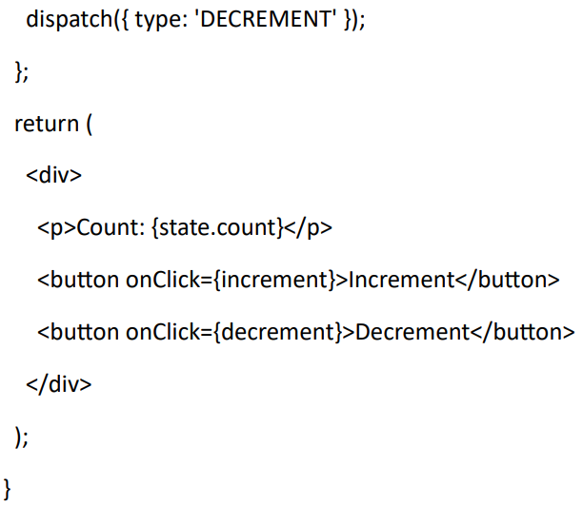
4. `useReducer` Hook:
The `useReducer` Hook is used for managing state in a more complex way compared to `useState`. It's often used when state transitions are more involved, such as in forms with multiple fields.

Slide 14
4. `useReducer` Hook:
1. We define a `counterReducer` function that specifies how the state should change in response to different actions. It takes the current state and an action object as parameters and returns the new state.
2. Inside the `Counter` component, we use the `useReducer` Hook with the `counterReducer` function and an initial state of `{ count: 0 }`. It returns the current state (`state`) and a `dispatch` function to send actions to the reducer.
3. When the "Increment" button is clicked, we call `dispatch` with the action `{ type: 'INCREMENT' }`, which triggers the state update according to the reducer logic.

Slide 15
Redux for state management
Redux is a predictable state container for JavaScript apps, primarily used with frameworks like React or Angular for managing the application state. It helps in writing applications that behave consistently, run in different environments (client, server, and native), and are easy to test.
Here's a detailed explanation of Redux:
Core Concepts:
Store:
Redux maintains the entire state of your application in a single JavaScript object called the "store".
This store is immutable, meaning you cannot directly modify it. Instead, you dispatch actions to update the store.

Slide 16
Redux for state management
4. State:
The state of the application is stored in the Redux store.
It represents the current snapshot of the application's data.
2. Actions:
Actions are plain JavaScript objects that represent "what happened" in your application.
They are dispatched using store.dispatch().
Actions must have a type property indicating the type of action being performed.
3. Reducers:
Reducers are pure functions responsible for handling actions and updating the state of the application.
They take the current state and an action as arguments, and return the next state.
Reducers must be pure functions, meaning they should not mutate the state directly.

Slide 17
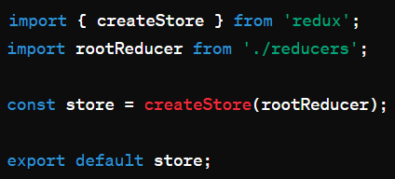
Store.js
This file sets up the Redux store using createStore function from Redux.
It imports the root reducer from reducers.js, which combines all the reducers.
The store is created by passing the root reducer to createStore.
Finally, the store is exported to be used in other parts of the application.

Slide 18
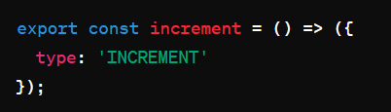
Actions.js
This file contains an action creator function named increment.
The increment function returns a plain JavaScript object with a type property set to 'INCREMENT'.
Action creators are functions that return actions. They are dispatched to the Redux store to update the state.

Slide 19
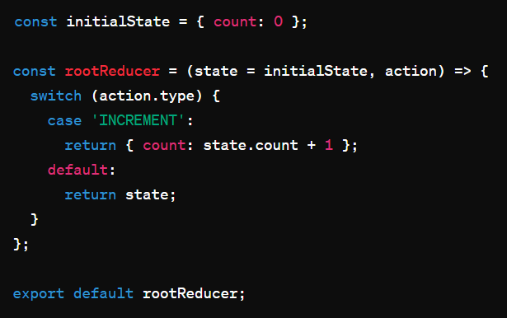
Reducers.js
This file defines the root reducer function responsible for handling state updates based on dispatched actions.
It starts by defining an initial state object with a count property initialized to 0.
The rootReducer function takes two arguments: the current state and the action.
It uses a switch statement to handle different action types. In this case, it increments the count property when the action type is 'INCREMENT'.
If the action type is not recognized, it returns the current state unchanged.
Finally, the rootReducer function is exported to be combined with other reducers if necessary.

Slide 20
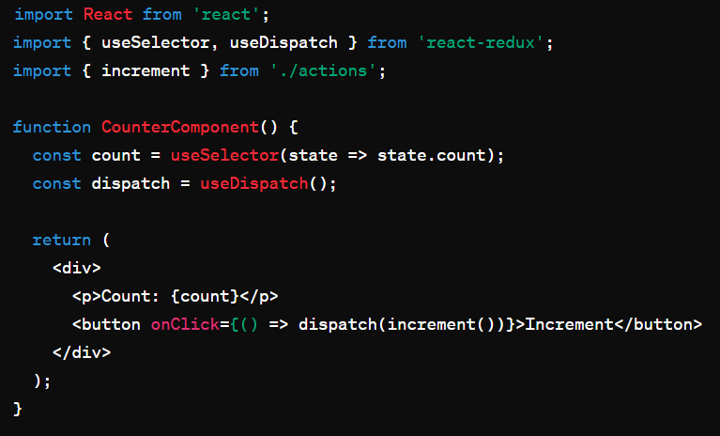
CounterComponent.js
This file defines a functional React component named CounterComponent.
It imports useSelector and useDispatch hooks from react-redux for accessing state and dispatching actions respectively.
The count variable is initialized using the useSelector hook, which extracts the count property from the Redux store state.
The dispatch function obtained from the useDispatch hook is used to dispatch the increment action when the button is clicked.
The component renders a paragraph displaying the current count value and a button that triggers the increment action when clicked.

Slide 21
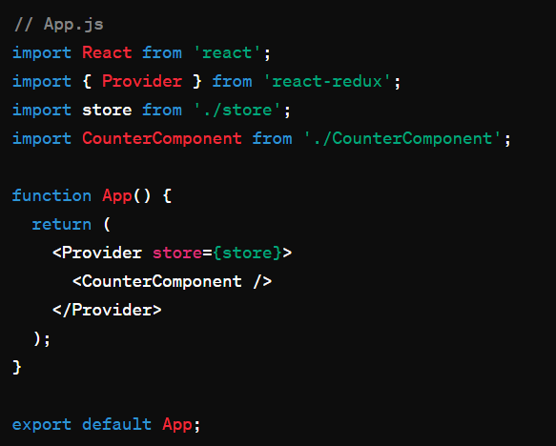
Usage in App
This example illustrates how Redux manages the state of a simple counter application. Actions are dispatched to update the state, and components subscribe to the store to access and display the state.
Reducers define how state changes in response to actions. This pattern scales well for complex applications, offering a predictable state management solution.

Slide 22
Routing with React Router
React Router is a standard library for routing in React applications.
Setting up React Router involves defining routes and rendering components based on the current URL.

Slide 23
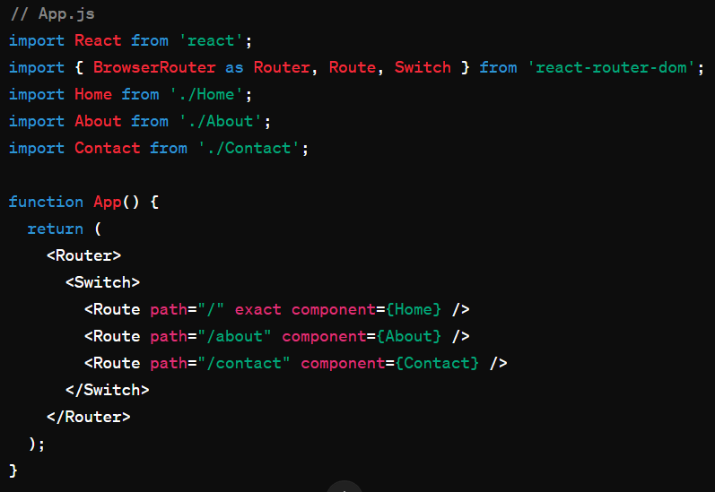
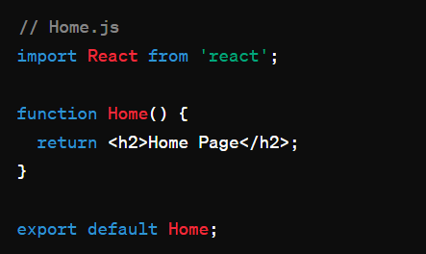
Routing with React Router
npm install react-router-dom

Slide 24
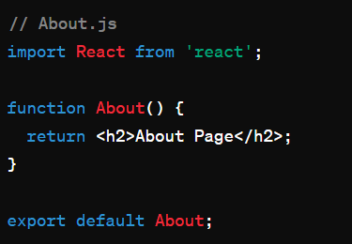
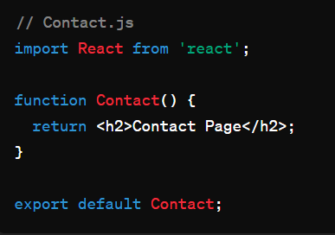
Routing with React Router

Slide 25
Exercise to be performed
Objective:
Build a Todo List application using React that allows users to add, delete, and mark tasks as completed.
Utilize React Hooks for local component state management (useState, useEffect) and
Redux for global state management.
Implement routing with React Router for navigating between different views.

Slide 26
Exercise to be performed
Requirements:
Home Page:
  Display a list of tasks.
  Each task should have a checkbox to mark it as completed and a delete button.
  Implement the functionality to add a new task.
Redux Setup:
  Create Redux actions and reducers for adding a task, deleting a task, and marking a task as completed.
Routing:
  Implement routing with React Router.
  Create separate routes for the Home page and a About page.
About Page:
  Display information about the application.
  Bonus:
    Add functionality to edit tasks.
    Implement local storage to persist the tasks even after refreshing the page.

Slide 27
Exercise to be performed
Instructions:
Set up your React project with Redux and React Router.
Design the UI components for the Todo List application.
Implement Redux actions and reducers for managing tasks.
Create the necessary React components for the Home page and About page.
Set up routing with React Router to navigate between different views.
Implement the functionality to add, delete, and mark tasks as completed using both local component state (useState, useEffect) and Redux.
Test the application thoroughly to ensure all features are working as expected.
Optionally, implement the bonus features for additional functionality.
Document your code and add comments for better understanding.
Style your application for a better user experience.

Slide 28
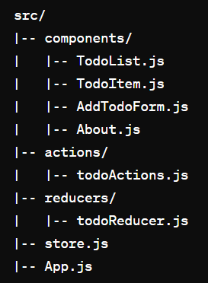
Example Code Structure

