Slide 1
Media Queries

Slide 2
Definition
Media queries allow you to apply CSS styles depending on a device's general type (such as print vs. screen) or other characteristics such as screen resolution or browser viewport width.
Media queries can be used to check many things, such as:
  width and height of the viewport
  width and height of the device
  orientation (is the tablet/phone in landscape or portrait mode?)
  resolution

Slide 3
Definition
Media Query Syntax
A media query consists of a media type and can contain one or more expressions, which resolve to either true or false.
@media not|only mediatype and (expressions) {
CSS-Code;
}
The result of the query is true if the specified media type matches the type of device the document is being displayed on and all expressions in the media query are true.
When a media query is true, the corresponding style sheet or style rules are applied, following the normal cascading rules.

Slide 4
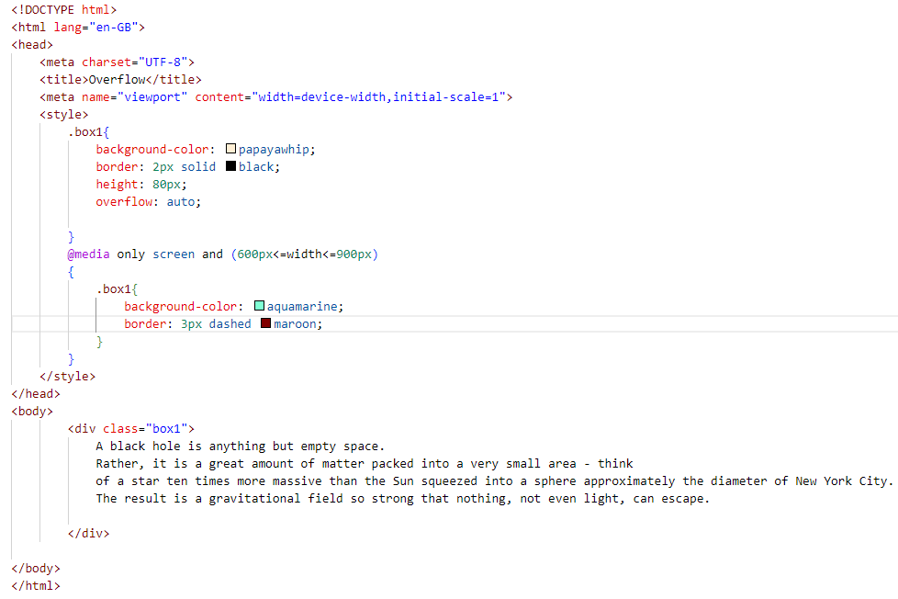
Example

Slide 5
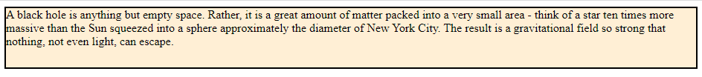

Example

Slide 6
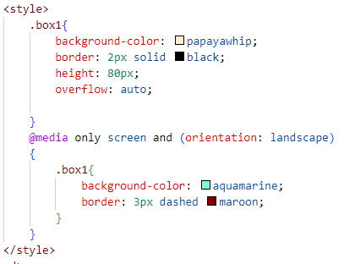
Portrait / Landscape
Media queries can also be used to change layout of a page depending on the orientation of the browser.
You can have a set of CSS properties that will only apply when the browser window is wider than its height, a so called "Landscape" orientation.

Slide 7
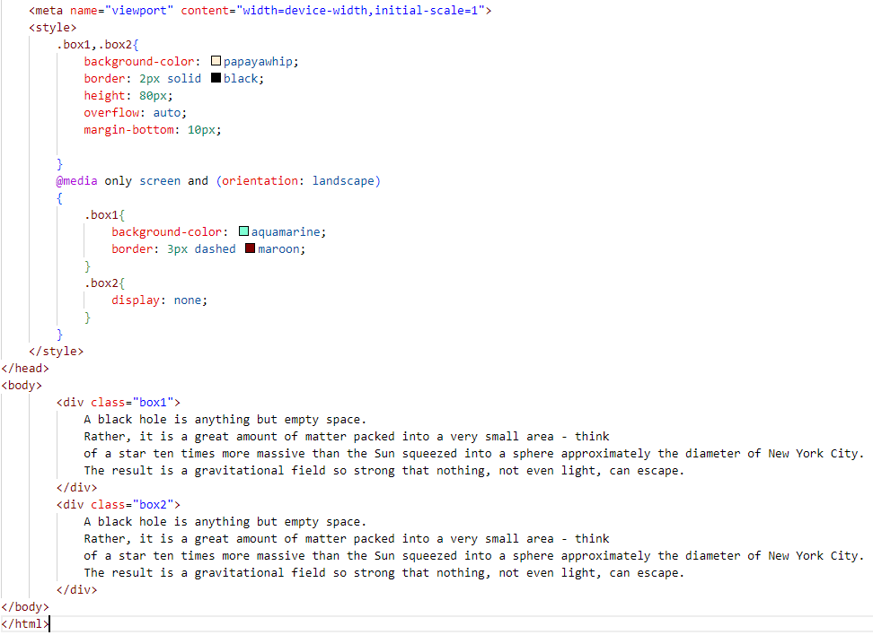
Hide Elements
Another common use of media queries, is to hide elements on different screen sizes.

