Slide 1
HTML

Slide 2
Introduction
HTML is an acronym which stands for Hyper Text Markup Language which is used for creating web pages and web applications.
HTML is a markup language which is used for creating attractive web pages with the help of styling, and which looks in a nice format on a web browser.
An HTML document is made of many HTML tags and each HTML tag contains different content.
Along with CSS and Javascript it is one of the cornerstone of the World Wide Web.

Slide 3
Building Blocks
An HTML document consist of its basic building blocks which are:
Tags
An HTML tag surrounds the content and apply meaning to it. It is written between < and > brackets.
Attribute
An attribute in HTML provides extra information about the element, and it is applied within the start tag.
An HTML attribute contains two fields: name & value.
Elements
An HTML element is an individual component of an HTML file. In an HTML file, everything written within tags are termed as HTML elements.

Slide 4
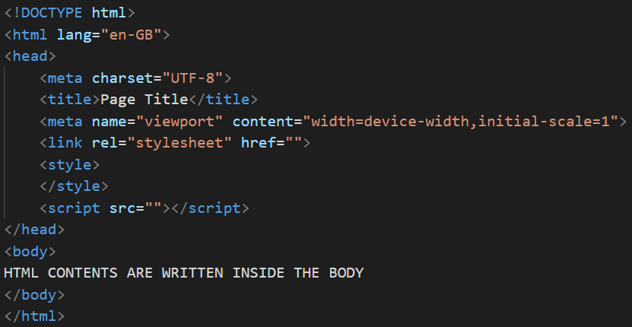
HTML Skeleton

Slide 5
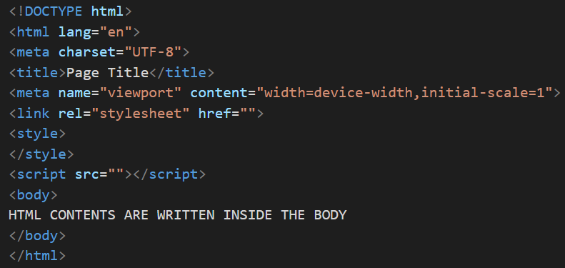

HTML Skeleton
All HTML documents must start with a <!DOCTYPE> declaration.
The declaration is not an HTML tag. It is an "information" to the browser about what document type to expect.
***The <!DOCTYPE> declaration is NOT case sensitive.

Slide 6



HTML Skeleton
The lang attribute specifies which language is used to write the content of a web page.
It is used to set the language for the whole text of the web page.
The HTML5 specification uses the UTF-8 character set, which covers almost all of the characters and symbols in the world
The <title> element:
  defines a title in the browser toolbar
  provides a title for the page when it is added to favorites
  displays a title for the page in search-engine results

Slide 7
HTML Skeleton
Go for a longer, descriptive title (avoid one- or two-word titles)
Search engines will display about 50-60 characters of the title, do not to have titles longer than that.
The title must be as accurate and meaningful as possible!
***You can NOT have more than one <title> element in an HTML document.

Slide 8
HTML Skeleton
The HTML <head> element is used as a container for metadata (data about data).
It is used between <html> tag and <body> tag.
The head of an HTML document is a part whose content is not displayed in the browser on page loading.
An HTML head can contain lots of metadata information or can have very less or no information.
Head part has a crucial role an HTML document while creating a website.

Slide 9
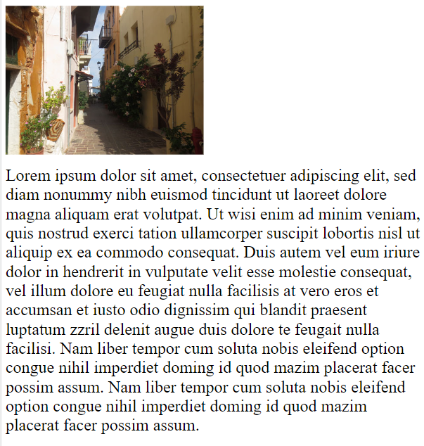
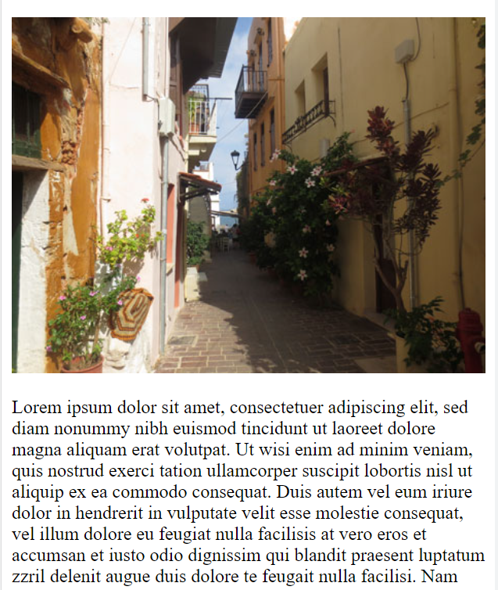
HTML Skeleton

Slide 10
HTML Skeleton

Slide 11
Tags
HTML tags are like keywords which defines that how web browser will format and display the content.
With the help of tags, a web browser can distinguish between an HTML content and a simple content.
HTML tags contain three main parts:
  opening tag,
  content and
  closing tag. (But some HTML tags are unclosed tags.)
When a web browser reads an HTML document, browser reads it from top to bottom and left to right.
HTML tags are used to create HTML documents and render their properties.
Each HTML tags have different properties.

Slide 12
Tags
You can use as many tags you want as per your code requirement.
Every tag in HTML perform different tasks.
If you have used an open tag <tag>, then you must use a close tag </tag> (except some tags).
***HTML Tags are always written in lowercase letters.

Slide 13
Unclosed HTML Tags
<br> Tag: br stands for break line, it breaks the line of the code.
<hr> Tag: hr stands for Horizontal Rule. This tag is used to put a line across the webpage.

Slide 14
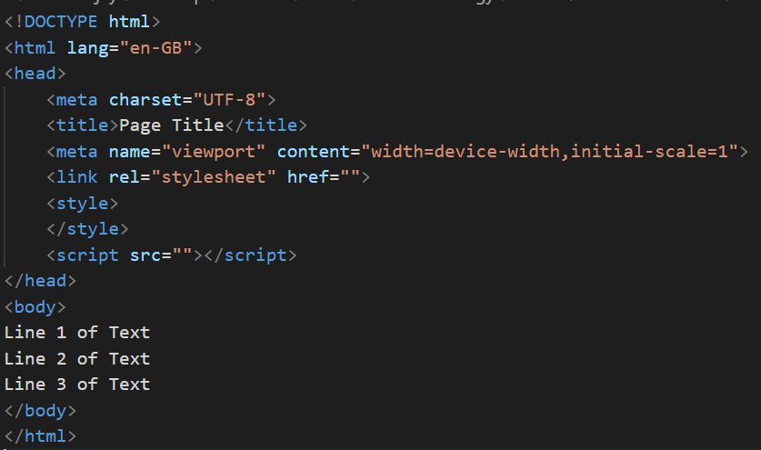
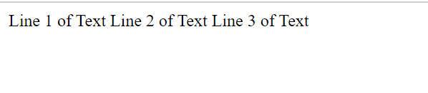
Unclosed HTML Tags

Slide 15
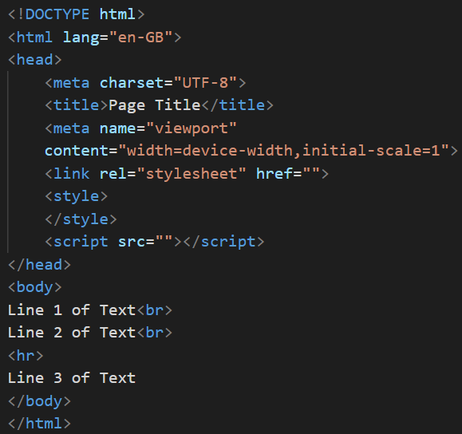
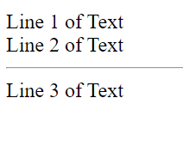
Unclosed HTML Tags

Slide 16
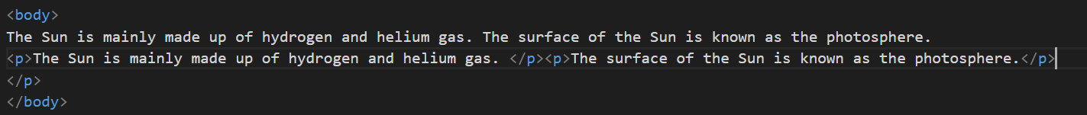
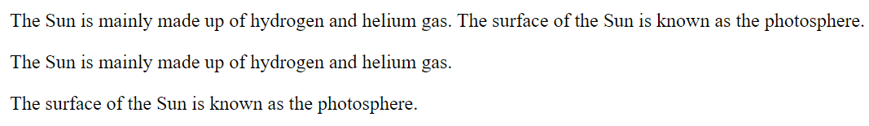
HTML Text Tags
<p>
<p> element defines a paragraph.
A paragraph always starts on a new line, and browsers automatically add some white space (a margin) before and after a paragraph.

Slide 17

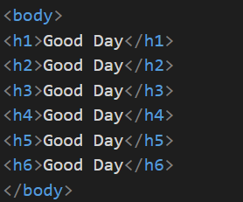
HTML Text Tags
Heading Elements
HTML headings are defined with the <h1> to <h6> tags.
<h1> defines the most important heading. <h6> defines the least important heading.

Slide 18
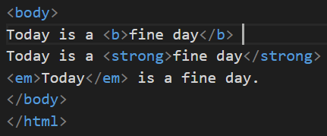
HTML Text Tags
<strong>
This tag is used to define text with strong importance.
The content inside is typically displayed in bold.
Tip: Use the <b> tag to specify bold text without any extra importance!
<em>
This tag is used to define emphasized text.
The content inside is typically displayed in italic.

Slide 19
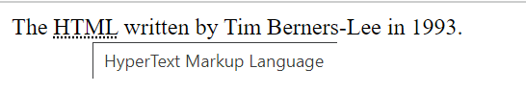
HTML Text Tags
<abbr>
The <abbr> tag defines an abbreviation or an acronym, like "HTML", "CSS", "Mr.", "Dr.", "ASAP", "ATM".
Tip: Use the global title attribute to show the description for the abbreviation/acronym when you mouse over the element.

Slide 20
HTML Text Tags
<address>
This tag defines the contact information for the author/owner of a document or an article.
The contact information can be an email address, URL, physical address, phone number, social media handle, etc.
The text in the <address> element usually is displayed in italic, and browsers will always add a line break before and after the <address> element.
<blockquote>
This tag specifies a section that is quoted from another source.
Browsers usually indent <blockquote>

Slide 21
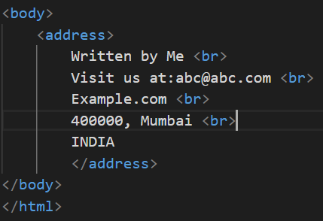
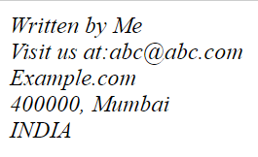
HTML Text Tags
<address>
This tag defines the contact information for the author/owner of a document or an article.
The contact information can be an email address, URL, physical address, phone number, social media handle, etc.
The text in the <address> element usually is displayed in italic, and browsers will always add a line break before and after the <address> element.

Slide 22
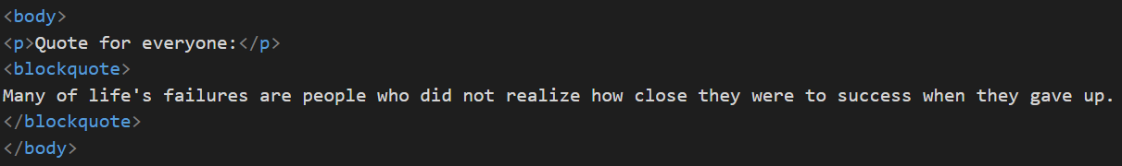
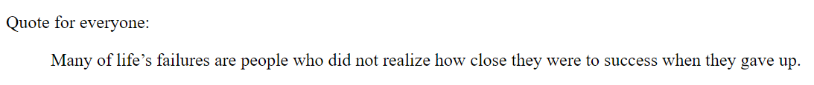
HTML Text Tags
<blockquote>
This tag specifies a section that is quoted from another source.
Browsers usually indent <blockquote>

Slide 23


HTML Text Tags
<cite>
This tag defines the title of a creative work

Slide 24
HTML Text Tags
<q>
This tag defines a short quotation.
Browsers normally insert quotation marks around the quotation.
<ins>
This tag defines a text that has been inserted into a document.
Browsers will usually underline inserted text.
<del>
This tag defines text that has been deleted from a document. Browsers will usually strike a line through deleted text.

Slide 25
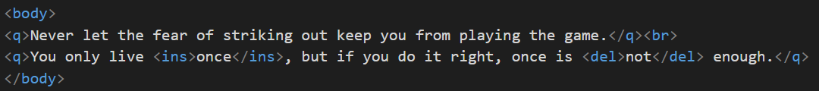

HTML Text Tags

Slide 26
HTML Text Tags
<pre>
This tag defines preformatted text.
Text in a <pre> element is displayed in a fixed-width font, and the text preserves both spaces and line breaks.
The text will be displayed exactly as written in the HTML source code.
<mark>
This tag defines text that should be marked or highlighted.
<details>
This tag specifies additional details that the user can open and close on demand.
The tag is often used to create an interactive widget that the user can open and close.
By default, the widget is closed.
When open, it expands, and displays the content within.

Slide 27
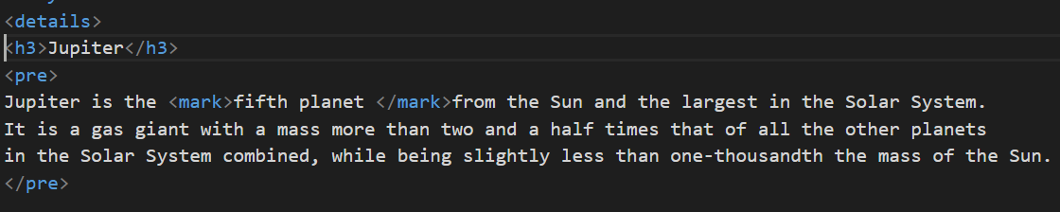

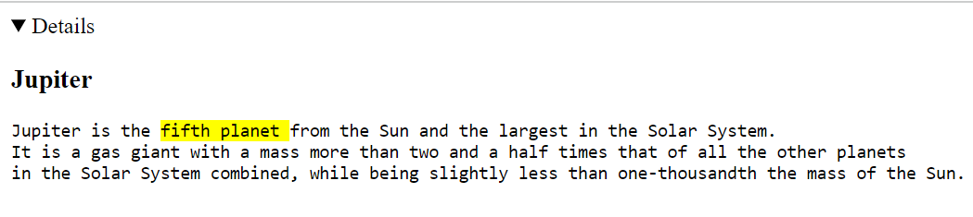
HTML Text Tags

Slide 28
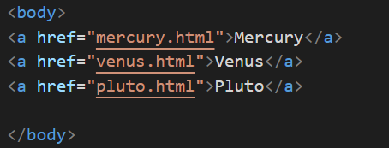
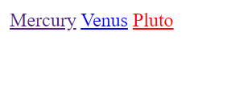
HTML Link Tags
<a>
The <a> tag defines a hyperlink, which is used to link from one page to another.
The most important attribute of the <a> element is the href attribute, which indicates the link's destination.
By default, links will appear as follows in all browsers:
An unvisited link is underlined and blue
A visited link is underlined and purple
An active link is underlined and red

Slide 29
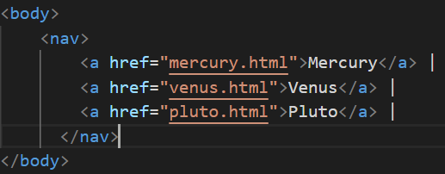

HTML Link Tags
<nav>
The <nav> tag defines a set of navigation links.
The <nav> element is intended only for major blocks of navigation links.

Slide 30


HTML Image and Object Tags
<img>
This tag is used to embed an image in an HTML page.
The <img> tag creates a holding space for the referenced image.
The <img> tag has two required attributes:
src - Specifies the path to the image
alt - Specifies an alternate text for the image, if the image for some reason cannot be displayed

Slide 31
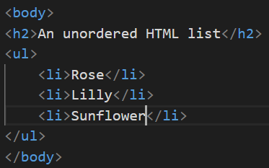
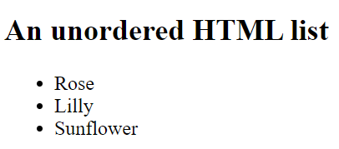
HTML List Tags
HTML lists allow web developers to group a set of related items in lists.
Unordered List
An unordered list starts with the <ul> tag.
Each list item starts with the <li> tag.
The list items will be marked with bullets (small black circles) by default:

Slide 32
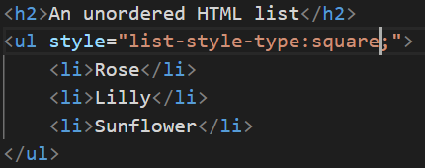
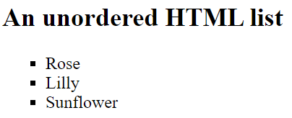
HTML List Tags
The CSS list-style-type property is used to define the style of the list item marker. It can have one of the following values:
Value | Description
disc | Sets the list item marker to a bullet (default)
circle | Sets the list item marker to a circle
square | Sets the list item marker to a square
none | The list items will not be marked

Slide 33
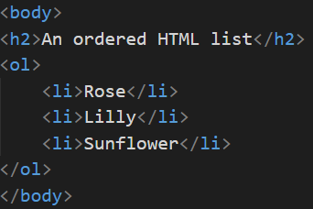
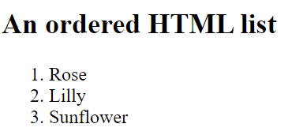
HTML List Tags
Ordered List
The HTML <ol> tag defines an ordered list.
An ordered list can be numerical or alphabetical.
The list items will be marked with numbers by default.

Slide 34
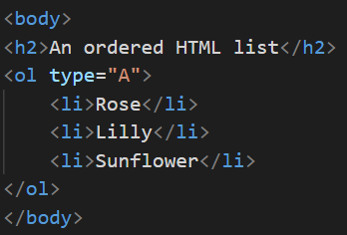
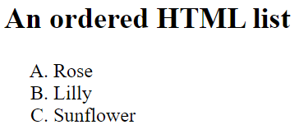
HTML List Tags
The type attribute of the <ol> tag, defines the type of the list item marker.
Value | Description
type="1" | The list items will be numbered with numbers (default)
type="A" | The list items will be numbered with uppercase letters
type="a" | The list items will be numbered with lowercase letters
type="I" | The list items will be numbered with uppercase roman numbers
type="i" | The list items will be numbered with lowercase roman numbers

Slide 35
HTML List Tags
Description Lists
A description list is a list of terms, with a description of each term.
The <dl> tag defines the description list.
The <dt> tag defines the term (name).
The <dd> tag describes each term

Slide 36
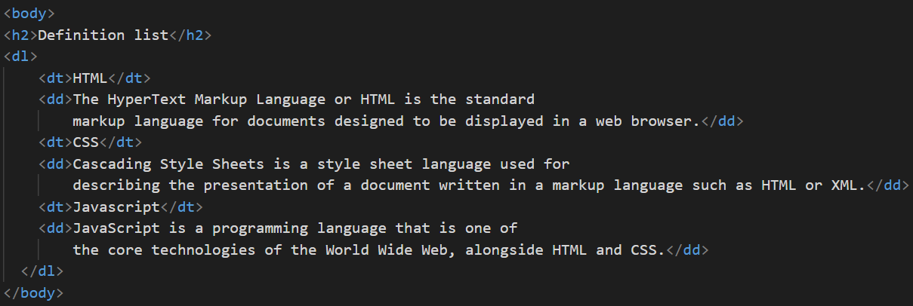
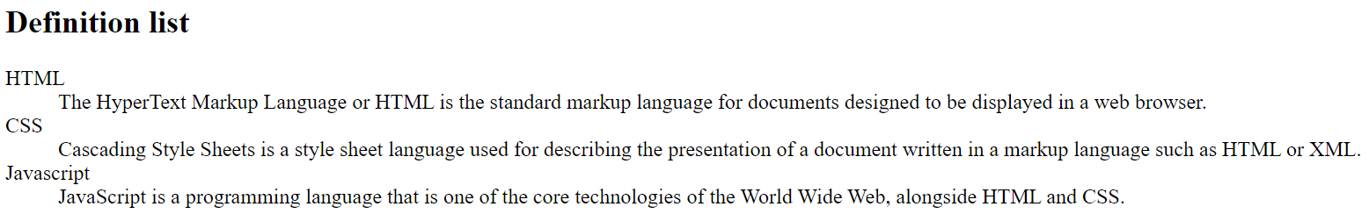

Slide 37
HTML Table Tags
Table
A simple HTML table, containing two columns and two rows.
An HTML table consists of one <table> element and one or more <tr>, <th>, and <td> elements.
<tr> - defines a table row.
<th> - element defines a table header.
<td> - element defines a table cell.

Slide 38
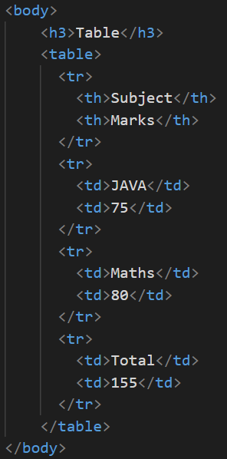
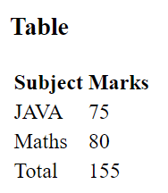
HTML Table Tags

Slide 39
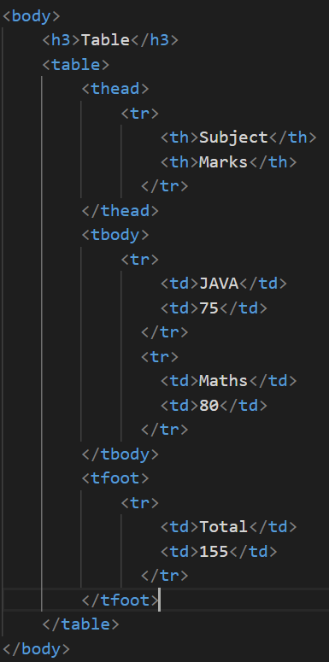
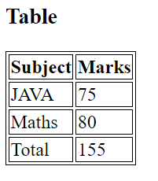
HTML Table Tags

Slide 40
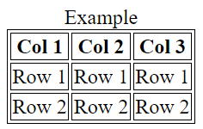
HTML Table Tags
The <caption> tag defines a table caption.
The <caption> tag must be inserted immediately after the <table> tag.
The <thead> tag is used to group header content in an HTML table.
The <tbody> tag is used to group the body content in an HTML table.
The <tfoot> tag is used to group footer content in an HTML table.
Colspan and Rowspan
To make a cell span over multiple columns, use the colspan attribute.

Slide 41
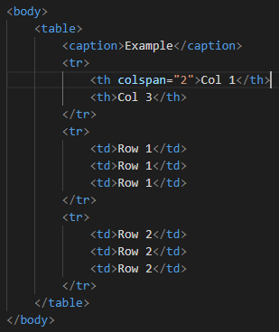
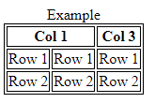
HTML Table Tags
Colspan

Slide 42
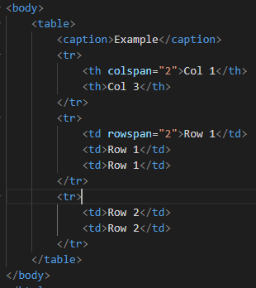
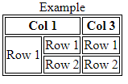
HTML Table Tags
Rowspan

Slide 43
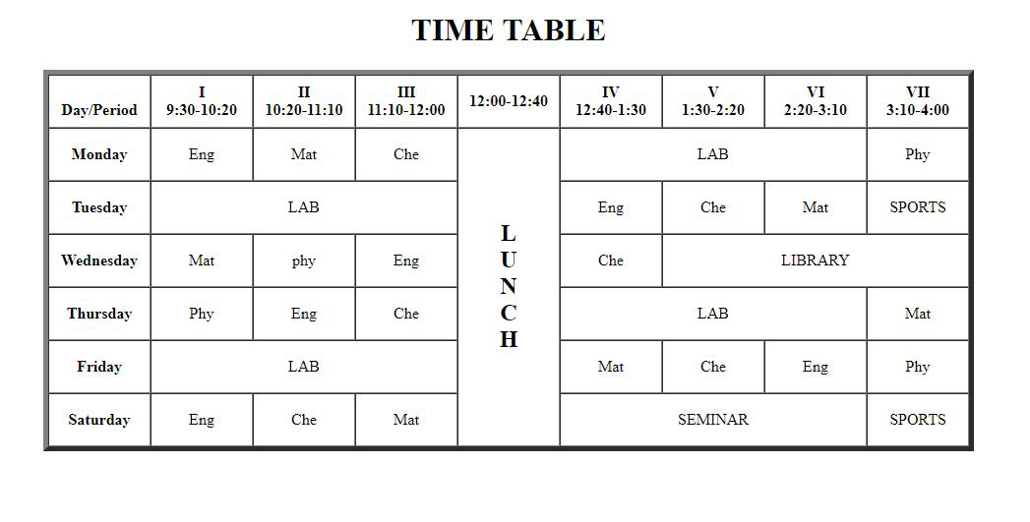
HTML Table Tags - Exercise

