Slide 1

Bootstrap

Slide 2
Introduction
Bootstrap is a free front-end framework for faster and easier web development.
Bootstrap includes HTML and CSS based design templates for typography, forms, buttons, tables, navigation, modals, image carousels and many other, as well as optional JavaScript plugins.
Bootstrap also gives you the ability to easily create responsive designs.
Advantages of Bootstrap:
Easy to use: Anybody with just basic knowledge of HTML and CSS can start using Bootstrap.
Responsive features: Bootstrap's responsive CSS adjusts to phones, tablets, and desktops.
Mobile-first approach: In Bootstrap, mobile-first styles are part of the core framework.
Browser compatibility: It supports the latest, stable releases of all major browsers and platforms. However, Internet Explorer 11 and down is not supported.

Slide 3
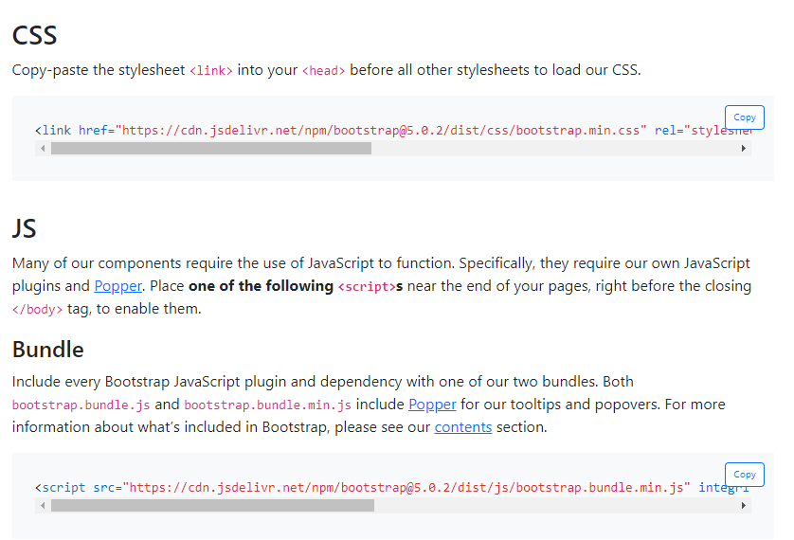
Introduction
There are two ways to start using Bootstrap 5 on your own web site.
You can:
Include Bootstrap from a CDN
Download Bootstrap from getbootstrap.com

Slide 4
Containers
Bootstrap 5 Containers are a core Bootstrap building piece that contains and align your content within a specific device or viewport.
The bootstrap 5 container contains responsive width with the required row and column for the advanced features and content.
The container class works as fixed and responsive on the web page.
Containers are the most fundamental Bootstrap layout elements necessary when using the grid system.
Containers are mostly used to envelop material with padding.
In the case of a fixed-width layout, they are also used to center the content horizontally on the page.

Slide 5
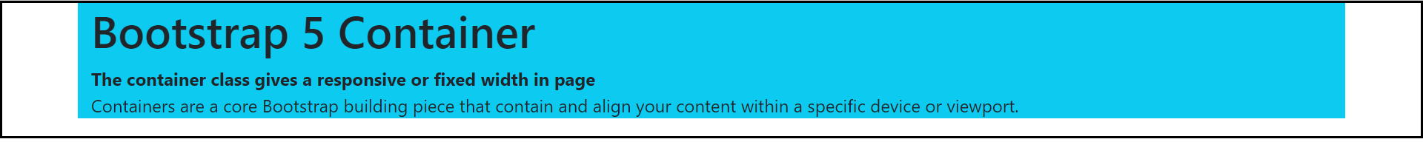
Containers
Bootstrap 5 has three types of containers:
Container: The ".container class" has a maximum width at each responsive breakpoint.
Container-fluid: The ".container-fluid" class has a width of 100 percent at all breakpoints.
Responsive Container: The ".container-breakpoint" has a width of 100 percent until the specified breakpoint. (-sm, -md, -lg, -xl, -xxl)

Slide 6
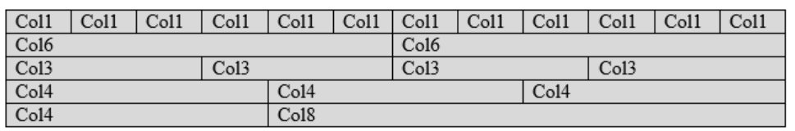
Grid
The grid system is responsive, and the columns will re-arrange themselves automatically based on screen size.
It is not necessary to use all 12 available columns.
Make sure the total is less than or equal to 12.
The Bootstrap's default grid classes can be used to easily create layouts for various devices like mobile phones, tablets, laptops, and desktops.
The following table shows the format of the bootstrap 5 grid systems.

Slide 7
Grid
Default Grid System
The default grid system helps create columns using the "col" class for a single column in a row.
Syntax of the Grid System
<div class = "row">
  <div class = "col"> </div>
  <div class = "col"> </div>
  <div class = "col"> </div>
  <div class = "col"> </div>
</div>

Slide 8
Grid
Default Grid System
The default grid system helps create columns using the "col" class for a single column in a row.
Grid System with Size
We can apply the size of the column to create the customized column.
The grid system helps create columns with the required size using the "col-size" class for a single column in a row.
For example, the "col-3" uses to create three column sizes in one column.

Slide 9
Grid
Syntax of the Grid System
<div class = "row">
  <div class = "col-size"> </div>
  <div class = "col-size"> </div>
  <div class = "col-size"> </div>
  <div class = "col-size"> </div>
</div>
Responsive Grid Classes
The Bootstrap 5 classes use for a responsive grid system.
The classes combine to create more dynamic and flexible layouts.
-sm, -md, -lg, -xl, -xxl.
col-xxl-2

Slide 10
Color Themes
Bootstrap 5 provides multiple color classes for the web component.
Bootstrap 5 colors convey a message about the function, element, and text.
It provides a class to display text and background in the required color.
Bootstrap 5 text color Description
Muted
Primary
Success
Info
Warning
Danger
secondary

Slide 11
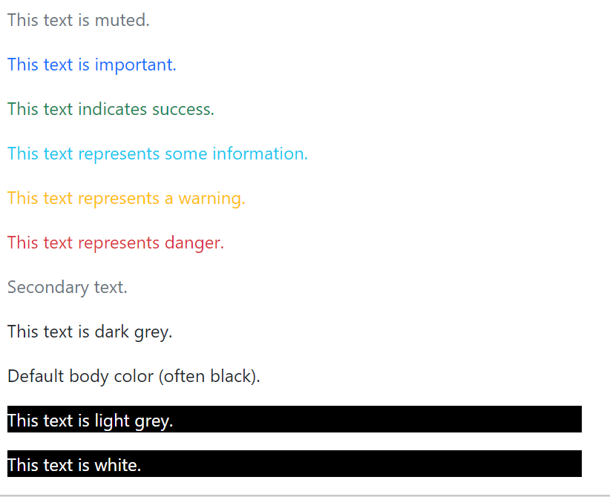
Color Themes
White
Dark
Body
light

Slide 12
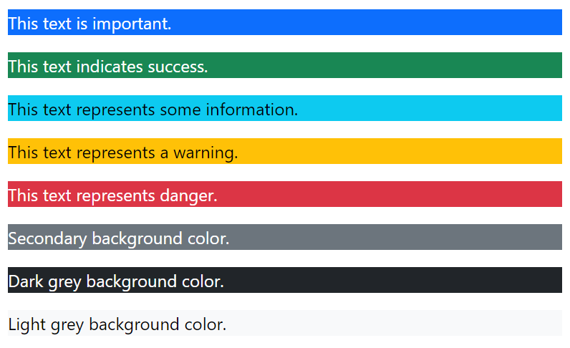
Color Themes
Background Colors
Primary
Success
Info
Warning
Danger
Secondary
Dark
light

Slide 13
Tables
Basic Table
A basic Bootstrap 5 table has a light padding and horizontal dividers.
The .table class adds basic styling to a table.
Striped Rows
The .table-striped class adds zebra-stripes to a table.
Bordered Table
The .table-bordered class adds borders on all sides of the table and cells
Hover Rows
The .table-hover class adds a hover effect (grey background color) on table rows
Black/Dark Table
The .table-dark class adds a black background to the table
Borderless Table
The .table-borderless class removes borders from the table

Slide 14
Images
Provides shapes to the images.
The .rounded class adds rounded corners to an image.
The .rounded-circle class shapes the image to a circle.
The .img-thumbnail class shapes the image to a thumbnail.

Slide 15
Cards
A card in Bootstrap 5 is a bordered box with some padding around its content.
It includes options for headers, footers, content, colors, etc.
Basic Card
A basic card is created with the .card class, and content inside the card has a .card-body class
Header and Footer
The .card-header class adds a heading to the card and the .card-footer class adds a footer to the card

Slide 16
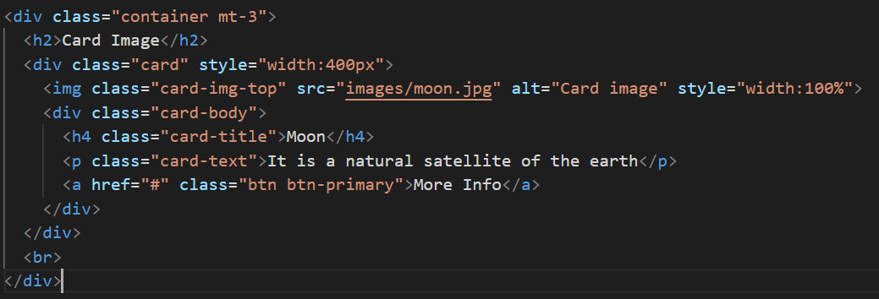

Slide 17
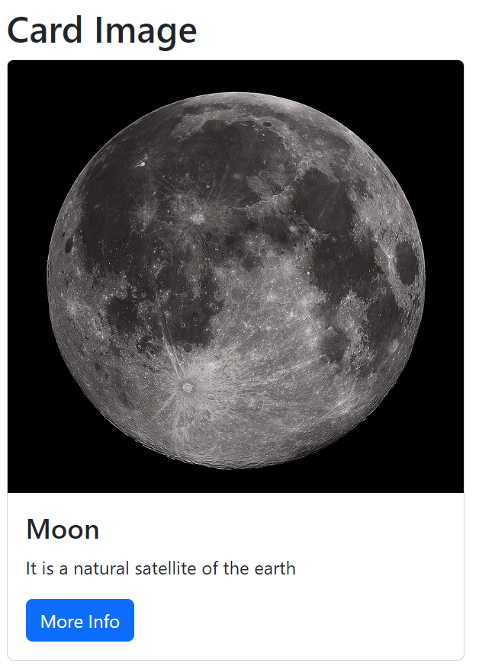

Slide 18
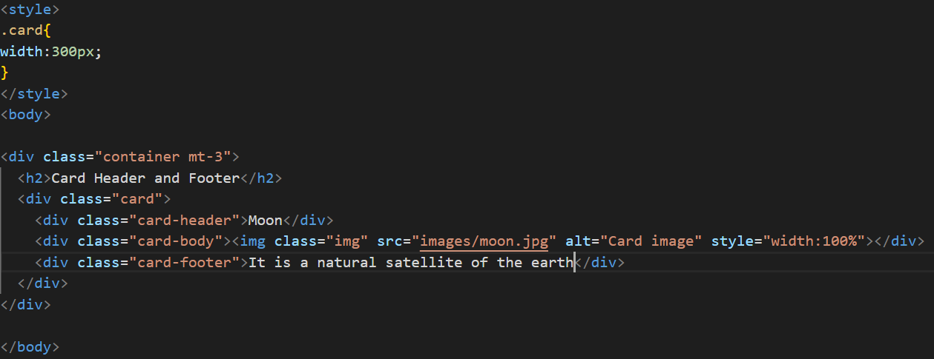

Slide 19
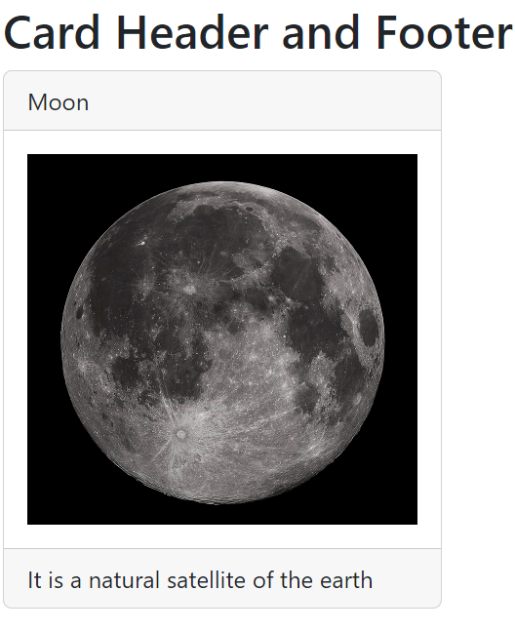

Slide 20
Collapse
A card in Bootstrap 5 is a bordered box with some padding around its content.
Collapsibles are useful when you want to hide and show large amount of content.
Use class="collapse show“ to show the content by default

Slide 21
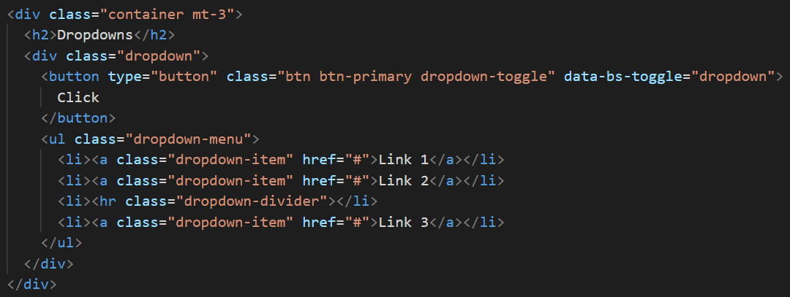
Dropdowns
A dropdown menu is a toggleable menu that allows the user to choose one value from a predefined list

Slide 22
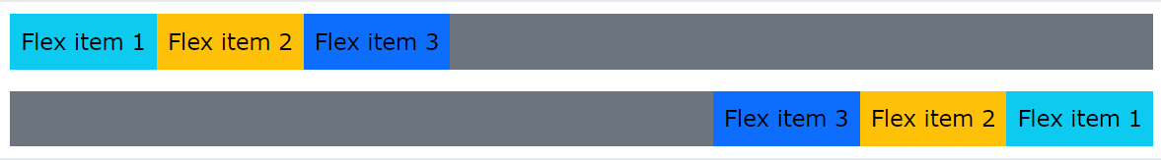
Flex
The Flexible Box Layout Module, makes it easier to design flexible responsive layout structure without using float or positioning.
To create a flexbox container and to transform direct children into flex items, use the d-flex class.
To create an inline flexbox container, use the d-inline-flex class
Horizontal Direction
Use .flex-row to display the flex items horizontally (side by side). This is default.
Tip: Use .flex-row-reverse to right-align the horizontal direction:

Slide 23
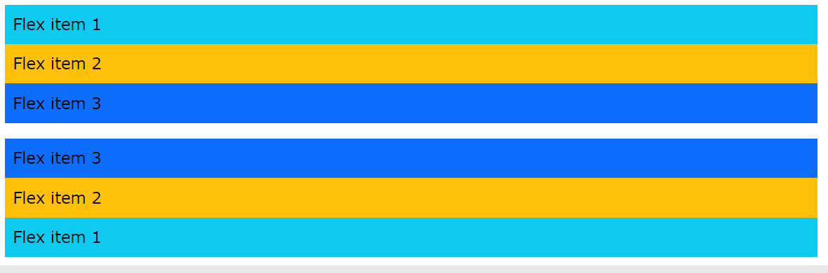
Flex
Vertical Direction
Use .flex-column to display the flex items vertically (on top of each other), or .flex-column-reverse to reverse the vertical direction

Slide 24
Flex
Fill / Equal Widths
Use .flex-fill on flex items to force them into equal widths

Slide 25
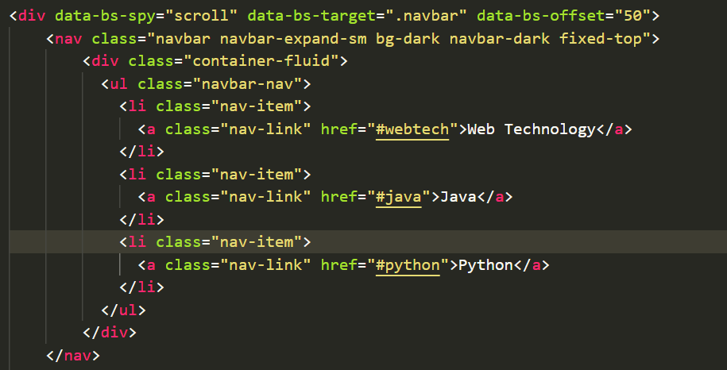
Scrollspy
Scrollspy is used to automatically update links in a navigation list based on scroll position.

Slide 26
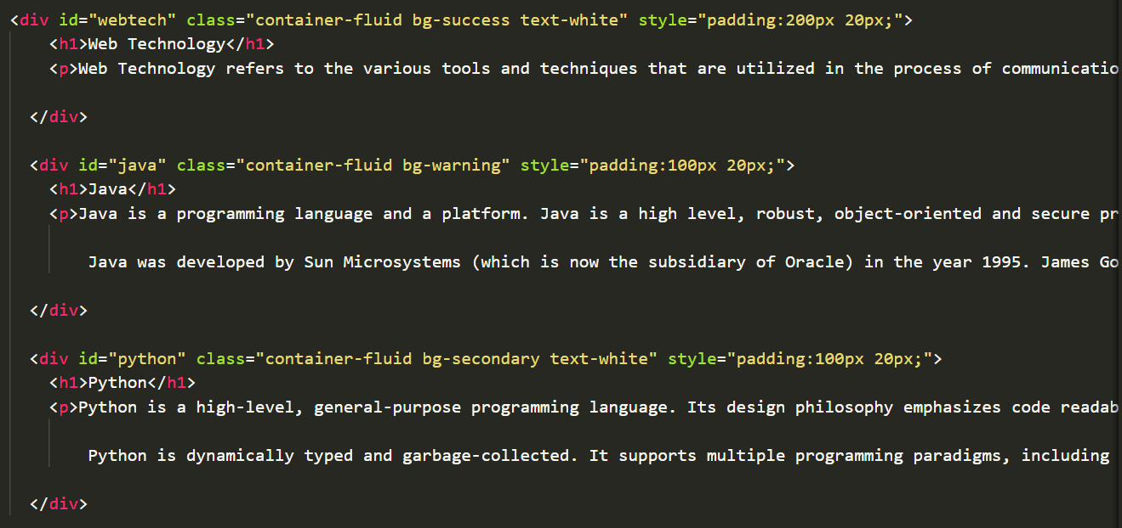
Scrollspy

Slide 27
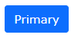
Button
Bootstrap 5 provides different styles of buttons.
<button type="button" class="btn btn-primary">Primary</button>
The button classes can be used on <a>, <button>, or <input> elements.
Bootstrap 5 also provides eight outline/bordered buttons.
As the mouse is moved over the button it creates a hover effect.
<button type="button" class="btn btn-outline-primary">Primary</button>

Slide 28
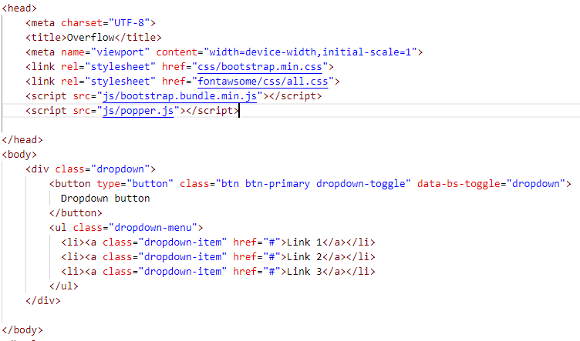
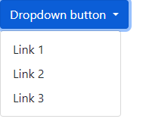
Dropdown
A dropdown menu is a toggleable menu that allows the user to choose one value from a predefined list

Slide 29



Dropdown
We can decide the direction in which the dropdown can be created.
<div class="dropdown dropend">
<div class="dropdown dropstart">
<div class="dropup">

Slide 30
Navigation
Simple Navigation
A standard navigation bar is created with the .navbar class, followed by a responsive collapsing class: .navbar-expand-xxl|xl|lg|md|sm
To add links inside the navbar, use either an <ul> element (or a <div>) with class="navbar-nav".
Then add <li> elements with a .nav-item class followed by an <a> element with a .nav-link class.

Slide 31
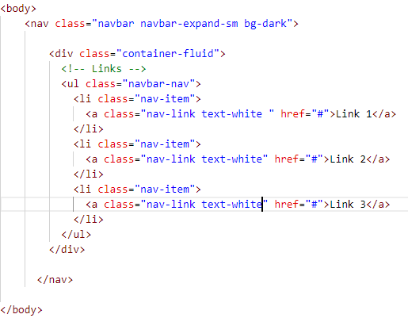

Navigation

Slide 32
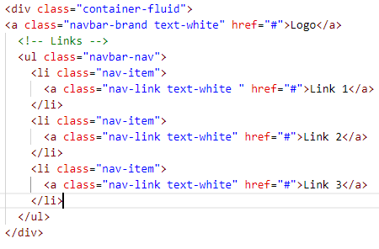
Navigation
Brand / Logo
The .navbar-brand class is used to highlight the brand/logo/project name of your page

Slide 33
Navigation
Toggler
The .navbar-brand class is used to highlight the brand/logo/project name of your page
Very often, especially on small screens, you want to hide the navigation links and replace them with a button that should reveal them when clicked on.
To create a collapsible navigation bar, use a button with class="navbar-toggler", data-bs-toggle="collapse" and data-bs-target="#thetarget".
Then wrap the navbar content (links, etc) inside a <div> element with class="collapse navbar-collapse", followed by an id that matches the data-bs-target of the button: "thetarget".

Slide 34
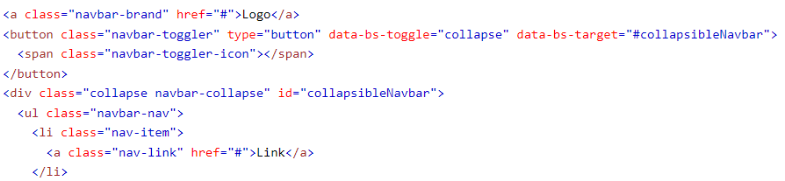
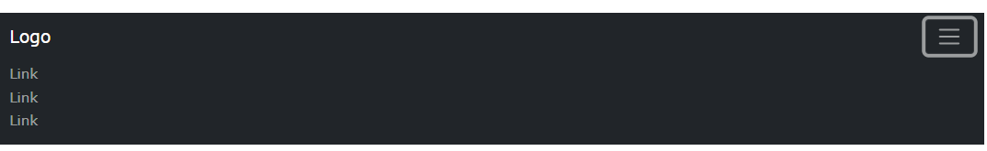
Navigation

Slide 35
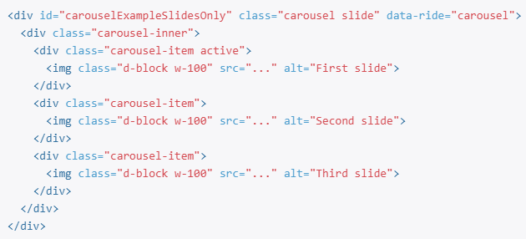
Carousel / Slideshow
The carousel is a slideshow for cycling through a series of content, built with CSS 3D transforms and a bit of JavaScript.
It works with a series of images, text, or custom markup.
It also includes support for previous/next controls and indicators.
Slides only

Slide 36
Carousel / Slideshow
With controls
Adding in the previous and next controls.

Slide 37
Forms
Form controls automatically receive some global styling with Bootstrap.
All textual <input>, <textarea>, and <select> elements with class .form-control have a width of 100%.
Bootstrap provides three types of form layouts:
  Vertical form (this is default)
  Horizontal form
  Inline form
Standard rules for all three form layouts:
  Wrap labels and form controls in <div class="form-group">
  Add class .form-control to all textual <input>, <textarea>, and <select> elements

Slide 38
Forms
Bootstrap Inline Form
In an inline form, all of the elements are inline, left-aligned, and the labels are alongside.
Additional rule for an inline form:
Add class .form-inline to the <form> element
Bootstrap Horizontal Form
A horizontal form means that the labels are aligned next to the input field (horizontal) on large and medium screens.
On small screens, it will transform to a vertical form (labels are placed on top of each input).
Additional rules for a horizontal form:
  Add class .form-horizontal to the <form> element
  Add class .control-label to all <label> elements

