Slide 1
Advanced Encryption Standard

Slide 2
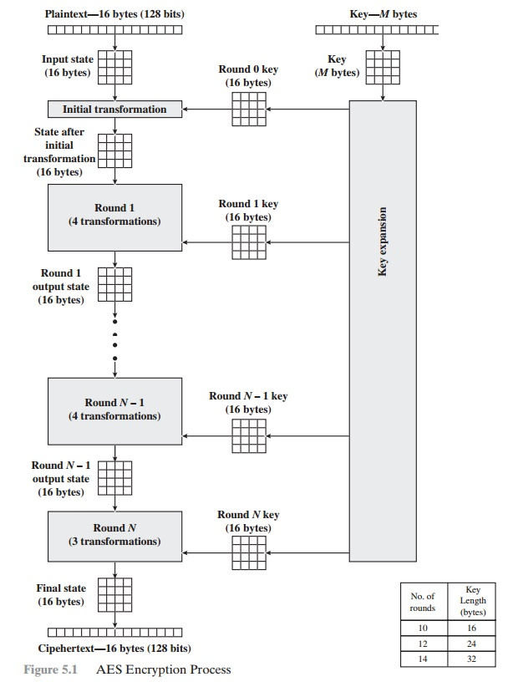
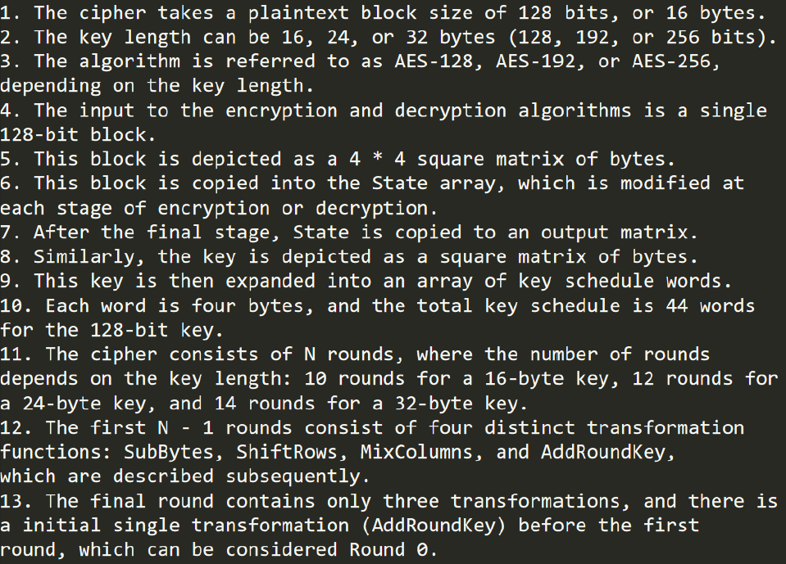
Overall Block Diagram

Slide 3
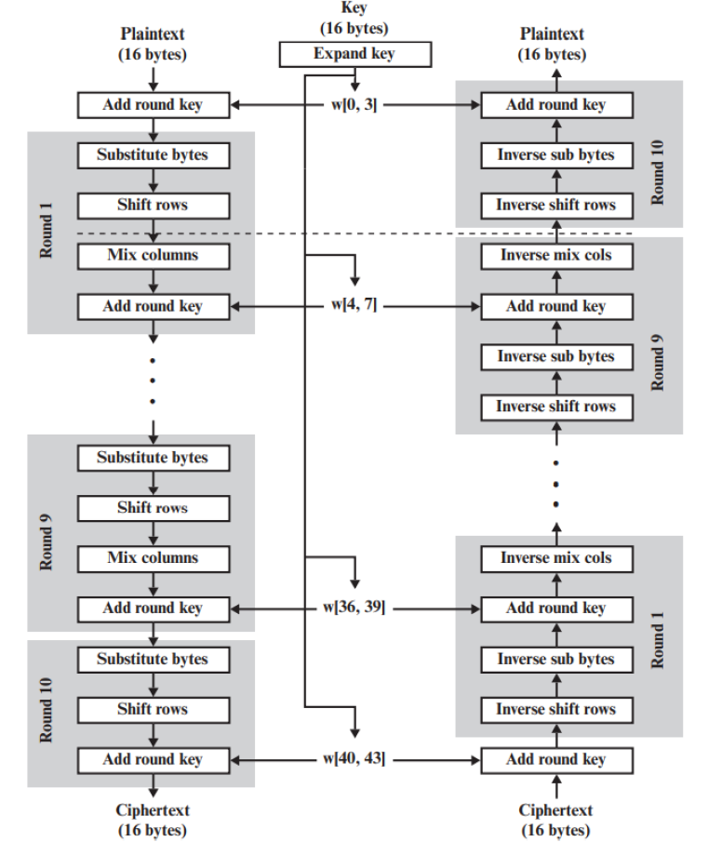
Internal Block Diagram

Slide 4
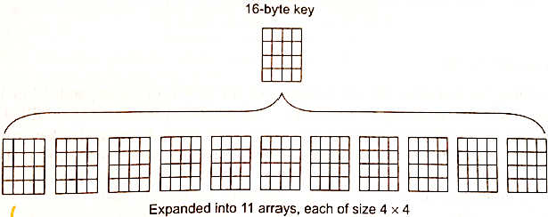
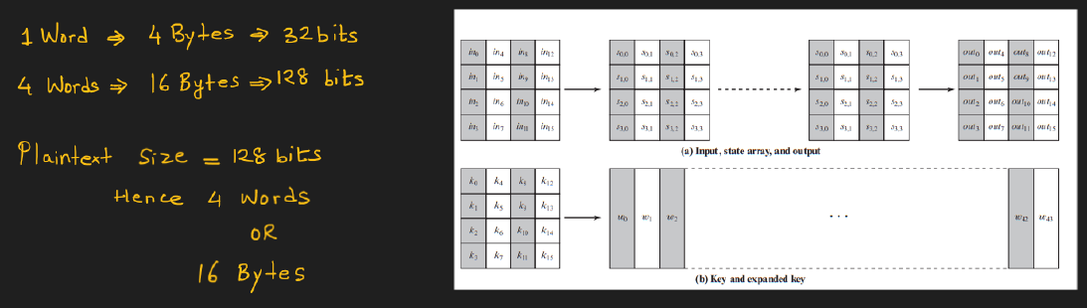
How the Key for each round is obtained?

Slide 5
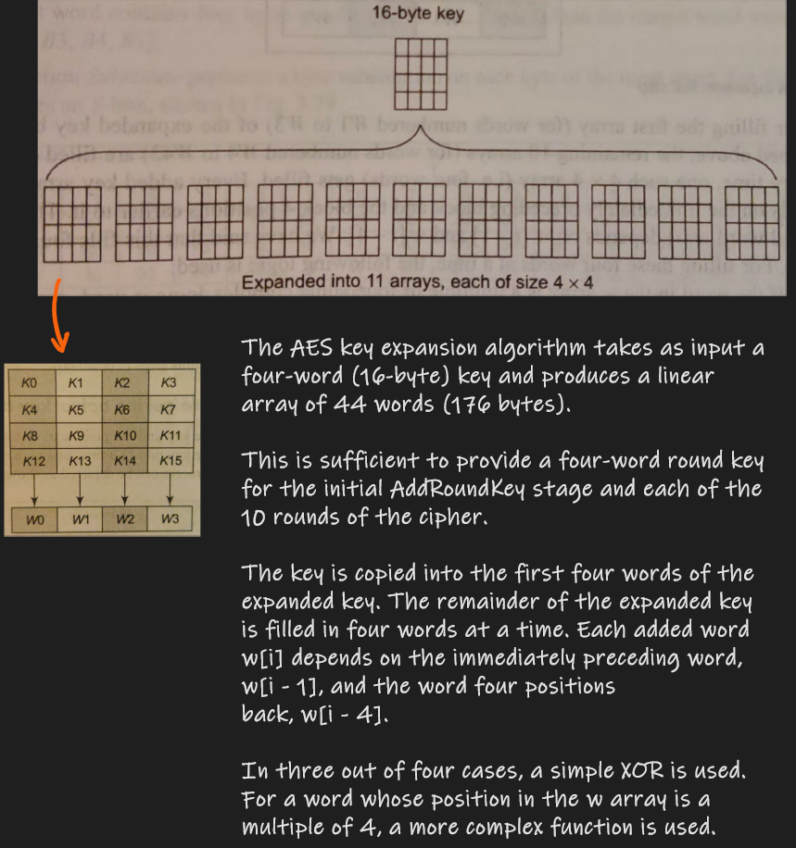
How the Key for each round is obtained?

Slide 6
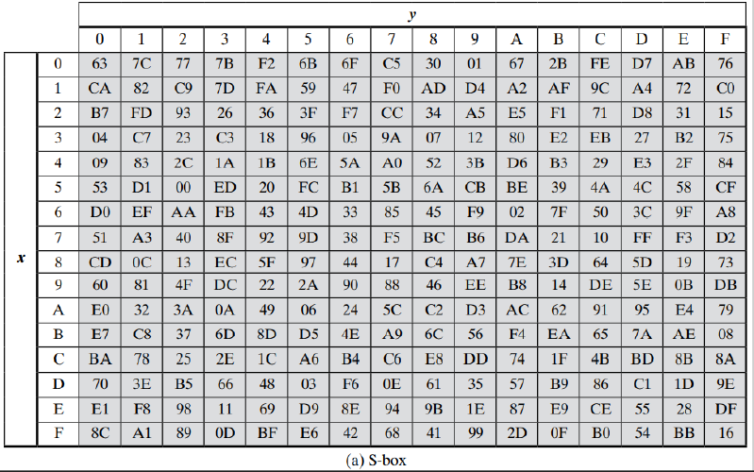
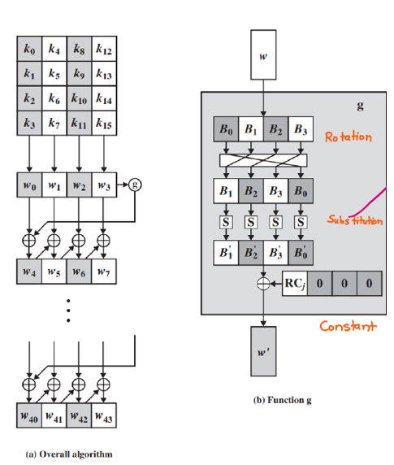

How the Key for each round is obtained?

Slide 7
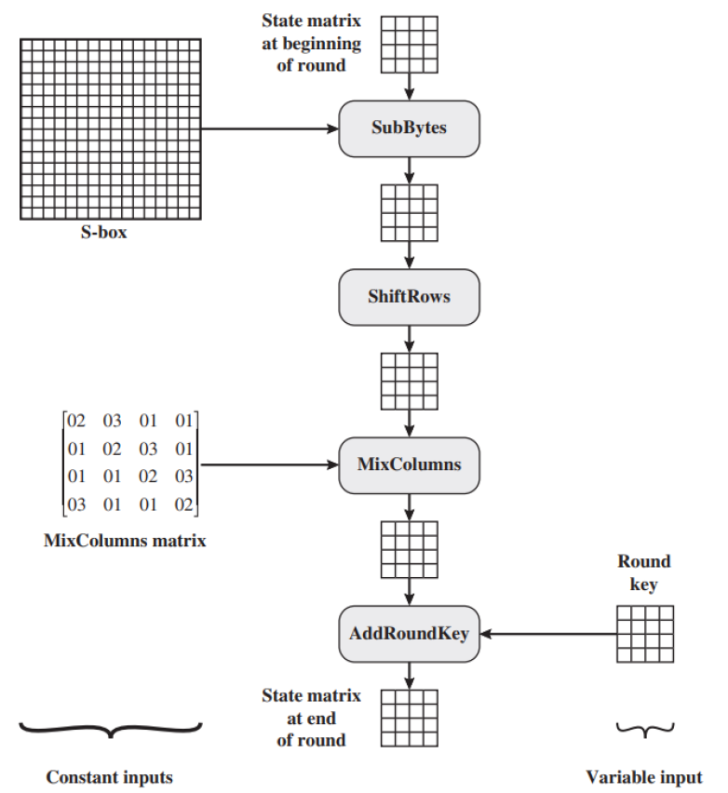
Operations in a Single AES Round

Slide 8
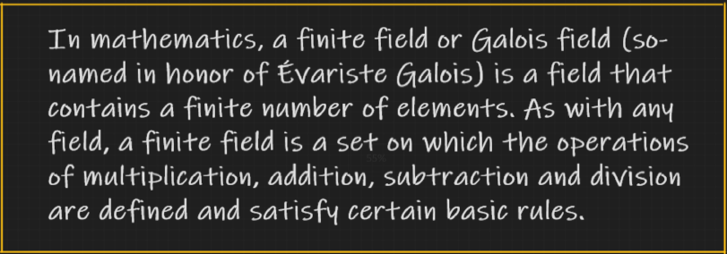
Detailed AES Round
Four different stages are used, one of permutation and three of substitution:
  Substitute bytes: Uses an S-box to perform a byte-by-byte substitution of the block
  ShiftRows: A simple permutation
  MixColumus: A substitution that makes use of arithmetic over GF (2^8)
  AddRoundKey: A simple bitwise XOR of the current block with a portion of the expanded key

Slide 9
Detailed AES Round
The structure is quite simple. For both encryption and decryption, the cipher begins with an AddRoundKey stage, followed by nine rounds that each includes all four stages, followed by a tenth round of three stages.
Each stage is easily reversible. For the Substitute Byte, ShiftRows, and MixColumns stages, an inverse function is used in the decryption algorithm.
For the AddRoundKey stage, the inverse is achieved by XORing the same round key to the block.
As with most block ciphers, the decryption algorithm makes use of the expanded key in reverse order

Slide 10
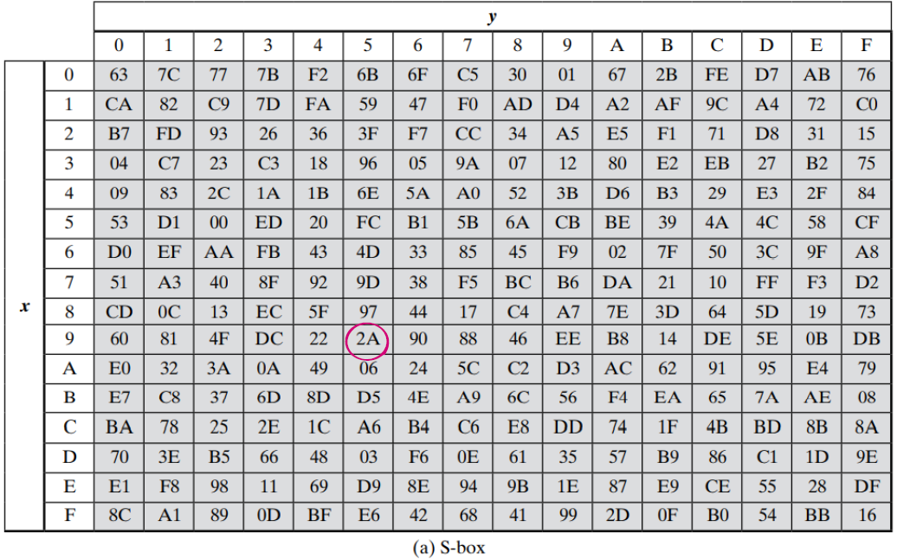
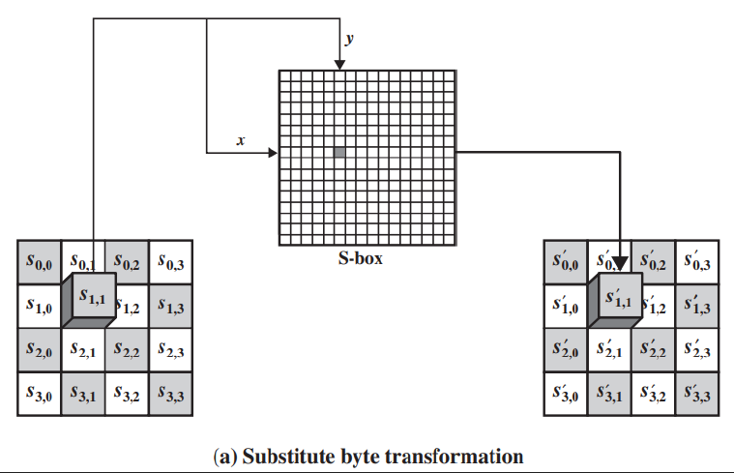
1. Substitute Bytes
The forward substitute byte transformation, called SubBytes, is a simple table lookup. AES defines a 16 * 16 matrix of byte values, called an S-box, that contains a permutation of all possible 256 8-bit values.
Each individual byte of State is mapped into a new byte in the following way: The leftmost 4 bits of the byte are used as a row value and the rightmost 4 bits are used as a column value.
These row and column values serve as indexes into the S-box to select a unique 8-bit output value.
For example, the hexadecimal value {95} references row 9, column 5 of the S-box, which contains the value {2A}. Accordingly, the value {95} is mapped into the value {2A3.

Slide 11
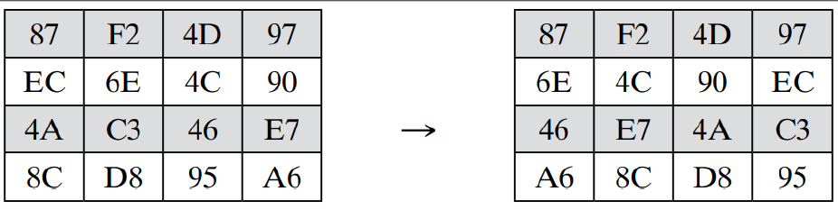
2. Shift Rows
The first row of State is not altered. For the second row, a 1-byte circular left shift is performed.
For the third row, a 2-byte circular left shift is performed.
For the fourth row, a 3-byte circular left shift is performed. The following is an example of ShiftRows.
The inverse shift row transformation, called InvShiftRows, performs the circular shifts in the opposite direction for each of the last three rows, with a 1-byte circular right shift for the second row, and so on.

Slide 12

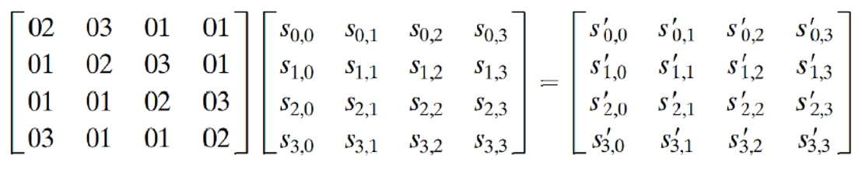
3. Mix Column Transformation
The forward mix column transformation, called MixColumns, operates on each column individually. Each byte of a column is mapped into a new value that is a function of all four bytes in that column. The transformation can be defined by the following matrix multiplication on State

Slide 13
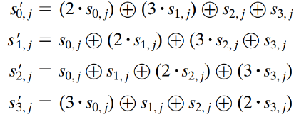
3. Mix Column Transformation
Each element in the product matrix is the sum of products of elements of one row and one column. In this case, the individual additions and multiplications are performed in GF (2^8). The MixColumns transformation on a single column of State can be expressed as

Slide 14
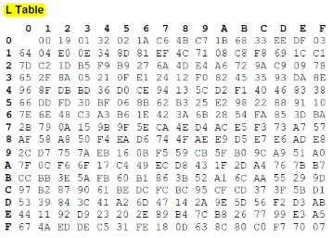
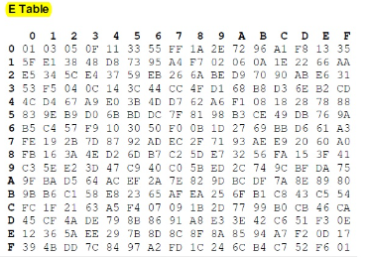
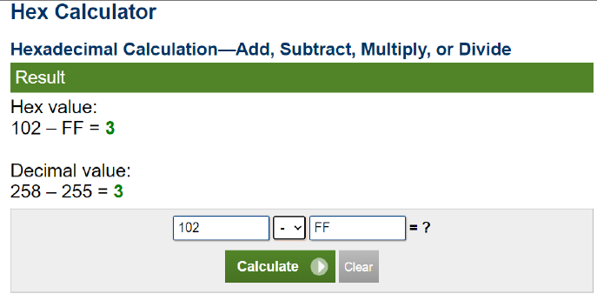
3. Mix Column Transformation
The multiplication mentioned above is performed over a Galois Field. Let us see how the multiplication is performed with the help of lookup tables E- Table and L- Table.
For example, if the two hex values being multiplied are AF *8, we first look up L(AF) index which returns B7 then lookup L(08) which returns 4B. We then simply add these 2 numbers, B7 and 4B to obtain 102.
Hex(102) =258 which is greater than FF i.e 255 so we subtract 255 from it and get the result as 03 in hex.
Now lookup 03 in the E table. i.e E(03) gives OF. Therefore the result of multiplying AF*8 over a Galois Field 2^8 is OF.

Slide 15
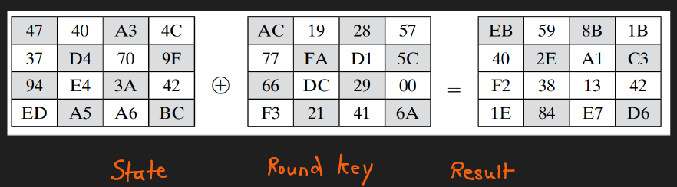
4. Add Round Key
In the forward add round key transformation, called AddRoundKey, the 128 bits of State are bitwise XORed with the 128 bits of the round key.
The first matrix is State, and the second matrix is the round key. The inverse add round key transformation is identical to the forward add round key transformation, because the XOR operation is its own inverse.

Slide 16
Conclusion
The Mix Column transformation stage happens till the (N-1)th Round. It is not performed in the Nth Round.
The output of the Nth Round is the final Ciphertext.

